Slide 1
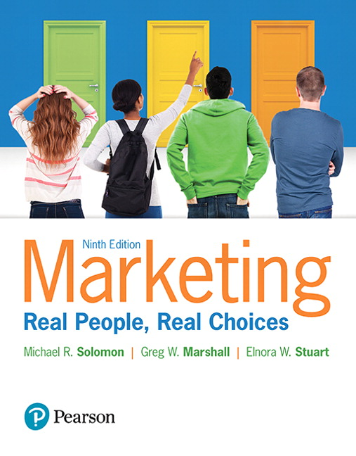
Marketing: Real People, Real Choices
Ninth Edition
Chapter 8
Product I
Copyright © 2018, 2016, 2012 Pearson Education, Inc. All Rights Reserved.
Notes:
If this PowerPoint presentation contains mathematical equations, you may need to check that your computer has the following installed:
1) MathType Plugin
2) Math Player (free versions available)
3) NVDA Reader (free versions available)

Slide 2
Learning Objectives
8.1 Explain how value is derived through different
product layers.
8.2 Describe how marketers classify products.
8.3 Understand the importance and types of product
innovations.
8.4 Show how firms develop new products.
8.5 Explain the process of product adoption and the
diffusion of new innovations.

Slide 3
Real People, Real Choices: Under Armour
Which option should Neal pursue?
Option 1: Approach the decision as a product problem, building new product offerings to get into retail ASAP.
Option 2: Approach the decision as a marketing problem. Stay the course with the current product line and invest resources into ramping up its messaging to target markets.
Option 3: Start over with a new business plan and rebuild the Baselayer product from the ground up.
Notes:
DISCUSSION NOTE:
This slide is best introduced by playing the full-length video corresponding to the Under Armour case.
Explain to students that you want them to think about each option, and that you will return to this question at the end of the chapter.

Slide 4
Build a Better Mousetrap … and Add Value
“Build a better mousetrap and the world will beat a path to your door.”
Old adage, but not always true!
Woodstream Company’s “Little Champ” failure …
Next set of chapters relate to developing value propositions for the customer.
Emphasis on the word develop
Notes:
LECTURE NOTES:
Introductory Slide for Chapter 8, Learning Objective 1 (Innovation and New Product Development).
DISCUSSION NOTES:
Chapter opens with story about the Woodstream Co., which or decades built Victor brand wooden mousetraps.
Then the company decided to build a better one, investing R&D funding into the eating, crawling, and nesting habits of mice
After building multiple prototypes to come up with the best possible design, the company unveiled the sleek-looking “Little Champ,” a black plastic miniature inverted bathtub with a hole. When the mouse went in and ate the bait, a spring snapped upward—and the mouse was history.
Despite the improved product, the Little Champ failed because Woodstream studied mouse habits, not consumer preferences.
The company later discovered that husbands set the trap at night, but in the morning it was the wives who disposed of the “present” they found waiting for them. Unfortunately, many of them thought the Little Champ looked too expensive to throw away, so they felt they should empty the trap for reuse. This was a task most women weren’t willing to do—they wanted a trap they could happily toss into the garbage.

Slide 5
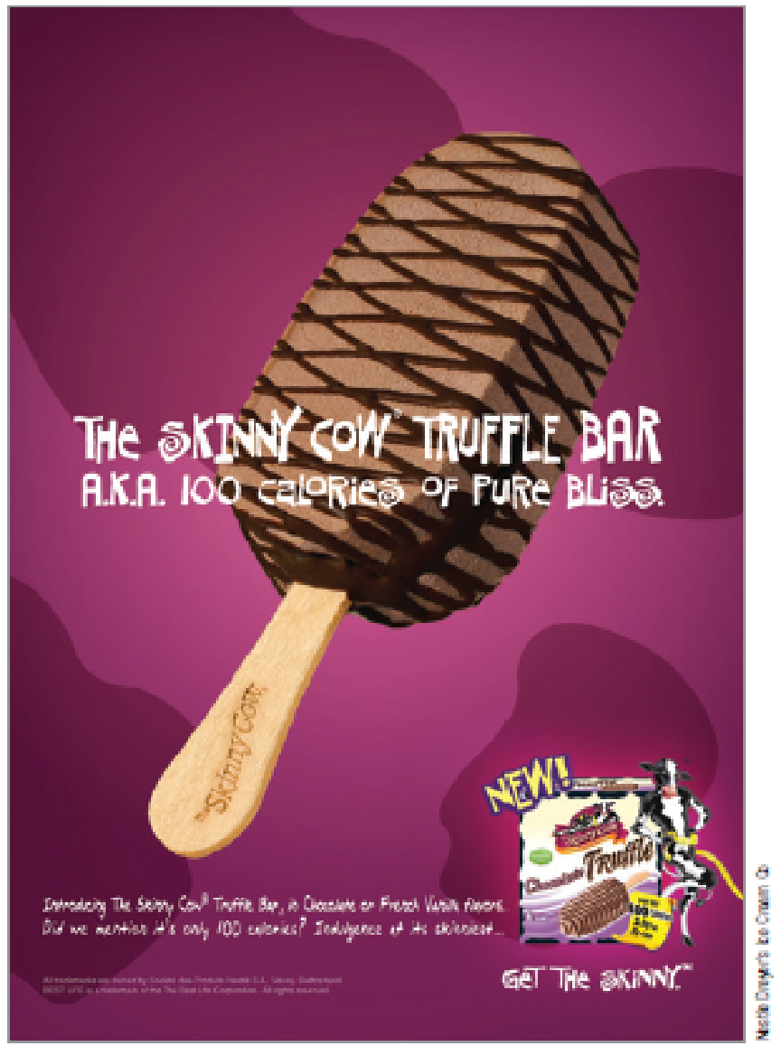
Layers of the Product Concept
A product represents all that a customer receives in an exchange.
Marketers distinguish among three distinct “layers” of the product:
Core product
Actual product
Augmented product
Notes:
LECTURE NOTES:
Slide introduces the layers of the product concept.
When marketers develop strategies, they need to consider how to satisfy customers’ wants and needs at each of these three layers – that is, how they can create value.

Slide 6
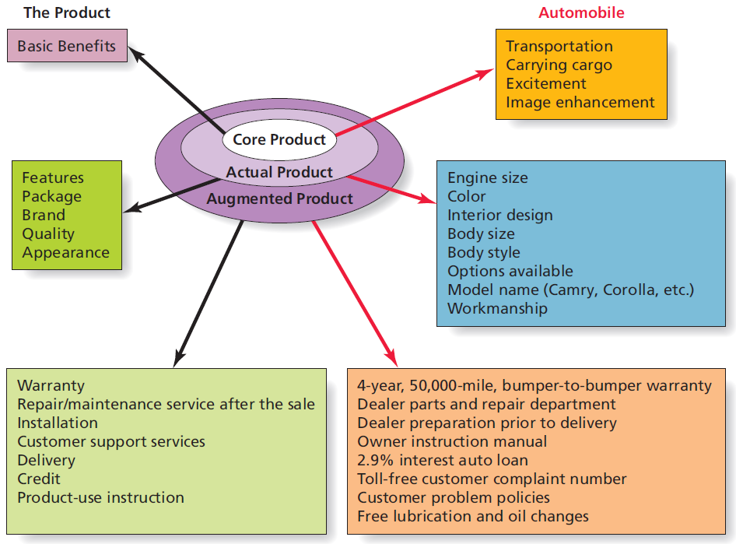
Figure 8.1 Layers of the Product
Notes:
LECTURE NOTES:
A product is everything that a customer receives from a purchase. Figure 8.1 illustrates how a product such an automobile can be broken down into three layers corresponding to the core product, actual product, and augmented product. Marketers need to understand consumers’ needs and wants at EACH level and market their products appropriately. Let’s discuss the three product layers in more detail.
Basic benefits relate to the primary reason why consumers purchase a given product within a product category. Obviously, anyone who purchases a vehicle is looking for transportation – this would be considered a basic benefit. But basic benefits might also be less functional or practical in nature. For example, an individual seeking to enhance their personal status would consider this a basic benefit when purchasing a luxury vehicle. Fun, or driving excitement might also be a primary benefit sought by individuals who purchase sports cars.
The core product is defined as the physical good or delivered service that supplies the desired benefits. Thus the core product includes specific features associated with the physical product, its appearance, the brand, or its package.
The augmented product includes the actual product PLUS other supporting features such as the warranty, service contract, credit and delivery services, installation and training or product use instructions. Many aspects of the augmented product can be adapted or changed much more easily than can the actual product itself. For example, loan rates offered by manufacturer’s fluctuate – low rates may be used to entice consumers to buy at certain times of the year. Similarly, warranties can change, though a change of this nature is more likely to coincide with the start of a new model year.

Slide 7
How Marketers Classify Products
Based on how consumers feel about, purchase, and consume products
How long products last
How consumers buy products
How businesses buy products
Notes:
LECTURE NOTES:
Products differ from one another in several ways and it is common for marketers to attempt to classify products in categories, especially when buyers feel differently or behave differently towards products of different categories.
One way that marketers classify products is according to their level of durability, that is, how long they are expected to last.
Nondurable goods are sometimes called consumables, because they are typically depleted or used up in a relatively short amount of time. What are some other examples of nondurable, or consumable items?
Durable goods last much longer and almost always cost more than nondurable goods. Cost and longevity differences are two reasons why durable goods are usually purchased under conditions of high involvement, compared to the low involvement levels which characterize nondurable good purchases.
Marketers must understand how consumer needs for augmented products as well as information differ for durable and nondurable goods. For example, all things being equal, would you expect the warranty to more important for a durable, or nondurable purchase? (Answer: Durable of course).
Since those who are highly involved in a purchase decision spend more time gathering information and comparing alternatives, marketers can cater to the needs of those looking to purchase a durable good by providing extensive information on the website, via the FAQ section or specific web pages devoted to important actual product features or augmented product aspects.
What other actions might marketers take to satisfy the needs of consumers of each type of good?
DISCUSSION NOTES:
Creating a Facebook page, monitoring and responding to tweets, creating a community forum or blog where users can talk about the product are all actions that may be appropriate for durable goods.
Since those who purchase nondurable goods are less likely to spend much time and effort shopping for alternatives, marketers should strive to keep their current users of the brand happy. As long as these users are satisfied, they are likely to continue purchasing the product. Marketers might consider creating new uses for the existing product, rewarding their loyalty via a continuity program (such as a frequency card, buy X items get the X+1 item free).

Slide 8
How Long Do Products Last?
Durable goods are consumer products that provide benefits over a period of months, years, or even decades.
Cars
Furniture
Appliances
Nondurable goods are consumed over the short term.
Magazines
Sushi
Notes:
LECTURE NOTES:
We are more likely to buy durable goods under the conditions of high involvement.
Conversely, we are more likely to buy nondurable goods under the conditions of low involvement.

Slide 9
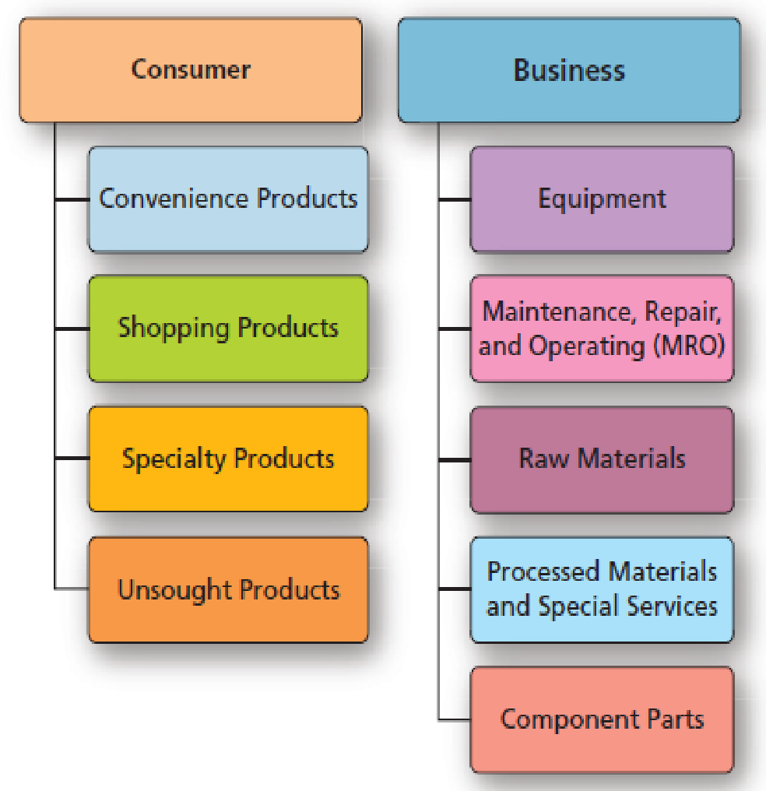
Figure 8.2 Classification of Products
Notes:
LECTURE NOTES:
Marketers also classify products based on their intended usage (by consumers for personal use vs. for business use) and according to either where it is bought (consumer) or the type of item it is (business).
In some cases, the same item (such as a laptop) may be sold to both consumers (as a shopping good) or to a business (as equipment). We’ll discuss the different classifications of consumer and business products in more detail in the following slides.

Slide 10
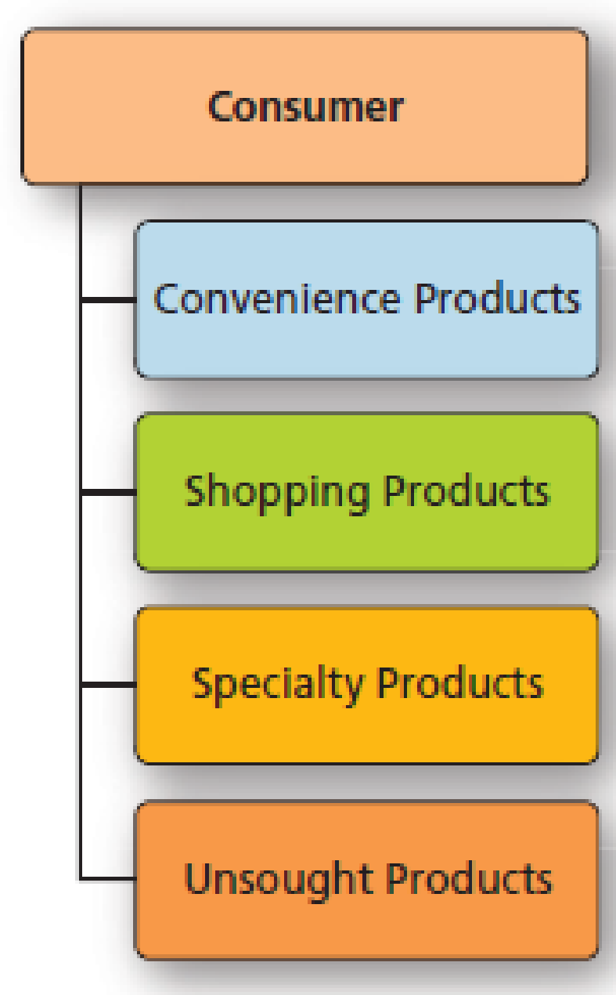
How Do Consumers Buy Products?
Marketers also classify products based on where and how consumers buy the product.
Similar to how consumer decisions differ in terms of effort they put into habitual decision making vs. limited problem solving vs. extended problem solving (Chapter 6)
Notes:
LECTURE NOTES:
Marketers classify products based on where and how they buy the product.
DISCUSSION NOTE:
The instructor should point out how this framework parallels ideas presented in Chapter 6 on consumer decision-making.

Slide 11
Convenience Products
Convenience products are typically nondurable goods or services bought with minimal effort.
Staples (e.g., milk, bread)
Consumer packaged good (CPG) or fast-moving consumer good (FMCG)
Impulse products
Emergency products
Consumers expect convenience products to be low priced and widely available.
Notes:
LECTURE NOTES:
Convenience products are frequently purchased nondurable products that are purchased with a minimum of time and effort. As the name implies, consumers want easy and convenient access to these products, so marketers often try to make them available in as many locations as possible that make sense given the specific type of product in question. Consumers who can’t find their preferred brand will simply purchase a competitive product because they aren’t that invested in the purchase decision.
There are three common subtypes of convenience products:.
Staple products are basic or necessary items that we simply can’t do without. Gasoline and milk are a couple of examples. Can you think of some others?
Impulse products are bought on the spur of the moment. Package designs of items like candy bars need to be bright and colorful so they catch the consumers attention, enhancing the likelihood of an impulse by. In-store placement is also important; many manufacturers of impulse items try to obtain special point-of-purchase displays to make the product standout, or seek to have them stocked near the cash registers where they may be noticed by bored shoppers waiting their turn in line. What’s another example of an impulse item?
Emergency products are items that have to be purchased immediately because of dire need. Because immediate access to the product takes priority, consumers may not consider price or product quality when making their choice. Some examples of emergency products include drain cleaner (when the sink is stopped or overflowing), diapers (when the baby is wet and none are in the house), or an umbrella when you’re outside somewhere and have to stay there, despite the fact that it is raining. Other examples?

Slide 12
Shopping Products
Shopping products are goods and services for which consumers will spend time and effort to gather information on price, product attributes, and product quality.
Computers
TVs
Appliances
Consumers are more likely to compare alternatives before they buy.
Notes:
LECTURE NOTES:
Shopping products are purchased after considerable time and effort is spent gathering information related to prices, stores, different features offered by different manufacturers, and product quality. Since consumers are likely to compare alternatives before making a decision, advertising that facilitates these comparisons can be helpful.
There are a variety of intelligent agents or shopbots that can help both businesses and consumers make comparisons among shopping products. Intelligent agents are computer programs that find sites selling a particular product.

Slide 13
Specialty Products
Specialty products have unique characteristics that are important to buyers at almost any price.
Generally, an extended problem-solving purchase that requires a lot of effort to choose
Marketers have to go to a lot of effort to make their products stand out.
Customers tend to be very loyal.
Notes:
LECTURE NOTES:
Specialty products have unique characteristics important to buyers at almost any price. One example is the Rolex watch. Can you think of another? Consumers are usually pretty knowledgeable about specialty products and tend to be brand loyal. That’s nice, because it means that consumers are willing to go out of their way and travel to purchase their preferred brand.
Specialty products often involve extended problem-solving and consumers may require a lot of time to make their initial decision. Marketers should strive to communicate any type of unique differential (or competitive) advantage offered by their product, if it could be important to the consumer.

Slide 14
Unsought Products
Unsought products are goods and services for which a consumer has little awareness or interest until a need arises.
Retirement plans
Life insurance
Often require a good deal of advertising or personal selling to interest buyers
Notes:
LECTURE NOTES:
Unsought products are those in which consumers have little interest until a need arises. While the same could be said of emergency products, a type of convenience good , unsought products tend to be higher priced, and are often are much more important in the long-term. The challenge then to the marketer is to convince consumers that not only should they be interested in the product, but that they need to buy it now. For this reason, personal selling is often the key to selling many types of unsought products.
Burial plots, and insurance are two examples of unsought products.

Slide 15
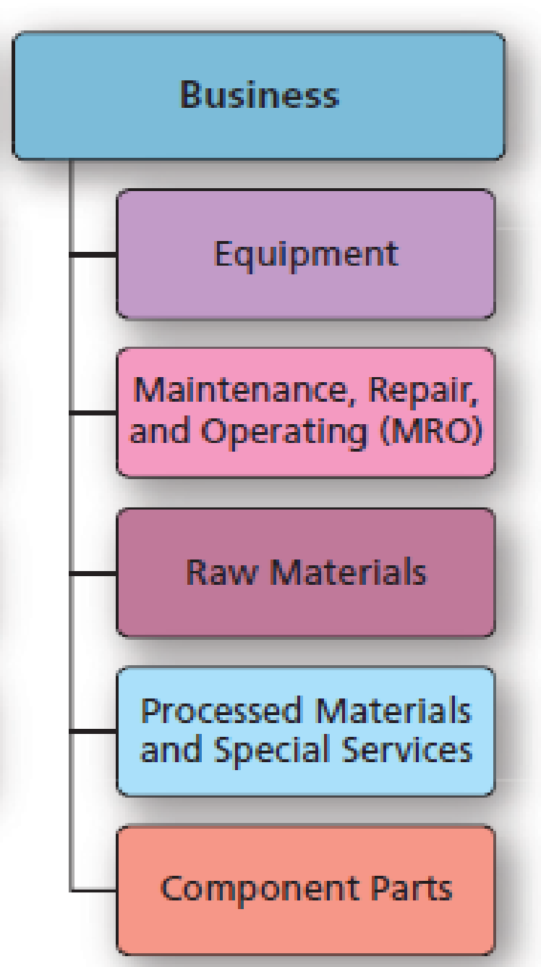
Business to Business Products
Marketers classify B2B products based on how organizations use them.
Knowledge of customer product use enables marketers to:
improve product designs.
craft an appropriate marketing mix.
Notes:
LECTURE NOTES:
This chart is the other half of Figure 8.2, illustrating B2B products. The following slides discuss this chart.

Slide 16
Categorizing B2B Products (1 of 2)
Equipment, often called installations or capital equipment, is used in daily operations.
Maintenance, repair, and operating (MRO) goods are consumed relatively quickly.
Raw materials are products of fishing, lumber, agricultural, and mining industries used to in the final product.
Notes:
LECTURE NOTES:
B2B products are classified by how organizational customers use them.
Equipment is used in daily operations. One form is heavy equipment, which is sometimes called capital equipment or installations. Examples might include a conveyor system used in a warehouse or as part of a production line, or the robotics used by Ford in the manufacturing of their vehicles. Computers, copy machines, and water fountains are examples of light or accessory equipment. Normally these types of items are more portable, cost less, and do not last as long as heavy equipment.
Regardless of the type of equipment, marketers commonly rely heavily upon personal selling of equipment in B2B situations.
Maintenance, repair, and operating (MRO) goods are consumed relatively quickly. Maintenance items include light bulbs, mops, etc., in comparison to repair products, which include small tools, nuts, bolts, and the like. Operating supplies include paper, toner, and the oil that keeps machines running smoothly.
The low cost and straightforward, non-technical nature of these items means most marketers use e-commerce or catalog marketing as the primary method of selling these items, as opposed to personal selling. However, sometimes inside sales representatives will be used to telephone business buyers for supply orders.
Raw materials are products of fishing, lumber, agricultural, and mining industries that are used in the manufacture of finished goods. Milk, soybeans, trees, and ore would be considered examples of raw materials.

Slide 17
Categorizing B2B Products (2 of 2)
Processed materials: produced by firms when they transform raw materials from their original state
Specialized services: services which are essential to the organization but are not a part of the actual production of a product
Component parts: manufactured goods or subassemblies of finished items an organizations needs to complete their own goods
Notes:
LECTURE NOTES:
Processed materials are produced by firms when they transform raw materials from their original state. So trees are trimmed, cut into boards, and treated. This treated lumber is then purchased by contractors for use in building homes or decks.
Specialized services are also purchased by business buyers. For example, a company that manufactures steel panels for use in metal buildings or roofing may purchase painting services from an outside supplier. Alternately, a firm may buy market research or legal services.
Finally, component parts are manufactured goods or subassemblies of finished items that organizations buy to incorporate into a larger product that are building. Ford buys tires – a finished item – and puts those tires on the vehicles they manufacture.
Marketing strategies for component parts, specialized services, and processed materials involve creating and maintaining relationships with customers, a strength of personal selling.

Slide 18
Classification of Consumer and B2B Products
Categorizing consumer and B2B products helps marketers to:
develop better new products
improved marketing mixes
Product durability, purchase process, and product use provide useful information.
Are consumer product classifications for a given product permanent? Can you think of products that have moved from one class to another?
Notes:
LECTURE NOTES:
Summary slide for Chapter 8, Learning Objective 2.
DISCUSSION NOTE:
Before we leave the consumer goods classification, it is worth noting that the classification of a product can change over the course of its’ life (high-definition TVs were specialty items when first introduced, and now have migrated into the shopping good classification).
Another factor to consider is that types of products may span multiple categories at the same time, depending upon the nature of the specific brand or item being shopped. For example, tropical fish (as a category) could be classified by different consumers as either a convenience, shopping, or specialty product. Consider . . . goldfish, guppies, betas, and other common low-cost freshwater fish would be convenience goods to harried mothers who shop at mass-merchandise stores such as Kmart and Wal-Mart for other items but don’t want to go out of their way to restock the family fish tank or goldfish bowl.
Less common forms of freshwater fish such as the beautiful and expensive Cichlids, as well as and saltwater fish, are seen as shopping goods that are distributed through pet stores. Many consumers may often visit more than one store before carefully selecting which fish to add to their tanks.
Very expensive saltwater fish, or rare and difficult to obtain fish such as breeding pairs of Angelfish may only be available from exclusive distributors or via mail order. In this case, these tropical fish would be considered specialty goods. Some individuals even schedule trips to the Amazon in order to collect fish from the wild. Obviously, this would be an extreme example of a specialty product.

Slide 19
“New and Improved!”: The Process of Innovation
Innovation is a hot topic in the boardroom today!
For marketers, an innovation is anything customers perceive as new or different.
May be a minor or game changing alteration to an existing good or service
May be a brand new product entirely
Notes:
LECTURE NOTES:
Marketer’s are fond of using the phrase, “new and improved” on packaging and in advertising. But what does this mean? Well, according to the Federal Trade Commission . . .
A product must be entirely new or changed significantly to be called “new”, and
A product may be called “new” for only six months.
While it’s good to know the legal definition of “new”, from a marketing perspective, we define an innovation as anything that a consumer PERCEIVES to be new or different from existing products. Remember, to the consumer, perception IS reality.

Slide 20
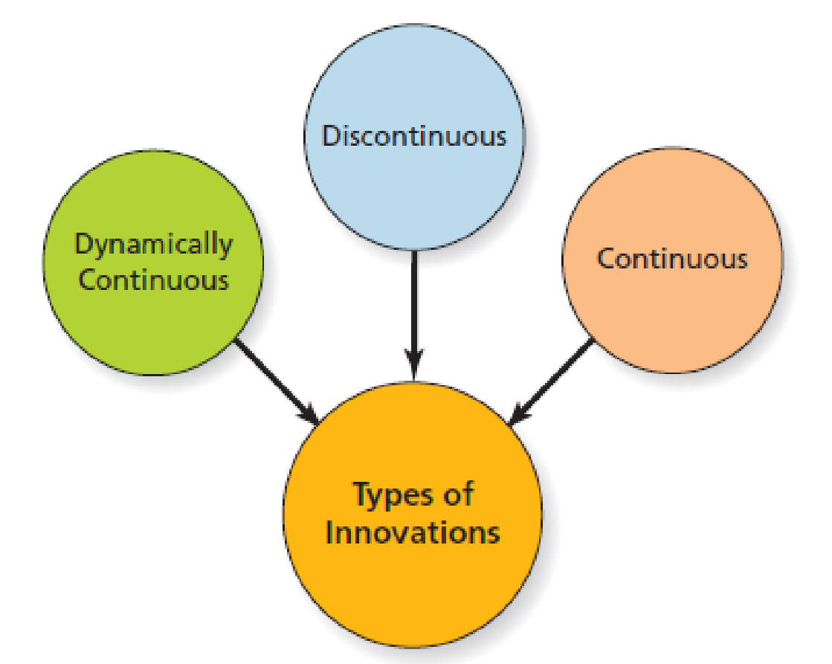
Figure 8.3 Types of Innovations
Notes:
LECTURE NOTES:
Innovations, as perceived by consumers, differ in terms of their DEGREE of newness. Innovations that are radically different from what we are used to require more time to learn, and tend to be more slowly adopted throughout the population as a result.
Figure 8.3 shows that marketers often classify innovations as continuous innovations, dynamically continuous innovation, or discontinuous innovations. The deciding factor that drives the classification is the degree to which the newness of the product changes people’s lives and consumption patterns.
For example, electricity and the light bulb fundamentally changed people’s lives. No longer bound to the rising and setting of the sun, people’s work and life habits changed. Electricity spawned entire new product categories of a wide variety of devices that changed the way people prepared food, cleaned their house, and completed a variety of tasks.

Slide 21
Continuous Innovation
A continuous innovation is a modification to an existing product.
Customer doesn’t have to learn anything new
A knockoff is a new product that copies, with slight modification, the design of an original product.
Harder to legally protect designs than technological innovations
Notes:
LECTURE NOTES:
Continuous innovations represent the bulk of new products, and are best described as a modification to an existing product.
Since customer don’t have to learn anything new to use a continuous innovation, they are very quickly adopted by the marketplace.
This type of innovation is often enough to set a brand apart from the competition. New flavors, bigger (or smaller) package sizes, or easy to open child-proof caps, as shown in the Aleve ad, are some examples.
Some firms create knockoffs of successful products to sell to a different market. Knockoffs change just enough of the original design of the product to avoid running a foul of the law, and often use cheaper and lower quality materials so the item can be sold for a lower price. Knock-offs are common in the fashion industry, where it is difficult to protect designs (as opposed to technological innovations which are much easier to patent and protect legally).

Slide 22
Dynamically Continuous Innovation
A dynamically continuous innovation is a pronounced modification to an existing product.
Requires a modest amount of learning for consumers to use
Notes:
LECTURE NOTES:
Dynamically continuous innovations are characterized by a major product change. These types of innovations are adopted more slowly than continuous innovations, as a modest amount of learning or behavior change is required before consumers can learn how to use the item.
What are some examples of products that you would consider to be dynamically continuous?
E.g., Audio products. 8-track tapes, cassette tapes, CDs, MP3.

Slide 23
Discontinuous Innovation
To qualify as a discontinuous innovation, the product must create major change in the way people live.
Consumers have to learn a great deal in order to be able to effectively use the product.
What’s the next “killer app?”
Notes:
LECTURE NOTES:
Examples of discontinuous innovation are the car, the airplane, and the personal computer.
DISCUSSION NOTES:
What’s the next really “big thing?”
Unlike continuous and dynamically continuous innovations, it’s hard to predict discontinuous innovations. Usually, marketers only know through 20/20 hindsight!
What do students think will be the next “killer app?” Why do they say so?

Slide 24
Convergence
Convergence is the coming together of two or more technologies to create a new system.
One of the most talked about forms of dynamically continuous innovation
Notes:
DISCUSSION NOTE:
Convergence is the blending of two or more technologies to create a new, better system and is one of the most talked-about forms of dynamically continuous innovations in the digital world.
Originally, the phone, organizer, and camera all came together in the Palm Treo and then the Motorola Q. Cable companies now provide cellular service, land phone lines, and high-speed Internet. Today devices like Apple’s iPad integrate numerous functions on one platform.
Can students think of other examples of digital products that are the result of convergence?

Slide 25
New Product Development (NPD)
The new product development model is based on categories of R&D expenditures.
In most organizations, this process is well- defined and systematic.
R&D investment is a central metric for measuring an organization’s commitment to innovation relative to its rivals.
Notes:
LECTURE NOTES:
For many firms, new products are critical for their long-term growth and success.
Apple has often been heralded for their new product success stories, particularly the iPod. However, they’ve had their fair share of failures too. An interesting article lists Apple’s top 10 failures (with the Apple Newton taking “first place” honors) can be found at: www.newlaunches.com/archives/top_10_apple_products_which_flopped.php.
Key reasons for new product failure include: 1) creating a product with no discernable benefit over existing alternatives; 2) overestimating the size of the market; 3) poor positioning strategy; and 4) poor implementation of the marketing mix (bad product quality, pricing too high or low; inadequate distribution; targeting the wrong market; ineffective advertising).
However, following the new-product development process can help firms avoid many of these pitfalls. Let’s talk about this process now.

Slide 26
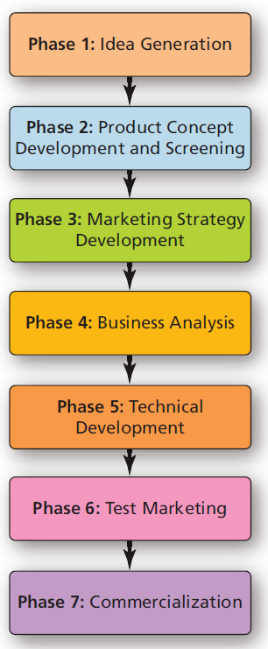
Figure 8.4 Phases in New Product Development
Notes:
LECTURE NOTE:
Seven phases or steps make-up the new product development process.

Slide 27
New Product Development (1 of 4)
Phase 1: Idea generation (Ideation)
Marketers use a variety of sources to come up with ideas for new products.
Value co-creation via collaboration with customers, salespeople, service personnel, and other stakeholders
Notes:
LECTURE NOTES:
Phase 1: Idea generation.
In this stage, marketers brainstorm ideas generated by customers, employees, service providers, or others that provide customer benefits and which are compatible with the firm’s mission. Focus groups can be particularly helpful in tapping into consumer ideas for new products that related to evolving or changing needs.
Some companies encourage their new product designers to “think outside the box” by exposing them to new ideas, people, and places.
The director of culinary innovation at McDonald’s runs the chain’s test kitchen and he’s challenged with finding new menu concepts that work within the context of a McDonald’s store.
Recently, he came up with a simple idea: He took the breaded chicken the chain uses in its Chicken Selects strips, topped it with shredded cheddar jack cheese and lettuce, added a few squirts of ranch sauce, and wrapped it in a flour tortilla. McDonald’s dubbed it the “Snack Wrap” and put it on the menu at a starter price of $1.29.
A hit was born—the Snack Wrap is one of the most successful new product launches in company history with sales exceeding projections by 20 percent.
Instructor may want to also introduce the idea of value co-creation, the process by which an organization creates value via collaboration with customers and other stakeholders.

Slide 28
New Product Development (2 of 4)
Phase 2: Product-concept development and screening
Product ideas are tested for technical and commercial success.
Phase 3: Marketing strategy development
Developing a plan including identifying the target market and developing strategies for the four Ps.
Notes:
LECTURE NOTES:
Phase 2: Product-concept development and screening
The marketer takes the ideas generated in phase 1 of the process, and expands these ideas into more complete product concepts. Product concepts are screened – meaning they are tested – for both technical AND commercial success. The idea is to weed out those concepts that have little chance of making it if actually produced and released for distribution.
Phase 3: Marketing strategy development
Marketers need to make some fundamental decisions at this stage, including identifying a target market, estimating its size and potential, and determining how to position the product to effectively appeal to the selected target market. Next, planning for pricing, distribution, and promotion is undertaken.

Slide 29
New Product Development (3 of 4)
Phase 4: Business analysis
The product’s commercial viability is assessed.
Phase 5: Technical development
Engineers work to develop and refine a working prototype.
Firm may need to apply for a patent.
Notes:
LECTURE NOTES:
Phase 4: Business analysis
While the concept development and screening stage estimated the basic commercial viability of the product, the concept is scrutinized in greater detail during the business analysis phase. To be commercially viable, the product concept must make a positive contribution to the overall profit of the firm.
Employees charged with determining the commercial viability of a product estimate product demand, and work hard to determine if the firm has adequate resources to introduce the new product. The new items fit in the overall product mix is also analyzed. In particular, marketers try to estimate if the new offering will cannibalize (e.g., steal sales from) existing brands. Possible synergies with existing brands are also evaluated. The business analysis must be thorough because the costs of new product development begin to climb rapidly from this stage forward.
Phase 5: Technical development
The technical development stage is expensive for firms because engineers begin refining the product concept, develop detailed blueprints, schemata, and models, and actual product prototypes. Prototypes are fully functioning test versions of the product developed by the R&D department.
Prototypes are often tested during focus groups, or by employees within the firm. For example, Gillette employees constantly test new products by shaving when they first come to work.
Prototypes are used by employees responsible for writing instructions, determining which parts will be manufactured internally versus purchased from a supplier as well as what type of new machinery will be needed for the production process.
Often, firms will patent the product during the technical development stage to protect the firm’s investment.

Slide 30
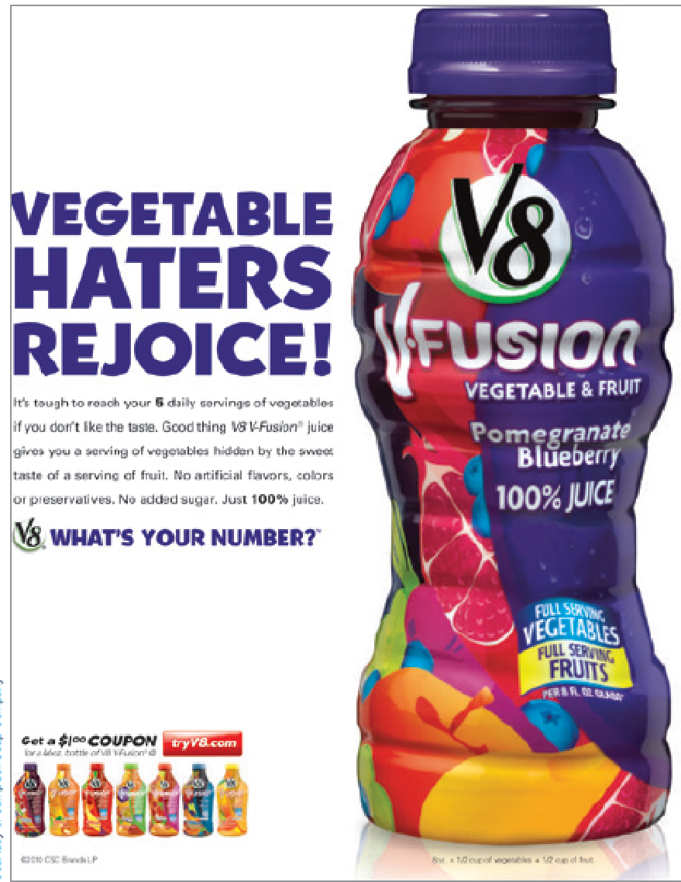
Technical Development
Even continuous innovations such as new beverage flavors may require multiple prototypes and consumer tests as part of the technical development phase.
Notes:
LECTURE NOTES:
Creating new beverages or other flavored foods can be tricky. Multiple prototypes are often tested so that the variation which BEST satisfies consumers’ expectations is chosen.

Slide 31
New Product Development (4 of 4)
Phase 6: Market Test
The complete marketing plan is tested in a small geographic area similar to the larger market or via a simulated market test.
Phase 7: Commercialization
The new product is launched into the market.
Full-scale production, distribution, advertising, and sales promotion are begun.
Notes:
LECTURE NOTES:
Phase 6: Test marketing
Once the final product configuration is created, a firm may decide to launch the product in a test market for a limited amount of time. During the test market, the entire marketing plan is tested – the geographic market in which the test takes place is exposed to the actual promotion, distribution, and pricing strategy planned for the final product launch.
Not all products warrant a test market though. A new flavored beverage for an established manufacturer probably wouldn’t warrant the expense. Aside from the tremendous cost associated with test market which often run in the millions of dollars, a firm runs the risk of alerting the competition to the new product, which allows them to begin developing a competitive product that much sooner.
However, the benefits can outweigh the costs. For example, test marketing allows marketers to fine tune their entire marketing strategy before taking the campaign and new product introduction national. Sometimes flaws in the product are discovered and fixed.
Sometimes, the firm saves millions of dollars by pulling a product that “fails” its test market.
As an alternative to actual test marketing, more and more firms are opting for simulated test markets that take place online, or in controlled warehouses which mimic a grocery store.
Phase 7: Commercialization
Commercialization is just what the name implies – a full scale launch of the new product. Sometimes products are rolled nationally all at once; other times, a product may be released first into a specific geographic region, with future regional introductions occurring over time as production gears up or as sales grown in the original region.
Commercialization requires careful preparation. Marketers begin by reaching out to the trade, such as retailers and wholesalers who are part of the distribution chain. These organizations must be convinced to carry the product. Publicity aimed at the media is often used to announce the new product, and accompanied by advertising, sales promotion, and other communication tactics geared towards consumers.

Slide 32
Adoption and Diffusion of New Products
Product adoption is the process by which a consumer or business customer begins to buy and use a new good, service, or idea.
Diffusion is the process by which the use of a product or innovation spreads throughout a population.
Notes:
LECTURE NOTES:
The last stage of the new product development process occurs when a new product is introduced commercially. Let’s talk about what happens after the product hits the marketplace.
Product adoption is the process by which a consumer or business customer begins to buy and use a new good, service, or idea
In contrast, Diffusion is a process by which the use of a product spreads throughout a population. The point where a product’s sales spike from a slow climb to a new level is called the tipping point. Marketers work hard to reach the tipping point as soon as possible, and undertake a variety of actions to reach and motivate consumers during each stage in the consumer adoption process.

Slide 33
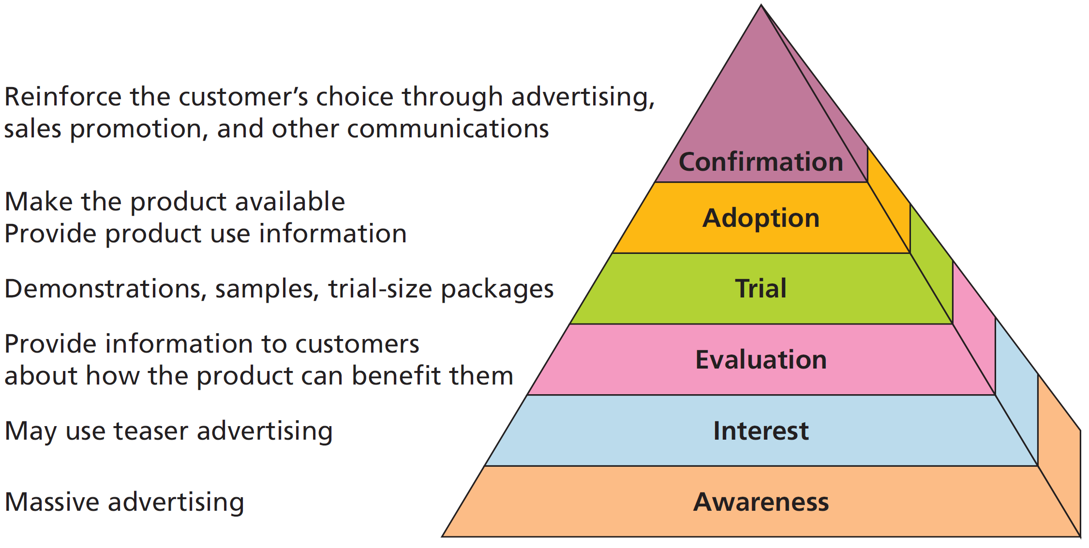
Figure 8.5 Adoption Pyramid
Notes:
LECTURE NOTES:
The process that leads to consumers’ adoption of an innovation is illustrated in Figure 8.5. The process begins at the ground level, and marketers’ first task is to create awareness among consumers. Different tactics used by marketers to create interest, spur product evaluations, and stimulate trial, adoption and confirmation are also shown in Figure 8.5.
However, not everyone who becomes aware of an innovation is interested in learning more. The pyramid shape of Figure 8.5 symbolizes the fact that some consumers “drop out” at each level despite the best efforts of marketers.
Let’s briefly discuss each step of the adoption pyramid:
A media blitz, or massive advertising campaign and publicity efforts are commonly used to create awareness among the target market.
Prospective adopters become interested when they see how the new product might satisfy a need. Teaser advertising is often used to stimulate curiosity and the desire to look for more information.
Consumers weigh the costs/benefits of the new innovation during the evaluation stage, though some types of products, such as those bought on impulse, may be bought with very little evaluation.
Sampling is the premiere technique for stimulating trial usage of the product among potential adopters, and demonstrations can be critical as well.
During Adoption, the prospect actually buys the product for the first time. But that’s not the end of the process!
After initially adopting the product, the consumer weighs the expected vs. actual benefits and costs. If he or she is satisfied following a favorable experience, the individual is likely to continue using the product for as long as it meets his or her needs better than the competition. Marketers can encourage confirmation via marketing communications by reinforcing the idea that the consumer made the correct choice.

Slide 34
Adoption Pyramid (1 of 2)
Awareness
Customers see that innovation exists.
Media blitz
Interest
Customers see how the product satisfies a need.
Seek out information
Evaluation
Costs and benefits
Impulse purchase
Notes:
LECTURE NOTE:
This slide provides further details about the Adoption Pyramid (Figure 8.5)

Slide 35
Adoption Pyramid (2 of 2)
Trial
Actually experience or use the product
Adoption
Purchase is made
Confirmation
Expected versus actual benefits and costs
Notes:
LECTURE NOTE:
This slide provides further details about the Adoption Pyramid (Figure 8.5)

Slide 36
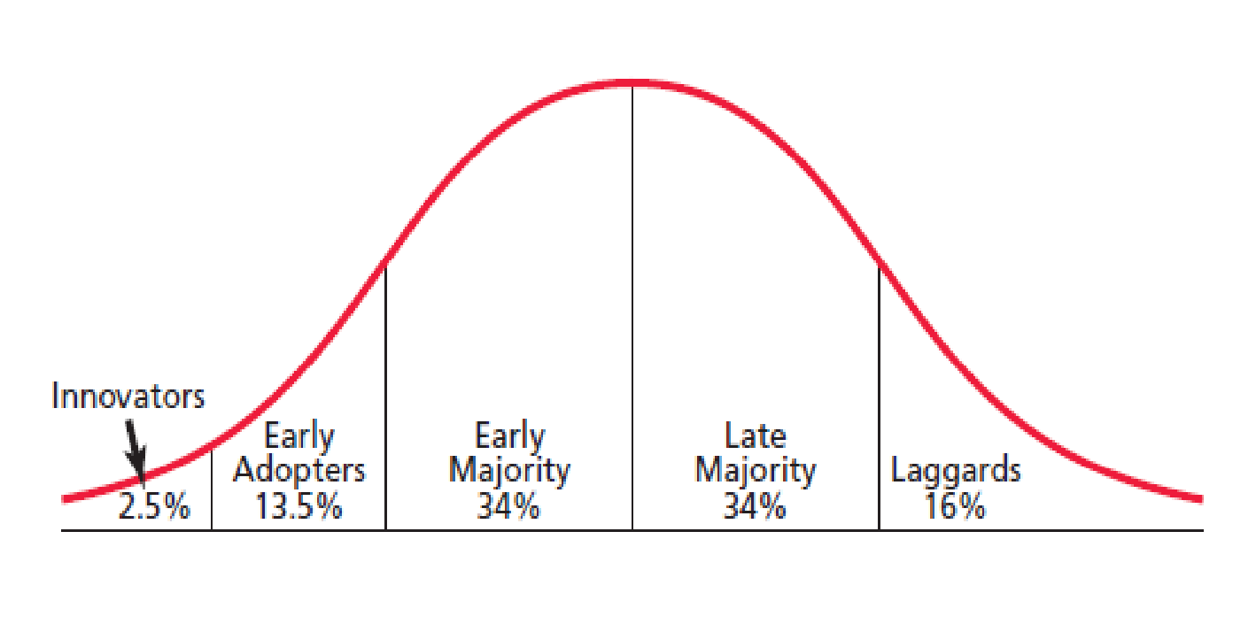
Figure 8.6 Categories of Adopters
Notes:
LECTURE NOTES:
Recall from our earlier discussion that diffusion describes how a product spreads throughout the marketplace. Some consumers are eager to try new innovations, while others may take a “wait and see” attitude, or be downright skeptical of new offerings. The simple fact is that different people adopt innovations at different times.
Figure 8.6 illustrates this idea.

Slide 37
Categories of Adopters (1 of 2 )
Innovators
Extremely adventurous
Risk takers
Well-educated
Early Adopters
Concerned about social acceptance
Heavy media users
Notes:
LECTURE NOTE:
The first to adopt a new product are innovators. These risk-taking, adventurous individuals are young, well educated, and better off financially than most others.
Early adopters are concerned about their standing with peers, and gravitate towards products that will enhance their social acceptance by making them appear to be fashionable or cutting-edge. Marketers will often spend more money targeting the early adopters than they will innovators, knowing that innovators are going to try the product anyways if it is at all relevant to them.

Slide 38
Categories of Adopters (2 of 2)
Early Majority
Avoid being first or last
Middle class
Deliberate and cautious
Late Majority
Older
Conservative
Lower than average education and income
Laggards
Lower education and income
Bound by tradition
Notes:
LECTURE NOTE:
More cautious than either of the first two groups mentioned, those who fall under the early majority are cautious and deliberate in their decision-making. Once they adopt a product, it is no longer considered to be new or all that different. Early majority are middle-class consumers, with slightly above average levels of education and income.
The late majority tends to be comprised of older consumers with lower levels of education and income. Those in the late majority are risk adverse, so they’ll only purchase a product once it has a proven track record and is no longer considered to be a risky buy.
Laggards, the very last group to adopt a product, are rarely, if ever actively targeted by marketers. Tradition bound to the core, laggards often only adopt a product when there is no other alternative. For example, there is a still a small group of men who use a strait razor to shave. As it becomes more difficult for these people to find a replacement razor or to sharpen and existing blade, straight razor users may be forced to purchase either an electric razor or disposable razor.

Slide 39
Product Factors That Affect the Rate of Adoption
The degree to which a new product has each of these characteristics affects the speed of diffusion.
Relative advantage
Compatibility
Complexity
Trialability
Observability
Notes:
LECTURE NOTES:
Not all products are successful, and the reason for most failures lies in the fact that consumers don’t perceive the new offering as better than what they are already using. Lack of a relative advantage therefore is a key characteristic tied to new product failures. Relative advantage is one of five product factors that researchers have found to affect the speed with which new innovations are adopted.

Slide 40
Characteristics of Innovations (1 of 3 )
Relative advantage is the degree to which a consumer perceives a new product as offering superior benefits.
Greater relative advantage means faster adoption
Compatibility is the extent to which an innovation is consistent with existing cultural values, customs, practices, and norms.
Lack of perceived compatibility slows adoption
Notes:
LECTURE NOTES:
Marketers must take care to promote the relative advantage of a new offering in such a way that its superiority to other products is clear. However, no amount of promotion will make up for a LACK of relative advantage, so the desirability and superiority of the relative advantage needs to be carefully tested and evaluated during the new product development process.

Slide 41
Characteristics of Innovations (2 of 3)
Complexity refers to the degree to which consumers perceive a new product as difficult to understand and use.
Higher the degree of perceived complexity, the slower the rate of adoption.
Trialability refers to the ease of sampling a new product and its benefits.
Lower costs associated with trial usage can speed rate of adoption.
Notes:
DISCUSSION NOTE:
Ask students how many of them know how a microwave operates? When the microwave oven was first introduced, marketers explained that the appliance causes molecules to move and rub together, thus creating friction, which cooks the food. This explanation was too complex for most consumers to understand in the 1960s.

Slide 42
Characteristics of Innovations (3 of 3)
Observability refers to the degree to which others can see the new product and the benefits it provides.
An innovation that is more visible will drive more word-of-mouth communication.

Slide 43
Copyright

