Slide 1
Business Essentials
Twelfth Edition
Chapter 10
Human Resource Management and Labor Relations
Copyright © 2019, 2016, 2013 Pearson Education, Inc. All Rights Reserved.
Notes:
If this PowerPoint presentation contains mathematical equations, you may need to check that your computer has the following installed:
1) MathType Plugin
2) Math Player (free versions available)
3) NVDA Reader (free versions available)

Slide 2
Introduction
In this chapter we
explain how managers plan for their organization’s human resource needs
discuss ways in which organizations select, develop, and appraise employee performance
examine the main components of a compensation system
look at some key legal issues
explain why workers organize into labor unions and describe the collective bargaining process

Slide 3
Learning Objectives (1 of 2)
Define human resource management, discuss its strategic significance, and explain how managers plan for their organization’s human resource needs.
Discuss the legal context of human resource management and identify contemporary legal issues.
Identify the steps in staffing a company and discuss ways in which organizations recruit and select new employees.

Slide 4
Learning Objectives (2 of 2)
Describe the main components of a compensation and benefits system.
Describe how managers develop the workforce in their organization through training and performance appraisal.
Discuss workforce diversity, the management of knowledge workers, and the use of a contingent workforce as important changes in the contemporary workplace.
Explain why workers organize into labor unions and describe the collective bargaining process.

Slide 5
The Foundations of Human Resource Management
Human resource management (HRM)
the set of organizational activities directed at attracting, developing, and maintaining an effective workforce
Human Capital
reflects the organization’s investment in attracting, retaining, and motivating an effective workforce
Notes:
Human resources (HR) are critical for effective organizational functioning. The importance of HRM has grown dramatically in the last two decades. Its new importance stems from increased legal complexities, the recognition that HR are a valuable means for improving productivity, and the awareness of the costs associated with poor HRM.
Human capital reflects the organization’s investment in attracting, retaining, and motivating an effective workforce. Hence, just as the phrase financial capital is an indicator of a firm’s financial resources and reserves, so, too, does human capital serve as a tangible indicator of the value of the people who comprise an organization.

Slide 6
HR Planning
Job Analysis
systematic analysis of jobs within an organization
Job Description
description of the duties and responsibilities of a job, its working conditions, and the tools, materials, equipment, and information used to perform it
Job Specification
description of the skills, abilities, and other credentials and qualifications required by a job
Notes:
Job analysis is a systematic analysis of jobs within an organization; most firms have trained experts who handle these analyses. A job analysis results in two things:
The job description lists the duties and responsibilities of a job; its working conditions; and the tools, materials, equipment, and information used to perform it.
The job specification lists the skills, abilities, and other credentials and qualifications needed to perform the job effectively.

Slide 7
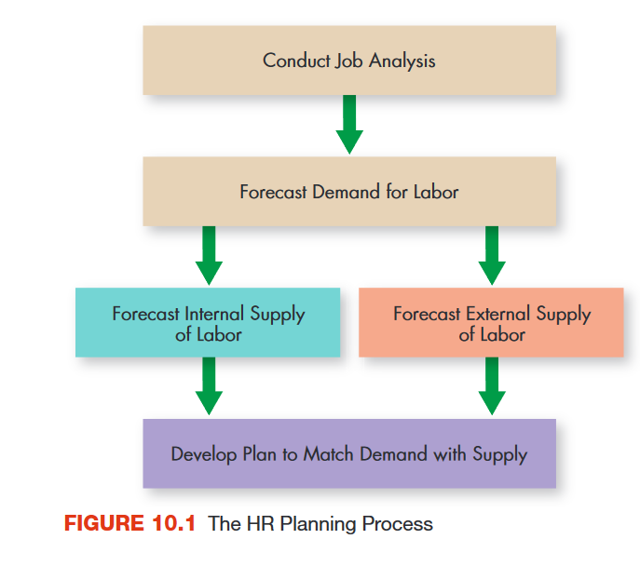
The HR Planning Process
Notes:
As you can see in Figure 10.1, the starting point in attracting qualified human resources is planning. Specifically, HR planning involves job analysis and forecasting the demand for, and supply of, labor.

Slide 8
Forecasting HR Demand and Supply (1 of 2)
Forecasting internal supply
the number and type of employees who will be in the firm at some future date
Forecasting external supply
the number and type of people who will be available for hiring from the labor market at large
Notes:
After managers comprehend the jobs to be performed within an organization, they can start planning for the organization’s future HR needs. The manager starts by assessing trends in past HR usage, future organizational plans, and general economic trends. Forecasting the supply of labor is really two tasks:
Forecasting internal supply, the number and type of employees who will be in the firm at some future date.
Forecasting external supply, the number and type of people who will be available for hiring from the labor market at large.

Slide 9
Forecasting HR Demand and Supply (2 of 2)
Replacement Chart
list of each management position, who occupies it, how long that person will likely stay in the job, and who is qualified as a replacement
Employee Information System (Skills Inventory)
computerized system containing information on each employee’s education, skills, work experiences, and career aspirations
Notes:
At higher levels of an organization, managers plan for specific people and positions. The technique most commonly used is the replacement chart, which lists each important managerial position, who occupies it, how long that person will probably stay in it before moving on, and who is now qualified or soon will be qualified to move into it.
To facilitate both planning and identifying people for transfer or promotion, some organizations also have employee information systems (skills inventories) that contain information on each employee’s education, skills, work experience, and career aspirations. Such a system can quickly locate every employee who is qualified to fill a position.

Slide 10
The Legal Context of HRM (1 of 6)
Title VII of the Civil Rights Act of 1964
forbids discrimination in all areas of the employment relationship
Adverse Impact
when minorities and women meet or pass the requirement for a job at a rate less than 80 percent of the rate of majority group members
Equal Employment Opportunity Commission (EEOC)
federal agency enforcing several discrimination-related laws
Notes:
A number of laws regulate various aspects of employee–employer relations, especially in the areas of equal employment opportunity, compensation and benefits, labor relations, and occupational safety and health.
Title VII of the Civil Rights Act of 1964 forbids discrimination in all areas of the employment relationship, such as hiring, opportunities for advancement, compensation increases, lay-offs, and terminations against members of certain protected classes based on factors such as race, color, gender, religious beliefs, or national origin.
Employment requirements such as test scores and other qualifications are legally defined as having an adverse impact on minorities and women when such individuals meet or pass the requirement at a rate less than 80 percent of the rate of majority group members. Criteria that have an adverse impact on protected groups can be used only when there is solid evidence that they effectively identify individuals who are better able than others to do the job.
The Equal Employment Opportunity Commission (EEOC) is charged with enforcing Title VII as well as several other employment-related laws.

Slide 11
The Legal Context of HRM (2 of 6)
Age Discrimination in Employment Act
outlaws discrimination against people older than 40 years
Equal Employment Opportunity
legally mandated nondiscrimination in employment on the basis of race, creed, sex, or national origin
Notes:
The Age Discrimination in Employment Act, passed in 1967, amended in 1978 and 1986, is an attempt to prevent organizations from discriminating against older workers. In its current form, it outlaws discrimination against people older than 40 years. Both the Age Discrimination in Employment Act and Title VII require passive non-discrimination, or equal employment opportunity. Employers are not required to seek out and hire minorities, but they must treat all who apply fairly.

Slide 12
Affirmative Action
Affirmative Action
intentionally seeking and hiring employees from groups that are underrepresented in the organization
Affirmative Action Plan
written statement of how the organization intends to actively recruit, hire, and develop members of relevant protected classes
Notes:
Several executive orders, however, require that employers holding government contracts engage in affirmative action, intentionally seeking and hiring employees from groups that are underrepresented in the organization. These organizations must have a written affirmative action plan that spells out employment goals for underused groups and how those goals will be met. These employers are also required to act affirmatively in hiring Vietnam-era veterans (as a result of the Vietnam Era Veterans Readjustment Assistance Act) and qualified handicapped individuals. Finally, the Pregnancy Discrimination Act forbids discrimination against women who are pregnant.

Slide 13
The Legal Context of HRM (3 of 6)
Americans With Disabilities Act
forbids discrimination on the basis of disabilities and requires employers to provide reasonable accommodations for disabled employees
Civil Rights Act of 1991
amended the original Civil Rights Act
Notes:
In 1990 Congress passed the Americans with Disabilities Act, which forbids discrimination on the basis of disabilities and requires employers to provide reasonable accommodations for disabled employees.
More recently, the Civil Rights Act of 1991 amended the original Civil Rights Act as well as other related laws by both making it easier to bring discrimination lawsuits (which partially explains the aforementioned backlog of cases) while simultaneously limiting the amount of punitive damages that can be awarded in those lawsuits.

Slide 14
Compensation and Benefits (1 of 2)
Fair Labor Standards Act
sets a minimum wage and requires the payment of overtime rates for work in excess of 40 hours per week
Equal Pay Act of 1963
requires that men and women be paid the same amount for doing the same job
Notes:
Laws also regulate compensation and benefits. The Fair Labor Standards Act, passed in 1938 and amended frequently since then, sets a minimum wage and requires the payment of overtime rates for work in excess of 40 hours per week. Salaried professional, executive, and administrative employees are exempt from the minimum hourly wage and overtime provisions.
The Equal Pay Act of 1963 requires that men and women be paid the same amount for doing the same job. Attempts to circumvent the law by having different job titles and pay rates for men and women who perform the same work are also illegal. Basing an employee’s pay on seniority or performance is legal, however, even if it means that a man and woman are paid different amounts for doing the same job.

Slide 15
Compensation and Benefits (2 of 2)
Employee Retirement Income Security Act (ERISA) of 1974
ensures the financial security of pension funds by regulating how they can be invested
Family and Medical Leave Act (FMLA) of 1993
requires employers to provide up to 12 weeks of unpaid leave for family and medical emergencies
Notes:
Certain benefits are mandatory, such as workers’ compensation insurance for employees who are injured on the job. Employers who provide a pension plan for their employees are regulated by the Employee Retirement Income Security Act (ERISA) of 1974. The purpose of this act is to help ensure the financial security of pension funds by regulating how they can be invested. The Family and Medical Leave Act (FMLA) of 1993 requires employers to provide up to 12 weeks of unpaid leave for family and medical emergencies.

Slide 16
The Legal Context of HRM (4 of 6)
Table 10.1 Major Laws and Regulations Affecting Human Resource Management
Equal Employment Opportunity Title VII of the Civil Rights Act of 1964 (as amended by the Equal Employment Opportunity Act of 1972). Forbids discrimination in all areas of the employment relationship. Age Discrimination in Employment Act. Outlaws discrimination against people older than 40 years. Various executive orders, especially Executive Order 11246 in 1965. Requires employers with government contracts to engage in affirmative action. Pregnancy Discrimination Act. Specifically outlaws discrimination on the basis of pregnancy. Vietnam Era Veterans Readjustment Assistance Act. Extends affirmative action mandate to military veterans who served during the Vietnam War. Americans with Disabilities Act. Specifically outlaws discrimination against disabled persons. Civil Rights Act of 1991. Makes it easier for employees to sue an organization for discrimination but limits punitive damage awards if they win.
Notes:
A number of laws regulate various aspects of employee–employer relations, especially in the areas of equal employment opportunity, compensation and benefits, labor relations, and occupational safety and health. Several major ones are summarized in Table 10.1.

Slide 17
The Legal Context of HRM (5 of 6)
Table 10.1 Continued
Compensation and Benefits Fair Labor Standards Act. Establishes minimum wage and mandated overtime pay for work in excess of 40 hours per week. Equal Pay Act of 1963. Requires that men and women be paid the same amount for doing the same job. Employee Retirement Income Security Act (ERISA) of 1974. Regulates how organizations manage their pension funds. Family and Medical Leave Act (FMLA) of 1993. Requires employers to provide up to 12 weeks of unpaid leave for family and medical emergencies.

Slide 18
The Legal Context of HRM (6 of 6)
Table 10.1 Continued
Labor Relations National Labor Relations Act. Spells out procedures by which employees can establish labor unions and requires organizations to bargain collectively with legally formed unions; also known as the Wagner Act. Labor-Management Relations Act. Limits union power and specifies management rights during a union-organizing campaign; also known as the Taft-Hartley Act.
Health and Safety Occupational Safety and Health Act (OSHA) of 1970. Mandates the provision of safe working conditions.

Slide 19
Labor Relations
National Labor Relations Act (also known as the Wagner Act)
sets up a procedure for employees to vote on whether to have a union
National Labor Relations Board (NLRB)
established by the Wagner Act to enforce its provisions
Labor-Management Relations Act (also known as the Taft-Hartley Act)
passed to limit union power
Notes:
Union activities and management’s behavior toward unions constitute another heavily regulated area.
The National Labor Relations Act (also known as the Wagner Act), passed in 1935, sets up a procedure for employees to vote on whether to have a union. If they vote for a union, management is required to bargain collectively with the union.
The National Labor Relations Board (NLRB) was established by the Wagner Act to enforce its provisions.
The Labor-Management Relations Act (also known as the Taft-Hartley Act) was passed in 1947 to limit union power. The law increases management’s rights during an organizing campaign. The Taft-Hartley Act also contains the National Emergency Strike provision, which allows the president of the United States to prevent or end a strike that endangers national security. Taken together, these laws balance union and management power. Employees can be represented by a legally created and managed union, but the business can make nonemployee-related business decisions without interference.

Slide 20
Health and Safety
Occupational Safety and Health Act (OSHA) of 1970
federal law setting and enforcing guidelines for protecting workers from unsafe conditions and potential health hazards in the workplace
Notes:
The Occupational Safety and Health Act (OSHA) of 1970 directly mandates the provision of safe working conditions. It requires that employers (1) provide a place of employment that is free from hazards that may cause death or serious physical harm and (2) obey the safety and health standards established by the Department of Labor. Safety standards are intended to prevent accidents, whereas occupational health standards are concerned with preventing occupational disease.

Slide 21
Other Legal Issues (1 of 2)
Sexual Harassment
making unwelcome sexual advances in the workplace
Quid Pro Quo Harassment
form of sexual harassment in which sexual favors are requested in return for job-related benefits
Hostile Work Environment
form of sexual harassment derived from off-color jokes, lewd comments, and so forth
Notes:
Sexual harassment is defined by the EEOC as unwelcome sexual advances in the work environment. If the conduct is indeed unwelcome and occurs with sufficient frequency to create an abusive work environment, the employer is responsible for changing the environment by warning, reprimanding, or firing the harasser.
The courts have defined two types of sexual harassment:
In cases of quid pro quo harassment, the harasser offers to exchange something of value for sexual favors. A male supervisor, for example, might tell or suggest to a female subordinate that he will recommend her for promotion or give her a raise in exchange for sexual favors.
The creation of a hostile work environment is a subtler form of sexual harassment. A group of male employees who continually make off-color jokes and lewd comments and perhaps decorate the work environment with inappropriate photographs may create a hostile work environment for a female colleague, who may become uncomfortable working in that environment.

Slide 22
Other Legal Issues (2 of 2)
Employment at Will
principle, increasingly modified by legislation and judicial decision, that organizations should be able to retain or dismiss employees at their discretion
Patriot Act
legislation that increased U.S. government’s power to investigate and prosecute suspected terrorists
Notes:
The concept of employment at will holds that both employer and employee have the mutual right to terminate an employment relationship at any time for any reason, with or without advance notice to the other. Over the last two decades, however, terminated employees have challenged the employment-at-will doctrine by filing lawsuits against former employers on the grounds of wrongful discharge.
In response to the terrorist attacks of September 11, 2001, the U.S. government passed legislation that increases its powers to investigate and prosecute suspected terrorists. This legislation, known as the Patriot Act, has several key implications for HRM. For instance, certain “restricted” individuals (including ex-convicts and aliens from countries deemed by the State Department to have “repeatedly provided support for acts of international terrorism”) are ineligible to work with potentially dangerous biological agents. More controversial are sections granting government investigators access to previously confidential personal and financial records.

Slide 23
Staffing the Organization
Recruiting
process of attracting qualified persons to apply for jobs an organization is seeking to fill
Internal Recruiting
considering present employees as candidates for openings
External Recruiting
attracting persons outside the organization to apply for jobs
Notes:
When managers have determined that new employees are needed and understand the legal context in which they operate, they must then turn their attention to recruiting and hiring the right mix of people. This involves two processes: (1) acquiring new employees from outside the company and (2) promoting current employees from within. Both external and internal staffing, however, start with effective recruiting.

Slide 24
Selecting Human Resources
Application forms
Tests
Interviews
Polygraph
Drug tests
Credit checks
References
Notes:
Once the recruiting process has attracted a pool of applicants, the next step is to select someone to hire. The intent of the selection process is to gather from applicants the information that will predict job success and then to hire the candidates likely to be most successful.

Slide 25
Compensation and Benefits
Compensation System
total package of rewards that organizations provide to individuals in return for their labor
Wages
compensation in the form of money paid for time worked
Salary
compensation in the form of money paid for discharging the responsibilities of a job
Notes:
People who work for a business expect to be paid, and most workers today also expect certain benefits from their employers. Indeed, a major factor in retaining skilled workers is a company’s compensation system, the total package of rewards that it offers employees in return for their labor.
Wages and salaries are the dollar amounts paid to employees for their labor. Wages are paid for time worked. For example, if your job pays you $10 an hour, that is your wage. A salary, on the other hand, is paid for performing a job. A salaried executive earning $100,000 per year is paid to achieve results even if that means working 5 hours one day and 15 the next. Salaries are usually expressed as an amount paid per month or year.

Slide 26
Incentive Programs (1 of 3)
Incentive Program
special compensation program designed to motivate high performance
Bonus
individual performance incentive in the form of a special payment made over and above the employee’s salary
Merit Salary System
Individual incentive linking compensation to performance in non-sales jobs
Notes:
Studies have shown that beyond a certain point, more money will not produce better performance. Money motivates employees only if it is tied directly to performance.
The most common method of establishing this link is the use of incentive programs, special pay programs designed to motivate high performance. Some programs are available to individuals, whereas others are distributed on a companywide basis.

Slide 27
Incentive Programs (2 of 3)
Pay For Performance (Variable Pay)
individual incentive that rewards a manager for especially productive output
Profit-Sharing Plan
incentive plan for distributing bonuses to employees when company profits rise above a certain level
Gainsharing Plan
incentive plan that rewards groups for productivity improvements
Notes:
A newer incentive plan is called pay for performance (or variable pay). In essence, middle managers are rewarded for especially productive output with earnings that significantly exceed the cost of bonuses.
Some incentive programs apply to all the employees in a firm. Under profit-sharing plans, for example, profits earned above a certain level are distributed to employees. Also, gainsharing plans distribute bonuses to employees when a company’s costs are reduced through greater work efficiency. Pay-for-knowledge plans pay workers to learn new skills and to become proficient at different jobs.

Slide 28
Incentive Programs (3 of 3)
Pay-for-Knowledge Plan
incentive plan to encourage employees to learn new skills or become proficient at different jobs

Slide 29
Benefits Programs
Benefits
compensation other than wages and salaries
Workers’ Compensation Insurance
legally required insurance for compensating workers injured on the job
Cafeteria Benefits Plan
benefit plan that sets limits on benefits per employee, each of whom may choose from a variety of alternative benefits
Notes:
Benefits, compensation other than wages and salaries and other incentives offered by a firm to its workers, account for an increasing percentage of most compensation budgets. Most companies are required by law to pay tax for Social Security retirement benefits and provide workers’ compensation insurance, insurance for compensating workers injured on the job. Most businesses also provide health, life, and disability insurance for their workers, as well as paid time off for vacations and holidays.

Slide 30
Developing the Workforce (1 of 4)
Training
usually refers to teaching operational or technical employees how to do the job for which they were hired
Development
usually refers to teaching managers and professionals the skills needed for both present and future jobs
Notes:
In HRM, training usually refers to teaching operational or technical employees how to do the job for which they were hired. Development refers to teaching managers and professionals the skills needed for both present and future jobs.16 Most organizations provide regular training and development programs for managers and employees.

Slide 31
Developing the Workforce (2 of 4)
On-the-Job Training
training, sometimes informal, conducted while an employee is at work
Off-the-Job Training
training conducted in a controlled environment away from the work site
Vestibule Training
off-the-job training conducted in a simulated environment
Notes:
When employees must learn a physical skill, methods allowing practice and the actual use of tools and materials are needed, as in on-the-job training or vestibule training. (Vestibule training enables participants to focus on safety, learning, and feedback rather than on productivity.)

Slide 32
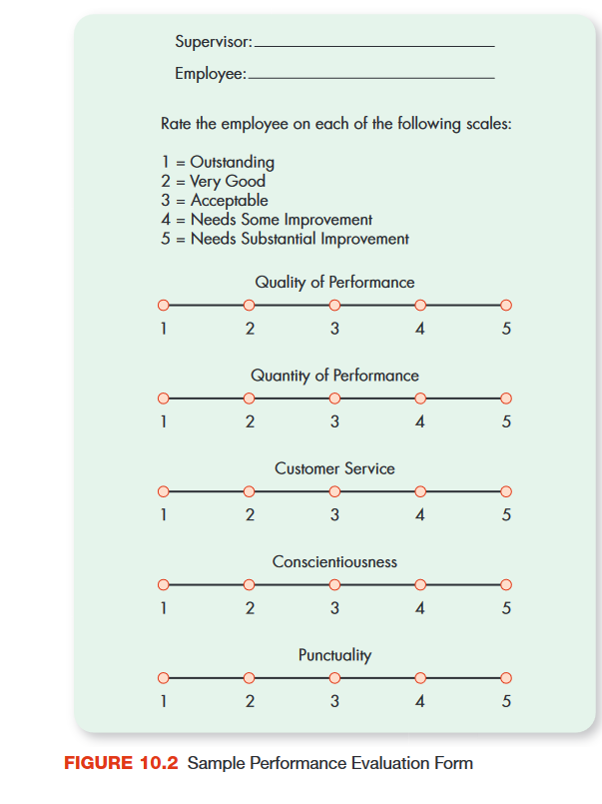
Developing the Workforce (3 of 4)
Performance Appraisal
evaluation of an employee’s job performance in order to determine the degree to which the employee is performing effectively
Notes:
The appraisal process begins when a manager defines performance standards for an employee. The manager then observes the employee’s performance. For some jobs, a rating scale like the abbreviated one in Figure 10.2 is useful in providing a basis for comparison.

Slide 33
Developing the Workforce (4 of 4)
360-Degree Feedback
performance appraisal technique in which managers are evaluated by everyone around them—their boss, their peers, and their subordinates
Notes:
One interesting innovation in performance appraisal used in some organizations today is called 360-degree feedback, in which managers are evaluated by everyone around them—their boss, their peers, and their subordinates. Such a complete and thorough approach provides people with a far richer array of information about their performance than does a conventional appraisal given by just the boss. Of course, such a system also takes considerable time and must be handled so as not to breed fear and mistrust in the workplace.

Slide 34
New Challenges in the Changing Workplace
Workforce Diversity
the range of workers’ attitudes, values, beliefs, and behaviors that differ by gender, race, age, ethnicity, physical ability, and other relevant characteristics
Knowledge Workers
employees who are of value because of the knowledge they possess
HR managers must ensure that the proper training is provided to enable knowledge workers to stay current while also making sure they are compensated at market rates
Notes:
One extremely important set of HR challenges centers on workforce diversity, the range of workers’ attitudes, values, beliefs, and behaviors that differ by gender, race, age, ethnicity, physical ability, and other relevant characteristics. In the past, organizations tended to work toward homogenizing their workforces, getting everyone to think and behave in similar ways. Partly as a result of affirmative action efforts, however, many U.S. organizations are now creating more diverse workforces than ever before.
Traditionally, employees added value to organizations because of what they did or because of their experience. In the information age, however, employees who add value because of what they know are usually called knowledge workers. Knowledge workers, which include computer scientists, engineers, physical scientists, and game developers, typically require extensive and highly specialized training. Once they are on the job, retraining and training updates are critical to prevent their skills from becoming obsolete.

Slide 35
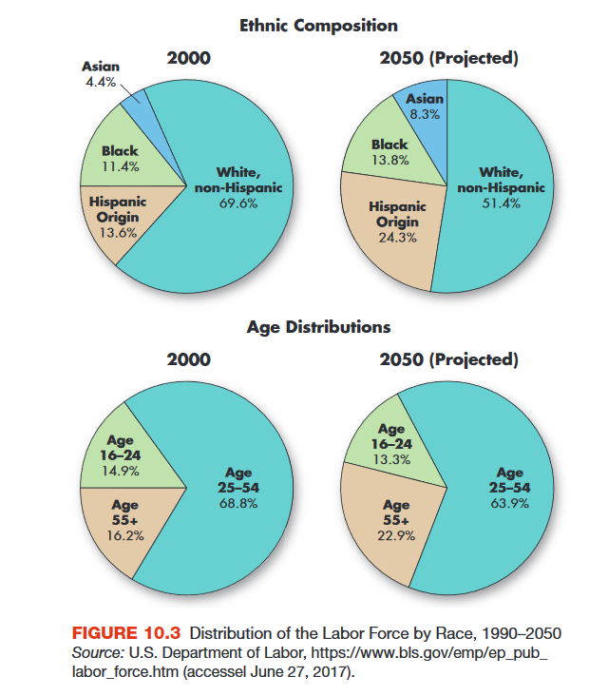
Distribution of the Labor Force by Race 2000-2050
Notes:
Figure 10.3 projects the racial and ethnic composition of the U.S. workforce through 2050. The picture is clearly one of increasing diversity.

Slide 36
Contingent and Temporary Workers
Contingent Worker
employee hired on something other than a full-time basis to supplement an organization’s permanent workforce
includes independent contractors, on-call workers, temporary employees, and contract and leased employees
Notes:
A contingent worker is a person who works for an organization on something other than a permanent or full-time basis. Categories of contingent workers include independent contractors, on-call workers, temporary employees (usually hired through outside agencies), and contract and leased employees.
Another category is part-time workers. In recent years there has been an explosion in the use of such workers by organizations. For instance, in 2010 about 12 percent of employed U.S. workers fell into one of these categories, up from 10 percent in 2008.

Slide 37
Dealing with Organized Labor
Labor Union
group of individuals working together to achieve shared job-related goals, such as higher pay, shorter working hours, more job security, greater benefits, or better working conditions
Labor Relations
process of dealing with employees who are represented by a union
Notes:
A labor union is a group of individuals working together to achieve shared job-related goals, such as higher pay, shorter working hours, more job security, greater benefits, or better working conditions. Labor relations refers to the process of dealing with employees who are represented by a union.

Slide 38
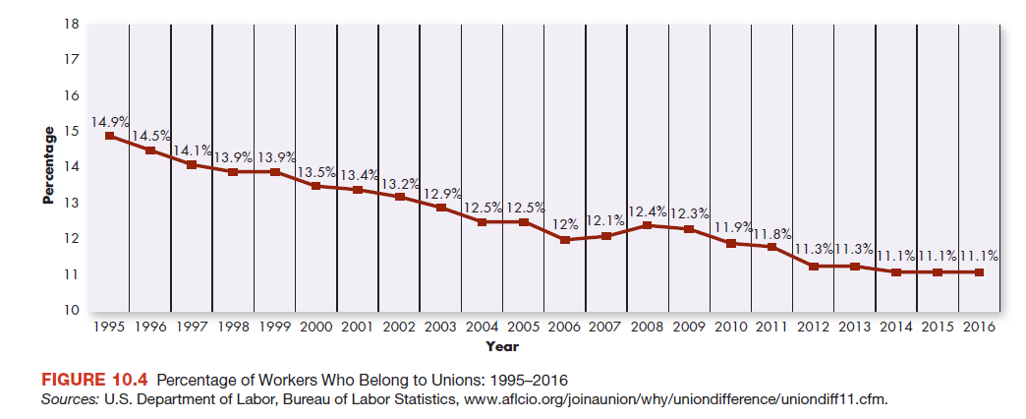
Percentage of Workers Who Belong to Unions: 1995–2016
Notes:
In 2007, only 12.1 percent of U.S. workers belonged to a labor union, down from 20.1 percent in 1983, when the U.S. Department of Labor first began compiling data.
As the recession of 2008–2010 began to increase fears about unemployment and wage cuts, union membership began to increase again, albeit only slightly.
By 2010 it had dropped again, falling below pre-recession levels. These trends are shown in Figure 10.4.

Slide 39
Collective Bargaining
Collective Bargaining
process by which labor and management negotiate conditions of employment for union-represented workers
Notes:
The power of unions comes from collective action, forcing management to listen to the demands of all workers rather than to just the few who speak out. Collective bargaining is the process by which labor and management negotiate conditions of employment for union-represented workers and draft a labor contract.

Slide 40
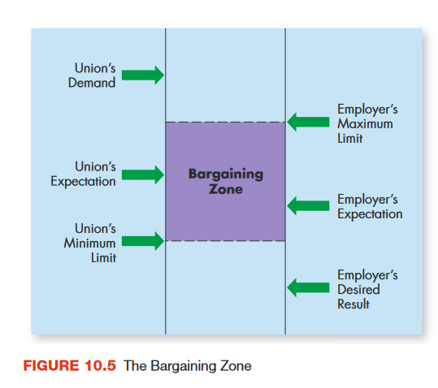
The Bargaining Zone
Notes:
The collective bargaining process begins when the union is recognized as the exclusive negotiator for its members, and union leaders meet with management representatives to agree on a contract. By law, both parties must sit down at the bargaining table and negotiate in good faith. Figure 10.5 shows what is called the “bargaining zone.”

Slide 41
Contract Issues
Cost-of-Living Adjustment (COLA)
labor contract clause tying future raises to changes in consumer purchasing power
Wage Reopener Clause
clause allowing wage rates to be renegotiated during the life of a labor contract
Notes:
Compensation includes both current and future wages. One common tool for securing wage increases is a cost-of-living adjustment (COLA). Most COLA clauses tie future raises to the Consumer Price Index (CPI), a government statistic that reflects changes in consumer purchasing power. Almost half of all labor contracts today include COLA clauses. A union might be uncomfortable with a long-term contract based solely on COLA wage increases. One solution is a wage reopener clause, which allows wage rates to be renegotiated at preset times during the life of the contract.

Slide 42
When Bargaining Fails
Strike
labor action in which employees temporarily walk off the job and refuse to work
Boycott
labor action in which workers refuse to buy the products of a targeted employer
Work Slowdown
labor action in which workers perform jobs at a slower than normal pace
Notes:
Historically, one of the most common union tactics has been the strike, which occurs when employees temporarily walk off the job and refuse to work. The number of major strikes in the United States has steadily declined over the past few decades. From 1960 to 1980, for example, an average of 281 strikes occurred per year. In the 1980s there was an average of 83 major strikes per year; in the 1990s this figure fell to an average of 35 per year. Between 2000 and 2009 there was an average of 20 major strikes per year.³¹ There were 19 major strikes in 2012.

Slide 43
Management Tactics
Lockout
management tactic whereby workers are denied access to the employer’s workplace
Strikebreaker
worker hired as a permanent or temporary replacement for a striking employee
Notes:
Like workers, management can respond forcefully to an impasse with the following:
Lockouts occur when employers deny employees access to the workplace. Lockouts are illegal if they are used as offensive weapons to give management a bargaining advantage. However, they are legal if management has a legitimate business need (for instance, avoiding a buildup of perishable inventory).
A firm can also hire temporary or permanent replacements called strikebreakers. However, the law forbids the permanent replacement of workers who strike because of unfair practices.

Slide 44
Mediation and Arbitration
Mediation
method of resolving a labor dispute in which a third party suggests, but does not impose, a settlement
Arbitration
method of resolving a labor dispute in which both parties agree to submit to the judgment of a neutral party
Notes:
Rather than wield these often unpleasant weapons against one another, labor and management can agree to call in a third party to help resolve the dispute:
In mediation, the neutral third party (the mediator) can suggest, but cannot impose, a settlement on the other parties. In arbitration, the neutral third party (the arbitrator) dictates a settlement between the two sides, which have agreed to submit to outside judgment. In some disputes, such as those between the government and public employees, arbitration is compulsory, or required by law.

Slide 45
Applying What You’ve Learned (1 of 2)
Define human resource management, discuss its strategic significance, and explain how managers plan for their organization’s human resource needs.
Discuss the legal context of human resource management and identify contemporary legal issues.
Identify the steps in staffing a company and discuss ways in which organizations recruit and select new employees.

Slide 46
Applying What You’ve Learned (2 of 2)
Describe the main components of a compensation and benefits system.
Describe how managers develop the workforce in their organization through training and performance appraisal.
Discuss workforce diversity, the management of knowledge workers, and the use of a contingent workforce as important changes in the contemporary workplace.
Explain why workers organize into labor unions and describe the collective bargaining process.

Slide 47
Copyright

