Slide 1
Business Essentials
Twelfth Edition
Chapter 6
Organizing the Business
Copyright © 2019, 2016, 2013 Pearson Education, Inc. All Rights Reserved.
Notes:
If this PowerPoint presentation contains mathematical equations, you may need to check that your computer has the following installed:
1) MathType Plugin
2) Math Player (free versions available)
3) NVDA Reader (free versions available)

Slide 2
Introduction
In this chapter we
examine factors that influence a firm’s organizational structure
discuss the building blocks of organizational structure as well as the differences between decision making in different types of organizations
look at a variety of organizational structures
describe the most popular new forms of organizational design

Slide 3
Learning Objectives (1 of 2)
Discuss the factors that influence a firm’s organizational structure.
Explain specialization and departmentalization as two of the building blocks of organizational structure.
Describe centralization and decentralization, delegation, and authority as the key ingredients in establishing the decision-making hierarchy.

Slide 4
Learning Objectives (2 of 2)
Explain the differences among functional, divisional, matrix, and international organizational structures and describe the most popular new forms of organizational design.
Describe the informal organization and discuss intrapreneuring.

Slide 5
What Is Organizational Structure?
Organizational Structure
specification of the jobs to be done within an organization and the ways in which they relate to one another
Notes:
We can define organizational structure as the specification of the jobs to be done within an organization and the ways in which those jobs relate to one another. Perhaps the easiest way to understand structure is in terms of an organization chart.

Slide 6
Organization Charts
Organization Chart
diagram depicting a company’s structure and showing employees where they fit into its operations
Chain of Command
reporting relationships within a company
Notes:
Most small businesses prepare an organization chart to clarify structure and to show employees where they fit into a firm’s operations.
The chain of command, in turn, refers to reporting relationships within the company. In theory, such reporting relationships follow a “chain” from the highest level in the organization to the lowest.

Slide 7
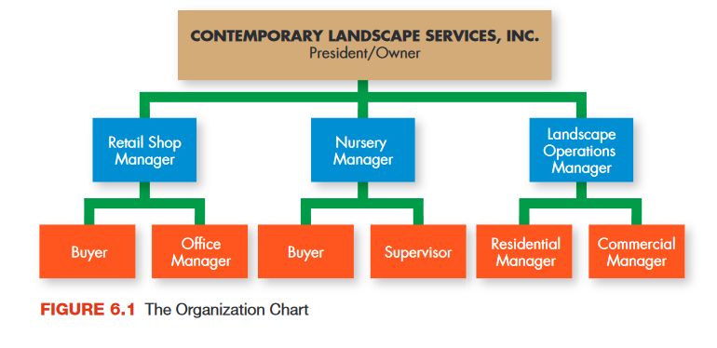
The Organization Chart
Notes:
Figure 6.1 is an organization chart for Contemporary Landscape Services, a small but thriving business in Bryan, Texas. Each box in the chart represents a job.

Slide 8
Determinants of Organizational Structure
Mission
Strategy
Size
Internal environment
External environment
Notes:
Many factors play a part in determining an organization’s optimal structure. Chief among them are the organization’s mission and strategy.
Size of the company and aspects of the organization’s environment also affect organizational structure. Organizing must be conducted with an equal awareness of both a firm’s external and internal environments.

Slide 9
The Building Blocks of Organizational Structure
Specialization
determining who will do what
Departmentalization
determining how people performing certain tasks can best be grouped together
Notes:
The process of identifying the specific jobs that need to be done and designating the people who will perform them leads to job specialization.
After jobs are specialized, they must be grouped into logical units, which is the process of departmentalization. Departmentalized companies benefit from this division of activities; control and coordination are narrowed and made easier, and top managers can see more easily how various units are performing.

Slide 10
Specialization
Job Specialization
the process of identifying the specific jobs that need to be done and designating the people who will perform them

Slide 11
Departmentalization (1 of 3)
Departmentalization
process of grouping jobs into logical units
product, process, functional, customer, geographic
Profit Center
separate company unit responsible for its own costs and profits
Notes:
After jobs are specialized, they must be grouped into logical units, which is the process of departmentalization. Departmentalized companies benefit from this division of activities; control and coordination are narrowed and made easier, and top managers can see more easily how various units are performing.
Departmentalization allows the firm to treat each department as a profit center, a separate company unit responsible for its own costs and profits.

Slide 12
Departmentalization (2 of 3)
Functional Departmentalization
dividing an organization according to groups’ functions or activities
Product Departmentalization
dividing an organization according to specific products or services being created
Process Departmentalization
dividing an organization according to production processes used to create a good or service
Notes:
Many service and manufacturing companies, especially smaller ones just getting started, use functional departmentalization to create departments according to a group’s functions or activities.
Both manufacturers and service providers often opt for product departmentalization, dividing an organization according to the specific product or service being created. This becomes especially true when a firm grows and starts to offer multiple products or services.
Other manufacturers favor process departmentalization, in which the organization is divided according to production processes used to create a good or service.

Slide 13
Departmentalization (3 of 3)
Customer Departmentalization
dividing an organization to offer products and meet needs for identifiable customer groups
Geographic Departmentalization
dividing an organization according to the areas of the country or the world served by a business
Notes:
Retail stores use customer departmentalization to create departments that offer products, and meet the needs of, identifiable customer groups.
Geographic departmentalization divides firms according to the areas of the country or the world that they serve. Levi Strauss, for instance, has one division for North and South America; one for Europe, the Middle East, and North Africa; and one for the Asia Pacific region.

Slide 14
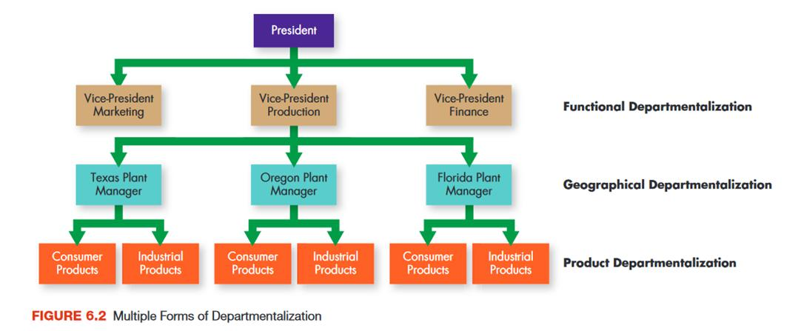
Multiple Forms of Departmentalization

Slide 15
Distributing Authority: Centralization and Decentralization
Establishment of a Decision-Making Hierarchy
deciding who will be empowered to make which decisions and who will have authority over others
Centralized Organization
organization in which most decision-making authority is held by upper-level management
Decentralized Organization
organization in which a great deal of decision-making authority is delegated to levels of management at points below the top
Notes:
The third major building block of organizational structure is the establishment of a decision-making hierarchy. This is usually done by formalizing reporting relationships.
In a centralized organization, most decision-making authority is held by upper-level managers.
As a company gets larger and more decisions must be made, the company tends to adopt decentralized organization, in which much decision-making authority is delegated to levels of management at various points below the top.

Slide 16
Flat and Tall Organizations (1 of 3)
Flat Organizational Structure
characteristic of decentralized companies with relatively few layers of management
Tall Organizational Structure
characteristic of centralized companies with multiple layers of management

Slide 17
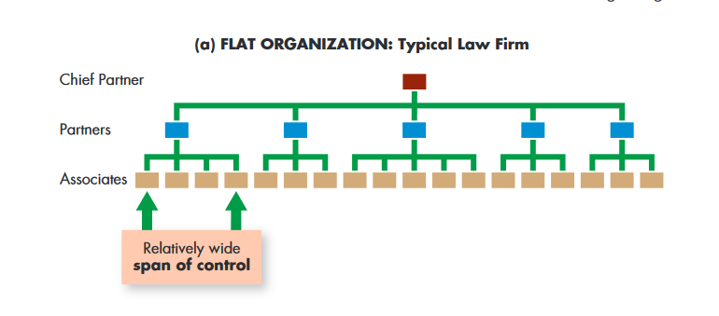
Flat and Tall Organizations (2 of 3)

Slide 18
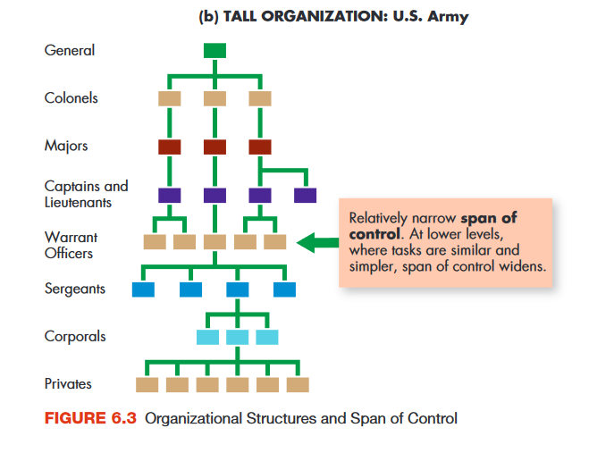
Flat and Tall Organizations (3 of 3)

Slide 19
Span of Control
The distribution of authority in an organization also affects the number of people who work for any individual manager.
Span of Control
number of people supervised by one manager
Notes:
As you can see in Figure 6.3, the distribution of authority in an organization also affects the number of people who work for any individual manager. In a flat organizational structure, the number of people directly managed by one supervisor, the manager’s span of control, is usually wide. In tall organizations, span of control tends to be narrower.

Slide 20
The Delegation Process
Delegation
process through which a manager allocates work to subordinates
Assigning responsibility - the duty to perform an assigned task
Granting authority - the power to make the decisions necessary to complete the task
Creating accountability - the obligation employees have for the successful completion of the task
Notes:
Delegation is the process through which a manager allocates work to subordinates.
In general, the delegation process involves:
Assigning responsibility, the duty to perform an assigned task.
Granting authority, or the power to make the decisions necessary to complete the task.
Creating accountability, the obligation employees have for the successful completion of the task.

Slide 21
Learning to Delegate Effectively
Table 6.1 Learning to Delegate Effectively
I’m afraid to delegate because . . . | Solution
My team doesn’t know how to get the job done. | If members of your team are exhibiting opportunities for improved performance, offer them the training necessary for them to become more effective at their jobs.
I like controlling as many things as possible. | Recognize that trying to accomplish everything yourself while your team does nothing only sets you up for burnout and failure. As you begin to relinquish control, you will come to trust your team more as you watch your team members succeed.
I don’t want anyone on my team outperforming me. | High-performing team members are a reflection of your success as a manager. Encourage them to excel, praise them for it, and share the success of your team with the rest of the organization.
I don’t know how to delegate tasks effectively. | Consider taking a management training course or reading some books on the topic of delegating effectively.

Slide 22
Forms of Authority (1 of 2)
Line Authority
organizational structure in which authority flows in a direct chain of command from the top of the company to the bottom
Staff Authority
authority based on expertise that usually involves counseling and advising line managers
Staff Members
advisers and counselors who help line departments in making decisions but who do not have the authority to make final decisions
Notes:
The type of authority that flows up and down the chain of command is line authority. Most companies rely heavily on line departments linked directly to the production and sales of specific products.
Some companies also rely on staff authority, which is based on special expertise and usually involves advising line managers in areas such as law, accounting, and human resources. Staff members help line departments make decisions but do not usually have the authority to make final decisions.

Slide 23
Forms of Authority (2 of 2)
Committee and Team Authority
authority granted to committees or teams involved in a firm’s daily operations
Work Team
group of operating employees who are empowered to plan and organize their own work and to perform that work with a minimum of supervision
Notes:
Recently, more organizations have started to grant committee and team authority to groups that play central roles in daily operations. A committee, for example, may consist of top managers from several major areas. If the work of the committee is especially important and if the committee members will be working together for an extended time, the organization may grant it committee and team authority, special authority as a decision-making body beyond the individual authority possessed by each of its members.
At the operating level, many firms today use work teams that are empowered to plan, organize, and perform their work with minimal supervision and often with special authority as well. Most U.S. companies today use teams in at least some areas; some make widespread use of teams throughout every area of their operations.

Slide 24
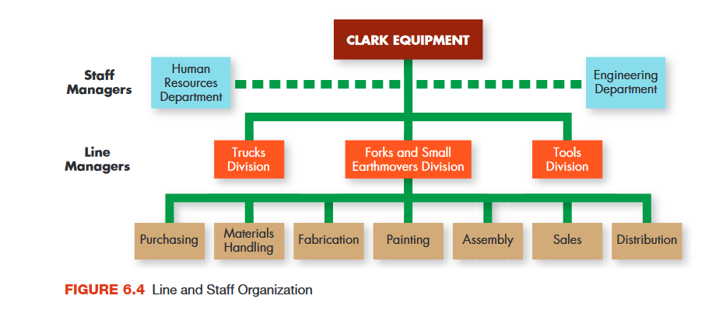
Line and Staff Organization
Notes:
Typically, the separation between line authority and staff responsibility is clearly delineated and is usually indicated in organization charts by solid lines (line authority) and dotted lines (staff responsibility), as shown in Figure 6.4.

Slide 25
Basic Forms of Organizational Structure (1 of 4)
Functional Structure
organization structure in which authority is determined by the relationships between group functions and activities
Notes:
Under a functional structure, relationships between group functions and activities determine authority. Functional structure is used by most small to medium-sized firms, which are usually structured around basic business functions: a marketing department, an operations department, and a finance department. The benefits of this approach include specialization within functional areas and smoother coordination among them.

Slide 26
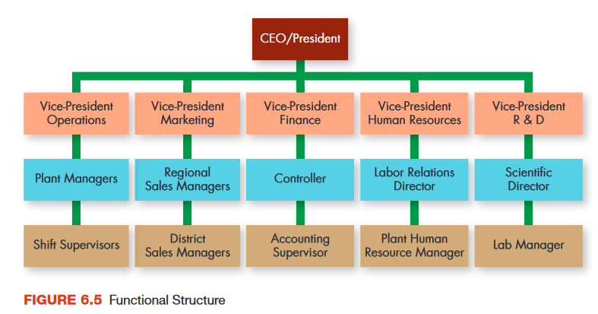
Functional Structure
Notes:
Figure 6.5 illustrates a functional structure.

Slide 27
Basic Forms of Organizational Structure (2 of 4)
Divisional Structure
organizational structure in which corporate divisions operate as autonomous businesses under the larger corporate umbrella
Notes:
A divisional structure relies on product departmentalization. Organizations using this approach are typically structured around several product-based divisions that resemble separate businesses in that they produce and market their own products. The head of each division may be a corporate vice-president or, if the organization is large enough, a divisional president. In addition, each division usually has its own identity and operates as a relatively autonomous business under the larger corporate umbrella.

Slide 28
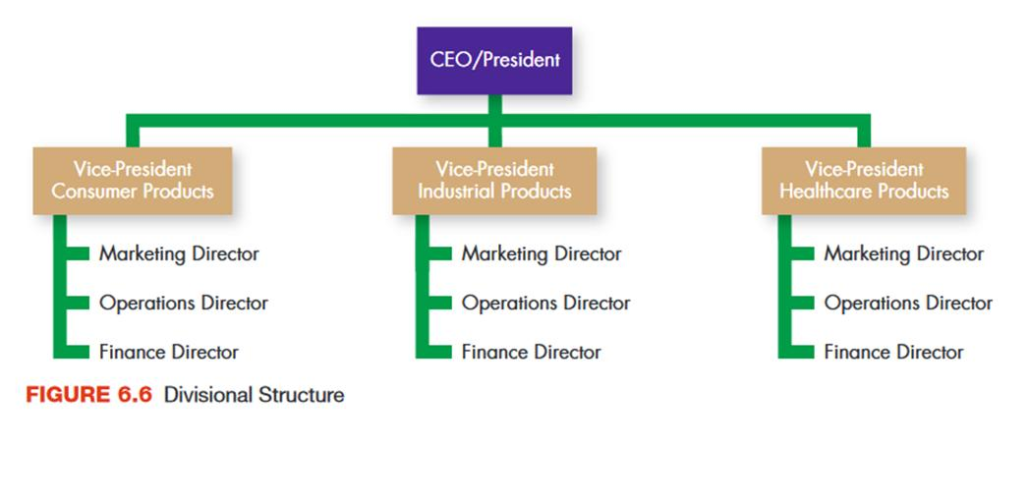
Divisional Structure

Slide 29
Basic Forms of Organizational Structure (3 of 4)
Matrix Structure
organizational structure created by superimposing one form of structure onto another
In some companies, the matrix organization is a temporary measure installed to complete a specific project and affecting only one part of the firm
Notes:
Sometimes a matrix structure, a combination of two separate structures, works better than either simpler structure alone. This structure gets its matrix-like appearance, when shown in a diagram, by using one underlying “permanent” organizational structure (say, the divisional structure flowing up-and-down in the diagram), and then super-imposing a different organizing framework on top of it (e.g., the functional form flowing side-to-side in the diagram). This highly flexible and readily adaptable structure was pioneered by NASA for use in developing specific space programs.

Slide 30
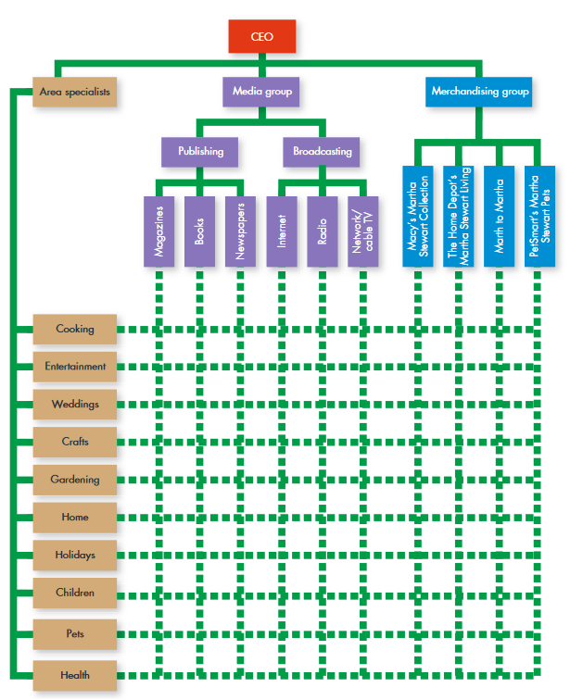
Matrix Structure
Notes:
Figure 6.7 shows how Martha Stewart Living Omnimedia has created a permanent matrix organization for its lifestyle business. As you can see, the company is organized broadly into media and merchandising groups, each of which has specific product and product groups.

Slide 31
Basic Forms of Organizational Structure (4 of 4)
International Organizational Structures
approaches to organizational structure developed in response to the need to manufacture, purchase, and sell in global markets
Notes:
Several different international organizational structures have emerged in response to the need to manufacture, purchase, and sell in global markets.

Slide 32
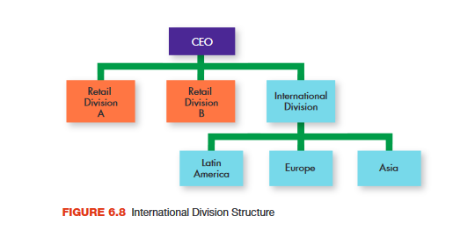
International Organizational Structure
Notes:
Until a few years ago, General Electric (GE) kept its international business operations as separate divisions, as illustrated in Figure 6.8.

Slide 33
Organizational Design for the Twenty-First Century (1 of 2)
Team organization
relies almost exclusively on project-type teams, with little or no underlying functional hierarchy
Learning organization
works to facilitate the lifelong learning and personal development of all of its employees while continually transforming itself to respond to changing demands and needs
Notes:
Team organization relies almost exclusively on project type teams, with little or no underlying functional hierarchy. People float from project to project as dictated by their skills and the demands of those projects. As the term suggests, team authority is the underlying foundation of organizations that adopt this organizational structure.
The so-called learning organization works to integrate continuous improvement with continuous employee learning and development.

Slide 34
Organizational Design for the Twenty-First Century (2 of 2)
Virtual organization
has little or no formal structure
has only a handful of permanent employees, a very small staff, and a modest administrative facility
Notes:
Closely related to the team organization is the virtual organization. A virtual organization has little or no formal structure. Typically, it has only a handful of permanent employees, a small staff, and a modest administrative facility.
As the needs of the organization change, its managers bring in temporary workers, lease facilities, and outsource basic support services to meet the demands of each unique situation.

Slide 35
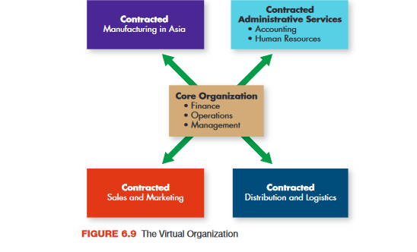
The Virtual Organization
Notes:
Figure 6.9 illustrates a hypothetical virtual organization.

Slide 36
Informal Organization
Informal Organization
network, unrelated to the firm’s formal authority structure, of everyday social interactions among company employees
Informal groups
groups of people who decide to interact among themselves
Notes:
Frequently, the informal organization, everyday social interactions among employees that transcend formal jobs and job interrelationships, effectively alters a company’s formal structure.
Informal groups are simply groups of people who decide to interact among themselves. They may be people who work together in a formal sense or who just get together for lunch, during breaks, or after work.
Their impact on the organization may be positive (if they work together to support the organization), negative (if they work together in ways that run counter to the organization’s interests), or irrelevant (if what they do is unrelated to the organization) relationships.

Slide 37
Organizational Grapevine
Grapevine
informal communication network that runs through an organization
By maintaining open channels of communication and responding vigorously to inaccurate information, managers can minimize the damage the grapevine can cause.
Notes:
The grapevine is an informal communication network that can permeate an entire organization. Grapevines are found in all organizations except the smallest, but they do not always follow the same patterns as, nor do they necessarily coincide with, formal channels of authority and communication. Research has identified two kinds of grapevines.

Slide 38
Intrapreneuring
Intrapreneuring
process of creating and maintaining the innovation and flexibility of a small-business environment within the confines of a large organization
Notes:
Many firms, including Rubbermaid, Dreamworks, 3M, and Xerox, support intrapreneuring, creating and maintaining the innovation and flexibility of a small-business environment within a large, bureaucratic structure.

Slide 39
Applying What You’ve Learned (1 of 2)
Discuss the factors that influence a firm’s organizational structure.
Explain specialization and departmentalization as two of the building blocks of organizational structure.
Describe centralization and decentralization, delegation, and authority as the key ingredients in establishing the decision-making hierarchy.

Slide 40
Applying What You’ve Learned (2 of 2)
Explain the differences among functional, divisional, matrix, and international organizational structures and describe the most popular new forms of organizational design.
Describe the informal organization and discuss intrapreneuring.

Slide 41
Copyright

