Slide 1
17
RETAILING AND OMNICHANNEL MARKETING
Copyright © 2016 McGraw-Hill Education. All rights reserved. No reproduction or distribution without the prior written consent of McGraw-Hill Education.
Notes:
Chapter 17 – Retailing and Omnichannel Marketing

Slide 2
Retailing and omnichannel Marketing
Discuss the four factors manufacturers should consider as they develop their strategy for working with retailers.
Outline the considerations associated with choosing retail partners.
List the three levels of distribution intensity.
Describe the various types of retailers.
Describe the components of a retail strategy.
Identify the benefits of stores.
Identify the benefits of omnichannel retailing.
Detail the challenges of omnichannel retailing.
LO1
LO2
LO3
LO4
LO5
LO6
LO7
LO8
Notes:
These are the learning objectives for this chapter.

Slide 3
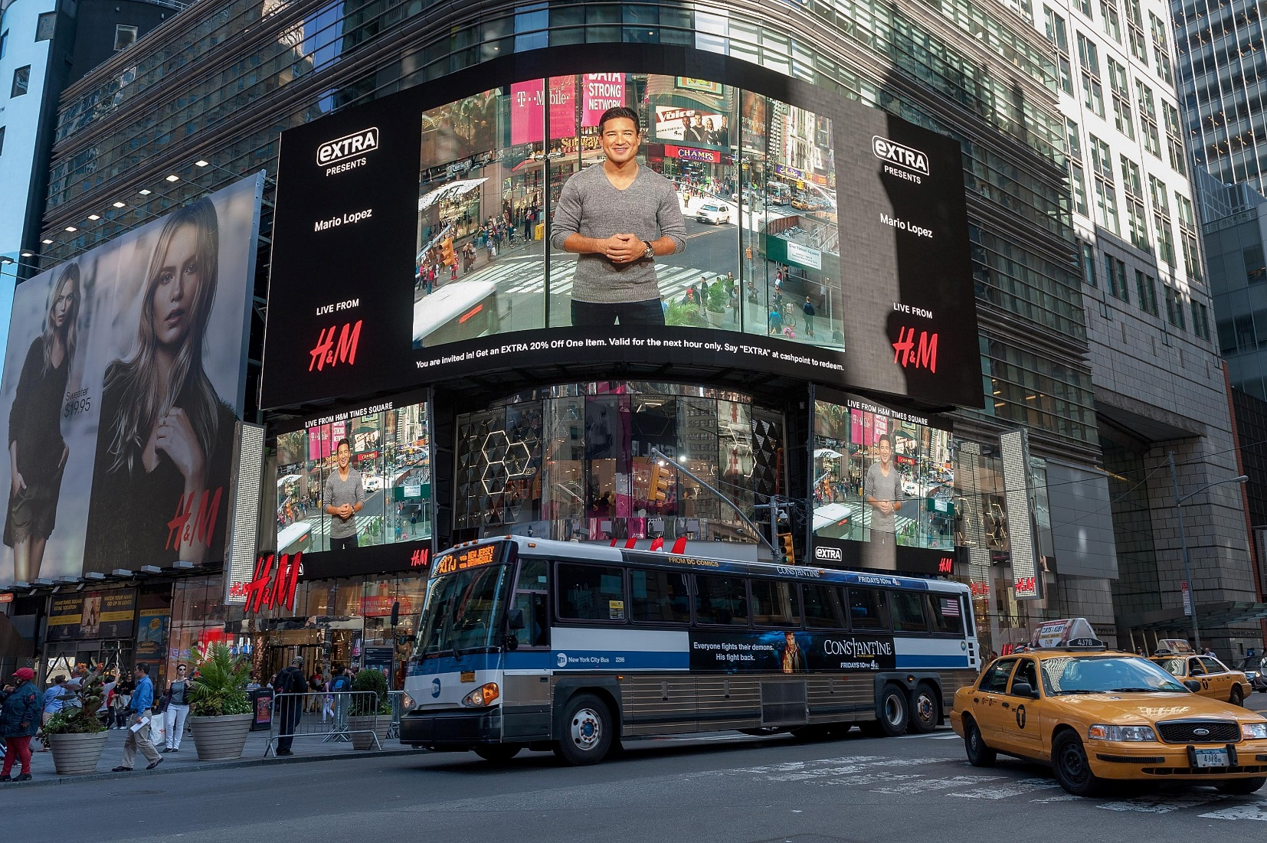
H&M
AP Images/Denis Doyle
Notes:
When H&M opened its flagship Times Square store, it aimed to create not just the most exciting store in the fashionable chain’s range of locations but also perhaps the most cutting-edge example of retail in the world.
Ask Students Do they shop at high-end department stores like H&M. If so, then why. If not, then why not.

Slide 4
Factors for Establishing a Relationship with Retailers
Choosing retailing partners
Identifying types of Retailers
Developing a retail strategy
Managing a omnichannel strategy
Notes:
This is an overview and each stage is presented on the following slides.

Slide 5
Choosing Retail Partners Channel Structure
Degree of vertical integration
Manufacturers brand
Power of manufacturer and retailer
©M Hruby
Notes:
Ask students to describe what is meant by “degree of vertical integration”. This is given in chapter 15 and refers to a supply chain where the members act as a unified system.
Ask students how vertical integration effects a manufacturer who is introducing a new product and choosing a retail partner. Students will mention that if the manufacturer and retailer already have a relationship from previous products that the retailer will be more likely to accept the new product.

Slide 6
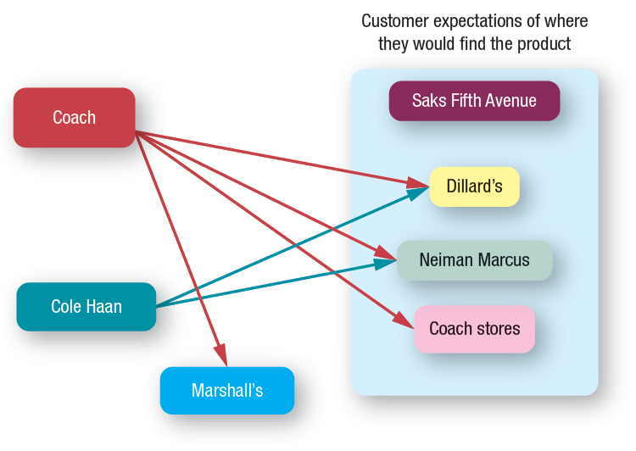
Choosing Retail Partners Customer Expectations
Notes:
Ask students how manufacturers determine which retailers would be best for consumers? Students will likely say focus group and surveys. They might also mention that sales reps within the stores can supply information on products that consumer request.

Slide 7
Choosing Retail Partners Channel Member Characteristics
Larger firms
Less likely to use supply chain intermediaries
Can gain more control, be more efficient, and save money.
Notes:
Larger firms often find that by performing the channel functions themselves, they can gain more control, be more efficient, and save money.

Slide 8
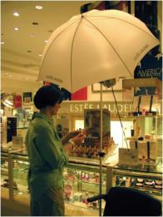
Choosing Retail Partners Distribution Intensity
Intensive
Selective
Exclusive
©Jeff Greenberg/PhotoEdit
©Susan Van Etten/PhotoEdit
Notes:
Product characteristics drive supply chain structures, in that mass merchandise products use intensive distribution, whereas luxury goods employ exclusive distribution.
Group activity: Match the following products to their likely type of distribution:
Pharmaceuticals (selective)
Clothing (depends on the product type)
Soft drinks (Intensive)

Slide 9
Distribution Intensity
Why might Birkenstock choose an exclusive distribution intensity?
Courtesy Birkenstock USA
Notes:
Birkenstock’s can only be purchased through certain retailers – this helps control conflict between retailers and gives the manufacturer better control. Some might argue that for products is the later stages of the product life cycle, it implies higher quality to the end consumer.

Slide 10
CHECK YOURSELF
What issues should manufacturers consider when choosing retail partners?
What is the difference between intensive, exclusive, and selective levels of distribution intensity?
Notes:
When choosing retail partners, manufacturers must look at the basic channel structure, where their target customers expect to find the products, channel member characteristics, and distribution intensity.
An intensive distribution strategy is designed to get products into as many outlets as possible. Exclusive distribution policy grants exclusive geographic territories to one or very few retail customers so no other customers in the territory can sell a particular brand. Selective distribution uses a few selected customers in a territory.

Slide 11
Retailer’s Reaction?
How do you expect retailers would respond to this?
Courtesy wwwadbustersorg
Notes:
These kinds of grass roots movements are very difficult for retailers. They rarely get a strong enough following to threaten retailers overall sales even if they slow down a particular day of sales.

Slide 12
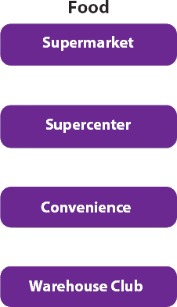
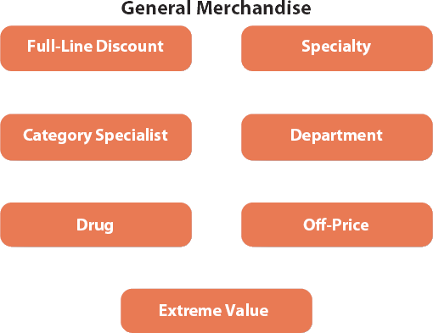
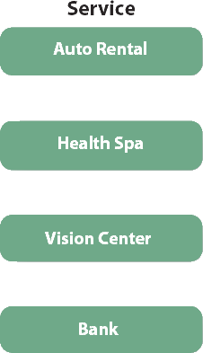
Types of Retailers
Notes:
This slide can be used as an introduction to a detailed discussion of this topic or as a shortened version.

Slide 13
Food Retailers
Supermarket | Supercenter | Warehouse Club | Convenience Store
Limited nonfood | Includes discount store | Limited assortment | Limited variety
Differentiates different types of foods | Wal-Mart, Meijer, K-Mart, Target | Little service Includes: Costco, Sams, BJ’s | Good locations
Peapod
Notes:
Ask students: In what circumstances do you shop at each type of food retailer? How do the price, selection, and quality vary across each type? This web link is for peapod, an online grocer (you might want to set up account in advance of class). Ask students if they have ever used this service? Why or why not?

Slide 14
General Merchandise Retailers
Department Stores
Full-line Discount
Broad variety and deep assortment
Broad variety at low prices
Specialty
Limited merchandise with service in small store
Drugstores
Specialty for pharmaceutical and heath
Category Specialist
Discount with narrow but deep assortment
Extreme value
Full line, limited, very low prices
Off-Price
Inconsistent assortment of brand name at low prices
Notes:
Group activity: Identify a retailer in each of these categories. Discuss how that specific retailer creates value for its target consumers.

Slide 15
Kmart and Sears
Notes:
Note: Please make sure that the video file is located in the same folder as the PowerPoint slides.

Slide 16
GNC Private Brands
Courtesy GNC Corporation
Courtesy GNC Corporation
Notes:
GNC sells many brands including its own products – private brands.

Slide 17
Services Retailers
Firms that primarily sell services rather than merchandise, are a large and growing part of the retail industry
Ryan McVay/Getty Images
Notes:
Several trends suggest considerable future growth in services retailing. For example, the aging population will increase demand for health care services. Younger people are also spending more time and money on health and fitness. Busy parents in two-income families are willing to pay to have their homes cleaned, lawns maintained, clothes washed and pressed, and meals prepared so they can spend more time with their families.

Slide 18
CHECK YOURSELF
What strategies distinguish the different types of food retailers?
What strategies distinguish the different types of general merchandise retailers?
Are organizations that provide services to consumers considered to be retailers?
Notes:
Food retailers include:
Supermarkets : a self service food store offering groceries, meat, and produce with limited sales of nonfood items, such as health and beauty aids and general merchandise.
Supercenters: the fastest growing retail category, are large stores (150,000–220,000 square feet) that combine a supermarket with a full-line discount Store.. By offering broad assortments of grocery and general merchandise products under one roof, supercenters provide a one-stop shopping experience.
Warehouse Clubs: large retailers (at least 100,000–150,000 square feet) that offer a limited and irregular assortment of food and general merchandise with little service at low prices for ultimate consumers and small businesses.
Convenience Stores: provide a limited variety and assortment of merchandise at a convenient location in 2,000–3,000 square foot stores with speedy checkout.. Milk, eggs, and bread once represented the majority of their sales, but now the majority of sales comes from gasoline and cigarettes.
General merchandisers include:
Department Stores: carry a broad variety and deep assortment, offer customer services, and organize their stores into distinct departments for displaying merchandise.
Full-Line Discount Stores :offer a broad variety of merchandise, limited service, and low prices. Specialty Stores: concentrate on a limited number of complementary merchandise categories and provide a high level of service in relatively small stores. Specialty stores tailor their retail strategy toward very specific market segments by offering deep but narrow assortments and sales associate expertise.
Drugstores: specialty stores that concentrate on pharmaceuticals and health and personal grooming merchandise.
Category Specialists: discount stores that offer a narrow but deep assortment of merchandise.
Extreme Value Retailers: small, full-line discount stores that offer a limited merchandise assortment at very low prices.
Off-Price Retailers: offer an inconsistent assortment of brand name merchandise at low prices.
Services retailers, or firms that primarily sell services rather than merchandise, are a large and growing part of the retail industry.

Slide 19
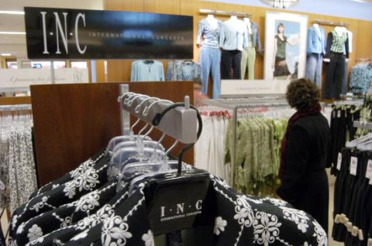
Developing a Retail Strategy Using the Four P’s: Product
AP Photo/David Kohl
Providing the right mix of merchandise and services
Notes:
Ask Students: What is the most important thing that retailers do? Answer: They provide assortments to customers.
Group activity: divide the class into groups. Tell them that the classroom represents a new store. Have them identify a target market. Ask them to decide what they are going to put into the store. Have them consider both variety (number of categories) and assortment (number of SKUs within a category.)

Slide 20
Price
Price defines the value of both the merchandise and the service provided
Courtesy DDB - London
Walmart’s Profits Drop
Notes:
Group activity continued: Now have them decide the general price range for their store, and justify their recommendation. This YouTube web link (always check before class) is for Build-a-Bear Workshop. Even though this retailer is so focused on the experience – they are sending a strong pricing message with this ad.
Video: “Wal-Mart's Profit Falls 15% on Higher Costs”
Ask students why are Walmart’s Profits Dropping? Ask students what global factors are effecting Walmart’s profits?
WSJ: http://live.wsj.com/video/wal-mart-profit-falls-15-on-higher-costs/B8AA28F9-2FB5-45F8-B5AA-5E51CF9A6236.html#!B8AA28F9-2FB5-45F8-B5AA-5E51CF9A6236

Slide 21
Promotion
AP Photo/MarkHumphrey
Retailers use a wide variety of promotions, both within their retail environment and through mass media
Courtesy Bass Pro Shops
Notes:
Discuss how promotions affect consumers’ perceptions of value, patronage intentions, purchase, loyalty, and share of wallet devoted to a particular retailer, both individually and in combination.
Group activity continued: Tell the students they have a fixed amount to spend on promotion, including personal selling. How would they divide up their promotional dollar? Justify their recommendation.

Slide 22
Place
©M Hruby
Convenience is a key ingredient to success
The McGraw-Hill Companies, Inc/
Jill Braaten, photographer
Notes:
In retailing there are two aspects to “place.” The first is location, and the second is supply chain management. Both are important.
Location is important because it is one of consumers’ most important criteria in choosing a retailer and it is a very long-term investment.
Group activity continued: Have students choose a location and justify it. Also, have them describe how they would design their supply chain, i.e., use of wholesalers versus distribution centers; direct store delivery versus, delivery to distribution centers; traditional warehouses versus cross-docking, etc.

Slide 23
Walmart Faces Biggest Civil Rights Suits
Notes:
This video brings up some additional concerns for retailers. Wal-Mart has had many issues with the way they treat their employees. Ask students if they are aware of any other issues?
Note: Please make sure that the video file is located in the same folder as the PowerPoint slides.

Slide 24
Benefits of Stores for Consumers
Browsing
Touching and Feeling
Personal Service
Cash and Credit
Entertainment and Social Interaction
Instant Gratification
Risk Reduction
Notes:
Ask students what they like to buy in stores vs. catalog vs. online?
Ask students: Have you ever started shopping online, then visited the store to make the actual purchase? What kind of product did you buy using this method?

Slide 25
Benefits of the Internet and Omnichannel Retailing
Deeper and Broader Selection
Personalization
Gain Insights into Consumer Shopping Behavior
Increase Customer Satisfaction and Loyalty
Expand Market Presence
Notes:
Shopping over the Internet provides the convenience offered by catalogs and other nonstory formats. However, the Internet, compared with store and catalog channels, also has the potential to offer a greater selection of products and more personalized information about products and services in a relatively short amount of time. It also offers sellers the unique opportunity to collect information about how consumers shop—information that they can use to improve the shopping experience
across all channels.

Slide 26
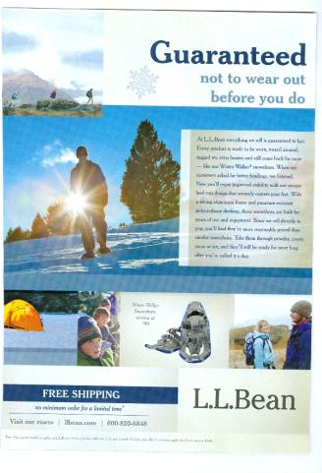
How does the Internet Improve Omnichannel Shopping?
Courtesy LL Bean
Notes:
The internet can supply research? Ask students what information Home Depot might gather research from web visits and how they would use it? Students might mention that they will search for products that the company does not currently stock. They might see products that consumers browse often but purchase little. For instance, they might look for lamps quite often but this is a low seller for Home Depot? What is it about the product that makes people come looking and leave not buying?

Slide 27
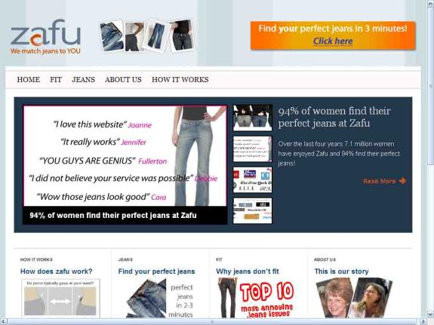
Retailers can do more online…
Courtesy Zafu.
Zafu
Notes:
Retailers can add value through the web – they can use it for PR and for delivering messages to the consumer that they are not able to deliver within the stores. This web link is to Zafu.com online video regarding their CSR.

Slide 28
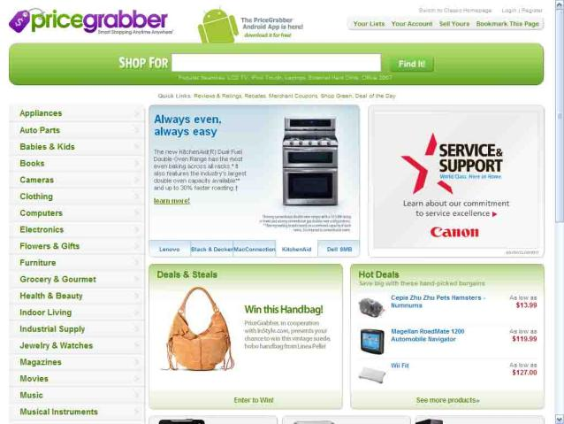
Perceived Risk in Internet Shopping
Courtesy Pricegrabber.com.
Notes:
Ask students when they are nervous to enter their credit card information online? How do they determine if a site is credible? How do they feel about privacy?

Slide 29
Effective Omnichannel Retailing
Integrated CRM
Brand Image
Pricing
Supply Chain
Notes:
Consumers desire a seamless experience when interacting with omnichannel retailers.

Slide 30
CHECK YOURSELF
What are the components of a retail strategy?
What are the advantages of traditional stores versus Internet-only stores?
What challenges do retailers face when marketing their products through multiple channels?
Notes:
Like other marketers, retailers perform important functions that increase the value of the products and services they sell to consumers. These functions are classified into the four Ps: product, price, promotion, and place.
The relative advantages of the most traditional retail channels are browsing, touching and feeling products, personal service, cash and credit payment, entertainment and social experience, immediate gratification, and risk reduction.
Consumers desire a seamless experience when interacting with omnichannel retailers. However, providing this seamless experience for customers is not easy for retailers. Because each of the channels is somewhat different, a critical decision facing omnichannel retailers is the degree to which they should or are able to integrate the operations of the channels.

Slide 31
Glossary
Category specialists are discount stores that offer a narrow but deep assortment of merchandise.
Notes:
Category specialists are discount stores that offer a narrow but deep assortment of merchandise.

Slide 32
Glossary
Convenience stores provide a limited variety and assortment of merchandise at a convenient location in 2,000-3,000 square foot stores with speedy checkout.
Notes:
Convenience stores provide a limited variety and assortment of merchandise at a convenient location in 2,000-3,000 square foot stores with speedy checkout.

Slide 33
Glossary
A conventional supermarket is a self-service food store offering groceries, meat, and produce with limited sales of nonfood items, such as health and beauty aids and general merchandise.
Notes:
A conventional supermarket is a self-service food store offering groceries, meat, and produce with limited sales of nonfood items, such as health and beauty aids and general merchandise.

Slide 34
Glossary
Department stores are retailers that carry a broad variety and deep assortment, offer customer services, and organize their stores into distinct departments for displaying merchandise.
Notes:
Department stores are retailers that carry a broad variety and deep assortment, offer customer services, and organize their stores into distinct departments for displaying merchandise.

Slide 35
Glossary
Drugstores are specialty stores that concentrate on pharmaceuticals and health and personal grooming merchandise.
Notes:
Drugstores are specialty stores that concentrate on pharmaceuticals and health and personal grooming merchandise.

Slide 36
Glossary
An exclusive distribution policy is when manufacturers grant exclusive geographic territories to one or very few retail customers so no other customers in the territory can sell a particular brand.
Notes:
An exclusive distribution policy is when manufacturers grant exclusive geographic territories to one or very few retail customers so no other customers in the territory can sell a particular brand.

Slide 37
Glossary
Extreme value retailers are small, full-line discount stores that offer a limited merchandise assortment at very low prices.
Notes:
Extreme value retailers are small, full-line discount stores that offer a limited merchandise assortment at very low prices.

Slide 38
Glossary
Full-line discount stores are retailers that offer a broad variety of merchandise, limited service, and low prices.
Notes:
Full-line discount stores are retailers that offer a broad variety of merchandise, limited service, and low prices.

Slide 39
Glossary
An intensive distribution strategy is designed to get products into as many outlets as possible.
Notes:
An intensive distribution strategy is designed to get products into as many outlets as possible.

Slide 40
Glossary
omnichannel retailers are retailers that use some combination of stores, catalogs, and the Internet to sell merchandise.
Notes:
omnichannel retailers are retailers that use some combination of stores, catalogs, and the Internet to sell merchandise.

Slide 41
Glossary
Off-price retailers offer an inconsistent assortment of brand name merchandise at low prices.
Notes:
Off-price retailers offer an inconsistent assortment of brand name merchandise at low prices.

Slide 42
Glossary
Selective distribution uses a few selected customers in a territory.
Notes:
Selective distribution uses a few selected customers in a territory.

Slide 43
Glossary
Specialty stores concentrate on a limited number of complementary merchandise categories and provide a high level of service in relatively small stores.
Notes:
Specialty stores concentrate on a limited number of complementary merchandise categories and provide a high level of service in relatively small stores.

Slide 44
Glossary
Supercenters are large stores that combine a supermarket with a full-line discount store.
Notes:
Supercenters are large stores that combine a supermarket with a full-line discount store.

Slide 45
Glossary
Warehouse clubs are large retailers that offer a limited and irregular assortment of food and general merchandise with little service at low prices for ultimate consumers and small businesses.
Notes:
Warehouse clubs are large retailers that offer a limited and irregular assortment of food and general merchandise with little service at low prices for ultimate consumers and small businesses.

