Slide 1
12
DEVELOPING NEW PRODUCTS

Slide 2
Developing New Products
Identify the reasons firms create new products.
Describe the different groups of adopters articulated by the diffusion of innovation theory.
Describe the various stages involved in developing a new product or service.
Explain the product life cycle.
LO1
LO2
LO3
LO4

Slide 3
Innovation and Value
Changing Customer Needs
Improving Business Relationships
Market Saturation
WHY DO FIRMS CREATE NEW PRODUCTS?
Fashion Cycles
Managing Risk through Diversity

Slide 4
CHECK YOURSELF
What are the reasons firms innovate?

Slide 5
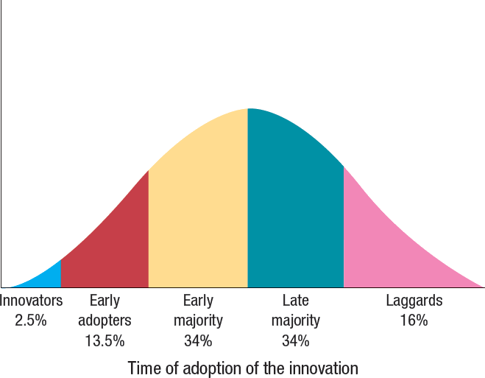
Diffusion of Innovation
Source: Adapted from Everett M. Rodgers, Diffusion of Innovation (New York: Free Press, 1983).

Slide 6
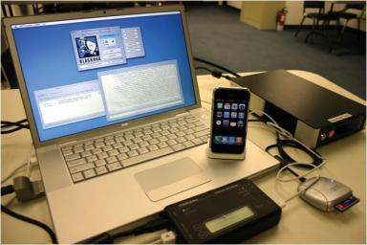
New Product Introductions
Pioneers radically change competition and consumer preferences.
©Derrick Donnelly, Blackbag Technologies

Slide 7
Using the Diffusion of Innovation Theory
Compatibility
Observability
Relative Advantage
Complexity and Trialability
Factors Affecting Product Diffusion

Slide 8
CHECK YOURSELF
What are the five groups on the diffusion of innovation curve?
What factors enhance the diffusion of a good or service?

Slide 9
How Firms Develop New Products
IDEA GENERATION
Development of viable new product ideas.
CONCEPT TESTING
Testing the new product idea among a set of potential customers.
PRODUCT DEVELOPMENT
Development of prototypes and/or the product.
MARKET TESTING
Testing the actual products in a few test markets.
PRODUCT LAUNCH
Full-scale commercialization of the product.
EVALUATION OF RESULTS
Analysis of the performance of the new product and making appropriate modifications.

Slide 10
Idea Generation
Source of ideas
Internal R&D
R&D consortia
Licensing
Brainstorming
Outsourcing
Competitor’ products
Customer input

Slide 11
Concept Testing
Concept is a brief written description of the product
Customers reactions determine whether or not it goes forward
Triggers the marketing research process
Stockbyte/Getty Images

Slide 12
Product Development
Prototype
Alpha testing
Beta testing

Slide 13
Market Testing
Premarket tests
Customers exposed
Customers surveyed
Firm makes decision
Test marketing
Mini product launch
More expensive than premarket tests
Market demand is estimated
Digital Vision/Getty Images
http://www.youtube.com/watch?v=pcj7QT0Abk8

Slide 14
Product Launch
Kellogg’s Drink’n Crunch Portable Cereals
An inner cup contains the cereal and the outer cup contains the milk
©2006 Kellogg North America Company
Minute Maid Premium Heart Wise Orange Juice
Each 8 oz. serving of the juice contains 1 gram of plan sterols that can reduce cholesterol levels
Courtesy The Coca-Cola Company
Aquafresh Floss ‘N’ Cap Fluoride Toothpaste
The cap of the toothpaste contains floss
©The Arbor Strategy Group, Inc

Slide 15
Evaluation of Results
Satisfaction of technical requirements
Customer acceptance
Satisfaction of the firm’s financial requirements
Ingram Publishing.
©Stockbyte/Getty Images.
Getty Images.

Slide 16
CHECK YOURSELF
What are the steps in the new product development process?
Identify different sources of new product ideas.

Slide 17
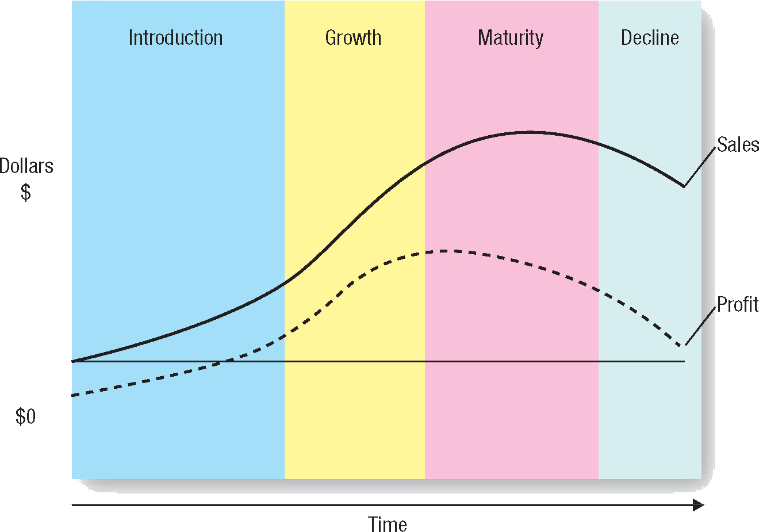
Product Life Cycle

Slide 18
Strategies Based on the Product Life Cycle: Some Caveats
Bell shaped, but can take many shapes.
Challenging to know precisely the stage of the PLC.

Slide 19
Glossary
Alpha testing is testing where the firm attempts to determine whether the product will perform according to its design and whether it satisfies the need for which it was intended.

Slide 20
Glossary
Beta testing uses potential consumers, who examine the product prototype in a “real use” setting to determine its functionality, performance, potential problems, and other issues specific to its use.
Notes:
20

Slide 21
Glossary
Firms with products in the decline stage either position themselves for a niche segment of diehard consumers or those with special needs or they completely exit the market.
Notes:
21

Slide 22
Glossary
Diffusion of innovation is the process by which the use of an innovation spreads throughout a market group, over time and over various categories of adopters.
Notes:
22

Slide 23
Glossary
The growth stage of the product life cycle is marked by a growing number of product adopters, rapid growth in industry sales, and increases in both the number of competitors and the number of available product versions.
Notes:
23

Slide 24
Glossary
Innovation is the process by which ideas are transformed into new products and services that will help firms grow.
Notes:
24

Slide 25
Glossary
The introduction stage for a new, innovative product or service usually starts with a single firm, and innovators are the ones to try the new offering.
Notes:
25

Slide 26
Glossary
The maturity stage of the product life cycle is characterized by the adoption of the product by the late majority and intense competition for market share among firms.
Notes:
26

Slide 27
Glossary
Pioneers or breakthroughs are new product introductions, especially new-to-the-world products that create new markets.
Notes:
27

Slide 28
Glossary
Premarket tests are conducted by firms before they actually bring a product or service to market to determine how many customers will try and then continue to use the product or service according to a small group of potential consumers.
Notes:
28

Slide 29
Glossary
The product life cycle defines the stages that new products move through as they enter, get established in, and ultimately leave the marketplace and thereby offers marketers a starting point for their strategy planning.
Notes:
29

Slide 30
Glossary
A prototype is the first physical form or service description of a new product, still in rough or tentative form, that has the same properties as a new product but is produced through different manufacturing processes—sometimes even crafted individually.
Notes:
30

Slide 31
Glossary
Reverse engineering involves taking apart a product, analyzing it, and creating an improved product that does not infringe on the competitors’ patents, if any exist.
Notes:
31

Slide 32
Glossary
Test marketing introduces the offering to a limited geographical area prior to a national launch.
Notes:
32

