Slide 1
7
BUSINESS-TO-BUSINESS MARKETING

Slide 2
Business-to-Business Marketing
Describe the ways in which business-to-business (B2B) firms segment their markets.
List the steps in the B2B buying process.
Identify the different roles within the buying center.
Describe the different types of organizational cultures.
Detail different buying situations.
LO1
LO2
LO3
LO4
LO5

Slide 3
B2B Markets
B2B Markets
Resellers
Institutions
Government
Manufacturers/ Service providers
U.S. Census

Slide 4
Manufacturers and Service Providers
Buy raw materials, components or parts
Manufacture their own goods
Car Culture/Getty Images
Gear Expo News Clip

Slide 5
Resellers
Manufacturer
Reseller
Retailer
Courtesy Eastman Chemical Company

Slide 6
Institutions
Schools, Museums and Religious Organizations
Royalty-Free/CORBIS
Annie Reynolds/PhotoLink/Getty Images
Royalty-Free/CORBIS

Slide 7
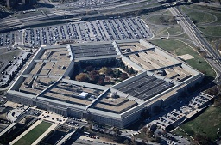
Government
US Government spends $2.1 trillion procuring goods
State and local governments also make significant purchases
Firms specialize in selling to government
Getty Images
Hisham F Ibrahim/Getty Images

Slide 8
Check Yourself
What are the various B2B markets?

Slide 9
B2B Buying Process
Need recognition
Product specification
RFP process
Proposal analysis and supplier selection
Order specification
Vendor/ performance assessment using metrics

Slide 10
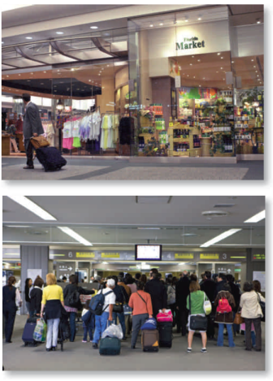
Stage 1: Need Recognition
Can be generated internally or externally
Sources for recognizing new needs:
Suppliers
Salespeople
Competitors
Times Photo by Toni L Sandys/Newscom
Sylvain Grandadam/The Image Bank/Getty Images

Slide 11
Stage 2: Product Specifications
Used by Suppliers to develop proposals
Can be done collaboratively with suppliers
Royalty-Free/CORBIS

Slide 12
Stage 3: RFP Process (Request for Proposal)
©Toyota Motor Engineering & Manufacturing North America, Inc.
Federal Business
Opportunities Website

Slide 13
Step 4: Proposal Analysis, Vendor Negotiation and Selection
Often several vendors are negotiating against each other
Considerations other than price play a role in final selection
Courtesy The Goodyear Tire & Rubber Company

Slide 14
Step 5: Order Specification
Firm places the order
The exact details of the purchase are specified
All terms are detailed including payment
Digital Vision/Getty Images

Slide 15
Step 6: Vendor Performance Assessment Using Metrics
(1) Key Issues | (2) Importance Score | (3) Vendor’s Performance | (4) Importance x Performance (2) x (3)
Customer Service | .40 | 5 | 2.0
Issue Resolution | .20 | 4 | 0.8
Delivery | .10 | 5 | 0.5
Quality | .30 | 3 | 0.9
Total | 1.00 |  | 4.2

Slide 16
Check Yourself
Identify the stages in the B2B buying process.
How do you perform a vendor analysis?

Slide 17
The Buying Center
Buying center
Influencer
Decider
Buyer
User
Gatekeeper
Initiator

Slide 18
Organizational Culture
Buying culture
Democratic
Consultative
Consensus
Autocratic

Slide 19
Buying Situations
Buying situations
New buy
Straight rebuy
Modified rebuy

Slide 20
CHECK YOURSELF
What factors affect the B2B buying process?
What are the six different buying roles?
What is the difference between new buy, rebuy, and modified rebuy?

Slide 21
Glossary
Business-to-business (B2B) marketing refers to the process of buying and selling goods or services to be used in the production of other goods and services, for consumption by the buying organization, and/or for resale by wholesalers and retailers.

Slide 22
Glossary
Buying center participants are people responsible for the buying decisions.

Slide 23
Glossary
The request for proposals (RFP) is a process through which buying organizations invite alternative suppliers to bid on supplying their required components.

Slide 24
Glossary
Resellers are marketing intermediaries that resell manufactured products without significantly altering their form.

