Slide 1
Chapter 8 Global Marketing
©McGraw-Hill Education. All rights reserved. Authorized only for instructor use in the classroom. No reproduction or further distribution permitted without the prior written consent of McGraw-Hill Education.

Slide 2
Learning Objectives
Learning Objective 8.1 Describe the components of a country market assessment.
Learning Objective 8.2 Understand the marketing opportunities in BRIC countries.
Learning Objective 8.3 Identify the various market entry strategies.
Learning Objective 8.4 Highlight the similarities and differences between a domestic marketing strategy and a global marketing strategy.
Notes:
LO8-1 Describe the components of a country market assessment.
LO8-2 Understand the marketing opportunities in BRIC countries.
LO8-3 Identify the various market entry strategies.
LO8-4 Highlight the similarities and differences between a domestic marketing strategy and a global marketing strategy.
These are the learning objectives guiding the chapter and will be explored in more detail in the following slides.

Slide 3
Apple
© Pascal Sittler/REA/Redux

Slide 4
Globalization
The processes by which goods, services, capital, people, information, and ideas flow across national borders.
© Dennis Van Tine/Newscom
Notes:
Few people think about how globalization affects their daily lives, but take a minute to read the labels on the clothing you are wearing right now. Chances are that most of the items, even if they carry U.S. brand names, were manufactured in another part of the world.
Ask students: How do LEGOS get from their manufacturer in Denmark to toy stores in the United States?

Slide 5
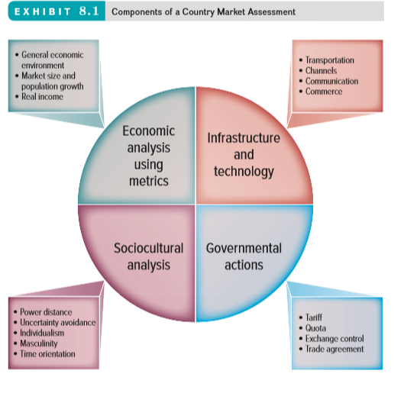
Assessing Global Markets
Jump to Appendix 1 long image description
Notes:
Any entry into a new market, especially into a new country, requires careful planning. A formal market assessment prevents firms from making costly mistakes.

Slide 6
Evaluating the General Economic Environment Using Economic Metrics
Gross domestic product
Gross national income
Purchasing power parity
Trade surplus or deficit
Notes:
Each of these standardized measures allows for comparisons across countries. The use of each depends on specific circumstances. Many reports now feature gross national income (GNI) rather than gross domestic product (GDP), because it includes the economic impact of firms that earn income from their global operations, unlike GDP, which dramatically undercounts the impact of those activities on the economy of the firms’ home markets. The Economist’s Big Mac Index, a novel metric that uses purchasing power parity (PPP) to assess the relative economic buying power among nations, may be interesting to students.
Ask students: What might you include as an indicator of quality of life in a country?
Answers could include life expectancy at birth, educational attainment. and whether average incomes are sufficient to meet the basic needs of life in that country.
The web link brings you to the Human Development Index, a measure of the full picture of human development in a country using GNI, education, and life expectancy. It can be viewed as a map OR as a bar chart.

Slide 7
Evaluating Market Size and Population Growth Rate
Population growth dispersal: strong demand in BRIC (Brazil, Russia, India, China) nations
Distribution of the population within a particular region: rural vs. urban
REUTERS/Arko Datta/Corbis
Notes:
Ask students: Is it in the best interest of a rapidly developing country to encourage foreign retailers to stimulate the economy even though they might harm small family owned businesses?
Students are likely to reflect on the landscape of the U.S. retail industry and notice the harm of some large retailers.

Slide 8
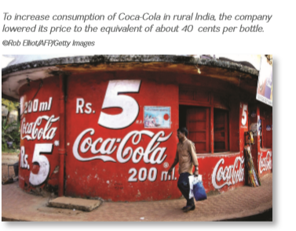
Evaluating Real Income
Firms can make adjustments to an existing product or change the price to meet the unique needs of a particular country market.
Bottom of the pyramid markets
Courtesy of Haier America
Notes:
Group activity: Break students into groups.
Have each group choose a less developed country for a new marketing venture.
Then have each group represent a firm considering marketing a new product or service in that country.
What adjustments would they have to make to their marketing strategy to be successful with their new venture?
There is more detail on this activity on the following slide
Example from the text: For the Chinese market, Haier sells washing machines that can wash both clothes and vegetables.

Slide 9
Analyzing Infrastructure and Technological Capabilities
Marketers are especially concerned with four key elements of a country’s infrastructure:
Transportation
Distribution Channels
Communications
Commerce
Notes:
A firm’s ability to conduct business in a particular country is in large measure determined by that country’s infrastructure. Infrastructure is defined as the basic facilities, services, and installations needed for a community or society to function, such as transportation and communications systems, water and power lines, and public institutions such as schools, post offices, and prisons.
Group activity: Continue with the previous group activity. Have students assess how the current infrastructure in their chosen country will affect the success of their new venture.

Slide 10
Analyzing Governmental Actions
Tariffs
Trade agreements
Governmental actions
Quotas
Exchange control
Notes:
Remind students that this category includes not just the impact of governmental actions but also those of nongovernmental political groups.

Slide 11
Tariffs and Quotas
Tariffs
Quotas
Tax on imported goods
Artificially raises prices
Lowers demand
Minimum or maximum limit
Reduces availability of imported goods
Both benefit domestically made products because they reduce foreign competition.
Notes:
Trade negotiations often revolve around reducing or eliminating tariffs, quotas, or similar impediments to trade. Discuss the recent trade battles between the United States and foreign agriculture producers (e.g., sugar, corn).
Many foreign producers accuse the United States of limiting market access through unfair tariffs and quotas, whereas the United States insists that it must protect United States agriculture.
Ask students: What do you think? Which side would you take in this debate?
Tariffs and quotas can have fundamental and potentially devastating impacts on a firm’s ability to sell products in another country—a lesson that the United Kingdom is discovering in the aftermath of its Brexit vote, as Adding Value 8.1 The Spin Cycle of International Currency: Whirlpool Raises Appliance Prices in Foreign Markets explains.

Slide 12
Exchange Control
Regulation of a country’s currency exchange rate: the measure of how much one currency is worth in relation to another.
In recent years, the value of the U.S. dollar has changed significantly compared with other important world currencies.
Prices are nearly always lower in the country of origin because there are no customs or import duties to pay, and international transportation expenses are less than domestic ones.
Notes:
The central bank of a country generally regulates its currency. Many countries try to keep their markets attractive to foreign investors while simultaneously making their goods attractive to foreign buyers through exchange control.
Ask students: If the value of the U.S. dollar goes up compared to other currencies, what happens to international trade?
Answer: U.S. businesses and consumers will buy more imports, but since the dollar is worth more, exports will go down.

Slide 13
Exhibit 8.3: Trade Agreements
Name | Countries
European Union | There are 28 member countries of the EU: Austria, Belgium, Bulgaria, Croatia, Cyprus, Czech Republic, Denmark, Estonia, Finland, France, Germany, Greece, Hungary, Ireland, Italy, Latvia, Lithuania, Luxembourg, Malta, Netherlands, Poland, Portugal, Romania, Slovakia, Slovenia, Spain, Sweden, and the United Kingdom. There are five official candidate countries to join the EU: Macedonia, Serbia, Turkey, Montenegro, and Albania. Bosnia and Herzegovina and Kosovo are also potential candidates.
NAFTA | United States, Canada, and Mexico.
CAFTA | United States, Costa Rica, the Dominican Republic, El Salvador, Guatemala, Honduras, and Nicaragua.
Mercosur | Full members: Argentina, Brazil, Paraguay, Uruguay, and Venezuela.
ASEAN | Brunei Darussalam, Cambodia, Indonesia, Laos, Malaysia, Myanmar, Philippines, Singapore, Thailand, and Vietnam.
Source: Information about EU members is from http://europa.eu/about-eu/countries/./index_en.htm
Notes:
Ask students: What trade agreements have you heard of?
Can you think of an existing trading bloc?
What benefits does belonging to a trading bloc offer members?

Slide 14
Analyzing Sociocultural Factors
Understanding another culture is crucial to the success of a global marketing initiative.
Exists on two levels:
Visible artifacts
Underlying values

Slide 15
Adding Value 8.2: Can Starbucks Give Italy’s Espresso Culture a Jolt?
Starbucks “Americanized” the Italian coffee experience.
Starbucks is quite different from Italy’s traditional espresso culture.
Starbucks’ first Milan store makes nods to local preferences.
©Alessia Pierdomenico/Getty Images
Notes:
The Adding Value 8.2 box in the text discusses how Starbucks brought Italian culture to the U.S., and its subsequent attempts to bring the Starbucks experience to Italy.

Slide 16
Geert Hofstede’s Cultural Dimensions
Individualism
Masculinity
Uncertainty avoidance
Time orientation
Power distance
Culture
Indulgence
Notes:
Hofstede’s cultural dimensions offer an effective understanding of the subtle elements of a culture.

Slide 17
Cultural Dimensions defined
Power Distance- willingness to accept social inequality as natural
Uncertainty avoidance- extent to which society relies on rules, and formalized procedures
Individualism- perceived obligation and dependence on groups
Masculinity- extent to which dominant values are male oriented
Time orientation- short vs long orientation when viewing time
Indulgence- the extent in which society allows for the gratification of fun and enjoyment

Slide 18
Exhibit 8.4: Country Clusters Power Distance and Individualism
Source: Geert Hofstede, Gert Jan Hofstede, and Michael Minkov, Cultures and Organizations, Software of the Mind, Third Revised Edition, McGraw-Hill 2010, ISBN: 0-07-166418-1. © Geert Hofstede B.V. quoted with permission.
Jump to Appendix 2 long image description
Notes:
Hofstede’s cultural dimensions offer an effective understanding of the subtle elements of a culture. Taken together, these dimensions enable marketers to group countries together according to their similarity on these dimensions and therefore engage in more efficient planning.
Ask students: How would you characterize American culture on these dimensions? How would you characterize other cultures with which you are familiar?

Slide 19
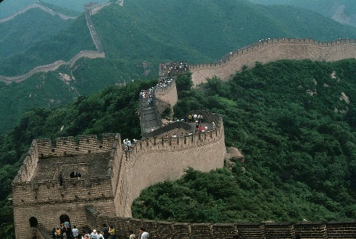
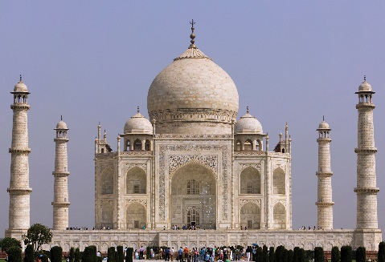
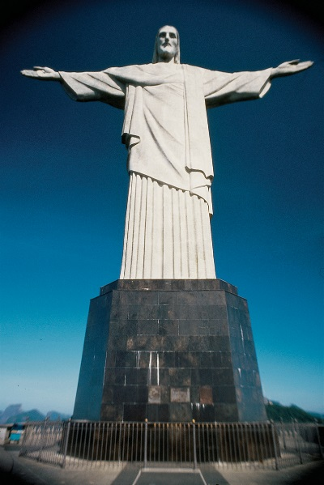
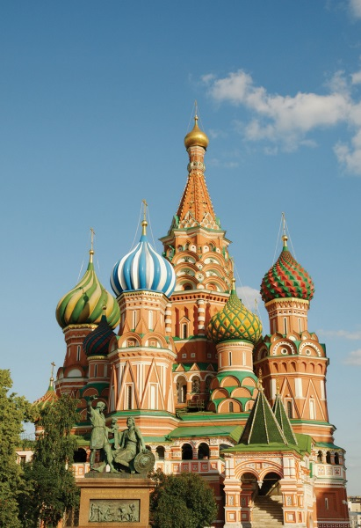
The Appeal of the BRIC Countries
Great potential for growth in the global community:
Brazil
Russia
India
China
© McGraw-Hill Education/Barry Barker, photographer, © Martin Child/Getty Images RF, © Travelif/iStock Exclusive/Getty Images, © McGraw-Hill Education/Barry Barker, photographer
Notes:
Perhaps the greatest change facing the global community in recent years has been the growth and expansion of four countries that together have come to be known as the BRIC countries: Brazil, Russia, India, and China.

Slide 20
PROGRESS CHECK (1 of 3)
What metrics can help analyze the economic environment of a country?
What types of governmental actions should we be concerned about as we evaluate a country?
What are some important cultural dimensions?
Why are each of the BRIC countries viewed as potential candidates for global expansion?
Notes:
The general economic environment, the market size and population growth rate, and real income.
Tariffs, quotas, boycotts, exchange controls, and trade agreements
Cultural Dimensions include power distance, uncertainty avoidance, individualism, masculinity and time orientation
Brazil’s ability to weather, and even thrive during, the most recent economic storm, has transformed it into a global contender. Russia has undergone multiple up- and downturns in its economy. However, its overall growth prospects appear promising, especially as a consumer market. With more than 1.2 billion people, or approximately 15 percent of the world’s population, together with expanding middle and upper classes, India is one of the world’s fastest growing markets. China’s leadership, while maintaining communist political ideals, has embraced market-oriented economic development, which has led to startlingly rapid gains.

Slide 21
Exhibit 8.5: Choosing a Global Entry Strategy
Jump to Appendix 3 long image description
Notes:
Ask students: Why do you think most firms try exporting first? In each strategy, the risks and rewards change. As risk increases, so do the potential rewards. Exporting represents the lowest risk level for the firm.
Group activity: Divide the class into groups that represent different firms. Each group should outline its product offering and the entry strategy it would choose for its global strategy.
Ask students: Why is your chosen entry strategy appropriate for your offering? What criteria did you use to determine your strategy? What risks does your strategy entail, and are the potential rewards worth those risks?

Slide 22
Franchising

Slide 23
Direct Investment

Slide 24
PROGRESS CHECK (2 of 3)
Which global entry strategy has the least risk and why?
Which global entry strategy has the most risk and why?
Notes:
Exporting requires the least financial risk but also allows for only a limited return to the exporting firm. Global expansion often begins when a firm receives an order for its product or service from another country, in which case it faces little risk because it has no investment in people, capital equipment, buildings, on infrastructure.
Direct investment requires a firm to maintain 100 percent ownership of its plants, operation facilities, and offices in a foreign country, often through the formation of wholly owned subsidiaries. This entry strategy requires the highest level of investment and exposes the firm to significant risks, including the loss of its operating and/or initial investments.

Slide 25
Choosing a Global Marketing Strategy: Segmentation, Targeting, and Positioning (STP)
Subcultures
More complicated than domestic STP
Cultural nuances
View of product and consumer role
Different positioning
Adaptation
Single positioning strategy
Notes:
Segmentation, targeting, and positioning to meet the needs of a new market may represent the most complex topic for global marketing. Chapter 9 discusses segmentation, targeting, and positioning in greater detail.
Group Activity: Divide the class into groups. Have them choose a product that they want to introduce into another country. (It may be the same product/firm they used in previous group activity.) Have students consider how they would adapt their positioning strategy to the new country.

Slide 26
The Global Marketing Mix: Global Product or Service Strategies
Same product or service in both the home country market and host country. (Glocalization)
Similar product or service with minor adaptations.
Totally new product or service.
Notes:
Ask Students: What products are the easiest to standardize? What makes these products easy to standardize?
Products at the extreme ends of high tech (e.g., electronics, computers, software versus paper and pencil) or high touch (e.g., luxury goods, jewelry versus staple products) continuums are easy to standardize, but those in the middle generally require varying levels of adaptation to local markets.
Respecting cultural differences is an important ethical choice too, as burger restaurants have learned as they seek ways to access the Indian consumer market, according to Ethical & Societal Dilemma 8.1, Burger Wars in India: Fast-Food Chains Are Finding Creative Ways to Enter a No-Beef Market.

Slide 27
The Global Marketing Mix: Global Pricing Strategies
Anti-dumping laws
Quotas
Currency exchange policies
Tariffs
Competitive factors
Price
Notes:
In addition to competitive, cost, and other considerations, global pricing involves additional dimensions that increase its complexity.

Slide 28
The Global Marketing Mix: Global Distribution Strategies
Global distribution networks form complex value chains.
In developing countries consumers may shop at small, family-owned stores.
Suppliers must be creative in delivering to these outlets.
Tupperware parties in Indonesia
©Alessia Pierdomenico/Getty Images
Notes:
Delivering products to local retailers can be incredibly difficult and frustrating. Infrastructure issues often prevent traditional distribution methods and require creative adjustments. Global firms must find distribution strategies that enable them to reach even really remote markets. For instance, Avon sells and delivers cosmetics to customers using canoes. This example could also prompt an ethical discussion on whether or not firms should be marketing hedonic products or services to consumers with very little disposable income. This YouTube ad (always check before class) is for FedEx and shows how international distribution can be difficult for many companies.
YouTube link: http://www.youtube.com/watch?v=MrMURochE6Y

Slide 29
The Global Marketing Mix: Global Communication Strategies
Literacy levels vary by country.
Differences in language and customs affect communication.
Cultural and religious differences also matter.
Notes:
Ask students: How do firms market their products in countries with very low literacy levels?
Imagine you are promoting a new soft drink. How would you do it without written communication?
Advertising and privacy regulations differ from country to country, leading to some contested choices, as Ethical & Societal Dilemma 8.2 Do European Rights Apply to the Online Universe? Google’s Battle with France discusses.

Slide 30
PROGRESS CHECK (3 of 3)
What are the components of a global marketing strategy?
What are the three global product strategies?
Notes:
Determining the target markets to pursue and developing a marketing mix that will sustain a competitive advantage over time.
Global product strategies:
Sell the same product or service in both the home country market and the host country.
Sell a product or service similar to that sold in home country but include minor adaptations.
Sell totally new products or services.

Slide 31
Glossary

Slide 32
Glossary-1
Exchange control refers to the regulation of a country’s currency exchange rate, the measure of how much one currency is worth in relation to another.
Return to slide
Notes:
Exchange control refers to the regulation of a country’s currency exchange rate, the measure of how much one currency is worth in relation to another.

Slide 33
Glossary-2
Infrastructure is the basic facilities, services, and installations needed for a community or society to function.
Return to slide
Notes:
Infrastructure is the basic facilities, services, and installations needed for a community or society to function.

Slide 34
Glossary-3
A quota designates the maximum quantity of a product that may be brought into a country during a specified time period.
Return to slide
Notes:
A quota designates the maximum quantity of a product that may be brought into a country during a specified time period.

Slide 35
Glossary-4
A tariff is a tax levied on a good imported into a country.
Return to slide
Notes:
A tariff is a tax levied on a good imported into a country.

Slide 36
Glossary-5
A trade agreement is an intergovernmental agreement designed to manage and promote trade activities for a specific region.
Return to slide
Notes:
A trade agreement is an intergovernmental agreement designed to manage and promote trade activities for a specific region.

Slide 37
Glossary-6
Glocalization is the process of firms standardizing their products globally, but using different promotional campaigns to sell them.
Return to slide
Notes:
Glocalization is the process of firms standardizing their products globally, but using different promotional campaigns to sell them.

Slide 38
Appendix: Image Descriptions for Unsighted Students

Slide 39
Appendix 1 Assessing Global Markets
The following are components of a country market assessment:
Economic analysis using metrics includes:
General economic environment
Market size and population growth
Real income
Infrastructure and technology includes:
Transportation
Channels
Communication
Commerce
Government actions include:
Tariff
Quota
Exchange control
Trade agreement
Sociocultural analysis includes:
Power distance
Uncertainty avoidance
Individualism
Masculinity
Time orientation
Return to slide

Slide 40
Appendix 2 Exhibit 8.4: Country Clusters Power Distance and Individualism
High in power distance and low in individualism are Guatemala, Panama, Venezuela, Ecuador, Columbia, El Salvador, Chile, and Brazil.
High in power distance and high in individualism are Poland and Czech Republic.
Low in power distance and high in individualism are Hungary, Finland, Germany, Switzerland, Norway, Ireland, Sweden, Denmark, Canada, United States, Australia, and United Kingdom.
Return to slide

Slide 41
Appendix 3 Choosing a Global Entry Strategy
A graphic lists five global entry strategies, ranked by their increasing amounts of control and risk. From the lowest amounts of control and risk and increasing upward, the strategies are: export, franchising, strategic alliance, joint venture, and direct investment.
Return to slide

Slide 42
Marketing Chapter 8
The End

