Slide 1
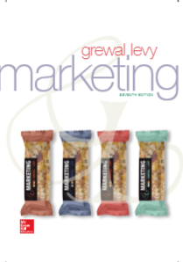
Chapter 9 Segmentation, Targeting, and Positioning
©McGraw-Hill Education. All rights reserved. Authorized only for instructor use in the classroom. No reproduction or further distribution permitted without the prior written consent of McGraw-Hill Education.

Slide 2
Learning Objectives
Learning Objective 9.1 Outline the different methods of segmenting a market.
Learning Objective 9.2 Describe how firms determine whether a segment is attractive and therefore worth pursuing.
Learning Objective 9.3 Articulate the difference among targeting strategies: undifferentiated, differentiated, concentrated, or micromarketing.
Learning Objective 9.4 Determine the value proposition.
Learning Objective 9.5 Define positioning and describe how firms do it.
Notes:
LO9-1 Outline the different methods of segmenting a market.
LO9-2 Describe how firms determine whether a segment is attractive and therefore worth pursuing.
LO9-3 Articulate the differences among targeting strategies: undifferentiated, differentiated, concentrated, or micromarketing.
LO9-4 Determine the value proposition.
LO9-5 Define positioning and describe how firms do it.
These are the learning objectives guiding the chapter and will be explored in more detail in the following slides.

Slide 3
The Segmentation, Targeting, and Positioning Process
Establish strategy or objectives
Use segmentation methods
Evaluate segment attractiveness
Select target market
Identify and develop positioning strategy

Slide 4
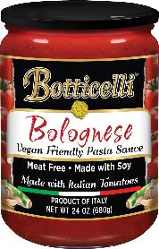
Step 1: Establish the Overall Strategy or Objectives
Derived from mission and objectives
Consistent with SWOT
Courtesy of Borticelli
Notes:
The first step in the segmentation process is to articulate the vision or objectives of the company’s marketing strategy clearly. Remind students that any strategy must be consistent with the firm’s mission statement and be based on the current assessments from SWOT analyses.

Slide 5
Step 2: Use Segmentation Methods
Notes:
The second step in the segmentation process is to use a particular method or combination of methods to segment the market.
Group activity: Divide the class into groups. Have them choose either a manufacturer or national retailer. Have them describe their segmentation method and then evaluate whether or not it is the best segmentation method for that firm.

Slide 6
Geographic Segmentation
Market could be grouped by:
Country
Region
Northeast, Southeast
Areas within region
State, city, neighborhoods, zip codes
Most useful for companies whose products satisfy needs that vary by region.
Notes:
Geographic segmentation organizes customers into groups on the basis of where they live. Geographic information software (GIS) aids in such segmentation. Many firms use regional brands of popular products. When Dunkin’ Donuts introduced soup to its menu, it included New England Clam Chowder which appealed to northeastern consumers, but franchisees in Texas objected to this choice. Understanding regional preferences can define a company’s success—or failure.
Ask students: How can firms successfully change a national brand into a international brand? This will tie into the previous chapter on global marketing—should firm adapt to local tastes?

Slide 7
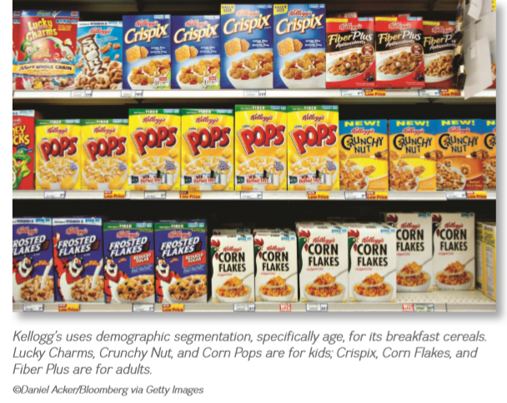
Demographic Segmentation
Most common segmentation strategy
- Easy to identify
- Easily measured
Notes:
Demographic segmentation groups consumers according to easily measured, objective characteristics such as age, gender, income, and education. These variables represent the most common means to define segments because they are easy to identify, and demographically segmented markets are easy to reach. This web link is to the U.S. Census Bureau. They provide one of the most important marketing research tools: Census data, which offer a rich, free source of information about various consumers that, suggests segmentation possibilities. On the Census Bureau website, walk students through the information available about the zip code in which your university is located.

Slide 8
Social & Mobile Marketing 9.1: The Social Sharing Practices of the Teen Segment
For Generation Z, “if it’s not sharable, it didn’t happen.”
Brands are struggling to connect with social media-addicted young consumers.
Influence is spilling over to older generations and altering the way they shop.
©Paul Bradbury/OJO Images RF/Getty Images
Notes:
As Social & Mobile Marketing 9.1 acknowledges, demographics also can be critical to defining an overall marketing strategy. Many of the clothing brands and retailers that dominated the market in previous decades are struggling, faced with a distinct lack of appeal to experience-focused, social media–addicted, young sharing consumers. They want to snap up the latest style, take a picture of how it looks, and share it with their followers and friends. To be able to provide constant content updates on their social media sites, they need a constant flow of new items and clothing to highlight. Such demands benefit the fast fashion retailers such as Zara, H&M, and Mango that allow consumers to grab the latest styles the very moment that they fly off the design boards. The influences stemming from the preferences and practices of these young consumers also is spilling over to older generations and altering the way they shop.
Ask students: Has social media changed your shopping preferences?

Slide 9
Psychographic Segmentation
How consumers describe themselves in terms of:
Self-values
Self-concept
Lifestyles
Notes:
Psychographic segmentation is the segmentation method that delves into how consumers actually describe themselves. Usually marketers determine (through demographics, buying patterns, or usage) into which segment an individual consumer falls. Determining psychographics involves knowing and understanding three components: self-values, self-concept, and lifestyles.
Group Activity: Divide students into groups. Have each choose a product/service they like. Have them describe users of that product/service in terms of psychographics.
Firms can target consumers based on consumers’ self-values. From a marketing point of view, self-values help determine the benefits the target market may be looking for from a product. Sanderson Farms targets consumers whose self-values prioritize saving money rather than worrying about antibiotic use, as Ethical & Societal Dilemma 9.1 Using Antibiotics Proudly: Sanderson Farms Distinguishes Its Brand by Going against the Grain reports.

Slide 10
Exhibit 9.3: VALS (Value and Lifestyle) Framework
VALS
Jump to Appendix 2 long image description
© 2017 by Strategic Business Insights. All rights reserved. This version is for the United States only. Different frameworks are used for different countries. Used with permission.
Notes:
The most widely used tool to support such psychographic segmentation efforts is VALS owned and operated by Strategic Business Insights (SBI). It examines the intersection of psychology, demographics, and lifestyles. Consumers can be classified into eight segments based on their answers to the VALS survey and proprietary algorithm. Click on the VALS hyperlink and take the survey as a class.
Group activity: Have students complete the VALS survey individually, and then bring their completed survey to class.
Ask students: Why might you fall into similar categories? Who fell into different categories? For example, few business students likely belong to the Believers category, but art majors very well may.

Slide 11
Benefit Segmentation
Dividing the market into segments whose needs and wants are best satisfied by the product’s benefits can be a very powerful tool.
Notes:
Benefit segmentation groups consumers on the basis of the benefits they derive from products or services. Because marketing is all about satisfying consumers’ needs and wants, dividing the market into segments whose needs and wants are best satisfied by the product benefits can be a very powerful tool.
Ask students: How does the movie industry use a benefit segmentation strategy?
Group activity: Have students identify products that provide different types of benefits. How else might these products be segmented?
This activity provides a good opportunity to remind students that products exist in multiple segments, just as consumers do.
Different motives lead different consumers to purchase the same product.

Slide 12
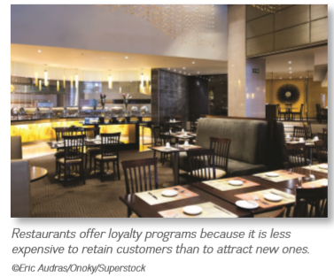
Behavioral Segmentation
Occasion segmentation:
Based on when a product or service is purchased or consumed
Clothing, snack foods
Loyalty segmentation:
Loyal customers are the most profitable in the long term
Hotels, airlines, restaurants (Starbucks)
Notes:
Behavioral segmentation based on when a product or service is purchased or consumed is called occasion segmentation. Men’s Wearhouse uses this type of segmentation to develop its merchandise selection and its promotions. Sometimes men need a suit for their everyday work, but other suits are expressly for special occasions such as a prom or a wedding. Snack food companies such as Frito-Lay also make and promote snacks for various occasions—individual servings of potato chips for a snack on the run but 16-ounce bags for parties.
Firms have long known that it pays to retain loyal customers. Loyal customers are those who feel so strongly that the firm can meet their relevant needs best that any competitors are virtually excluded from their consideration; that is, these customers buy almost exclusively from the firm. Firms encourage loyalty in various ways, such as airline mileage or hotel point reward programs. Marketing Analytics 9.1 discusses the My Starbucks Reward program, which has more than 9 million members.
Ask students: Are you a loyal buyer of any single product, to the extent that you refuse to purchase a substitute?
Students may refer to soft drinks, but true brand loyalty is extremely rare.

Slide 13
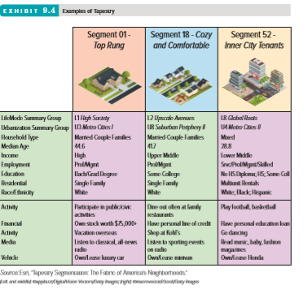
Using Multiple Segmentation Methods
Tapestry ™ uses a combination of geographic, demographic, and lifestyle characteristics to classify consumers.
Jump to Appendix 3 long image description
Notes:
Although all segmentation methods are useful, each has its unique advantages and disadvantages. Thus, firms often employ a combination of segmentation methods, using demographics and geography to identify and target marketing communications to their customers, then using benefits or lifestyles to design the product or service and the substance of the marketing message.
One very popular mixture of segmentation schemes is geodemographic segmentation. Based on the adage “birds of a feather flock together,” geodemographic segmentation uses a combination of geographic, demographic, and lifestyle characteristics to classify consumers. One widely used tool for geodemographic market segmentation is the Tapestry™ Segmentation system developed and marketed by Esri. Tapestry Segmentation classifies all U.S. residential neighborhoods into 65 distinctive segments based on detailed demographic data and lifestyles of people who live in each U.S. block tract (zip code +4).

Slide 14
PROGRESS CHECK (1 of 2)
What are the various segmentation methods?
Notes:
Geographic, Demographic, Psychographic, Geodemographic, Benefits, and Behavioral

Slide 15
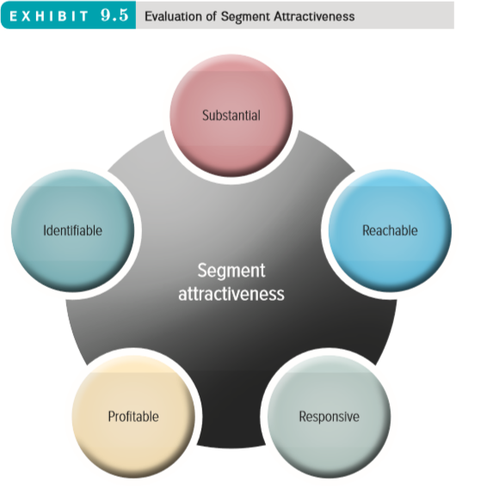
Step 3: Evaluate Segment Attractiveness
Notes:
Marketers first must determine whether the segment is worth pursuing, using several descriptive criteria: Is the segment identifiable, substantial, reachable, responsive, and profitable?

Slide 16
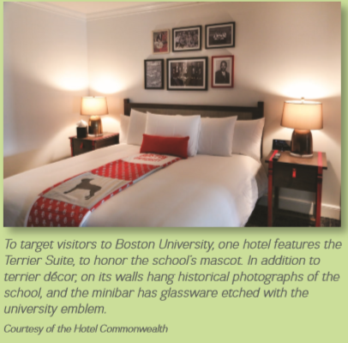
Identifiable
Who is in their market?
Are the segments distinct from one another?
Does each segment require a unique marketing mix?
Notes:
Firms must be able to identify who is within their market to be able to design products or services to meet their needs. It is equally important to ensure that the segments are distinct from one another, because too much overlap between segments means that distinct marketing strategies aren’t necessary to meet segment members’ needs. As Adding Value 9.1 Symbiosis in Your Stay: How Hotels Leverage Their Proximity to Universities details, an effective marketing strategy to distinct segments might even offer similar options but with different mascots and colors, if those identifiable segments are connected with particular universities.
Ask students: When would these women all be in the same segment? When would they be in different segments?
These women would appear in the same segment if the segmentation variable were gender but in individual segments based on race or lifestyle. They also may be in different geographic or income segments, for example.

Slide 17
Substantial
How large is the market segment in terms of size and buying power?
If a market segment is too small, it won’t generate sufficient profits.
If its buying power is insignificant, despite its size, the marketing mix cannot be supported.
Notes:
Just because a firm can find a market does not necessarily mean it represents a good market. If a market is too small or its buying power insignificant, it won’t generate sufficient profits or be able to support the marketing mix activities.

Slide 18
Reachable
Can the market be reached through persuasive communication and product distribution?
The consumer must:
Know the product exists.
Understand what it can do.
Recognize how to buy.
Notes:
The best product or service cannot have any impact, no matter how identifiable or substantial the target market is, if that market cannot be reached (or accessed) through persuasive communications and product distribution. The consumer must know that the product or service exists, understand what it can do for him or her, and recognize how to buy it.
Ask students: What types of media influence the way they shop?
The answer may lead to an interesting discussion about how difficult it is to reach Generation Y customers either because they don’t participate in traditional media such as newspapers or because they are skeptical about being influenced by commercial messages.

Slide 19
Responsive
Customers must react similarly and positively to the firm’s offering.
If a firm cannot provide products and services to the segment, it shouldn’t be targeted.

Slide 20
Profitable
Assess potential profitability of each segment, both current and future.
Key factors:
Current market growth rate
Future growth rate
Market competitiveness
Market access costs

Slide 21
How to Determine the Profitability of a Segment
Segment = Children under 15
Segment size = 60 million (<15 yrs)
Segmentation Adoption Percentage = 35%
Purchase Behavior = $500 x 1 time purchase
Profit margin % = 10%
Fixed Cost = $50M
Is this segment profitable?
Notes:
Children under 15 represent a very profitable market segment, as this example illustrates.

Slide 22
Exhibit 9.6: Profitability of Two Market Segments for Camillo’s Lawn Service
 | Homeowners | Businesses
Segment size | 75,000 | 1,000
Segment adoption percentage | 1% | 20%
Purchase behavior Purchase price Frequency of purchase | $100 12 times | $500 20 times
Profit margin percentage | 60% | 80%
Fixed costs | $400,000 | $1,000,000
Segment profit | $140,000 | $600,000
Notes:
A hot segment today may not last long enough to make it worth investment. Many firms are investigating when and how much to invest in the Millennial/GenY generational cohort. Firms in financial services and housing understand that it provides a new potential market, but the debt levels this segment carries makes it difficult to target effectively.
To illustrate how a business might determine a segment’s profitability, consider Camillo’s start-up lawn service. He is trying to determine whether to target homeowners or businesses in a small midwestern town. The slide estimates the profitability of the two segments.

Slide 23
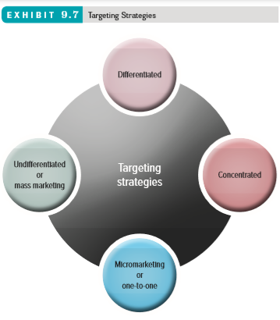
Step 4: Select a Target Market
The key factor is the marketer’s ability to pursue the market.
Four different targeting strategies can be used.
Notes:
When everyone might be considered a potential user of its product, a firm uses an undifferentiated targeting strategy (mass marketing). Firms using a differentiated targeting strategy target several market segments with a different offering for each. When an organization selects a single, primary target market and focuses all its energies on providing a product to fit that market’s needs, it is using a concentrated targeting strategy. When a firm tailors a product or service to suit an individual customer’s wants or needs, it is undertaking an extreme form of segmentation called micromarketing or one-to-one marketing.
Ask students: What is an example of a mass market product?
Answer: There are very few mass market products. Even commodity goods such as flour are now differentiated.
Ask students: What are examples of products that use differentiated, concentrated, and micromarketing segmentation strategies?
Differentiated = Coca Cola
Concentrated = Helena Rubenstein or Clinique
Micromarketing = Financial Services Providers

Slide 24
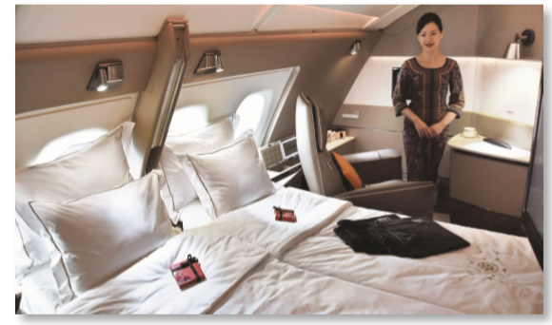
Step 5: Identify and Develop Positioning Strategy
Market positioning
Defining marketing mix variables so target customers have a clear, distinctive, desirable understanding of what the product does.
Value proposition
Communicates the customer benefits to be received from a product or service.
(left): ©Buskirk Services, Inc./PhotoEdit; (right): ©Kyodo News via Getty Images
Notes:
A firm’s value proposition is represented by the benefits that a firm provides but that its competitors do not. Airline customers who are looking for a good value and will therefore tolerate a cattle-call approach to seating, which allows them to choose their own seats on the plane as long as they get an early check-in, turn to Southwest for their flights. Alternatively, customers who are looking for lots of worldwide flight options will turn to American Airlines/US Airways.

Slide 25
Exhibit 9.8: Circles for a Successful Value Proposition (1 of 2) Part A. No Overlap with Competition
Jump to Appendix 4 long image description
Notes:
To visualize the value proposition, examine the Circles for a Successful Value Proposition framework. The bottom left circle in part A represents the customer needs and wants, the bottom right circle represents the company’s offerings (i.e., its capabilities), and the top circle represents the benefits offered by competitors. The best situation is if a company’s product or service offering overlaps with customer needs and wants but suffers no overlap with competitors’ offerings. The shaded portion reflects the value proposition, or the intersection of what the customer needs and wants with what the company can offer.

Slide 26
Exhibit 9.8: Circles for a Successful Value Proposition (2 of 2) Part B. Determining the Value Proposition
Jump to Appendix 5 long image description
Notes:
In the second circle, the intersection of customer needs, the benefits provided by our focal firm, and the benefits provided by a competing firm reveal seven specific spaces where a product or service might be located.
The main value proposition components are: 1. Target marking, 2. Offering name or brand, 3. Product/service category or concept, 4. Unique point of difference/benefits.

Slide 27
Value Proposition Key Elements

Slide 28
Positioning Methods
Positioning Methods
Value
Salient Attributes
Symbols
Competition
Notes:
Positioning strategies generally focus on either how the product or service affects the consumer or how it is better than competitors’ products and services. When positioning against competitors, the objective is to play up how the brand being marketed provides the desired benefits better than do those of competitors. Firms thus position their products and services according to value, salient attributes, and symbols, and against competition.

Slide 29
Positioning Using Perceptional Mapping
A perceptual map displays, in two or more dimensions, the position of products or brands in the consumer’s mind.
Ideal Points: Where a particular market segment’s ideal product would lie on the map.

Slide 30
Six Positioning Steps to Derive a Perceptual Map
Determine consumers’ perceptions and evaluations in relation to competitors’.
Identify the market’s ideal points and size.
Identify competitors’ positions.
Determine consumer preferences.
Select the position.
Monitor the positioning strategy.
Notes:
This slide provides the steps necessary to develop the perceptual maps on the next slides. Switch back and forth on these slides to explain the perceptual maps. The example used in this slide is the car industry.

Slide 31
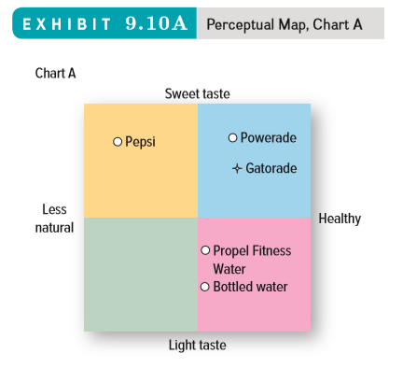
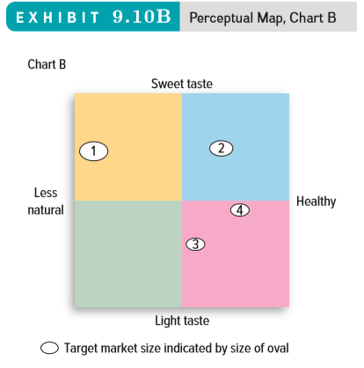
Perceptual Maps (1 of 2)
Jump to Appendix 6 long image description
Notes:
4
Marketers determine their brand’s position by asking a series of questions about their firm’s and the competitors’ products. Here, cars are depicted on two dimensions: style and price. Kia is known for having a low price and a more traditional style.

Slide 32
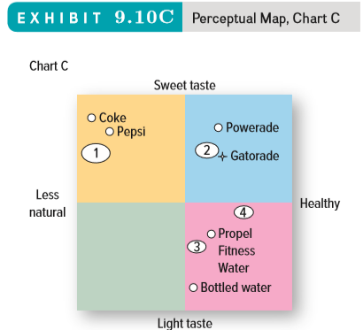
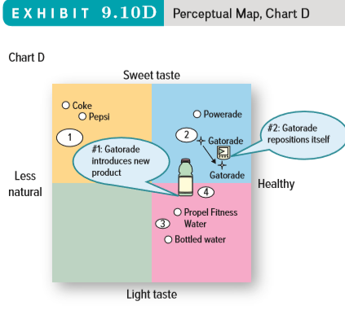
Perceptual Maps (2 of 2)
Jump to Appendix 7 long image description
Notes:
4
On a perceptual map, marketers can represent the size of current and potential markets. The largest target market is consumers looking for a contemporary vehicle at a moderate price.

Slide 33
PROGRESS CHECK (2 of 2)
What is a perceptual map?
Identify the six positioning steps.
Notes:
A perceptual map displays, in two or more dimensions, the position of products or brands in the consumer’s mind.
Determine consumers’ perceptions and evaluations of the product or service in relation to competitors’, identify competitors’ positions, determine consumer preferences, select the position, monitor the positioning strategy.

Slide 34
Glossary

Slide 35
Glossary-1
Benefit segmentation groups consumers on the basis of the benefits they derive from products or services.
Return to slide
Notes:
Benefit segmentation groups consumers on the basis of the benefits they derive from products or services.

Slide 36
Glossary-2
Demographic segmentation groups consumers according to easily measured, objective characteristics such as age, gender, income, and education.
Return to slide
Notes:
Demographic segmentation groups consumers according to easily measured, objective characteristics such as age, gender, income, and education.

Slide 37
Glossary-3
Geodemographic segmentation uses a combination of geographic, demographic, and lifestyle characteristics to classify consumers.
Return to slide
Notes:
Geodemographic segmentation uses a combination of geographic, demographic, and lifestyle characteristics to classify consumers.

Slide 38
Glossary-4
Geographic segmentation organizes customers into groups on the basis of where they live.
Return to slide
Notes:
Geographic segmentation organizes customers into groups on the basis of where they live.

Slide 39
Glossary-5
Behavioral segmentation divides customers into groups based on how they use the product or service.
Return to slide
Notes:
Behavioral segmentation divides customers into groups based on how they use the product or service.

Slide 40
Glossary-6
Psychographic segmentation, or psychographics, allows people to describe themselves using characteristics that help them choose how they occupy their time (behavior) and what underlying psychological reasons determine these choices.
Return to slide
Notes:
Psychographic segmentation, or psychographics, allows people to describe themselves using characteristics that help them choose how they occupy their time (behavior) and what underlying psychological reasons determine these choices.

Slide 41
Glossary-7
The Value and Lifestyle Survey (VALS) is a psychographic tool that classifies consumers into eight categories based on their answers to a questionnaire.
Return to slide
Notes:
The Value and Lifestyle Survey (VALS) is a psychographic tool that classifies consumers into eight categories based on their answers to a questionnaire.

Slide 42
Appendix: Image Descriptions for Unsighted Students

Slide 43
Appendix 1 The Segmentation, Targeting, and Positioning Process
Segmentation
Step 1 Establish strategy or objectives.
Step 2 Use segmentation methods.
Targeting
Step 3 Evaluate segment attractiveness.
Step 4 Select target market.
Positioning
Step 5 Identify and develop positioning strategy.
Return to slide

Slide 44
Appendix 2 Exhibit 9.3: VALS (Value and Lifestyle) Framework
Innovators have high resources and high innovation, while Survivors have low resources and low innovation. The three primary motivations are Ideals, Achievement, and Self-Expression. Those who are motivated by Ideals are Thinkers and Believers. Those who are motivated by Achievement are Achievers and Strivers. Those who are motivated by Self-Expression are Experiencers and Makers.
Return to slide

Slide 45
Appendix 3 Using Multiple Segmentation Methods
The first segment is Segment 01, Top Rung. Their LifeMode Summary Group is L1 High Society. Their Urbanization Summary Group is U3 Metro Cities 1. The Household Type is Married-Couple Families. Income is high, employment is professional/management, and education is bachelor’s and graduate degrees. They live in single-family residences and their race/ethnicity is white. Their activities are participate in public/civic activities and vacation overseas. They own stock worth over $75,000. For media, they listen to classical and all-news radio. Their vehicle is an owned or leased luxury car.
The second segment is Segment 18, Cozy and Comfortable. Their LifeMode Summary Group is L2 Upscale Avenues. Their Urbanization Summary Group is U8 Suburban Periphery 2. The Household Type is Married-Couple Families. Income is upper middle, employment is professional/management, and education is some college. They live in single-family residences and their race/ethnicity is white. Their activities are dine out often at family restaurants and shop at Kohl’s. They have a personal line of credit. For media, they listen to sporting events on the radio. Their vehicle is an owned or leased minivan.
The third segment is Segment 52, Inner City Tenants. Their LifeMode Summary Group is L8 Global Roots. Their Urbanization Summary Group is U4 Metro Cities 2. The Household Type is Mixed. Income is lower middle, employment is service, professional, management, skilled, and education is no high school diploma, high school, and some college. They live in multiunit rentals and their race/ethnicity is white, black, and Hispanic. Their activities are play football and basketball and go dancing. They have a personal education loan. For media, they read music, baby, and fashion magazines. Their vehicle is an owned or leased Honda.
Return to slide

Slide 46
Appendix 4 Exhibit 9.8: Circles for a Successful Value Proposition Part A. No Overlap with Competition
Three circles are shown: competitive offering, customer needs and wants, and company offering. The customer needs and wants and company offering circles overlap. This overlap is designated the value proposition.
Return to slide

Slide 47
Appendix 10 Perceptual Maps
Drinks are charted based on their sweet taste, if they are healthy, their light taste, and if they are less natural. Coke and Pepsi are in the sweet taste, less natural quadrant. Propel Fitness Water and Bottled Water are in the light taste, healthy quadrant. Powerade is in the sweet taste, healthy quadrant. Gatorade is introduced as healthy and having a light taste. By repositioning itself, Gatorade is now shown as healthy and having a sweet taste.
Return to slide

Slide 48
Marketing Chapter 9
The End

