Slide 1
Chapter 1 Overview of Marketing
©McGraw-Hill Education. All rights reserved. Authorized only for instructor use in the classroom. No reproduction or further distribution permitted without the prior written consent of McGraw-Hill Education.

Slide 2
Learning Objectives
Learning Objective 1.1 Define the role of marketing.
Learning Objective 1.2 Describe the evolution of marketing over time.
Learning Objective 1.3 Describe how marketers create value for a product or service.
Notes:
LO1-1 Define the role of marketing in organizations.
LO1-2 Describe how marketers create value for a product or service.
LO1-3 Understand why marketing is important both within and outside the firm.
These are the learning objectives guiding the chapter and will be explored in more detail in the following slides.

Slide 3
Phyter Bars
© Getty Images

Slide 4
What Is Marketing?
Marketing is the activity, set of institutions, and processes for creating, capturing, communicating, delivering, and exchanging offerings that have value for customers, clients, partners, and society at large.
Notes:
This is the American Marketing Association’s definition of marketing. Point out that this definition covers many different perspectives.
Ask students: What does this definition really mean?

Slide 5
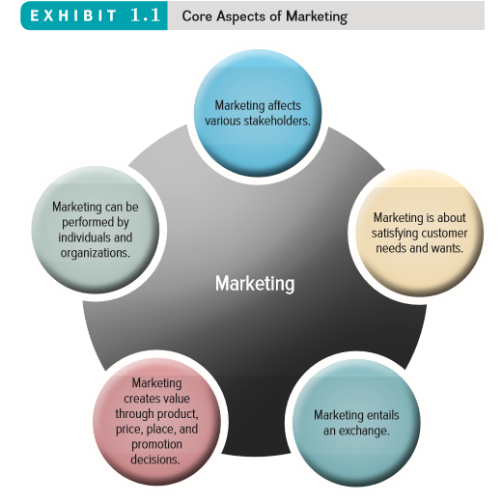
Exhibit 1.1 Core Aspects of Marketing
Jump to Appendix 1 long image description
Notes:
Ask students: What problems do you have for which there are no products to meet their needs?
They might think about products that they could use for their homes, their computers, organizing their work, their cars.
This is how marketers generate ideas for new products—by uncovering consumer needs.

Slide 6
Marketing Is about Satisfying Customer Needs and Wants
How does Hershey’s offer value?
©Education Images/UIG via Getty Images
Notes:
Ask students: Point out the different ways that Godiva and Hershey’s offer value.
Ask students: Would these benefits would convince them to purchase the product?

Slide 7
Exhibit 1.2: Exchange the Underpinning of Seller-Buyer Relationships
Jump to Appendix 2 long image description
Notes:
Each party to the exchange gives up something of value:
The customer usually gives up money, however, sometimes they also give up time and information.
The firm gives up the good or service.
The exchange in the end is mutually beneficial.

Slide 8
Exhibit 1.3: The Marketing Mix
Jump to Appendix 3 long image description
Notes:
This is an overview of the marketing mix, or four Ps (product, price, place, and promotion), which will be discussed later in greater depth.
Ask students: Choose a product you see in the classroom (i.e., VitaminWater, Coke, Aquafina) and describe the four Ps for this product.

Slide 9
Marketing Creates Value through Product, Price, Place, and Promotion Decisions
The Marketing Mix:
The controllable set of decisions or activities that the firm uses to respond to the wants of its target markets.
Product
Price
Promotion
Place

Slide 10
Product: Creating Value
The fundamental purpose of marketing is to create value by developing a variety of offerings, including goods, services, and ideas, to satisfy customer needs.
Goods
Services
Ideas

Slide 11
Price: Capturing Value
Price is everything a buyer gives up (money, time, energy) in exchange for the product or service.
©Rich Polk/Clear Channel/Getty Images
Notes:
A good example of how price expresses value depicted in this slide is how price represents the monetary value a customer places on the service performance. This slide shows how money is used in the exchange process for the performance by Bruno Mars.
Pricing strategies will be discussed in later chapters, but you may also wish at this point to introduce the notion of market pricing versus cost pricing.

Slide 12
Place: Delivering the Value Proposition
Place represents all the marketing processes necessary to get the product to the right customer when that customer wants it.
Place more commonly deals specifically with retailing and marketing channel management, also known as supply chain management.
Notes:
Place delivers the product to the customers.
Students may overlook the importance of this component of the marketing mix because it is not as readily visible from the consumer perspective. To get this point across, suggest a few products and then trace the path those products likely take from manufacturer to retailer to consumer.
Marketing Analytics 1.1 Location, Location, Analytics: Starbucks’ Use of Data to Place New Stores describes how for Starbucks, place means expanding its storefronts constantly and proactively, so that it is easy for caffeine junkies to find their fix.

Slide 13
Promotion: Communicating the Value Proposition
Promotion is communication by a marketer that informs, persuades, and reminds potential buyers about a product or service to influence their buying decisions and elicit a response.
Notes:
The fourth P is promotion. Even the best products and services will go unsold if marketers cannot communicate their value to customers. Promotion is communication by a marketer that informs, persuades, and reminds potential buyers about a product or service so as to influence their opinions and elicit a response. Promotion generally can enhance a product’s or service’s value.

Slide 14
Exhibit 1.4: Marketing Can Be Performed by Individuals and Organizations
Etsy Website
Jump to Appendix 4 long image description
Notes:
This exhibit illustrates how the same product, a desktop computer, can be sold from firm to firm, from firm to consumer, and then sold from consumer to consumer.
Ask students: Have you bought from other consumers online?
Many options are available to buy C2C online, especially with the development of online cooperatives like esty.com.
Website: http://www.etsy.com/

Slide 15
Marketing Impacts Various Stakeholders
Customers
Supply Chain Partners
Employees
Industry
Society
Notes:
Marketers affect many stakeholders. Customers represent one stakeholder group, but others include all those in the supply chain, employees, and society at large.
Supply chain partners include manufacturers, agents, wholesalers, retailers, and so on.
Companies market to employees with employment marketing, also known as internal marketing, to recruit and retain the best employees.

Slide 16
PROGRESS CHECK (1 of 3)
What is the definition of marketing?
Marketing is about satisfying ______ and ______.
What are the four components of the marketing mix?
Who can perform marketing?
Notes:
Marketing is an organizational function and a set of processes for creating, communicating, and delivering value to customers and for managing customer relationships in ways that benefit the organization and its stakeholders.
Needs and wants
Product, price, place, and promotion
Individuals and organizations

Slide 17
Exhibit 1.5 Marketing Evolution: Production, Sales, Marketing and Value
Photos (left to right): © Ryan McVay/Getty Images RF; © CMCD/Getty Images RF; © Ryan McVay/Getty Images RF; © Ted Dayton Photography/Beateworks/Corbis RF; © McGraw-Hill Education/Mark Dierker, photographer
Jump to Appendix 5 long image description
Notes:
Marketing has been through several eras. This exhibit graphically represents the changes over time from an emphasis on production to one based on value-based marketing.
The production-oriented era took place around the turn of the 20th century, when most firms believed a good product would sell itself.
In the sales-oriented era, production and distribution techniques became more sophisticated and supply outpaced demand. Firms found an answer to overproduction by focusing on sales.
In the market-oriented era, the focus was on what customers wanted. It was during this period that firms discovered marketing.
Now, we are in the value-based era, which maintains the market orientation but also includes a focus on giving greater value than the competition. Value reflects the relationship of benefits to costs. Value-based marketing means implementing a marketing strategy according to what customers value.

Slide 18
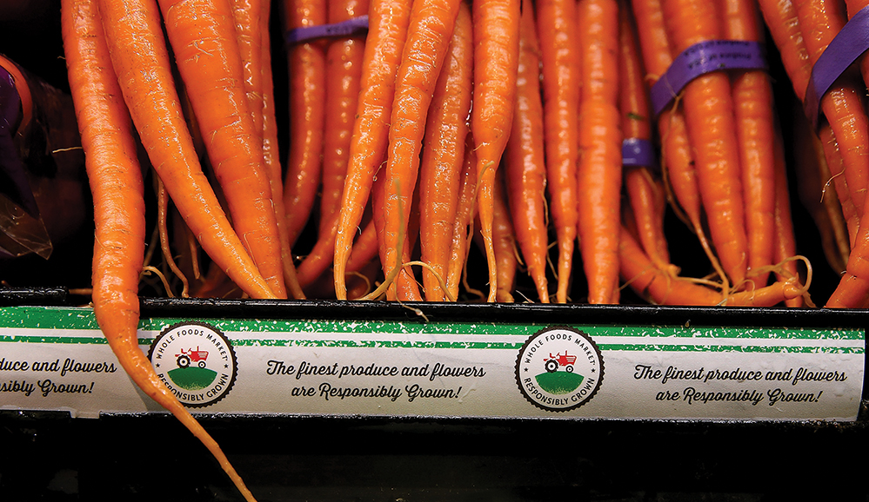
Value-Based Marketing
The Meaning of Best Value: Whole Foods’ Purpose-Based Marketing
© Justin Sullivan/Getty Images
Notes:
Whole Foods’ Responsibly Grown rating program identifies all fresh produce and flowers according to their environmental impact. In parallel with this new initiative (and others), Whole Foods has developed a revised advertising campaign, with a prominent tagline that reminds shoppers that “Values matter.” The commercials emphasize that by shopping at Whole Foods, consumers can be confident that their food has been sourced responsibly and fairly.
Ask students: Is this campaign for Whole Foods about value? Some customers are willing to pay asking prices for all types of food at all price levels because to those individuals what they get for what they give is a good value.

Slide 19
Value-Based Marketing Era
What is Value?
Value Cocreation
Relational Orientation
CRM: Customer Relationship Management

Slide 20
PROGRESS CHECK (2 of 3)
What are the various eras of marketing?
Notes:
Production
Sales
Marketing
Value-Based

Slide 21
How Does Marketing Create Value and How Do Firms Become More Value Driven?
Build relationships with customers.
Gather and analyze information.
Balance benefits and costs.
Connect with customers using social and mobile media.

Slide 22
Value Stems From Four Main Activities
Adding Value
Using Marketing Analytics
Embracing Social and Mobile Marketing
Ethical and Societal Dilemma: Engaging in Conscious Marketing

Slide 23
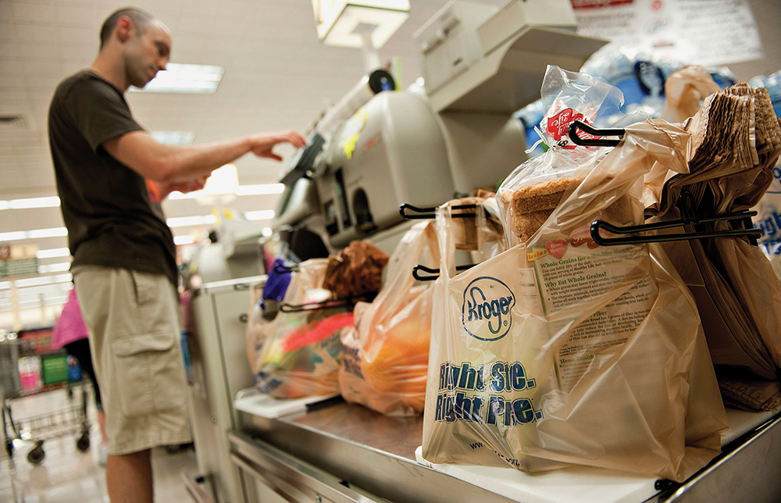
Marketing Analytics
Companies collect massive amounts of data about how, when, why, where, and what people buy.
© Daniel Acker/Bloomberg/Getty Images
Notes:
Modern marketers rely on sophisticated data analytics to define and refine their approaches to their customers and their markets. Companies such as Starbucks, CVS, Kroger, Netflix, and Amazon collect massive amounts of data about how, when, why, where, and what people buy, and then analyze those data to inform their choices.

Slide 24
Connecting With Customers Using Social and Mobile Marketing
97% of marketers use social media tools for their businesses.
4.2 billion people link to some social media sites through their mobile devices.
.
© Tanya Constantine/Getty Images RF
Notes:
Ask students: What percentage of the world’s population uses Facebook? They will probably be amazed that only 20 percent of the world’s population uses Facebook — which means 80 percent still have not signed up. There is still a huge growth potential for social networks.
Social & Mobile Marketing 1.1 What Comes Around: Marketing Today discusses how marketers keep up with consumers’ rapidly changing demands.

Slide 25
Resolving Ethical and Societal Dilemmas
Conscious Marketing
Socially Responsible
Firms
Making socially responsible activities an integral component of corporate strategies.
©Hero Images Inc./Alamy Stock Photo
Notes:
Socially responsible firms recognize that including a strong social orientation in business is a sound strategy that is in both its own and its customers’ best interest.
Ethical & Societal Dilemma 1.1: Free Fruit for Children: What Could Go Wrong?: Some grocers have set up stands to give away free fruit to children under a certain age. The idea is that a banana or apple at the start of the shopping trip can keep kids from getting hungry and cranky, thus making the shopping experience more pleasant for their parents. The fruit options are more healthful and less troublesome than other options, such as the free cookies or doughnuts that some in-store bakeries provide for young shoppers. The key complaint has been hygiene, in that there are few options for washing fruit such as apples, peaches, and pears before children bite down. Still, the generally positive responses have led at least one chain to estimate that it will give away approximately 1 million pieces of fruit over the next year.

Slide 26
PROGRESS CHECK (3 of 3)
Does providing a good value mean selling at a low price?
How are marketers connecting with customers through social and mobile media?
Notes:
Value-based marketing isn’t just about low price, it is also about creating strong products and services.
Marketers are steadily embracing new technologies, such as social and mobile media, to allow them to connect better with their customers and thereby serve their needs more effectively.

Slide 27
Glossary

Slide 28
Glossary-1
Exchange is the trade of things of value between the buyer and the seller so that each is better off as a result.
Return to slide
Notes:
Exchange is the trade of things of value between the buyer and the seller so that each is better off as a result.

Slide 29
Glossary-2
Goods are items that can be physically touched.
Return to slide
Notes:
Goods are items that can be physically touched.

Slide 30
Glossary-3
Ideas include thoughts, opinions, and philosophies; intellectual concepts such as these also can be marketed.
Return to slide
Notes:
Ideas include thoughts, opinions, and philosophies; intellectual concepts such as these also can be marketed.

Slide 31
Glossary-4
Services are intangible customer benefits that are produced by people or machines and cannot be separated from the producer.
Return to slide
Notes:
Services are intangible customer benefits that are produced by people or machines and cannot be separated from the producer.

Slide 32
Glossary-5
A supply chain is the group of firms that make and deliver a given set of goods and services.
Return to slide
Notes:
A supply chain is the group of firms that make and deliver a given set of goods and services.

Slide 33
Glossary-6
Value reflects the relationship of benefits to costs.
Return to slide
Notes:
Value reflects the relationship of benefits to costs.

Slide 34
Appendix: Image Descriptions for Unsighted Students

Slide 35
Appendix 1 Core Aspects of Marketing
Marketing helps create value.
Marketing is about satisfying customer needs and wants.
Marketing entails an exchange.
Marketing requires product, price, place, and promotion decisions.
Marketing can be performed by both individuals and organizations.
Marketing affects various stakeholders.
Return to slide

Slide 36
Appendix 2 Exchange the Underpinning of Seller-Buyer Relationships
Goods and services producers (sellers) use communications and delivery to get the products to customers and consumers (buyers). The customers purchase products with money and information, which goes back to the sellers.
Return to slide

Slide 37
Appendix 3 The Marketing Mix
The marketing mix consists of:
Product (creating value)
Price (capturing value)
Place (delivering value)
Promotion (communicating value)
Return to slide

Slide 38
Appendix 4 Marketing Can Be Performed by Individuals and Organizations
This exhibit illustrates how the same product, a desktop computer, can be sold from firm to firm, from firm to consumer, and then sold from consumer to consumer.
The manufacturer makes the monitors, which are then sold to the retailer, who sells PCs and monitors. This is a business-to-business transaction.
The retailer sells the computer to Consumer A. This is a business-to-consumer sale.
Consumer A sells the computer to Consumer B. This is a consumer-to-consumer sale.
Return to slide

Slide 39
Appendix 5 Marketing Evolution: Production, Sales, Marketing and Value
This exhibit graphically represents the changes over time from an emphasis on production to one based on value-based marketing. The different versions of the telephone are used as an example.
The production-oriented era began around the turn of the twentieth century. An early model of the telephone is used to represent this era.
The sales-oriented era was between 1920 and 1950. A rotary phone represents this era.
The market-oriented era was between 1950 and 1990. A rotary phone that looks more modern represents this era.
The value-based era began around 1990. A cordless phone represents this era. This era continues today, with an iPhone used to represent this era beyond the turn of the twenty-first century.
Return to slide

Slide 40
Appendix 6 Why Is Marketing Important?
Marketing:
Can be entrepreneurial.
Expands global presence.
Enriches society.
Is pervasive across channel members. This is accompanied by images of a factory, a Saks Fifth Avenue Store, and a woman shopping for clothing.
Return to slide

Slide 41
Appendix 7 Marketing Is Pervasive across Marketing Channel Members
Raw materials are bought by the manufacturer. The manufacturer turns these into products, which it sells to the retailer. The products are sold by the retailer to the consumer.
Return to slide

Slide 42
Marketing Chapter 1
The End

