Slide 1
8 Attitudes & Persuasive Communications
CONSUMER BEHAVIOR, 12e Michael R. Solomon
Notes:
Chapter 8 focuses on the role attitudes play in consumer behavior.

Slide 2
Chapter Objectives
It is important for consumer researchers to understand the nature and power of attitudes.
Attitudes are more complex than they first appear.
We form attitudes in several ways.

Slide 3
Chapter Objectives (Cont.)
A need to maintain consistency among all of our attitudinal components motivates us to alter one or more of them.
Attitude models identify specific components and combine them to predict a consumer’s overall attitude toward a product or brand.

Slide 4
Chapter Objectives (Cont.)
The communications model identifies several important components for marketers when they try to change consumers’ attitudes toward products and services.
The consumer who processes such a message is not necessarily the passive receiver of information marketers once believed him to be.

Slide 5
Chapter Objectives (Cont.)
Several factors influence a message source’s effectiveness.
The way a marketer structures his or her message determines how persuasive it will be.
Many modern marketers are reality engineers.

Slide 6
Chapter Objectives (Cont.)
11. Audience characteristics help to determine whether the nature of the source or the message itself will be relatively more effective.

Slide 7
Learning Objective 1
It is important for consumer researchers to understand the nature and power of attitudes.

Slide 8
The Power of Attitudes
Attitude: a lasting, general evaluation of people, objects, advertisements, or issues
Attitude object (AO): anything toward which one has an attitude
Notes:
We use the term attitude in many contexts. Attitudes are general evaluations of people, objects, or issues that tend to last. They also tend to be predictive of behavior and to endure over time. Anything toward which one has an attitude is known as an attitude object.

Slide 9
Functional Theory of Attitudes
UTILITARIAN
FUNCTION:
Relates to rewards
and punishments
VALUE-EXPRESSIVE FUNCTION:
Expresses consumer’s
values or self-concept
EGO-DEFENSIVE
FUNCTION:
Protect ourselves from external threats
or internal feelings
KNOWLEDGE
FUNCTION:
Need for order, structure,
or meaning
Notes:
Daniel Katz developed the functional theory of attitudes to explain how attitudes facilitate social behavior. This theory suggests that attitudes exist because they serve some function for the person. Two people can have an attitude toward some object for very different reasons.

Slide 10
For Reflection
Imagine that you work for the marketing department of your college or university and have segmented students into four different clusters, each representing one of the four functions identified by Katz.
Develop a marketing strategy based on each of the four functions to motivate students to stay in school and complete their degrees.

Slide 11
Learning Objective 2
Attitudes are more complex than they first appear.
Notes:
An attitude has three components:
Affect: the way a consumer feels about an attitude object
Behavior: person’s intentions to do something with regard to an attitude object
Cognition: beliefs a consumer has about an attitude object
Which comes first: knowing, feeling, or doing? It turns out that each element may lead things off depending on the situation. The hierarchies of effects show the relative impact of the three components. Each hierarchy shows a fixed sequence of steps which can occur en route to an attitude.
The standard learning hierarchy shown first assumes that a person approaches a product decision as a problem-solving process. She first forms beliefs based on knowledge, then evaluates the beliefs and forms feelings about the product. She then engages in relevant behavior.
The low-involvement hierarchy assumes the consumer initially does not have strong preferences for one brand over another and instead forms an evaluation only after she has bought the product.
The experiential hierarchy of effects says we act on our emotional reactions.

Slide 12
Hierarchies of Effects
High-involvement hierarchy
Low-involvement hierarchy
Experiential hierarchy of effects
Cognitive-affective model
Independence hypothesis
Notes:
The high-involvement hierarchy assumes that a person approaches a product decision as a problem-solving process.
The low-involvement hierarchy of effects assumes that the consumer initially doesn’t have a strong preference for one brand over another; instead, he or she acts on the basis of
limited knowledge and forms an evaluation only after he or she has bought the product.
According to the experiential hierarchy of effects, we act on the basis of our emotional reactions.
The cognitive-affective model proposes that an emotional reaction is just the last step in a series of cognitive processes that follows sensory recognition of a stimulus and retrieval of information from
memory that helps to categorize it. In contrast the independence hypothesis argues that affect and cognition are separate systems so that it’s not always necessary to have a cognition to elicit an emotional response.

Slide 13
Figure 8.1: Three Hierarchies of Effects

Slide 14
For Reflection
Share a decision you made following the three learning hierarchies:
Think Feel Do
Do Feel Think
Feel Do Think

Slide 15
Learning Objective 3
We form attitudes in several ways.

Slide 16
Attitude Commitment
INTERNALIZATION
Highest level: deep-seeded attitudes become part of consumer’s value system
IDENTIFICATION
Mid-level: attitudes formed in order to conform to another person or group
COMPLIANCE
Lowest level: consumer forms attitude because it gains rewards or avoids punishments
Notes:
Consumers vary in their commitment to an attitude. Their degree of commitment relates to their level of involvement with the attitude object. The lowest level is compliance. At the compliance level, we form an attitude because it helps us gain rewards or avoid punishment. At the identification level, we form an attitude to conform to another person’s or group’s expectations. At the highest level of involvement, called internalization, our attitudes become a deep part of our value system. At this level, attitudes are difficult to change because they are important to us.

Slide 17
For Reflection
Share a commitment you’ve made at each of the three levels of commitment:
Internalization
Identification
Compliance
Can you feel the variations in commitment for the three types? Explain.

Slide 18
Learning Objective 4
A need to maintain consistency among all of our attitudinal components often motivates us to alter one or more of them.

Slide 19
Consistency Principle
We value/seek harmony among thoughts, feelings, and behaviors
We will change components to make them consistent
Relates to the theory of cognitive dissonance – we take action to resolve dissonance when our attitudes and behaviors are inconsistent
Notes:
Our nature is to keep our attitudes and behaviors consistent. This is the basis for the principle of cognitive consistency. Further, the theory of cognitive dissonance explains that when we do have inconsistent attitudes and behaviors, we will find some way to rectify the dissonance and bring our attitudes and behaviors back into consistency.

Slide 20
Self-Perception Theory
FOOT-IN-THE-DOOR TECHNIQUE
Consumer is more likely to comply with a request if he has first agreed to comply with a smaller request
LOW-BALL TECHNIQUE
Person is asked for a small favor and is informed after agreeing to it that it will be very costly.
DOOR-IN-THE-FACE TECHNIQUE
Person is first asked to do something extreme (which he refuses), then asked to do something smaller.
Notes:
There is another explanation to the theory of cognitive dissonance. Self-perception theory assumes that we observe our own behavior to determine just what our attitudes are. We infer the attitude from our behavior. This theory helps to explain the effectiveness of sales strategies such as the foot-in-the door technique. Such sales techniques are noted in the slide.

Slide 21
Social Judgment Theory
We assimilate new information about attitude objects in light of what we already know/feel
Initial attitude = frame of reference
Latitudes of acceptance and rejection
Assimilation effects
Contrast effects
Example: “Choosy mothers choose Jif Peanut Butter”
Notes:
Social judgment theory also assumes that people assimilate new information about attitude objects in light of what they already know or feel. The initial attitude acts like a frame of reference, and we categorize new information in light of this standard. People do differ in terms of what information they find acceptable. They form what is known as latitudes of acceptance and rejection around the attitude standard. Ideas that fall within the latitude are deemed favorable but others are not. Messages that fall within the latitudes are deemed consistent even if they are not. This is known as an assimilation effect. However, those that fall outside our latitude of acceptance are rejected even if they are not that different. This is known as a contrast effect.

Slide 22
Balance Theory
Considers how a person might perceive relations among different attitude objects and how he might alter attitudes to maintain consistency.
Triad attitude structures:
Person
Perception of attitude object
Perception of other person/object
Notes:
Balance theory considers how a person perceives relations among different attitude objects, and how he alters his attitudes so that these remain consistent (or “balanced”). This perspective involves relations among three elements, so we call the resulting attitude structures triads. Each triad contains (1) a person and his perceptions of (2) an attitude object, and (3) some other person or object. The theory specifies that we want relations among elements in a triad to be harmonious. If they are unbalanced, this creates tension that we are motivated to reduce by changing our perceptions in order to restore balance.

Slide 23
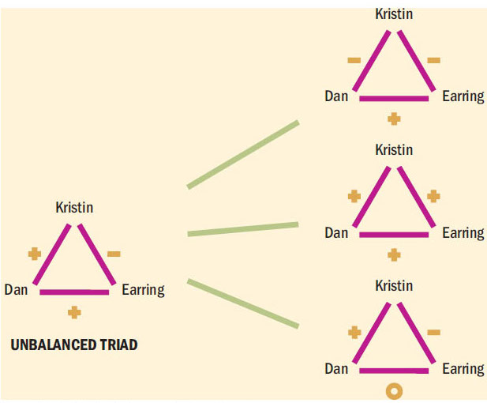
Self-PerceptionTheory
Figure 8.2 Balance Theory
Notes:
To see how balance theory works, consider this scenario. Alex wants to date Larry; Alex has positive sentiment toward Larry.
Larry wears an earring; Larry has positive attitude toward earring. Alex doesn’t like men who wear earrings and has negative sentiment toward earrings. Alex will now feel pressure to restore balance by altering the triad. She can decide she doesn’t like Larry or that she really does like earrings on men. She might try to negate the relationship between Larry and the earring. The theory doesn’t say what specific route Alex will take but it does explain that she will do something to restore balance.

Slide 24
For Reflection
Interview a student next to you about a behavior that he or she has that is inconsistent with his or her attitudes (e.g., attitudes toward healthy eating or active lifestyle, attitudes toward materialism, etc.)
Ask the student to elaborate on why he or she has the behavior, then try to identify the way the person has resolved dissonant elements.

Slide 25
Learning Objective 5
Attitude models identify specific components and combine them to predict a consumer’s overall attitude toward a product or brand.
Notes:
This type of model assumes that a consumer’s attitude toward an attitude object depends on the beliefs that she has about several of its attributes. The three elements that make up multiattribute models are attributes, beliefs, and important weights. The attributes are used to evaluate the attitude object. The beliefs refer to the assessment of whether the brand has specific attributes. Importance weights reflect the relative priority of an attribute to the consumer.

Slide 26
A Multiattribute Attitude Model: The Fishbein Model
Salient Beliefs
Object-Attribute Linkages
Evaluation
Notes:
Multiattribute attitude models assume that consumers’ attitude toward an attitude object (Ao) depends on the beliefs they have about several of its attributes
The Fishbein model, developed by Martin Fishbein, is the most influential of multiattribute models. The model measures three components of attitudes: 1) salient beliefs, 2) object-attribute linkages, and 3) evaluation of each of the important attributes. Using these components, we can compute a consumer’s overall attitude toward an object.
Salient Beliefs – beliefs about the object a person considers during evaluation.
Object- Attribute- probability that a particular object has an important attribute
Evaluation- evaluate each important attribute.

Slide 27
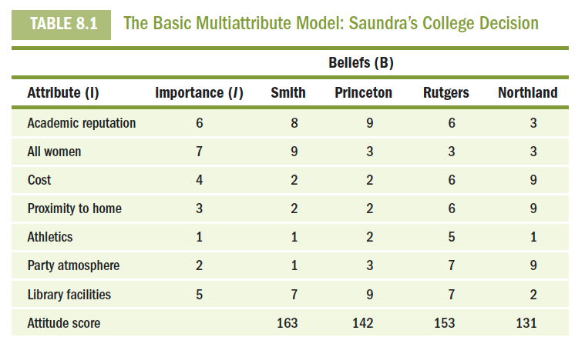
Marketing Applications of the Multiattribute Model
Notes:
Table 8.1 illustrates a multiattribute model of the hypothetical ratings that we can develop by summing scores on each attribute after weighting each by its relative importance. Based on this example, we can see that Saundra has the best view of Smith as a college choice.

Slide 28
Marketing Applications of the Multiattribute Model
Capitalize on Relative Advantage
Strengthen Perceived Linkages
Add a New Attribute
Influence Competitor’s Ratings
Notes:
If prospective customers viewed one brand as superior, a marketer could try to convince the consumer that a particular attribute is important. A marketer might discover that consumers do not equate his brand with a certain attribute; a communications campaign can be used to strengthen the linkage. Marketers can encourage consumers to add a new attribute when new features are developed for products. Finally, one can decrease the competitors’ higher ratings with comparative advertising.

Slide 29
The Extended Fishbein Model: The Theory of Reasoned Action
Intentions versus behavior: measure behavioral intentions, not just intentions
Social pressure: acknowledge the power of other people in purchasing decision
Attitude toward buying: measure attitude toward the act of buying, not just the product
Notes:
To improve Fishbein’s model a new version called the theory of reasoned action was developed. It contains several additions to the original to improve its ability to predict behavior. First, the theory of reasoned action aims to measure behavioral intentions. Second, it recognizes the power of other people to influence what we do. Third, it measures attitude toward the act of buying rather than just attitude toward the product. This means that it considers the consequences of purchase.
Even with these improvements, there are still obstacles to predicting behavior using the model.

Slide 30
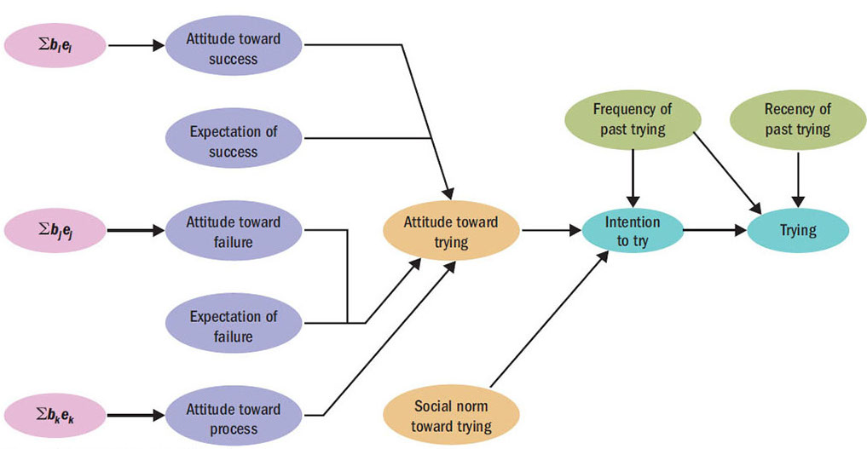
Figure 8.3 Theory of Trying
Notes:
The theory of trying states that we should replace the criterion of behavior in the reasoned action model with trying to reach a goal. As the figure shows, this perspective recognizes that additional factors might intervene between intent and performance.

Slide 31
How Do Marketers Change Attitudes?
Reciprocity
Scarcity
Authority
Consistency
Liking
Consensus
Notes:
Marketers try to persuade consumers and these persuasion attempts are based on basic psychological principles. There are six approaches to persuasion, as shown in the slide.
Reciprocity means that we are more likely to give if we first receive.
Scarcity means that people tend to find things that are not readily available more desirable.
Authority means that we tend to believe authoritative sources.
Consistency means that we try not to contradict what we’ve said before.
Liking means that we will agree with those we like or admire.
Consensus means that we will consider what others do before we decide what to do.

Slide 32
For Reflection
Can you think of a time that you were persuaded by marketing? Which of the persuasion tactics were used and in what way?

Slide 33
Learning Objective 6
The communications model identifies several important components for marketers when they try to change consumers’ attitudes toward products and services.
Notes:
Marketers traditionally rely on the communications model shown on the next slide. The model shows the elements we must control in order to communicate with our customers.

Slide 34
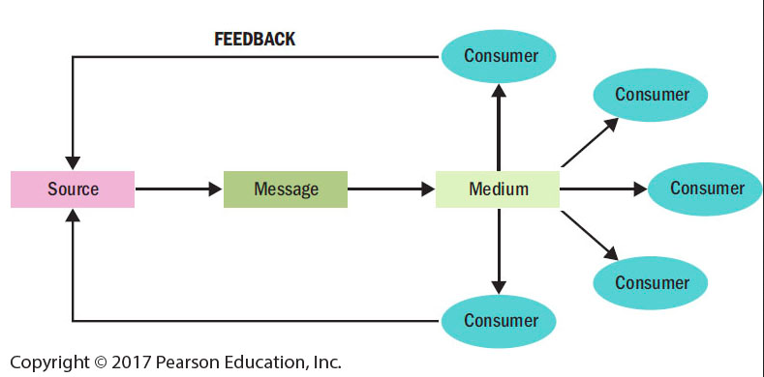
An Updated View: Interactive Communications
Figure 8.4 The Traditional Communications Model
Notes:
The figure illustrates the communications model. The elements of the model include the source, the message, and the method of transmitting the message. Social scientists developed this model to understand mass communications in which a source transmits information to many receivers at one time. This model doesn’t work as well in some situations like those encompassing social media.

Slide 35
For Reflection
In what kinds of situations would the traditional communications model work less effectively?

Slide 36
Learning Objective 7
The consumer who processes a message is not necessarily the passive receiver of information marketers once believed him or her to be.

Slide 37
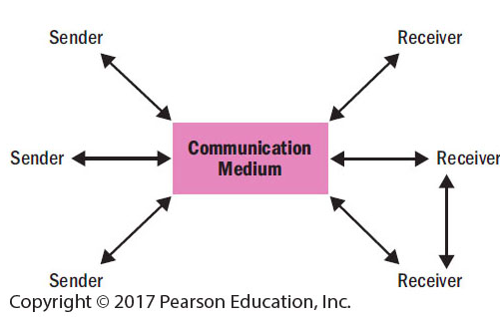
Figure 8.5 Updated Communications Model
Notes:
Figure 8.5 shows an updated model which accounts for the new developments like social media that now affect the communications process.

Slide 38
New Message Formats
M-commerce - marketers promote goods and services via wireless devices.
New social media platforms:
Blogs and video blogs
Podcasts
Twitter
Virtual worlds
Widgets
Notes:
The revised communications model accounts for many new forms of messages that have arisen as social media has developed.

Slide 39
For Reflection
To what extent have mobile messages changed your behavior as a buyer? Have you acted on a mobile coupon or message?

Slide 40
Learning Objective 8
Several factors influence the effectiveness of a message source.
Notes:
The source is the perceived source of the message. It may be perceived as the person or people shown in the ad. Credibility and attractiveness are desirable source components. Source attractiveness refers to the perceived social value the message receivers associate with the source. It is related to appearance, personality, social status, and similarity to the receiver. Celebrities increase awareness of a firm’s advertising and enhance company image. A celebrity endorsement can be a way to differentiate among products.

Slide 41
The Source
Source credibility
Disclaimers
Sleeper effect
Native advertising
Knowledge bias
Reporting bias
Source attractiveness
Shared endorsements
Halo effect
Spokecharacters
Notes:
Source credibility refers to a communicator’s expertise, objectivity, or trustworthiness.
Disclaimers typically happen at the end of a commercial message that supply additional information the advertiser is required to provide.
The Sleeper effect is when after a while, people appear to “forget” about the negative source and change their attitudes anyway.
Native advertising refers to digital messages designed to blend into the editorial content of the publications in which they appear.
Knowledge bias implies that a source’s knowledge about a topic is not accurate.
Reporting bias occurs when a source has the required knowledge but we question his or her willingness to convey it accurately—as when a racket manufacturer pays a star tennis player to use its products exclusively.
Source attractiveness refers to the social value recipients attribute to a communicator.
Shared endorsements; users who follow or rate a product or service may find that their endorsements show up on the advertiser’s page.
Halo effect occurs when we assume that persons who rank high on one dimension excel on others as well.

Slide 42
For Reflection
Think of a celebrity endorser that you find to lack persuasive ability.
What is it about the person, product, or endorser-product fit that fails to persuade you?

Slide 43
Learning Objective 9
The way a marketer structures his or her message determines how persuasive it will be.

Slide 44
Decisions to Make About the Message
Should we use pictures or words?
How often should message be repeated?
Should it draw an explicit conclusion?
Should it show both sides of argument?
Should it explicitly compare product to competitors?
Should it arouse emotions?
Should it be concrete or based on imagery?
Notes:
There are so many decisions to make about how we say what it is that we want to say. The questions listed are some of the decisions marketers must make about messages.

Slide 45
The Message
Characteristics of Good and Bad Messages
Positive Effects | Negative Effects
Showing convenience of use | Extensive information on components, ingredients, nutrition
Showing new product/improved features | Outdoor setting (message gets lost)
Casting background (i.e., people are incidental to message) | Large number of onscreen characters
Indirect comparison to other products | Graphic displays
Notes:
Messages may have good and/or bad characteristics. To be effective, messages shouldn’t cover too much information or distract the receiver.

Slide 46
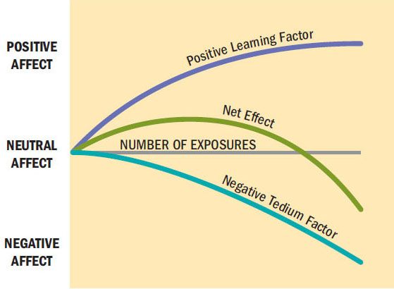
Repeating the Message
Figure 8.6 Two -Factor Theory of Message Repetition
Notes:
The two-factor theory explains the fine line between familiarity and boredom. It proposes that separate psychological processes operate when we repeatedly show an ad to a viewer. The positive side of repetition is that it increases familiarity and reduces uncertainty about the product. The negative side is that boredom increases with each exposure. At some point, the boredom is greater than the amount of reduced uncertainty and then wear-out begins. The figure depicts this relationship.

Slide 47
How Do We Structure Arguments?
One-sided: supportive arguments
Two-sided: both positive and negative information
Refutational argument: negative issue is raised, then dismissed
Positive attributes should refute presented negative attributes
Effective with well-educated and not-yet-loyal audiences

Slide 48
Comparative Advertising
Comparative advertising: message compares two+ recognizable brands on specific attributes.
“Unlike McDonalds, all of Arby's chicken sandwiches are made with 100% all-natural chicken”
Negative outcomes include source derogation
Notes:
Comparative advertising enables a brand to compare itself to another on specific attributes. However, it can result in a negative outcome. Consumers may doubt credibility.

Slide 49
New Message Formats
Martyrdom effect
M-commerce
Transmedia storytelling
Reality engineering
Guerrilla marketing

Slide 50
Product Placement and Branded Entertainment
Insertion of specific products and use of brand names in movie/TV scripts
Directors incorporate branded props for realism
Is product placement a positive or negative when it comes to consumer decision-making?
Notes:
The use of branded products in film is an old practice but it has renewed attention as brands pay large sums to be included in popular programming. Sometimes the product placement is free because the director wants to use the branded prop for realism. Other times, the placement comes with a fee. The practice is called branded entertainment sometimes because the brands may sponsor the program (like American Idol). Some researchers claim that product placement helps consumers to make decisions because consumers are then familiar with the brands when they shop. However, others say that placements can be a negative influence on consumer decisions if they are not congruent with the plot. In other words, the placement has to make sense in the minds of consumers in order to be effective.

Slide 51
Advergaming
Advergaming refers to online games merged with interactive advertisements
Advertisers gain many benefits with advergames
Plinking is the act of embedding a product in a video
Notes:
Many brands have used advergaming including Axe, Burger King, and Mini Cooper. The games keep the attention of players longer than typical advertising. They let marketers target specific types of consumers. Marketers can tailor the nature of the game and the products in it to the profiles of different users. The format gives advertisers a great deal of flexibility. Lastly, the games enable marketers to track exposure to advertising in the games.

Slide 52
Types of Message Appeals
Emotional versus Rational Appeals
Sex Appeals
Humorous Appeals
Fear Appeals
Notes:
The types of message appeals that we may use to communicate are listed in the slide. Whether to use emotion or rational argument depends on the situation. It may depend on the nature of the product and the relationship consumers have with the product. Sex appeals can be good for getting attention but also come with risks. Humor is also a good choice for gaining attention but one has to be careful that the humor does not overwhelm the primary message. Fear appears emphasize the negative consequences that can occur unless the consumer changes a behavior or an attitude.
Advertisers use literary elements to communicate benefits and meaning
Allegory: story about an abstract concept personified in a fictional character
Metaphor: two dissimilar objects in a close relationship (“A is B”)
Simile: compares two objects (“A is like B”)
Resonance: play on words with pictures

Slide 53
For Reflection
Old Spice used a sex/humor appeal in its campaign, The Man Your Man Could Smell Like.
What benefits were communicated in the ad?
Is the message implicit or explicit? Explain.

Slide 54
Learning Objective 10
Many modern marketers are reality engineers.

Slide 55
Learning Objective 11
Audience characteristics help to determine whether the nature of the source or the message itself will be relatively more effective.

Slide 56
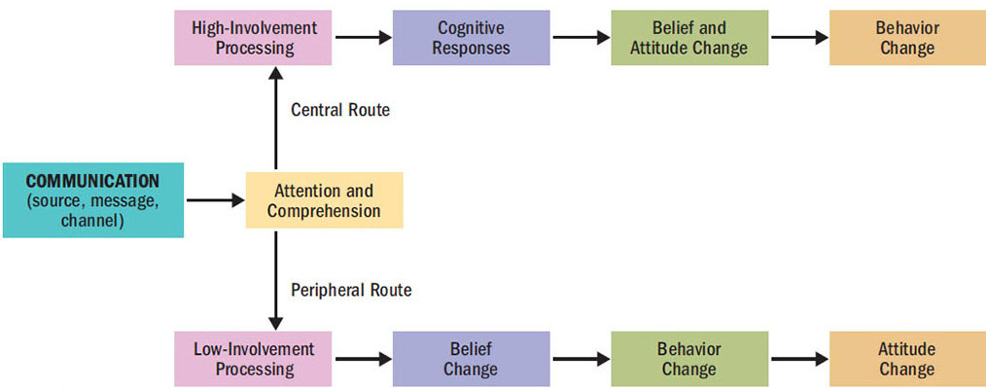
ELM
Figure 8.7 The Elaboration Likelihood Model (ELM) of Persuasion
Notes:
The elaboration likelihood model, known as the ELM, assumes that under conditions of high involvement, we will take the central route to persuasion, but under conditions of low involvement, we will take a peripheral route. The central route is focused on the consumer’s cognitive response to the message. The peripheral route focuses on other cues to decide how to react to the message.

Slide 57
For Reflection
As people become more accustomed to short messages like “tweets,” will we be less likely to elaborate on communications? Explain.

Slide 58
Chapter Summary
Attitudes are very powerful, and they are formed in several ways.
People try to maintain consistency among their attitudinal components and their attitudes and behaviors.
The communications model includes several important components which can be influenced by marketers to enhance the persuasiveness of the message.

Slide 59
Chapter Summary
The communications model identifies several important components for marketers when they try to change consumers’ attitudes toward products and services.
The consumer who processes such a message is not necessarily the passive receiver of information marketers once believed him to be.

Slide 60
Chapter Summary
Several factors influence a message source’s effectiveness.
The way a marketer structures his message determines how persuasive it will be.
Audience characteristics help to determine whether the nature of the source or the message itself will be relatively more effective.

