Slide 1
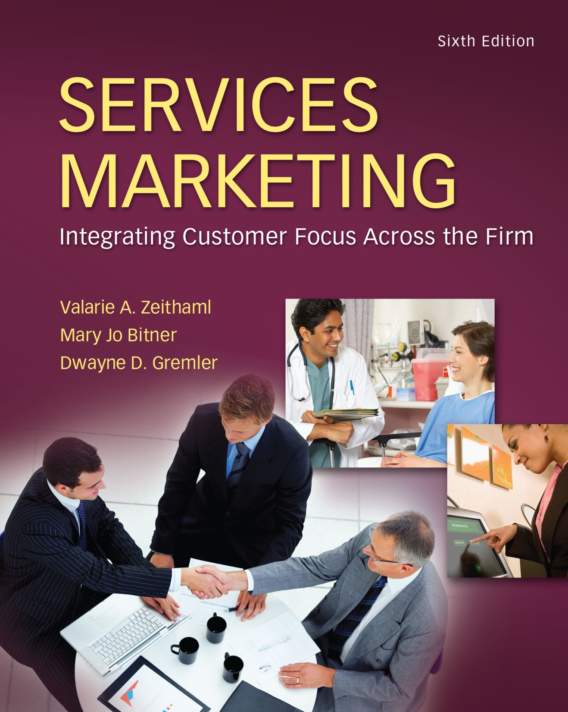
McGraw-Hill/Irwin
Copyright © 2013 by The McGraw-Hill Companies, Inc. All rights reserved.

Slide 2
Part 5
DELIVERING AND PERFORMING SERVICE
11-2

Slide 3
Provider Gap 3
CUSTOMER
COMPANY
Service delivery
Gap 3: The Service Performance Gap
Customer-driven
service designs and standards
11-3

Slide 4
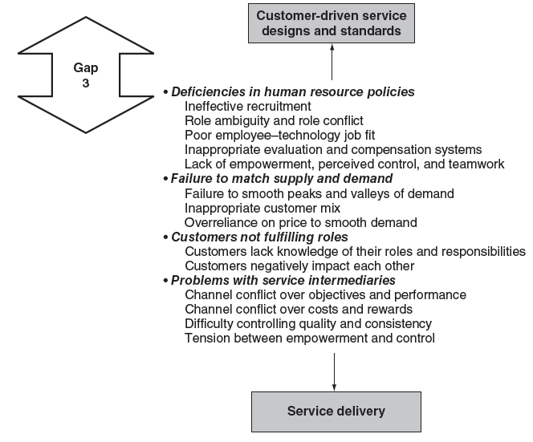
Key Factors Leading to Provider Gap 3
11-4

Slide 5
Employees’ Roles in Service
Delivery
Chapter
11
Service Culture
The Critical Importance of Service Employees
Boundary-Spanning Roles
Strategies for Delivering Service Quality Through People
Customer-Oriented Service Delivery
11-5

Slide 6
Objectives for Chapter 11:
Employees’ Roles in Service Delivery
Demonstrate the importance of creating a service culture in which providing excellent service to both internal and external customers is a way of life.
Illustrate the pivotal role of service employees in creating customer satisfaction and service quality.
Identify the challenges inherent in boundary-spanning roles.
Provide examples of strategies for creating customer-oriented service delivery through hiring the right people, developing employees to deliver service quality, providing needed support systems, and retaining the best service employees.
11-6

Slide 7
Service Culture
“A culture where an appreciation for good service exists, and where giving good service to internal as well as ultimate, external customers, is considered a natural way of life and one of the most important norms by everyone in the organization.”
- Christian Grönroos
11-7

Slide 8
The Critical Importance of Service Employees
They are the service.
They are the organization in the customer’s eyes.
They are the brand.
They are marketers.
Their importance is evident in:
  the services marketing mix (people)
  the service-profit chain
  the services triangle
11-8
Notes:
They are the service.
in many cases, the contact employee is the service
- we often DO NOT DISTINGUISH between the person and the firm
(haircutting, child care, counseling, legal services)
in these cases, the offering is the employee
- other examples?
They are the organization in the customer’s eyes.
employees represent the firm to the client
may be the ONLY contact they have with the firm
e.g., Dixon Pest Control
everything they say and do can influence perceptions of the organization
even “off-duty” employees can influence perceptions
They are marketers.
they are walking “billboards”
they represent the company and influence customer satisfaction
they are salespersons
(waiters selling dessert; AT&T operators cross-selling)

Slide 9
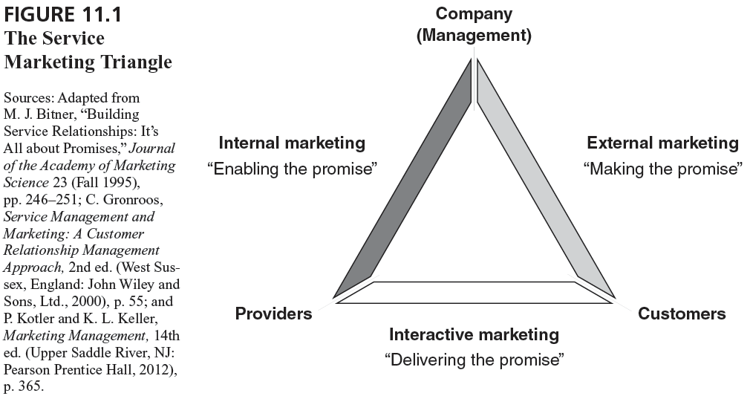
The Service Marketing Triangle
11-9

Slide 10
The Service Marketing Triangle
Company
(Management)
Internal Marketing
External Marketing
“Enabling the promise”
“Making the promise”
Providers
Customers
Interactive Marketing
“Delivering the promise”
11-10
Source: Adapted from Mary Jo Bitner, Christian Gronroos, and Philip Kotler

Slide 11
Aligning the Triangle
Organizations that seek to provide consistently high levels of service excellence will continuously work to align the three sides of the triangle.
Aligning the sides of the triangle is an ongoing process.
11-11

Slide 12
Services Marketing Triangle
Applications Exercise
Focus on a service organization. In the context you are focusing on, who occupies each of the three points of the triangle?
How is each type of marketing being carried out currently?
Are the three sides of the triangle well aligned?
Are there specific challenges or barriers in any of the three areas?
11-12

Slide 13
Making Promises
Understanding customer needs
Managing expectations
Traditional marketing communications
Sales and promotion
Advertising
Internet and web site communication
11-13

Slide 14
Keeping Promises
Service delivery
  Reliability, responsiveness, empathy, assurance, tangibles, recovery, flexibility
Face-to-face, telephone & online interactions
The Customer Experience
Customer interactions with sub-contractors or business partners
The “moment of truth”
11-14

Slide 15
Enabling Promises
Hiring the right people
Training and developing people to deliver service
Employee empowerment
Support systems
Appropriate technology and equipment
Rewards and incentives
11-15

Slide 16
Ways to Use the
Services Marketing Triangle
Overall Strategic Assessment
  How is the service organization doing on all three sides of the triangle?
  Where are the weaknesses?
  What are the strengths?
Specific Service Implementation
  What is being promoted and by whom?
  How will it be delivered and by whom?
  Are the supporting systems in place to deliver the promised service?
11-16

Slide 17
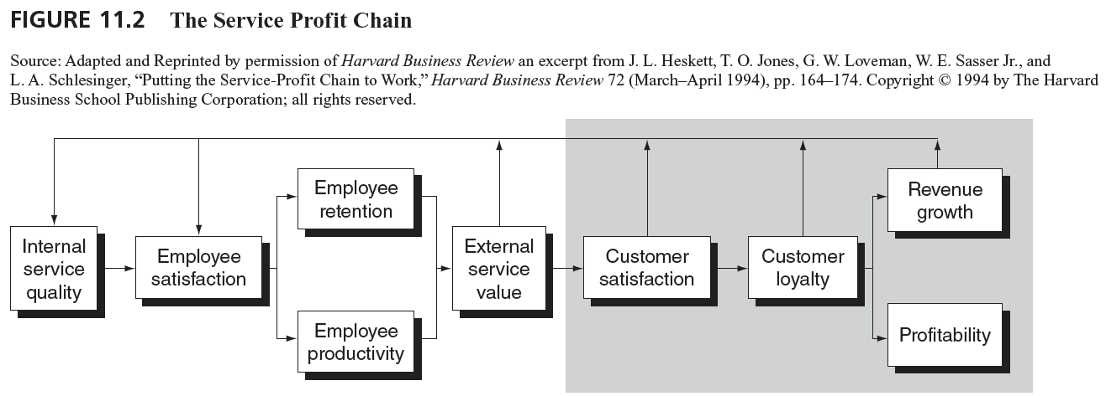
The Service Profit Chain
11-17

Slide 18
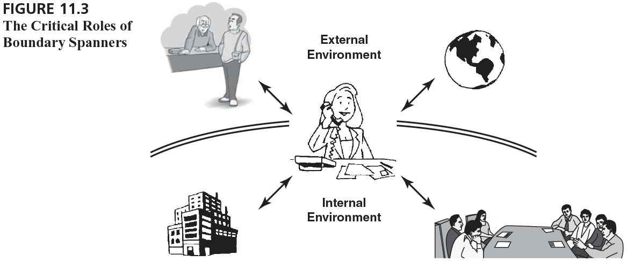
Boundary Spanners Interact with Both Internal and External Constituents
11-18

Slide 19
Boundary-spanning Roles
Boundary spanners:
  Provide a critical link between the external customer environment and the internal operations of the organization
  Serve a critical function in understanding, filtering, interpreting information and resources to and from the organization and its external constituencies
  High stress!!!
11-19

Slide 20
Boundary-spanning Roles
What are these jobs like?
  Emotional labor
    The labor that goes beyond the physical or mental skills needed to deliver quality service.
    Often requires suppression of true feelings
  Many sources of potential conflict
    person/role
    organization/client
    interclient
  Quality/productivity tradeoffs
11-20

Slide 21
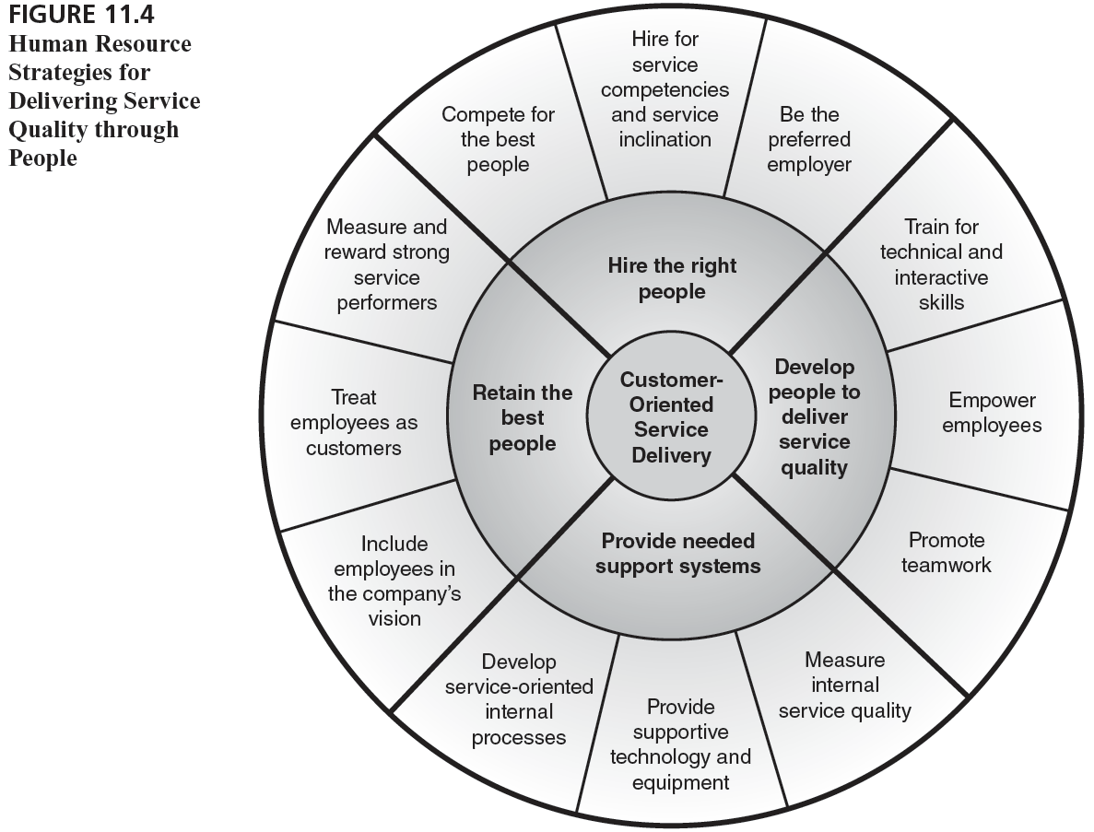
Strategies for Delivering Service Quality through People
11-21

Slide 22
Strategies for Delivering Service Quality through People
Hire the right people
    Compete for the best people
    Hire for service competencies and service inclination
    Be the preferred employer
Develop people to deliver service quality
    Train for technical and interactive skills
    Empower employees
    Promote teamwork
11-22

Slide 23
Benefits and Costs of Empowerment
Benefits:
  Quicker responses to customer needs during service delivery
  Quicker responses to dissatisfied customers during service recovery
  Employees feel better about their jobs and themselves
  Employees tend to interact with warmth/enthusiasm
  Empowered employees are a great source of ideas
  Great word-of-mouth advertising from customers
Costs:
  Potentially greater dollar investment in selection and training
  Higher labor costs
  Potentially slower or inconsistent service delivery
  May violate customers’ perceptions of fair play
  Employees may “give away the store” or make bad decisions
11-23

Slide 24
Strategies for Delivering Service Quality through People (continued)
Provide needed support systems
    Measure internal service quality
    Provide supportive technology and equipment
    Develop service-oriented internal processes
Retain the best people
    Include employees in the company’s vision
    Treat employees as customers
    Measure and reward strong service performers
11-24

Slide 25
Traditional Organizational Chart
Manager
Supervisor
Supervisor
Front-line
Employee
Front-line
Employee
Front-line
Employee
Front-line
Employee
Front-line
Employee
Front-line
Employee
Front-line
Employee
Front-line
Employee
Customers
11-25

Slide 26
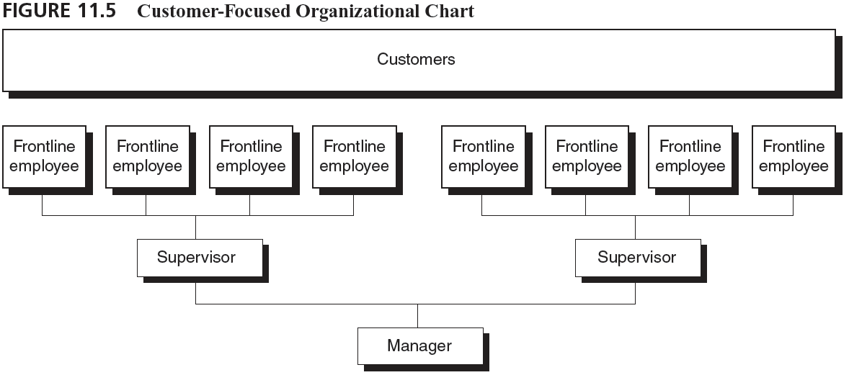
Customer-Focused Organizational Chart
11-26

Slide 27
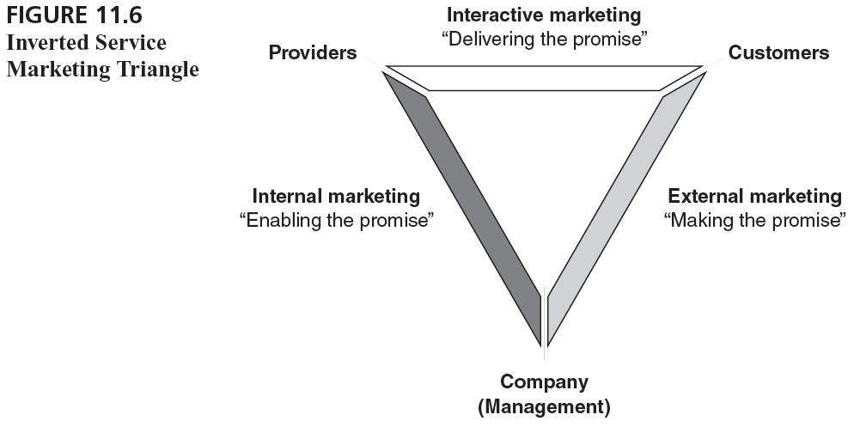
Inverted Services Marketing Triangle
11-27

