Slide 1
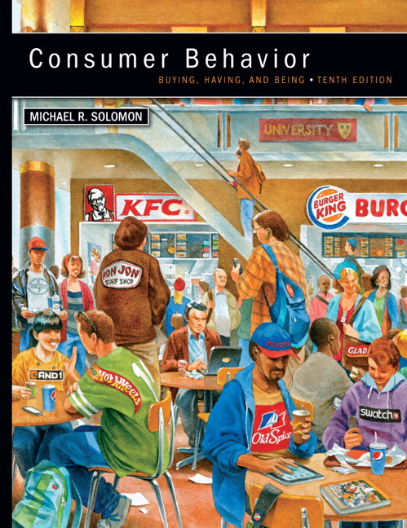
Chapter 13 Subcultures
CONSUMER BEHAVIOR, 10e Michael R. Solomon
Notes:
Chapter 13 explains how some subcultures affect us as consumers – especially ethnic affiliations and age.

Slide 2
Chapter Objectives
When you finish this chapter, you should understand why:
Our identification with microcultures that reflect a shared interest in some organization or activity influences what we buy.
Our memberships in ethnic, racial, and religious subcultures often play a big role in guiding our consumption behaviors.

Slide 3
Chapter Objectives (continued)
Many marketing messages appeal to ethnic and racial identity.
African Americans, Hispanic Americans, and Asian Americans are the three most important ethnic/racial subcultures in the United States.
Marketers increasingly use religious and spiritual themes when they talk to consumers.

Slide 4
Chapter Objectives (continued)
We have many things in common with others because they are about the same age.
Teens are an important age segment for marketers.
Baby Boomers continue to be the most powerful age segment economically.
Seniors continue to increase in importance as a market segment.

Slide 5
Learning Objective 1
Our identification with microcultures that reflect a shared interest in some organization or activity influences what we buy.
Notes:
The United States is truly a melting pot. Our affiliations with ethnic groups contribute to much of our behavior as consumers.

Slide 6
Subcultures, Microcultures, and Consumer Identity
Consumers’ lifestyles are affected by group membership within the society-at-large
Subcultures of age, race/ethnicity, place of residence
Microcultures share a strong identification with an activity or art form
Have own unique set of norms, vocabulary, and product insignias
Notes:
Our group memberships within our society-at-large help to define us. A subculture is a group whose members share beliefs and common experiences that set them apart from others. We all belong to many subcultures, depending on our age, race, ethnic background, and place of residence.
People who are part of a microculture freely identify with a lifestyle or aesthetic preference. Microcultures exhibit their own unique set of norms, vocabulary, and product insignias. Microcultures can even gel around fictional characters and events and play a role in defining the extended self.

Slide 7
For Reflection
Identify some of the subcultures to which you belong. How do you identify with these subcultures?

Slide 8
Learning Objective 2
Our memberships in ethnic, racial, and religious subcultures often guide our consumption behaviors.

Slide 9
Ethnic and Racial Subcultures
An ethnic subculture is a self-perpetuating group of consumers who share common cultural or genetic ties where both its members and others recognize it as a distinct category.
In countries like Japan, ethnicity is synonymous with the dominant culture because most citizens claim the same cultural ties.
Notes:
Ethnicity matters when it comes to marketing, whether in a single country or for brands operating globally. For instance, McDonald’s has tailored its menu in different parts of the US and the world to meet the needs of ethnic subcultures.

Slide 10
The Context of Culture
High-Context
Low-Context
Notes:
An important subcultural difference is how abstract or literal a group is. Sociologists make a distinction between high-context cultures and low-context cultures. In a high-context culture, group members are tightly knit and they infer meanings that go beyond the spoken word. Symbols and gestures are used instead of words to carry the weight of the message. In contrast, people in a low-context culture are more literal. Compared to Anglos, many minority cultures are high-context and have strong oral traditions. This means that consumers are more sensitive to nuances in advertising.

Slide 11
For Reflection
Do you think social media influence cultures to operate in a more high-context or low-context manner? Explain.

Slide 12
Learning Objective 3
Many marketing messages appeal to ethnic and racial identity.
Notes:
Some people feel uncomfortable with the notion that marketers should explicitly take into account people’s racial and ethnic differences when they formulate strategies. Still, we must because ethnicity affects consumers’ behaviors.

Slide 13
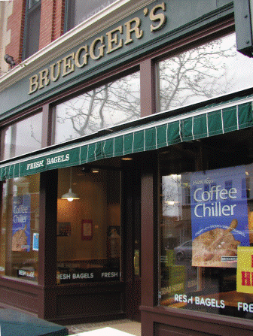
Is Ethnicity a Moving Target?
Defining/targeting an ethnic group is not always so easy (“melting pot” society)
Deethnicization occurs when a product we associate with a specific ethnic group detaches itself from its roots and appeals to other groups as well
Notes:
Targeting using such characteristics can be challenging. It’s not always easy to define members of a distinct group and in our society, many people are members of multiple groups.
Products that companies market for one ethnic group sometimes gain appeal with others outside the subculture. This is known as deethnicization. There are many food products that are examples of deethnicization, such as bagels.

Slide 14
What is Acculturation?
Acculturation occurs, at least in part, with the influence of acculturation agents
Family
Friends
Church organizations
Media
Notes:
Acculturation is the process of movement and adaptation to one country’s cultural environment by a person from another country. Acculturation agents are the influences in our environment which affect the process of transitioning from one culture to another that contains components of both the old and new culture. These agents are family and friends, as well as organizations like churches, and even the media. The agents may be from the culture of origin or from the culture of immigration.

Slide 15
The Progressive Learning Model
Assumes that people gradually learn a new culture as they increasingly come into contact with it
When people acculturate they will blend their original culture and the new one
Consumers who retain much of their original ethnic identity differ from those who assimilate

Slide 16
For Reflection
Identify products which have been deethnicized. How should these products be marketed now?

Slide 17
Learning Objective 4
African Americans, Hispanic Americans, and Asian Americans are the three most important ethnic/racial subcultures in the United States.
Notes:
We refer to these three groups as “The Big Three.”

Slide 18
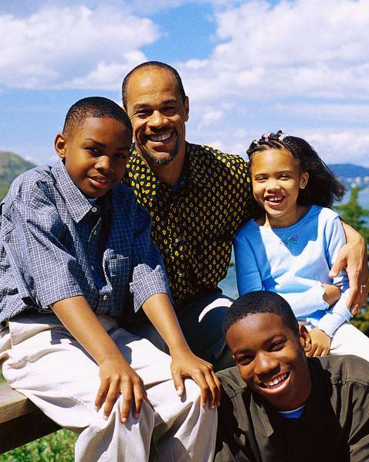
African Americans
Overall spending patterns of blacks and whites are roughly similar
Household income and educational levels rising for African Americans
Differences in consumption behaviors subtle but important
Notes:
African Americans represent a significant racial subculture, making up about 12.3% of the U.S. population in the last census. Although African Americans differ in some important ways, they may not be very different from white consumers. With a few exceptions, both groups have the same overall spending patterns. They allocate about two-thirds of their incomes to housing, transportation, and food.

Slide 19
Hispanic Americans
“Hispanic” = many different backgrounds
Hispanics are:
Brand loyal
Highly concentrated geographically by country of origin (easy to reach)
Notes:
Hispanic is an umbrella term that describes people of many different backgrounds. About 60% are from Mexico with the next largest group (from Puerto Rico) making up less than 10%. The phrase, Hispanic, also captures Central Americans, Dominicans, South Americans, and Cubans. The segment is relatively easy to find with more than 50% living in the major metropolitan areas of Los Angeles, New York, Miami, San Antonio, San Francisco, and Chicago. However, among many Hispanics, there is a relatively low level of acculturation.

Slide 20
Distinguishing Characteristics of the Hispanic Market
Looking for spirituality, stronger family ties, and more color in their lives
Large family size of Hispanic market
Spend more on groceries
Shopping is a family affair
Regard clothing children well as matter of pride
Convenience/saving time is not important to Hispanic homemaker
Notes:
As this slide shows, Hispanic Americans differ substantially from Anglo consumers.

Slide 21
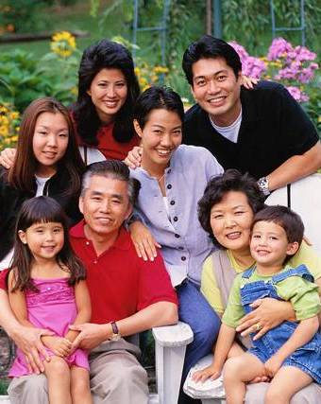
Asian Americans
Most affluent, best educated
Most brand-conscious but least brand loyal
Made up of culturally diverse subgroups that speak many different languages/dialects
Notes:
This slide reveals many of the distinguishing characteristics of Asian Americans. This group has a great deal of marketing potential but it is also difficult to target. This is because it is made up of many culturally diverse subgroups that use different languages and dialects. The term Asian refers to 20 ethnic groups.

Slide 22
For Reflection
Though the “Big Three” are attractive segments for marketers to reach, why might they be difficult to approach?

Slide 23
Learning Objective 5
Marketers increasingly use religious and spiritual themes when they talk to consumers.
Notes:
Marketers once avoided religious references but this is changing. Still, marketers have not extensively studied religious influences on consumer behavior.

Slide 24
Religion and Consumption
Organized religion and product choices
Born-again consumers
Islamic marketing
Notes:
Religious subcultures have an impact on consumer variables such as personality, attitudes toward sexuality, birthrates and household formation, income, and political attitudes. Church leaders may encourage or discourage consumption of some products.
Even churches themselves are being marketed. For instance, megachurches actively market themselves to individuals who are born again and/or seeking a different sense of worship.
Importantly, muslims will be more than 25% of the Earth’s population by 2030. Marketing to muslims will require a special attentiveness to religious influences.

Slide 25
For Reflection
Should members of a religious group adapt marketing techniques that manufacturers customarily use to increase market share for their products? Why or why not?

Slide 26
Learning Objective 6
We have many things in common with others because they are about the same age.
Notes:
Our age is a big part of our identity. We are more likely to have things in common with people close to our age. An age cohort consists of people of similar ages who have similar experiences. They share many common memories about cultural heroes, important historical events, and so on.

Slide 27
Generational Categories
The Interbellum Generation
The Silent Generation
The War Baby Generation
The Baby Boom Generation
Generation X
Generation Y
Generation Z
Notes:
Although there is a general consensus on how analysts describe age cohorts, the exact labels and cutoff dates do vary. These are some approximations for the primary categories.
The Interbellum generation describes those who are born at the beginning of the 20th century. The Silent Generation describes those who were born between the two World Wars. The War Baby Generation was born during World War II. The Baby Boom Generation was born between 1946 and 1964. Generation X was born between 1965 and 1985. Generation Y was born between 1986 and 2002. Generation Z was born 2003 and later.

Slide 28
Table 13.1 Nostalgia Scale
Scale Items
They don’t make ‘em like they used to.
Things used to be better in the good old days.
Products are getting shoddier and shoddier.
Technological change will ensure a brighter future (reverse coded).
History involves a steady improvement in human welfare (reverse coded).
We are experiencing a decline in the quality of life.
Steady growth in GNP has brought increased human happiness (reverse coded).
Modern business constantly builds a better tomorrow (reverse coded).
Notes:
Because consumers within an age group confront crucial life changes at roughly the same time, the values and symbolism marketers use to appeal to them can evoke powerful feelings of nostalgia. The table shown in the slide is a scale researchers use to measure the impact of nostalgia on individual consumers.

Slide 29
For Reflection
What are some possible marketing opportunities present at reunions?
What effects might attending such an event have on consumers’ self-esteem, body image, and so on?

Slide 30
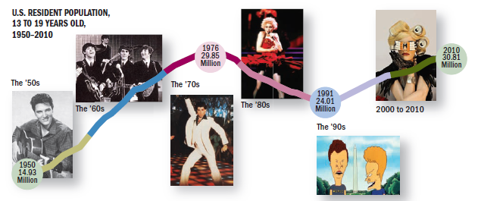
Learning Objective 7
Teens are an important age segment for marketers.
Notes:
The global youth market is massive. It represents about $100 billion in spending power.

Slide 31
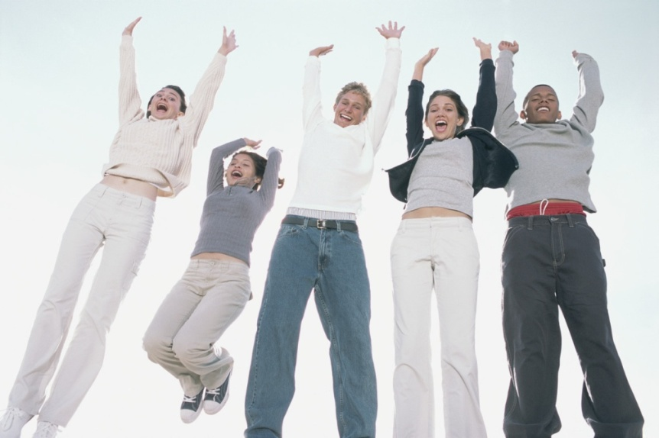
The Youth Market
“Teenage” first used to describe youth generation in 1950s
Youth market often represents rebellion
$100 billion in spending power
Notes:
In 1956, the label teenage entered the generational American vocabulary with Frankie Lymon and the Teenagers became the first pop group to identify themselves with this new subculture. Throughout most of history, a person simply shifted from child to adult without the ritual we have today. The youth market globally is massive. It represents about $100 billion in spending power and much of this money goes to feel-good products like cosmetics and fast food.

Slide 32
Teen Values, Conflicts, and Desires
Four basic conflicts common among all teens:
Autonomy versus belonging
Rebellion versus conformity
Idealism versus pragmatism
Narcissism versus intimacy
Notes:
Teenagers in every culture grapple with fundamental developmental issues when they transition from childhood to adult. Throughout history young people have coped with insecurity, parental authority, and peer pressure. The Saatchi & Saatchi advertising agency identified four basic conflicts common to all teens. These are listed on the slide and described here.
Autonomy versus belonging means that teens want to acquire independence so they try to break away from their families. But at the same time, they want to attach themselves to a support structure. Rebellion versus conformity grasps that teens need to rebel against social standards of appearance and behavior but they need to fit in and be accepted by others. Idealism versus pragmatism means that they tend to view adults as hypocrites whereas they see themselves as sincere. Narcissism versus intimacy means that they tend to obsess about their appearance and needs. However, they also feel the desire to connect with each other.

Slide 33
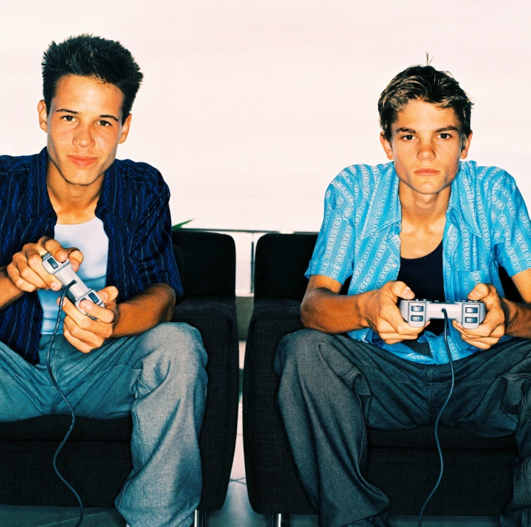
Getting to Know Gen Y
“Echo Boomers” = “millennials” = Gen Yers
Make up one-third of U.S. population
Spend $170 billion a year
First to grow up with computers in their homes, in a 500-channel TV universe
Notes:
Generation Y also goes by the labels of Millennials and Echo Boomers. They were born between 1984 and 2002. They may grow up in nontraditional families. Members of Gen Y are jugglers who value being footloose and connected to their “peeps.” Saatchi & Saatchi label this new kind of lifestyle ‘connexity.’
These Millennials are the first generation to grow up with computers at home. They are multitaskers. They truly are digital natives. They use texting and video and create user-generated content.

Slide 34
Rules of Engagement
Rule #1: Don’t talk down
Rule #2: Don’t try to be what you’re not
Rule #3: Entertain them. Make it interactive and keep the sell short
Rule #4: Show that you know what they’re going through but keep it light
Notes:
Modern teens are savvy and marketers must tread lightly when talking to them. The message must be authentic and not condescending. These are the four rules for marketers to abide by when engaging teens.

Slide 35
Tweens
Children ages 8 to 14
Spend $14 billion a year on clothes, CDs, movies (“feel-good” products)
Exhibit characteristics of both children and adolescents
Victoria Secret’s Pink lingerie line for younger girls (“Team Pink”)
Notes:
Tweens are not quite teens but not still kids. They are in-between. They exhibit patterns of behavior from both age groups. Victoria Secret’s Pink lingerie targets tween girls.

Slide 36
Big (Wo)Man on Campus
College market is attractive
Many students have extra cash/free time
Undeveloped brand loyalty
College students are hard to reach via conventional media
Online advertising is very effective
Sampler boxes
Wall media
Spring break beach promotions
Notes:
College students are hard to reach by conventional media but they can be reached where they live and play.

Slide 37
Baby Busters: “Generation X”
Consumers born between 1966 and 1976
Today’s Gen Xer is both values-oriented and value-oriented
Desire stable families, save portion of income, and view home as expression of individuality
Notes:
Generation X got a bad reputation unfairly. Originally they were called slackers and baby busters, but since they’ve grown up, they have been responsible for many culture-changing products like Google, YouTube, and Amazon.

Slide 38
For Reflection
If you were a marketing researcher assigned to study what products are “cool,” how would you do this?
Do you agree with the definitions of cool provided by the young people in this chapter?

Slide 39
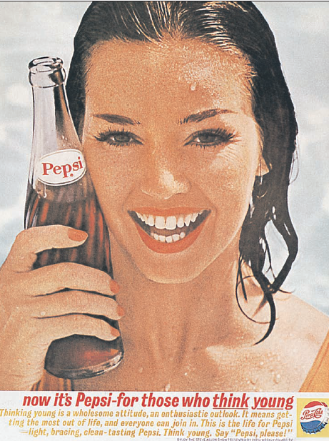
Learning Objective 8
Baby boomers continue to be the most powerful age segment economically.

Slide 40
Baby Boomers
Consumers born between 1946 and 1965
Active and physically fit
Currently in peak earning years
Food, apparel, and retirement programs
“Midlife crisis” products
Notes:
The baby boomer cohort consists of people whose parents established families following the end of World War II and during the 1950s when the peacetime economy was strong and stable. In addition to the direct demand for products and services this group creates, these consumers have also fostered a new baby boom of their own to keep marketers busy in the future. Because it wasn’t as big as the first, we call it a baby boomlet.

Slide 41
For Reflection
What will happen to the markets for products like Restylane as the Baby Boomers continue to age?

Slide 42
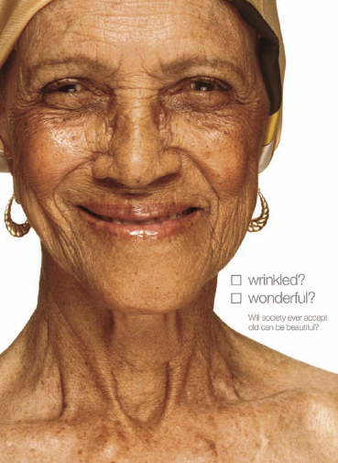
Learning Objective 9
Seniors continue to increase in importance as a market segment.
Notes:
The United Nations says that people older than 60 are the fastest-growing age group on earth. We call this group the gray market. Older adults control more than 50% of discretionary income.

Slide 43
Perceived Age: You’re Only as Old as You Feel
Age is more a state of mind than of body
Perceived age: how old a person feels as opposed to his or her chronological age
“Feel-age”
“Look-age”
The older we get, the younger we feel relative to actual age
Notes:
Perceived age is how old a person feels and is a better yardstick of age than how old a person is biologically. Researchers measure age by feel-age (how old one feels) and look-age (how old a person looks). Marketers may need to emphasize product benefits rather than age-appropriateness in marketing campaigns for older adults because the older we get, the younger we feel relative to our actual age.

Slide 44
Values of Older Adults
Autonomy: want to be self-sufficient
Connectedness: value bonds with friends and family
Altruism: want to give something back to the world
Notes:
It is important for marketers to understand the psyche of older people. Researchers point to a set of key values relevant to mature consumers. These include autonomy, connectedness, and altruism.

Slide 45
For Reflection
Is it practical to assume that people 60 and over constitute one large consumer market (i.e., the gray market)? How can marketers segment this age subculture?

Slide 46
Chapter Summary
People share an identification with microcultures as well as subcultures and cultures.
Membership in ethnic, racial, and religious subcultures plays a role in our consumption decisions.
African Americans, Hispanic Americans, and Asian Americans are the three most important ethnic/racial subcultures.
Notes:
We’ve reviewed many concepts in this chapter. The key points are noted on this slide and the next.

Slide 47
Chapter Summary
People tend to have things in common with others about their same age.
Teens, tweens, baby boomers, and seniors are all important markets.
Baby boomers continue to be the most powerful segment.

