Slide 1
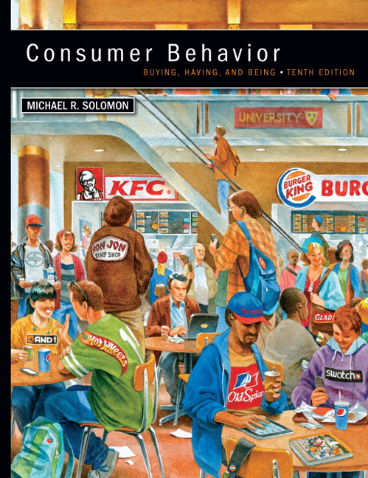
Chapter 4 Motivation and Global Values
CONSUMER BEHAVIOR, 10e Michael R. Solomon
Notes:
Chapter 4 discusses our reasons or motivations to absorb this information and how our cultural values influence what we do.

Slide 2
Learning Objectives
When you finish this chapter, you should understand why:
It’s important for marketers to recognize that products can satisfy a range of consumer needs.
The way we evaluate and choose a product depends upon our degree of involvement with the product, the marketing message, and/or the purchase situation.

Slide 3
Learning Objectives (continued)
Our deeply held cultural values dictate the types of products and services we seek out or avoid.
Consumers vary in the importance they attach to worldly possessions, and this orientation in turn has an impact on their priorities and behaviors.

Slide 4
Learning Objectives (continued)
Products that succeed in one culture may fail in another if marketers fail to understand the differences among consumers in each place.
Western cultures have a huge impact around the world, although people in other countries don’t necessarily ascribe the same meanings to products we do.

Slide 5
Learning Objective 1
It is important for marketers to recognize that products can satisfy a range of consumer needs.
Notes:
Motivation refers to the processes that lead people to behave as they do. It occurs when a need is aroused that the consumer wishes to satisfy. The need creates a state of tension that drives the consumer to attempt to reduce or eliminate it. This need may be utilitarian (i.e., a desire to achieve some functional or practical benefit, as when a person loads up on green vegetables for nutritional reasons) or it may be hedonic (i.e., an experiential need, involving emotional responses or fantasies). The desired end state is the consumer’s goal . Marketers try to create products and services to provide the desired benefits and help the consumer to reduce this tension.

Slide 6
Needs and Motivation
Needs may be utilitarian or hedonic
The desired end state is the goal
The degree of arousal is drive
Personal and cultural factors combine to create a want – one manifestation of a need
Motivation is described in terms of strength and direction
Notes:
A need creates a state of tension that drives the consumer to attempt to reduce or eliminate it. This need may be utilitarian (i.e., a desire to achieve some functional or practical benefit, as when a person loads up on green vegetables for nutritional reasons) or it may be hedonic (i.e., an experiential need, involving emotional responses or fantasies, as when Basil longs for a juicy steak). The desired end state is the consumer’s goal.
Marketers try to create products and services to provide the desired benefits and help the consumer to reduce this tension. Whether the need is utilitarian or hedonic, the magnitude of the tension it creates determines the urgency the consumer feels to reduce it. We call this degree of arousal a drive. We can satisfy a basic need in any number of ways, and the specific path a person chooses is influenced both by her unique set of experiences and by the values his or her culture instills. These personal and cultural factors combine to create a want, which is one manifestation of a need.

Slide 7
Motivational Strength
Motivational strength: degree of willingness to expend energy to reach a goal
Drive theory: biological needs that produce unpleasant states of arousal (e.g., hunger)
Expectancy theory: behavior is pulled by expectations of achieving desirable outcomes
Notes:
The degree to which a person will expend energy to reach one goal as opposed to another reflects his or her motivation to attain that goal.
Drive theory focuses on biological needs that produce unpleasant states of arousal (e.g., your stomach grumbles during a morning class). The arousal this tension causes motivates us to reduce it. Some researchers feel this need to reduce arousal is a basic mechanism that governs much of our behavior. In a marketing context, tension refers to the unpleasant state that exists if a person’s consumption needs are not fulfilled. A person may be grumpy if he hasn’t eaten, or he may be dejected or angry if he cannot afford that new car he wants. This state activates goal-oriented behavior, which attempts to reduce or eliminate this unpleasant state and return to a balanced one we call homeostasis.
Expectancy theory suggests that expectations we will achieve desirable outcomes—positive incentives—rather than being pushed from within motivate our behavior. We choose one product over another because we expect this choice to have more positive consequences for us.

Slide 8
What Do We Need?
Biogenic Needs
Psychogenic Needs
Utilitarian Needs
Hedonic Needs
Notes:
We are born with a need for certain elements necessary to maintain life such as food, water, air, and shelter. These are biogenic needs. We have many other needs, however, that are not innate. We acquire psychogenic needs as we become members of a specific culture. These include the needs for status, power, and affiliation.
Psychogenic needs reflect the priorities of a culture, and their effect on behavior will vary from environment to environment.
We also can be motivated to satisfy either utilitarian or hedonic needs. When we focus on a utilitarian need, we emphasize the objective, tangible attributes of products, such as miles per gallon in a car; the amount of fat, calories, and protein in a cheeseburger; or the durability of a pair of blue jeans. Hedonic needs are subjective and experiential; here we might look to a product to meet our needs for excitement, self-confidence, or fantasy perhaps to escape the mundane or routine aspects of life.

Slide 9
Motivational Conflicts
Goal valence (value): consumer will:
Approach positive goal
Avoid negative goal
Example: Partnership for a Drug-Free America communicates negative consequences of drug addiction for those tempted to start
Notes:
A goal has valence, which means that it can be positive or negative. We direct our behavior toward goals we value positively; we are motivated to approach the goal and to seek out products that will help us to reach it. However as we saw in the previous chapter’s discussion of negative reinforcement, sometimes we’re also motivated to avoid a negative outcome rather than achieve a positive outcome.

Slide 10
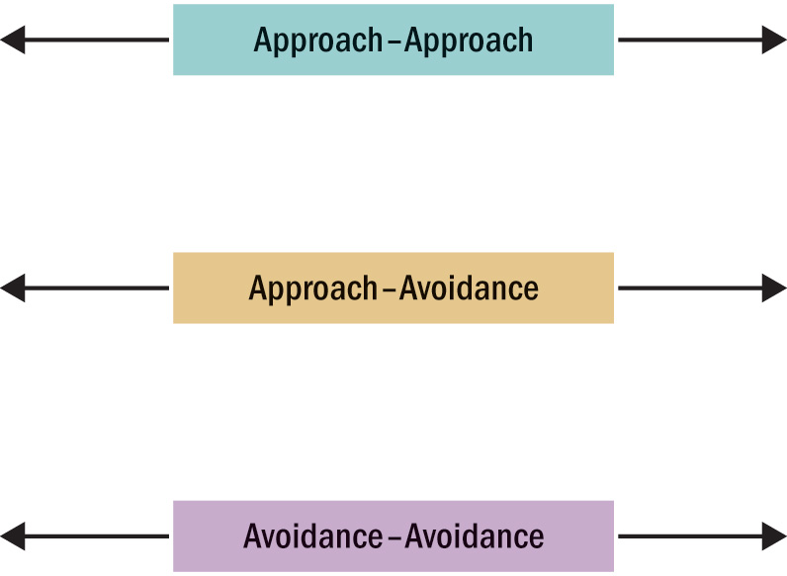
Figure 4.1 Types of Motivational Conflicts
Two desirable alternatives
Cognitive dissonance
Positive & negative aspects
of desired product
Guilt of desire occurs
Facing a choice with two
undesirable alternatives
Notes:
A person has an approach–approach conflict when she must choose between two desirable alternatives. The theory of cognitive dissonance is based on the premise that people have a need for order and consistency in their lives and that a state of dissonance (tension) exists when beliefs or behaviors conflict with one another. We resolve the conflict that arises when we choose between two alternatives through a process of cognitive dissonance reduction, where we look for a way to reduce this inconsistency (or dissonance) and thus we eliminate unpleasant tension.
Dissonance occurs when a consumer must choose between two products, both of which possess good and bad qualities. When he chooses one product and not the other, the person gets the bad qualities of the product he buys and loses out on the good qualities of the one he didn’t buy. This loss creates an unpleasant, dissonant state he wants to reduce. We tend to convince ourselves, after the fact, that the choice we made was the smart one as we find additional reasons to support the alternative we did choose—perhaps when we discover flaws with the option we did not choose (sometimes we call this “rationalization”). A marketer can bundle several benefits together to resolve an approach–approach conflict.

Slide 11
Specific Needs and Buying Behavior
NEED FOR ACHIEVEMENT
Value personal accomplishment
Place a premium on products that signify success (luxury brands, technology products)
NEED FOR AFFILIATION
Want to be with other people
Focus on products that are used in groups (alcoholic beverages, sports bars)
NEED FOR POWER
Control one’s environment
Focus on products that allow them to have mastery over surroundings (muscle cars, loud boom-boxes)
NEED FOR UNIQUENESS
Assert one’s individual identity
Enjoy products that focus on their unique character (perfumes, clothing)
Notes:
Need for achievement refers to the desire to accomplish something. Sometimes people will express a need for achievement with premium products that express success.
Need for affiliation is the desire to be with other people. Products that express emotion and aid in group activities are relevant.
Need for power is the need to control one’s environment. Products that allow us to feel mastery over our surroundings and situation meet this need.
Need for uniqueness is the need to assert one’s individual identity. Products that pledge to illustrate our distinct qualities meet this need.

Slide 12
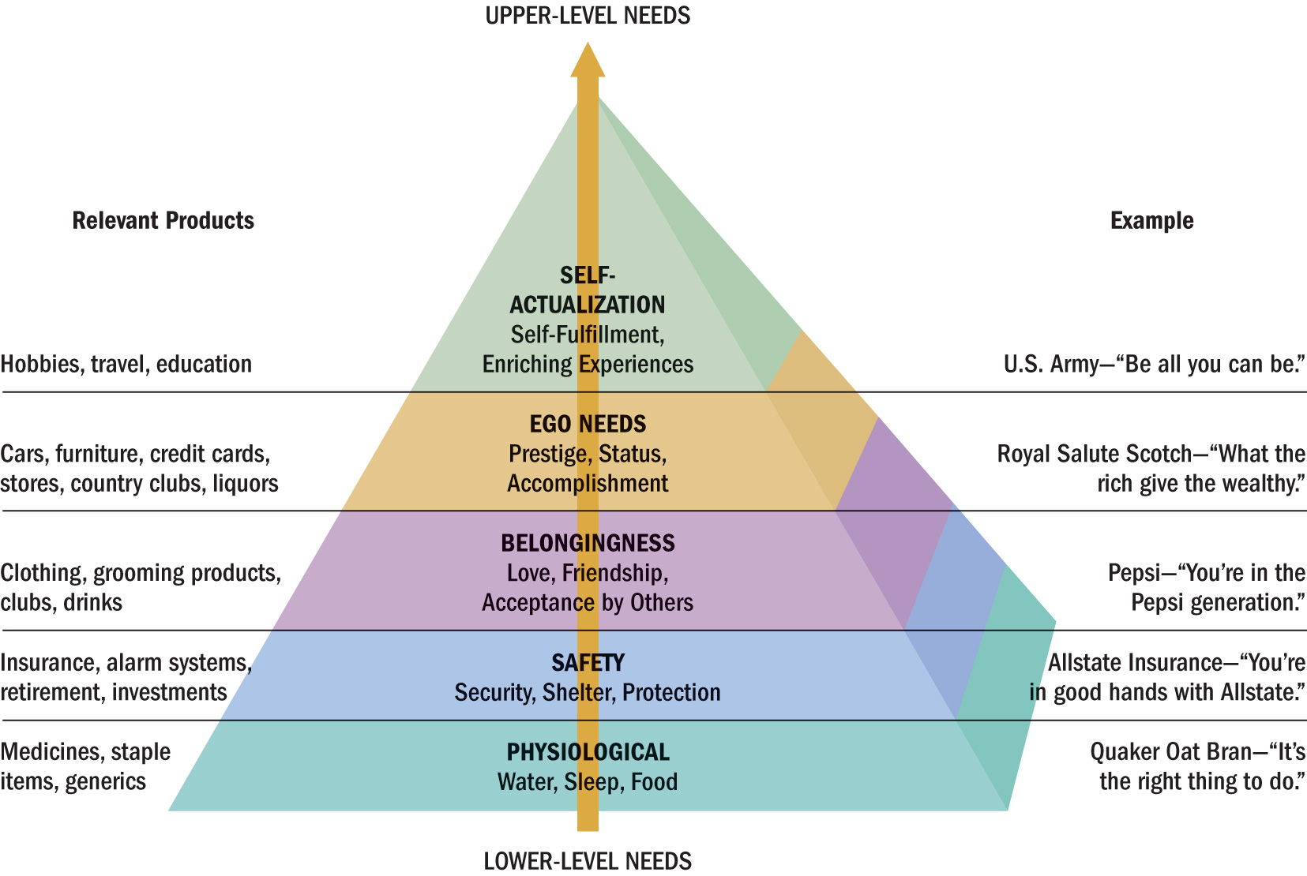
Levels of Needs in the Maslow Hierarchy
Notes:
This exhibit illustrates Maslow’s Hierarchy of Needs. The hierarchy includes five levels: 1) physiological, 2) safety, 3) belongingness, 4) ego needs, and 5) self-actualization. Marketers’ application of this hierarchy has been somewhat simplistic, especially as the same product or activity can gratify different needs. For example, one study found that gardening could satisfy needs at every level of the hierarchy:
• Physiological—“I like to work in the soil.”
• Safety—“I feel safe in the garden.”
• Social—“I can share my produce with others.”
• Esteem—“I can create something of beauty.”
• Self-actualization—“My garden gives me a sense of peace.”

Slide 13
For Reflection
Some studies show that an activity can satisfy every level of Maslow’s hierarchy. What does this say about the hierarchy?
I like to work in the soil (physiological)
I feel safe in my garden (safety)
I can share my produce with others (affiliation)
I can create something of beauty (esteem)
My garden gives me a sense of peace (self-actualization)

Slide 14
Learning Objective 2
The way we evaluate and choose a product depends upon our degree of involvement with the product, the marketing message, and/or the purchase situation.

Slide 15
Consumer Involvement
Involvement: perceived relevance of an object based on one’s needs, values, and interests
We get attached to products:
“All in One” restaurant tattoo on consumer’s head
Lucky magazine for women who obsess over shopping
A man tried to marry his car when his fiancée dumped him

Slide 16
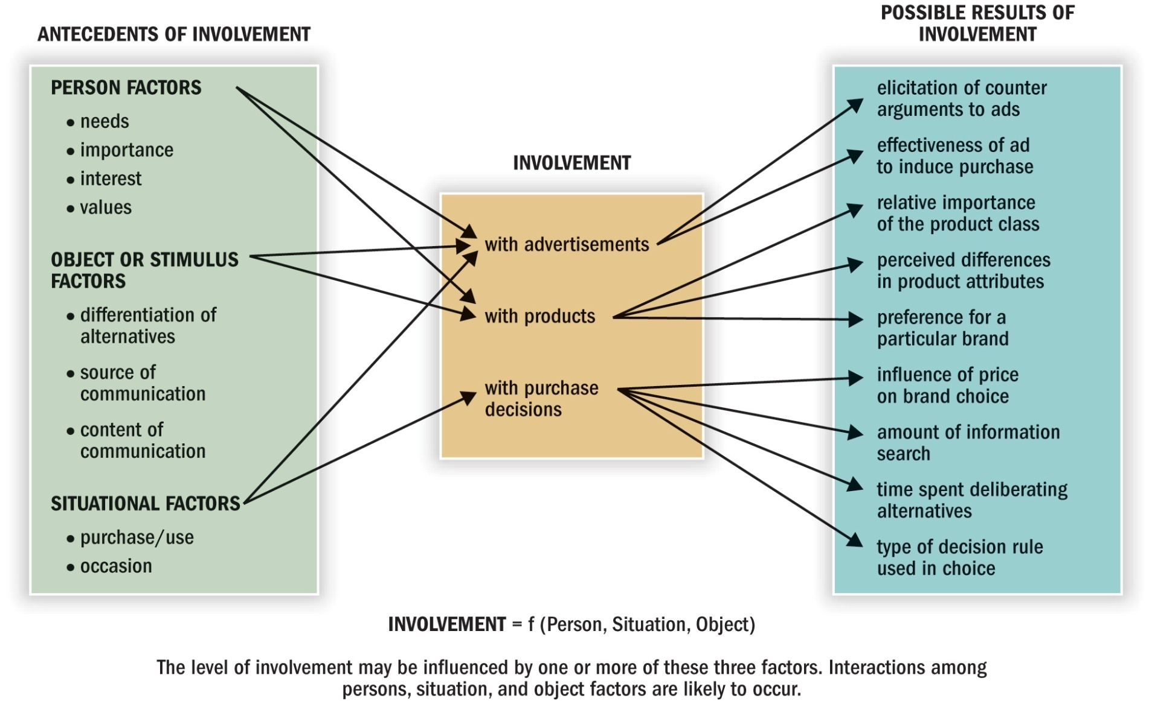
Figure 4.3 Conceptualizing Involvement
Notes:
Figure 4.3 shows that different factors may create involvement. These factors can be something about the person, something about the object, or something about the situation.

Slide 17
Levels of Involvement: From Inertia to Passion
Inertia is consumption at the low end of involvement; decisions made out of habit (lack of motivation)
Flow state occurs when consumers are truly involved
Sense of control
Concentration
Mental enjoyment
Distorted sense of time
Notes:
A person’s degree of involvement is a continuum that ranges from absolute lack of interest in a marketing stimulus at one end to obsession at the other end. Inertia is consumption at the low end.
When consumers are truly involved with something, they enter a flow state. Flow is an optimal experience with several qualities such as a sense of playfulness, a feeling of being in control, concentration and highly focused attention, a mental enjoyment of the activity for its own sake, and a distorted sense of time.

Slide 18
Table 4.1 Measuring Involvement
To me (object to be judged) is:
1. | important | _:_:_:_:_:_:_ | unimportant
2. | boring | _:_:_:_:_:_:_ | interesting
3. | relevant | _:_:_:_:_:_:_ | irrelevant
4. | exciting | _:_:_:_:_:_:_ | unexciting
5. | means nothing | _:_:_:_:_:_:_ | means a lot
6. | appealing | _:_:_:_:_:_:_ | unappealing
7. | fascinating | _:_:_:_:_:_:_ | mundane
8. | worthless | _:_:_:_:_:_:_ | valuable
9. | involving | _:_:_:_:_:_:_ | uninvolving
10. | not needed | _:_:_:_:_:_:_ | needed
Notes:
Table 4.1 shows a scale for measuring involvement. Measuring involvement is important for many marketing applications.

Slide 19
Purchase Situation Involvement
Purchase situation involvement: differences that occur when buying the same object for different contexts.
Example: wedding gift
For boss: purchase expensive vase to show that you want to impress boss
For cousin you don’t like: purchase inexpensive vase to show you’re indifferent

Slide 20
For Reflection
Describe your level of involvement with the “product” and devise some marketing opportunities to reach this group.

Slide 21
Learning Objective 3
Our deeply held cultural values dictate the types of products and services we seek out or avoid.

Slide 22
Consumer Values
Value: a belief that some condition is preferable to its opposite
Example: looking younger is preferable to looking older
Products/services = help in attaining value-related goal
We seek others that share our values/ beliefs
Thus, we tend to be exposed to information that supports our beliefs
Notes:
A person’s set of values plays a very important role in consumption activities. Consumers purchase many products and services because they believe that these products will help to attain a value-related goal. Two people can believe in the same behaviors but their underlying belief systems may be quite different. The extent to which people share a belief system is a function of individual, social, and cultural forces.

Slide 23
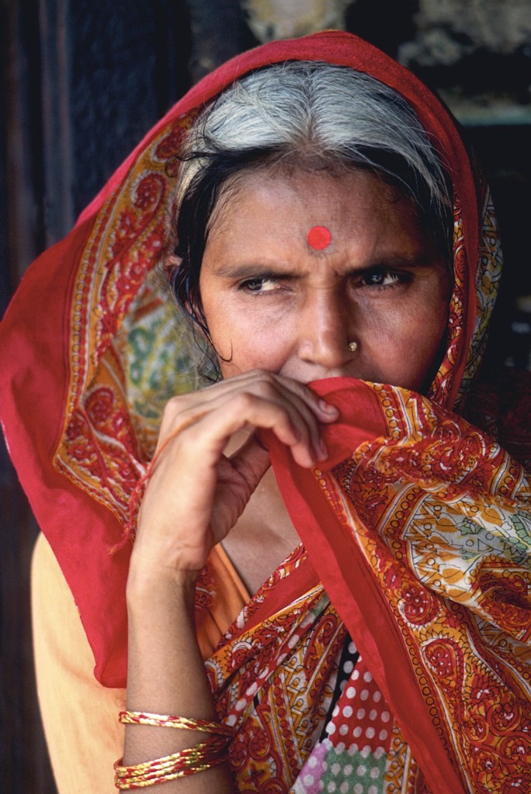
Core Values
Core values: values shared within a culture
Enculturation: learning the beliefs and values of one’s own culture
Acculturation: learning the value system and behaviors of another culture
Notes:
It is usually possible to identify a general set of core values that unique define a culture. Core values such as freedom, youthfulness, achievement, materialism, and activity characterize American culture.
How do we determine what a culture values? We term the process of learning the beliefs and behaviors endorsed by one’s own culture enculturation. In contrast, we call the process of learning the value system and behaviors of another culture acculturation. Socialization agents, including parents, friends, and teachers, impart these beliefs to us. Even the media help us to learn about a culture’s priorities.

Slide 24
For Reflection
What do you think are the three to five core values that best describe Americans today?
How are these core values relevant to the following product categories:
Cars?
Clothing?
Higher education?

Slide 25
Learning Objectives 4 and 5
Consumers vary in the importance they attach to worldly possessions, and this orientation in turn has an impact on their priorities and behaviors.
Products that succeed in one culture may fail in another if marketers fail to understand the differences among consumers in each place.

Slide 26
Hofstede’s Cultural Dimensions
Power distance
Individualism
Masculinity
Uncertainty avoidance
Long-term orientation
Notes:
One of the most widely used measures of cross-cultural values is an instrument developed by Geert Hofstede. This measure scores a country in terms of its standing on five dimensions so that users can compare and contrast values:
• Power Distance is the extent to which the less powerful members of organizations and institutions (like the family) accept and expect that power is distributed unequally.
• Individualism is the degree to which individuals are integrated into groups.
• Masculinity is the distribution of roles between the genders.
• Uncertainty Avoidance is a society’s tolerance for uncertainty and ambiguity.
• Long-Term Orientation is values associated with Long-Term Orientation are thrift and perseverance. Values associated with Short-Term Orientation are respect for tradition, fulfilling social obligations, and protecting one’s “face.”

Slide 27
Table 4.2 Terminal and Instrumental Values
Instrumental Value | Terminal Value
Ambitious | A comfortable life
Capable | A sense of accomplishment
Self-controlled | Wisdom
Notes:
The Rokeach Value Survey includes a set of instrumental and terminal values. It was developed by Milton Rokeach to explain the value states that apply to different cultures. The terminal values are desired end states. The instrumental values are actions we need to take to achieve these terminal values. Table 4.2 lists these two sets of values. (Note: Table 4.2 shown on this slide is an abbreviated list of instrumental and terminal values.).

Slide 28
List of Values (LOV)
Identifies nine consumer segments based on values they endorse; and
Relates each value to differences in consumption behaviors
Example: those who endorse sense of belonging read Reader’s Digest and TV Guide drink and entertain more, and prefer group activities
Notes:
The LOV scale isolates values with more direct marketing applications. The instrument identifies nine consumer segments based on the values members endorse and relates each value to differences in consumption behaviors.

Slide 29
Means-End Chain Model
Very specific product attributes are linked at levels of increasing abstraction to terminal values
Alternative means to attain valued end states
Laddering technique uncovers consumers’ associations between specific attributes and general consequences
Notes:
Another research approach that incorporates values is the means-end chain model. This approach assumes that people link very specific product attributes to terminal values. We choose among alternative means to attain some end state we value. Thus we value products to the extent that they provide the means to some end we desire. A technique researchers call laddering uncovers consumers’ associations between specific attributes and these general consequences.

Slide 30
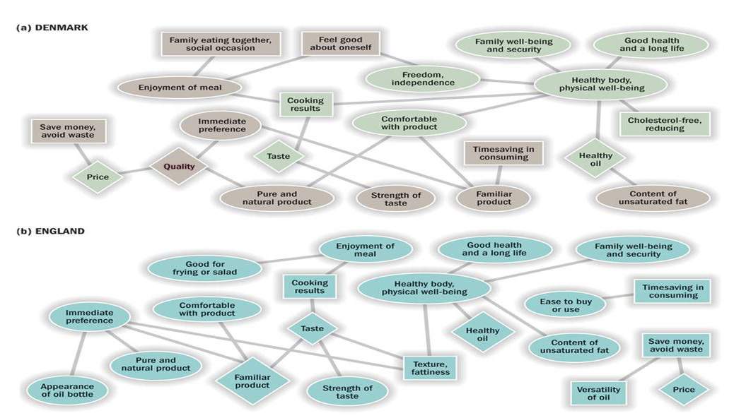
Figure 4.4 Hierarchical Value Maps for Vegetable Oil in Three Countries
Notes:
Figure 4.4 shows three different hierarchical value maps from a study of consumers’ perceptions of cooking oils in three European countries. England and Denmark are shown in the slide.

Slide 31
Learning Objective 6
Western cultures have a huge impact around the world, although people in other countries don’t necessarily ascribe the same meanings to products we do.

Slide 32
Conscientious Consumerism
Conscientious consumerism is a focus on personal health merging with a growing interest in global health
LOHAS (lifestyles of health and sustainability)
Worry about the environment
Want products to be produced in a sustainable way
Notes:
One survey revealed that 8 in 10 consumers said they believe it’s important to buy green brands and products from green companies. Analysts call this new value conscientious consumerism. A sizeable number of people are interested in being more green. Marketers point to a segment called LOHAS – an acronym for lifestyles of health and sustainability.

Slide 33
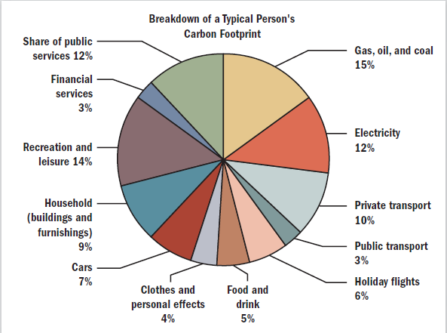
Carbon Footprint Breakdown
Notes:
The carbon footprint measures, in units of carbon dioxide, the impact human activities have on the environment in terms of the amount of greenhouse gases they produce. The average American is responsible for 9.44 tons of CO2 per year! As the figure shows, a carbon footprint comes from the sum of two parts, the direct, or primary, footprint and the indirect, or secondary, footprint:
1) The primary footprint is a measure of our direct emissions of CO2 from the burning of fossil fuels, including domestic energy consumption and transportation (e.g., cars and planes).
2 The secondary footprint is a measure of the indirect CO2 emissions from the whole life cycle of products we use, from their manufacture to their eventual breakdown.

Slide 34
Materialism
Materialism: the importance people attach to worldly possessions
“The good life”...“He who dies with the most toys, wins”
Materialists: value possessions for their own status and appearance
Non-materialists: value possessions that connect them to other people or provide them with pleasure in using them
Notes:
Our possessions play a central role in our lives and our desire to accumulate them shapes our value systems.
A value that’s related to materialism is cosmopolitanism. Researchers define a cosmopolitan as someone who tries to be open to the world and who strives for diverse experiences.

Slide 35
Chapter Summary
Products address a wide range of consumer needs.
How we evaluate a product depends on our involvement with that product, the marketing message, and the purchase situation.
Our cultural values dictate the products we seek out and avoid.
Consumers vary in how important possessions are to them.
Notes:
We’ve covered several key concepts in this chapter including needs and wants, involvement, cultural values, and the latest trends in consumerism.

