Slide 1
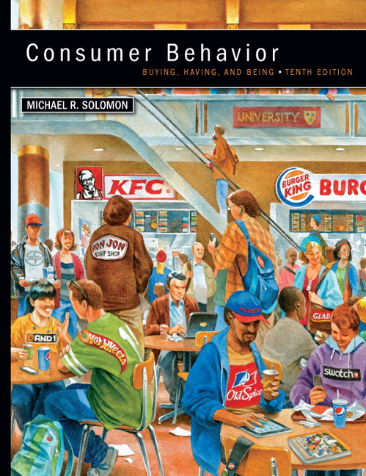
Chapter 1 Buying, Having, Being
CONSUMER BEHAVIOR, 10e Michael R. Solomon
Notes:
The book begins with a look at the role of consumers. We will look at how consumers influence the field of marketing and how marketers influence consumers.

Slide 2
Chapter Objectives
When you finish this chapter, you should understand why:
Consumers use products to help them define their identities in different settings.
Consumer behavior is a process.
Marketers need to understand the wants and needs of different consumer segments.

Slide 3
Chapter Objectives (continued)
The Web is changing consumer behavior.
Consumer behavior relates to other issues in our lives.
Many different types of specialists study consumer behavior.
There are two major perspectives that seek to understand and study consumer behavior.

Slide 4
Learning Objective 1
Consumers use products to help them define their identities
Notes:
Consumers interact with products and other aspects of the marketing system but for marketers to best meet consumer needs, they need to be able to understand their behavior and categorize them into useful segments.

Slide 5
Consumer Identity as an Aid to Marketers
Consumers segmented by demographics and psychographics
Consumers understood in part based on their consumption communities and reference groups
Brands target consumers using market segmentation strategies
Consumers may choose brands that match with their own identities
Notes:
For some purposes, marketers find it useful to categorize consumers in terms of age, gender, income, and occupation. These are descriptive characteristics of a population, or demographics . In other cases, marketers would rather know something about interests in clothing or music, and other information that falls under the category of psychographics. The conversations we have with others transmit a lot of product information, as well as recommendations to use or avoid particular brands. The use of market segmentation strategies means targeting a brand only to specific groups of consumers rather than to everybody—even if it means that other consumers who don’t belong to this target market aren’t attracted to that product. Brands often have clearly defined images, or “personalities,” created by advertising, packaging, branding, and other marketing strategies. The choice of a favorite Web site is very much a lifestyle statement: It says a lot about a person’s interests, as well as something about the type of person she would like to be. People often choose a product because they like its image or because they feel its “personality” somehow corresponds to their own. People often buy products not for what they do but for what they mean. The roles products play in our lives extend well beyond the tasks they perform.

Slide 6
What is Consumer Behavior?
Consumer behavior: the study of the processes involved when individuals or groups select, purchase, use, or dispose of products, services, ideas, or experiences to satisfy needs and desires.

Slide 7
For Reflection
Do your consumption choices differ depending upon the role you are playing at the time?
Give examples from your own life.
How do your choices as a consumer differ depending upon whether you are in the role of student, child, employee, and so on?

Slide 8
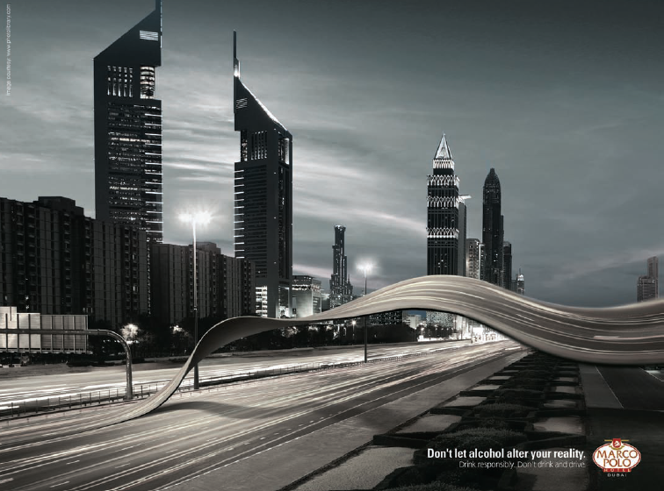
Learning Objective 2
Consumer behavior is a process.
Notes:
In the early stages of development, researchers referred to the field as buyer behavior. Marketers now recognize that consumer behavior is an ongoing process, not merely what happens at one point in the transaction cycle. We call the transaction of value between two or more an exchange. It’s an integral part of marketing but consumer behavior recognizes that the entire consumption process is relevant for marketers. Figure 1.1 in the text illustrates these issues.

Slide 9
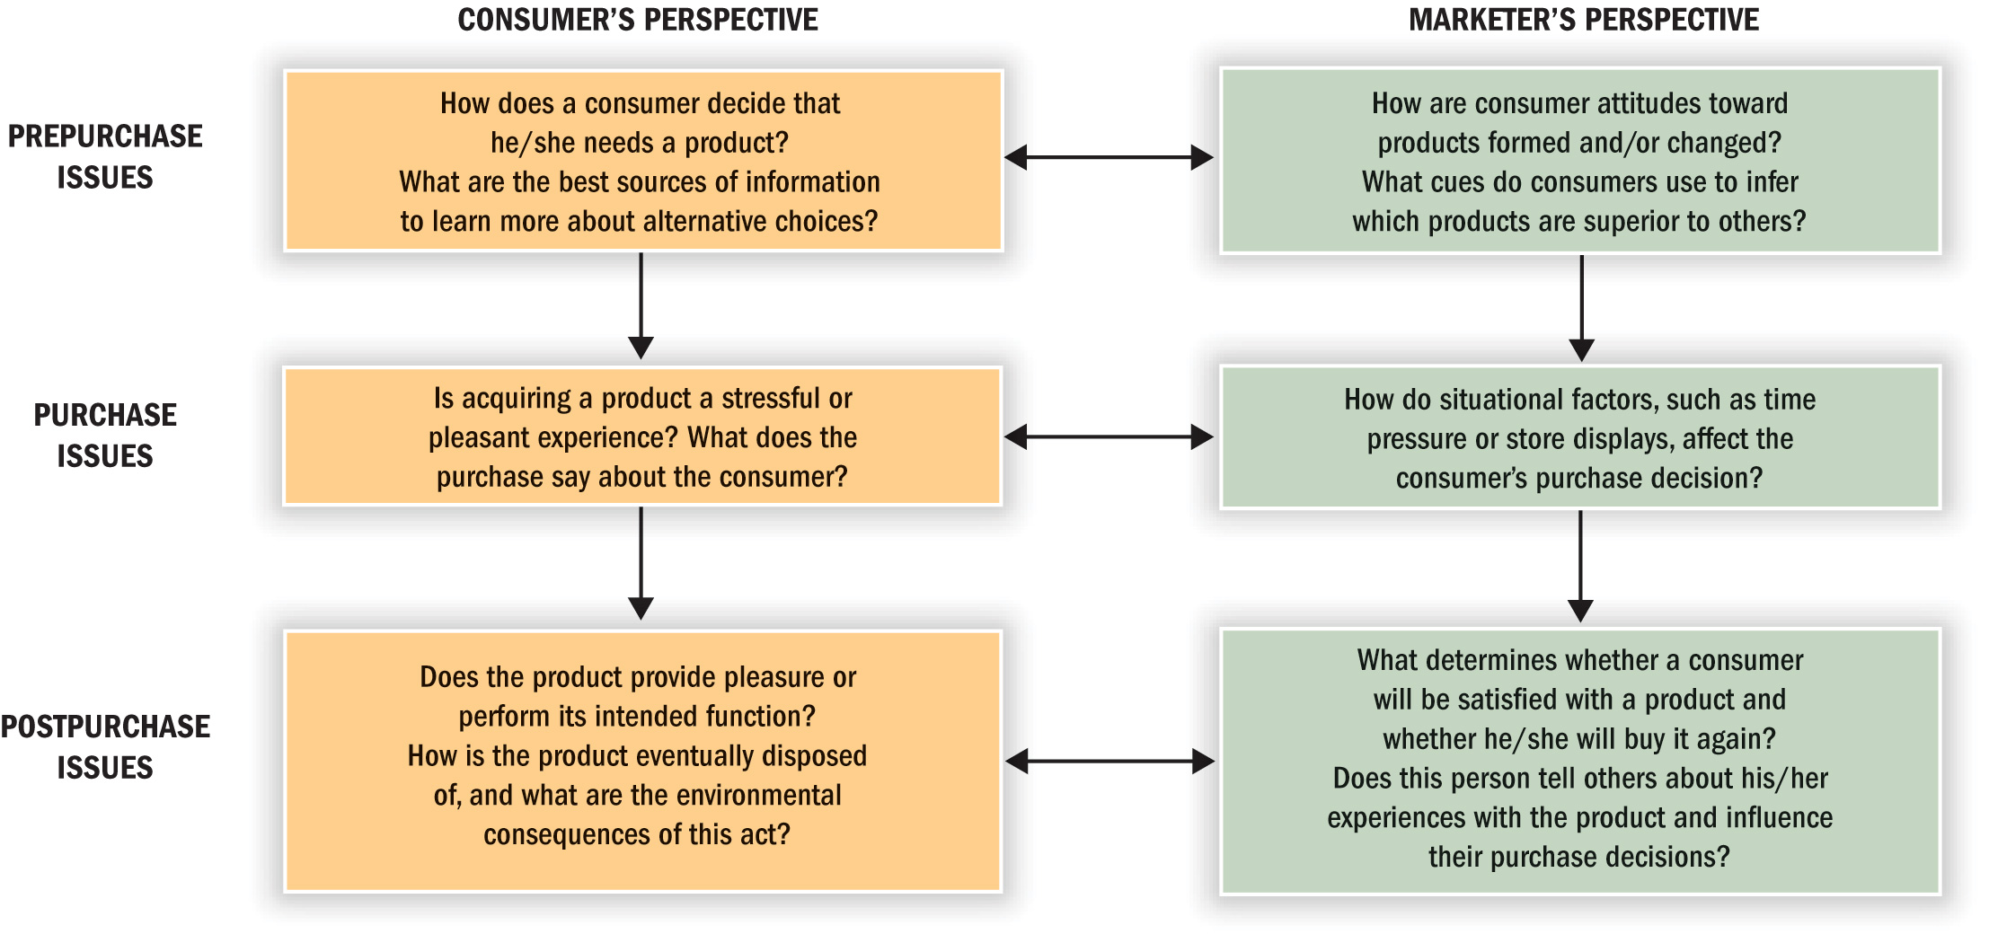
Figure 1.1 Stages in the Consumption Process
Notes:
We call the person who identifies a need or desire, makes a purchase, and then disposes of the product as a consumer. The purchaser or user might be the same person, or not. You can see in the slide that there are three key stages: 1) prepurchase, 2) purchase, and 3) postpurchase. Marketers need an understanding of all three stages.

Slide 10
For Reflection
Thinking about the three stages in the consumption process, what issues do you consider in each stage when you are making important decisions?

Slide 11
Learning Objective 3
Marketers need to understand the wants and needs of different consumer segments.
Notes:
Marketers must understand the various consumer segments they are targeting in order to meet the segment’s needs. In the ad shown, the woman is fed up with bad financial news. Bianco adjusted its message strategy to address the concerns of its audience.
Many dimensions are relevant for understanding consumer needs and wants. Usage, whether heavy or light, can help to focus marketer’s energies. In addition there are many demographic variables that can help in understanding groups of consumers.

Slide 12
Segmenting Consumers: Demographics
Demographics:
Age
Gender
Family structure
Social class/income
Race/ethnicity
Geography
Notes:
Demographics are statistics that measure observable aspects of a population. Some of the most common demographic measures are age, gender, family structure, social class, race or ethnicity, and geography. Even lifestyles can be useful to marketers in that consumers may share demographic characteristics but have very different lifestyles. Marketers try to understand their customers and develop lifelong relationships. Marketers who follow this approach are said to follow the philosophy of relationship marketing.
They may also utilize database marketing in order to track the buying habits of consumers.

Slide 13
Redneck Bank Targets by Social Class
Notes:
People who belong to the same social class are approximately equal in terms of their incomes and social standing in the community. This bank boastfully targets rednecks.

Slide 14
Popular Culture
Music
Movies
Sports
Books
Celebrities
Entertainment
Marketers influence preferences for movie and music heroes, fashions, food, and decorating choices.
Notes:
Many people don’t realize the extent to which marketers influence popular culture. Whether we are talking about music, movies, sports, or entertainment, these forms of popular culture both influence and are influenced by marketing.

Slide 15
Consumer-Brand Relationships
Self-concept attachment
Nostalgic attachment
Interdependence
Love
Notes:
We find that consumers may develop relationships with brands over time. The slide lists some of the types of relationships we may see between consumers and their brands.
Self-concept attachment means that the product helps to establish the user’s identity. This was one of our early points in this chapter.
Nostalgic attachment means the product serves as a link to the consumer’s past.
Interdependence means that the product is a part of the user’s daily routine.
Love means that the product elicits emotional bonds of warmth, passion, or other strong emotion.

Slide 16
For Reflection
What kind of relationship do you have with your car?
Do these feelings correspond to the types of relationships consumers may develop with products?
How do these relationships affect your behavior?

Slide 17
Learning Objective 4
The Web is changing consumer behavior.
Notes:
Access to the Internet is incredibly influential for consumer behavior. It changes who you may interact with, the information you can find, the choices you see as available, and the time and energy you spend dealing with various decisions. The Internet has made it possible for businesses to use an additional channel of distribution (B2C e-commerce) but it’s also made possible C2C e-commerce, in the form of outlets like Etsy.com.
You are likely at the forefront of the impact of the Web on consumer behavior because you are a digital native. Digital natives grew up in a wired world.
The Web hasn’t just changed consumer behavior by shifting our options in terms of channels of distribution. It’s also made possible a whole new form of media known as social media.

Slide 18
Social Media
Social media are the online means of communication, conveyance, collaboration, and cultivation among interconnected and interdependent networks of people, communities, and organizations enhanced by technological capabilities and mobility.
Notes:
Social media have created what is known as the horizontal revolution. Because of the interconnectivity and the ability for consumers to participate actively in communities across the Web, social media have shifted the balance of power between consumers and marketers. Some of the most important developments for understanding consumer behavior are the growth of user-generated content and our ability to communicate both asynchronously and synchronously.
Social media are made possible by something known as Web 2.0, the technological development of the Internet.

Slide 19
For Reflection
Did you know
If you were paid $1 for every time an article was posted on Wikipedia, you’d earn $156.23/hour?
80% of companies use LinkedIn as their primary recruiting tool?
More than 1.5 billion pieces of content are shared on Facebook daily?
Notes:
How do you participate in social media? Can you think of any instances in which social media influenced a purchase decision you made?

Slide 20
Learning Objective 5
Our beliefs and actions as consumers strongly connect to other issues in our lives.
Notes:
In business, conflicts often arise between the goal to succeed and the desire to maximize well-being of consumers by providing them with safe and effective products. Sometimes consumers expect too much of companies. Thus, thinking about marketing ethics means considering how businesses may manipulate consumers as well as how consumers may manipulate businesses.

Slide 21
Marketing Ethics and Public Policy
Business ethics are rules of conduct that guide actions in the marketplace
There are cultural differences in what is considered ethical.
Notes:
It can be difficult to avoid ethical conflicts because our thoughts of what is right and wrong vary among people, organizations, and cultures. These cultural differences certainly influence whether business practices such as bribery are acceptable. Bribing foreigners to gain business has been against the law in the United States since 1977, under the Foreign Corrupt Practices Act. The Organization for Economic Cooperation and Development (OECD), to which most industrialized countries belong, also outlaws bribery. Still, these practices are common in many countries.

Slide 22
Do Marketers Create Artificial Needs?
Objective of marketing: create awareness that
needs exist, not to create needs
versus
Need: a basic biological motive
Want: one way that society has taught us that the need can be satisfied
Notes:
Marketing is commonly criticized as trying to convince consumers that they need something when they really don’t. This is an ethical issue. Marketers respond to this question by pointing out that the need already exists in the consumer, but marketers recommend ways to satisfy the need.

Slide 23
Are Advertising & Marketing Necessary?
Does advertising foster materialism?
Products are designed to meet existing needs;
Advertising only helps to communicate their availability
Notes:
Yes, we can say that advertising and marketing are necessary because consumers may not know that solutions to problems exist without the information provided by advertising and marketing. This is the view of the economics of information perspective. It points out that there is an economic cost to searching for information. Advertising helps consumers by reducing search time.

Slide 24
Do Marketers Promise Miracles?
Advertisers simply do not know enough about people to manipulate them
Notes:
The failure rate for new products ranges from 40 to 80%. Although people may think that advertisers use magic to sell products, marketers are only successful when they promote good products.

Slide 25
Public Policy & Consumerism
Concern for the welfare of consumers
Department of Agriculture
Federal Trade Commission
Food and Drug
Administration
Securities and Exchange Commission
Environmental Protection Agency
Notes:
A summary of important consumer protection legislation is provided in Table 1.1.

Slide 26
For Reflection
Advertisers are often blamed for promoting a materialistic society by making their products as desirable as possible.
Do you agree with this?
If yes, is materialism a bad thing?
If no, what are your reasons?

Slide 27
Learning Objective 6
Many specialists study consumer behavior.
Disciplinary Focus | Product Role
Experimental Psychology | Perception, learning, and memory processes
Clinical Psychology | Psychological adjustment
Human Ecology | Allocation of individual or family resources
Social Psychology | Behavior of individuals as members of social groups
Sociology | Social institutions and group relationships
Macroeconomics | Consumers’ relations with the marketplace
Demography | Measurable characteristics of a population
History | Societal changes over time
Cultural Anthropology | Society’s beliefs and practices
Notes:
Table 1.2 illustrates the interdisciplinary nature of consumer behavior.

Slide 28
Figure 1.2 Disciplines in Consumer Research
MICRO CONSUMER BEHAVIOR
(INDIVIDUAL FOCUS)
Experimental Psych
Clinical Psychology
Developmental Psych
Human Ecology
Microeconomics
Social Psychology
Sociology
Macroeconomics
Semiotics/Literary Criticism
Demography
History
Cultural Anthropology
Consumer behavior
involves many different
disciplines
MACRO CONSUMER
BEHAVIOR
(SOCIAL FOCUS)
Notes:
This figure provides a glimpse at some of the disciplines working in the field and the level at which each tackles research issues. The fields closer to the top of the pyramid concentrate on individual behavior. Those toward the base are more interested in the aggregate activities that occur among large groups of people.

Slide 29
For Reflection
Pick two of the disciplines shown in Figure 1.2. How would their approaches to the same marketing issue differ?

Slide 30
Learning Objective 7
There are two major perspectives on consumer behavior:
Positivist approach
Interpretivist approach
Notes:
We call a set of beliefs that guide our understanding of the world a paradigm. Some belief consumer behavior is in the midst of a paradigm shift, which occurs when a competing paradigm challenges the dominant set of assumptions. The basic set of assumptions underlying the dominant paradigm is positivism or modernism. It emphasizes that human reason is supreme and there is a single, objective truth that science can discover.
The newer paradigm of interpretivism (or postmodernism) questions these assumptions. This perspective argues that societal beliefs deny the complex social and cultural world in which we really live.

Slide 31
Table 1.3 Positivist versus Interpretivist Approaches
Assumptions | Positivist Approach | Interpretivist Approach
Nature of reality | Objective, tangible Single | Socially constructed Multiple
Goal | Prediction | Understanding
Knowledge generated | Time free Context-independent | Time-bound Contest dependent
View of causality | Existence of real causes | Multiple, simultaneous shaping events
Research relationship | Separation between researcher and subject | Interactive, cooperative with researcher being part of phenomenon under study
Notes:
Table 1.3 summarizes the major differences between these two perspectives on consumer research. To understand how an interpretive framework helps us to understand marketing communications, let’s refer to an analysis of one of the best-known and longest-running (1959–1978) advertising campaigns of all time: the work the advertising agency Doyle Dane Bernbach (DDB) did for the Volkswagen Beetle. This campaign, was widely noted for its self-mocking wit. It found many ways to turn the Beetle’s homeliness, small size, and lack of power into positive attributes at a time when most car ads were emphasizing just the opposite. An interpretative analysis of these messages linked the image DDB created for the humble car to other examples of what scholars of comedy call the “Little Man” pattern. This is a type of comedic character who is related to a clown or a trickster, a social outcast who is able to poke holes in the stuffiness and rigidity of bureaucracy and conformity.

Slide 32
For Reflection
How do you think the two paradigms of consumer research affect the choices marketers make in targeting consumer segments?

Slide 33
Chapter Summary
Consumer behavior is a process.
Consumer use products and brands to define their identity to others.
Consumers from different segments have different needs and wants.
Consumer behavior benefits from several fields.
There are two major perspectives guiding our study of consumer behavior.
Notes:
We’ve covered several key concepts in this chapter. Consumer behavior is the study of the processes involved when individuals or groups select, purchase, use, or dispose of products, services, ideas, or experiences to satisfy needs and wants. Consequently, it is a broad field.

