Slide 1
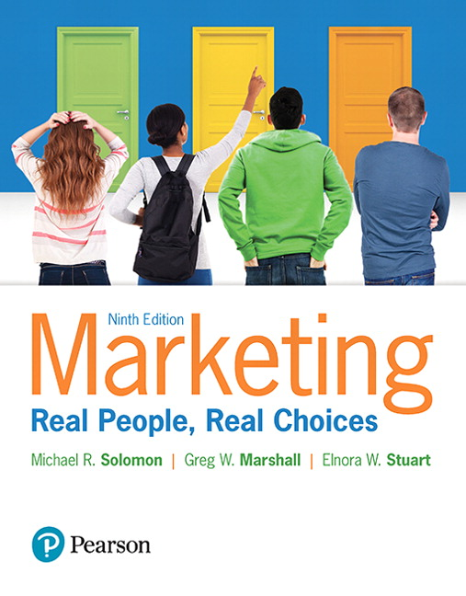
Marketing: Real People, Real Choices
Ninth Edition
Chapter 12
Deliver the Customer Experience
Copyright © 2018, 2016, 2012 Pearson Education, Inc. All Rights Reserved.
Notes:
If this PowerPoint presentation contains mathematical equations, you may need to check that your computer has the following installed:
1) MathType Plugin
2) Math Player (free versions available)
3) NVDA Reader (free versions available)

Slide 2
Learning Objectives
12.1 Define retailing, understand how retailing evolves
and consider some ethical issues in retailing.
12.2 Understand how we classify traditional retailers.
12.3 Describe business-to-consumer (B2C) e-
commerce and the other common forms of
non-store retailing.
12.4 Understand the marketing of services and other
intangibles.
Notes:
LECTURE NOTES:
Learning objectives associated for Chapter 12 (Retailing).

Slide 3
Real People, Real Choices: Eskimo Joe’s
Which option should Stan pursue?
Option 1: Convert the beer bar into a full-service restaurant that focuses on selling great food.
Option 2: Continue operating as a beer bar at the core and work to offset declining beer sales with an increase in apparel sales.
Option 3: Close Eskimo Joe’s bar and refocus resources on building the growing apparel business.
Notes:
DISCUSSION NOTE:
Tell students to think about these options and choose which one they would select.

Slide 4
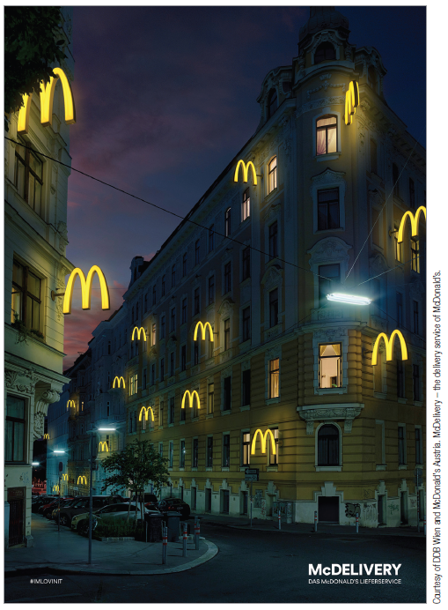
Retailing, Twenty-First-Century Style
Retailing is the process by which organizations sell goods and services to consumers for their personal use.
Provide time, place, and ownership utility
Retailing is big business:
2015 U.S. sales totaled $4.87 trillion
More than 1 in 10 U.S. workers employed in retail
Retailing practices vary around the world.
Notes:
LECTURE NOTES:
Introductory slide for Chapter 12 (Retailing), learning objective 1.
A few quick facts to start off the conversation about retailing:
Retailing is big business. In 2013, U.S. retail sales totaled $4.53 trillion. E-commerce accounted for 16.9 percent, or over $263 billion, and m-commerce accounted for $42.13 billion.
Over 1 million retail businesses employ over 15.3 million workers—more than 1 of every 10 U.S. workers.
Globally, retailing may have a very different face.
In some European countries, don’t even think about squeezing a tomato to see if it’s too soft or picking up a cantaloupe to see if it smells ripe. Such mistakes will quickly gain you a reprimand from the store clerk, who will choose your oranges and bananas for you.
In developing countries like those in Asia, Africa, and South America, retailing often includes many small butcher shops where sides of beef and lamb proudly hang in store windows so everyone will be assured that the meat comes from healthy animals.

Slide 5
The Evolution of Retailing
Retailing has taken many forms over time –
From the peddler hawking wares from a horse-drawn cart to a majestic urban department store
As the economic, social, and cultural climates change, different retail types emerge …
Often squeezing out older, outdated models
Wheel-of-retailing hypothesis
Notes:
LECTURE NOTES:
Retailing has taken many forms over time, including the peddler who hawked his wares from a horse-drawn cart, a majestic urban department store, an intimate boutique, and a huge “hyperstore” that sells everything from potato chips to snow tires.
But now the cart you see at your local mall that sells new-age jewelry or monogrammed golf balls to passersby has replaced the horse-drawn cart.
As the economic, social, and cultural pictures change, different types of retailers emerge—and they often squeeze out older, outmoded types.
This pattern of change is explained by the Wheel of Retailing.

Slide 6
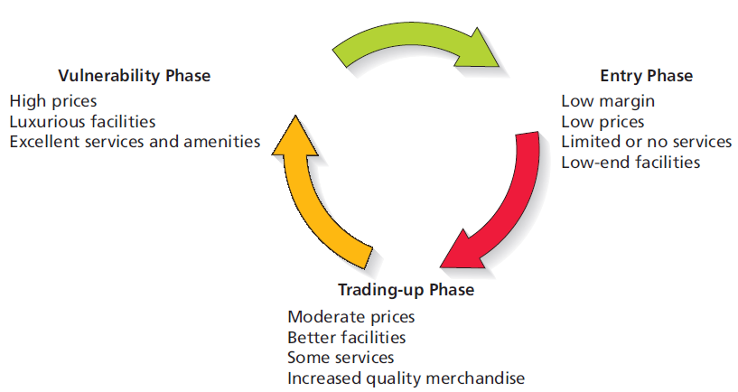
Figure 12.1 The Wheel of Retailing
Notes:
LECTURE NOTES:
The Wheel of Retailing Theory explains how retail firms change, becoming more upscale as they go through their life cycle. Visually, the Wheel of Retailing is displayed in Figure 12.1.
During the entry phrase, new types of retailers enter the market by offering lower-priced goods with little focus on additional services or the facility itself.
During the trading-up phrase, these retailers gradually improve their facilities, quality and assortment of merchandise, and amenities and also increase prices.
Finally, retailers move up to a high-end strategy with superior facilities, desirable amenities (free gift wrapping), higher operating costs, and of course higher prices. However, this leaves them vulnerable to the entry of new competitors, who undercut their price, offer limited services, and etc., as the entry phrase begins anew.
New ways to sell products are constantly appearing. American Airlines tested the concept of selling services such as Heathrow Express train tickets on London-bound flights, and items from the SkyMall catalog on 165 of its planes.
Still, trading up or upgrading too quickly can spell disaster for a retailer. Walmart attempt to upgrade its clothing line from the basic T-shirt, shorts, and pants collections to brand-name apparel that proved to be out-of-reach of the loyal core user.
While the wheel of retailing helps explain how some retailing forms develop, it doesn’t explain everything. For example, some retailers never trade-up but instead choose to continue to serve their niche as discounters. Still other retailers strategically choose to begin their life as upscale specialty stores, though they sometimes choose to open “sister” stores at the lower end of the price spectrum (as was the case when Gap Stores chose to open Old Navy).

Slide 7
The Evolution Continues: What’s “In-Store” for the Future?
Four factors motivate innovative merchants to reinvent the way they do business:
Changes in economic conditions
Demographic and consumer preference change
Technology
Globalization
Notes:
LECTURE NOTES:
Innovation in retailing that retailers keep pace with four key factors change regularly, requiring merchants to reinvent the way they do business.
Cultural trends are also important. The anti-fur movement and focus on sustainability are just two examples of how trends may impact the retail merchandising mix. Sustainability concerns also make certain forms of marketing less attractive, such as direct mail, which “wastes” papers and kills trees.
WEBSITE NOTES:
The consumer confidence link leads to http://www.tradingeconomics.com/united-states/consumer-confidence where the instructor can not only find information about the current consumer confidence level, but also create a custom graph showing the changes in the index over whatever period of time the instructor chooses.
The National Retail Federation web site provides a wealth of information related to retailing. It is suggested that instructors visit the web site prior to class, as the site offers a number of reports, briefs, and news releases, which instructors may wish to download or purchase, including the Top 100 Hot Retailers, Top 100 Retailers, and a variety of other reports. These reports can be found in the retail industry research portion of the web site (www.nrf.com/modules.php?name=Pages&sp_id=429). Many other areas of the web site are worth exploring before class begins, as the site offers a great deal of information which could be integrated into various portions of the retailing lecture.

Slide 8
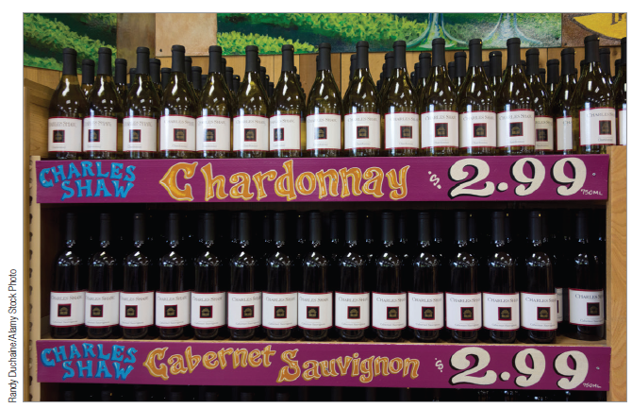
The Changing Economy
Economic downturn that began in 2008 had great impact on retailers
Lowered consumer confidence resulted in less discretionary spending.
Sales for upscale stores especially vulnerable
Stores like T.J. Maxx, Marshall’s, and Amazon.com thrived.
Some retailers responded by allocating more shelf space to private label brands.
Notes:
LECTURE NOTES:
The changing economy: The 2008–2010 economic downturn drastically affected the retail environment as consumers worldwide lost consumer confidence and became less willing to spend their discretionary income. The consumer confidence index is an economic measure that reflects consumer’s optimism in a given country about their personal financial situation and the state of the economy as a whole. In January of 2008, the U.S. consumer confidence was high, hovering just under 90, but immediately began a steep decline dropping approximately 20 points by July of the same year. Consumer confidence dropped below 25 in the first quarter of 2009, but gradually climbed throughout the remainder of 2009 and 2010, finally surpassing 60 in February of 2011.
Unfortunately, the lower consumer confidence levels during this time period caused many consumers to minimize spending of their discretionary income and focus instead on lowering their debt level and increasing their savings.
During economic downturns, many retailers choose to use sales, promotions, and free shipping in attempts to attract price conscious consumers. Others change their merchandise assortment to better meet consumer’s needs —sales of private labels brands for example reached an all time high in 2009. Discount merchandisers such as Walmart thrive, while a number of retailers often find themselves unable to compete. In fact, Sharper Image, Circuit City, Waldenbooks, and CompUSA are among the many retailing firms that went bankrupt at least in part due to the recent economic downturn.

Slide 9
Changing Demographics and Consumer Preferences (1 of 2)
More dual-career families places greater emphasis on convenience
Increased number of locations and format
Extended hours
Ethnic diversity
Need to adjust retail mix to attract consumers in areas with high concentration of ethnic population
Notes:
LECTURE NOTES:
Demographics and cultural changes also require adjustments on the retailer’s part.
Some of the key trends affecting retailing include:
Convenience: Expanding store hours to meet the needs of working consumers is one method by which many retailers have adjusted to changing demographics. Drive-up windows, or mobile retailing (bringing windshield repair to the consumer), and walk-in medical clinics located at retailer, pharmacy, or even grocery stores are some other adaptations made by innovative retailers.
Ethnic diversity: Larger firms have recognized that they must recognize and celebrate ethnic diversity specific to the cultural makeup of the areas within which they operate. Texas, California, and Florida contain large numbers of consumers who speak only Spanish; catering to this group includes hiring multi-lingual sales clerks, and use culturally connected events, such as Cinco De Mayo as an opportunity for special sales targeting this group.

Slide 10
Changing Demographics and Consumer Preferences (2 of 2)
Experiential Merchandising
Tactic whose intent is to convert shopping from a passive activity into a more interactive one, by better engaging the customer
Destination Retailer
Firm that consumers view as distinctive enough to become loyal to it.
Notes:
LECTURE NOTES:
An example of experiential merchandising is Build-a-Bear.
Consumers will go out of their way to shop at a destination retailer. The Verizon Destination Store in Bloomington, Minnesota is an exmaple.

Slide 11
Technology (1 of 2)
Technology is revolutionizing retailing!
Store associates carry an iPod Touch to quickly ring up sales from anywhere in the store
Electronic POS systems feed data into inventory control and auto replenishment systems
RFID tags on items
E-menus and other electronic ordering systems
Electronic banking
Notes:
LECTURE NOTES:
Stores may use POS systems to create perpetual inventory unit control systems that keep a running total on sales, returns, transfers to other stores, and so on.
This technology allows stores to develop computerized automatic reordering systems that are activated when inventories reach a certain level.
The store of the future will use RFID tags (and other technology) to assist the shopper in ways we haven’t even thought of. For example, an RFID tag on a bottle of wine can tip off a nearby plasma screen that will project an ad for Barilla pasta and provide a neat recipe for fettuccine with bell peppers and shrimp.
e-menus help customers because they can see what every item on the menu will look like and, it is hoped, avoid a surprise when the waiter arrives. This innovation also increases sales for the restaurant—who can avoid that mouth-watering picture of the eight-layer chocolate cake with peppermint-stick ice cream on top?

Slide 12
Technology (2 of 2)
Omni-channel Marketing
Seamless shopping experience whether shopping online, mobile device, phone, or brick-and-mortar
Beacon Marketing
Bluetooth signal within a store that communicates with shoppers’ smartphones
Digital Wallets
Bluetooth technology permitting customers to use their smartphones to pay for items
Notes:
LECTURE NOTES:
Omnichannel marketing allows customers to use any shopping experience to interact with the retailer. The idea is that whether using your phone, laptop, or even being in the store, your information, past purchases, etc. are available.
Beacon marketing is way to provide instant coupons or other incentives to shoppers while they are in the store. Macy’s, Target, and American Apparel are examples of companies using beacon marketing.
Digital wallets permit customers to pay for items without cash or even swiping their credit card.

Slide 13
Globalization
Many retailers have expanded operations into different countries.
Retailers must adjust to global differences in culture, law, and regulations.
Notes:
LECTURE NOTES:
Retailers are busy expanding to other countries, and they bring with them innovations and new management philosophies. McDonald’s, T.G.I. Friday’s, Starbucks, and the Hard Rock Café are global success stories for U.S. retailers. Similarly, Spanish fashion retailers Zara and Mango are now global brands, while Swedish home goods company IKEA furnishes rooms around the world. Even French hyperstore chain Carrefour has stores in Europe, South America, Asia, North Africa, and the United States.
Still, retailers need to adjust to different conditions around the world. In countries in the Middle East with large Muslim populations, you won’t find the riblet basket on the Applebee’s menu, and McDonald’s offers customers McArabia Kofta sandwiches.
And some countries require that certain percentages, often over half, of goods sold in retail stores are locally produced.

Slide 14
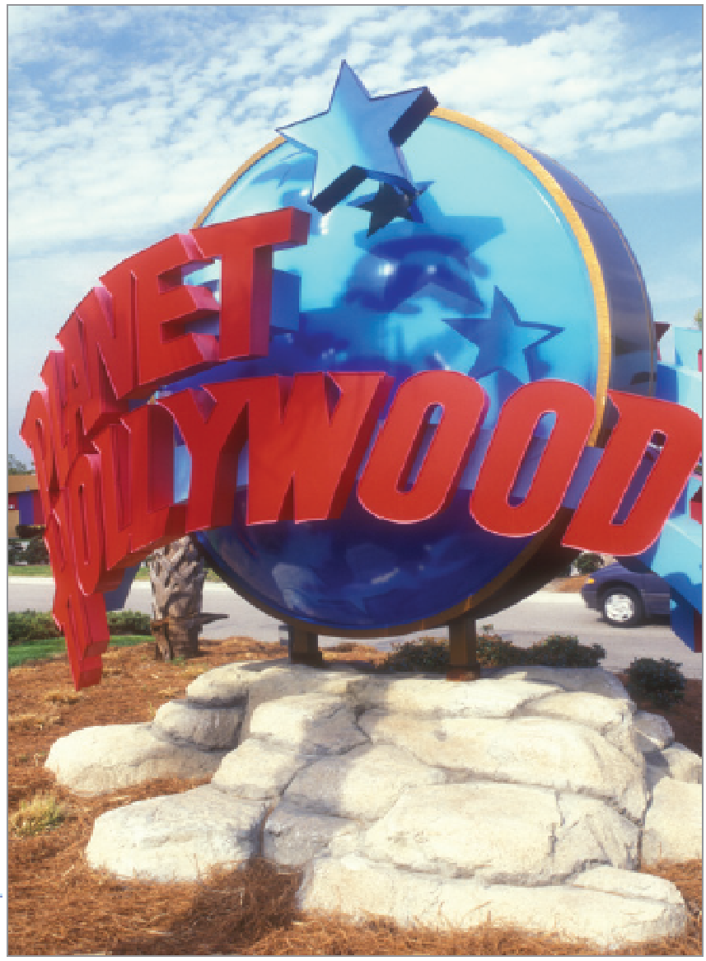
Retailtainment to Satisfy Experiential Shoppers
Retailtainment is all about marketing strategies that enhance the shopping experience.
Many consumers are seeking fun!
Retail experiences that incorporate elements of surprise, excitement, and novelty lead to increased purchase likelihood.
Notes:
LECTURE NOTES:
Stores need to position themselves in a manner that demonstrates their competitive advantage over other stores while attracting the interest and attention of the consumer.
Many retailers recognize that there is a “theatre” aspect to what they do. Shoppers represent the audience to be entertained, while the store design sets the stage. When sales people—the equivalent of actors in retail—are added to the mix, the scene is set. Employee uniforms often serve as costumes . . . For example, consider the referee shirts worn by Foot Locker employees.
Merchandising displays can be very creative, making the buying experience less about buying and more about having an experience. It’s clear that the line between entertainment and retail is blurring.

Slide 15
Ethical Problems in Retailing
Retailers must deal with ethical problems that involve both customers and employees.
Shoplifting
Employee theft
Retail “borrowing”
Ethical treatment of customers
Customer profiling
Sale of harmful products
Notes:
LECTURE NOTES:
Retailers experience ethical problems with both their customers and employees. Losses due to shrinkage are a growing problem. Shrinkage occurs due to shoplifting, employee theft or merchandise damage, or retail borrowing.
Shoplifting has increased substantially in recent years and accounts for 35% of all shrinkage. In 2009, shoplifting accounted for $15.1 billion in losses. Thus while the text labels shrinkage an ethical problem, it certainly has legal overtones. In fact, shoplifting is often an organized criminal activity in which thieves take various measures to evade security sensors. Items are then easily sold via eBay.
Employee theft of both merchandise and cash represents a second form of shrinkage. While some employees unconsciously take pens from work home in their pocket and forget to bring them back to work, the real damage comes from systematic, planned efforts to steal from the store. Theft of store gift cards is common, as is “sweethearting,”, a practice in which a cashier consciously undercharges or provides a cash refund to a friend. In extreme instances, unethical cashiers allow friends to walk away with merchandise without paying anything.
Retail borrowing occurs when nondefective products are returned and a refund is received for items that have already been used for the purpose for which they were bought. Liberal return policies of many merchandisers have allowed consumers to take advantage of “the system” in this fashion. Retail borrowing often occurs with special occasion clothing (suits, cocktail dresses for weddings, etc.). Unfortunately, sometimes this practice damages the merchandise in a manner that it makes unsuitable for resale, costing the retailer and manufacturer money.
Ethical treatment of customers: Some retailers treat their customers in an unethical manner, particularly when “snobbery” on the part of clerks discourages people who appear socially or economically disadvantaged from shopping. While preventing these individuals from entering the store outright is illegal, making snide comments, delaying service to the individual, or demeaning them by demanding to see their money upfront it not. Obviously, such treatment is unethical, though retail management may turn a blind eye to these tactics when they feel they are helpful in protecting the store’s image.
Some individuals believe that retailers have an obligation not to sell products that can be harmful to at risk groups. Retailers are obligated to follow the law, meaning that they must card those who purchase alcohol and tobacco products and follow appropriate regulations for the purchase of firearms and drug products. But there are limits to what retailers can be realistically asked to do. Expecting retailers to police the purchase of every item that could be potentially dangerous or harmful (particularly if misused) is irrational.

Slide 16
Ethical/Sustainable Decisions in the Real World
Most clothing purchased in the United States is made in developing countries.
Workers earn less than a living wage.
Fair Trade movement is gaining momentum.
Should all retailers seek out and buy Fair Trade goods?
Notes:
DISCUSSION NOTES:
Instructor may ask students whether they have had experiences shopping at any of the retailers mentioned in the piece. Do they have a generally positive or negative impression?
How important to you is it buy goods (including clothing) from Fair Trade retailers?
If you had to pay twice the amount for your clothes to ensure fair trade, would you do it? Why or why not?

Slide 17
Retailing is Big Business – All Around the World!
Retail formats and practices are constantly evolving due to economic, social and cultural changes.
Wheel-of-retailing hypothesis explains retail change.
Many Western consumers are today seeking out entertainment in their retail experiences.
Notes:
LECTURE NOTES:
This is a summary slide of the previous material.

Slide 18
Classify Retailers by What They Sell
One of the most important strategic decisions a retailer makes is what to sell—its merchandise mix.
Merchandise breadth: Number of different product lines
Narrow vs. broad assortment
Merchandise depth: Variety of choices available within each product line
Shallow vs. deep assortment
Notes:
LECTURE NOTES:
Merchandise breadth, or variety, is the number of different product lines available.
A narrow assortment, such as we encounter in convenience stores, means that shoppers will find only a limited selection of product lines, such as candy, cigarettes, and soft drinks.
A broad assortment, such as a warehouse store like Costco or Sam’s Club offers, means there is a wide range of items from eyeglasses to barbecue grills.
Merchandise depth is the variety of choices available within each specific product line.
A shallow assortment means that the selection within a product category is limited, so a factory outlet store may sell only white and blue men’s dress shirts (all made by the same manufacturer, of course) and only in standard sizes.
In contrast, a men’s specialty store may feature a deep assortment of dress shirts (but not much else) in varying shades and in hard-to-find sizes.
Figure 12.2 (next slide) illustrates these assortment differences for one product: science fiction books.

Slide 19
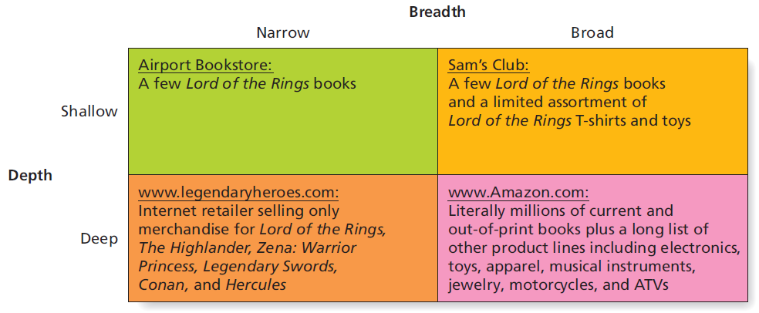
Figure 12.2 Classification of Book Retailers by Merchandise Selection
Notes:
LECTURE NOTES:
A retailer’s merchandise assortment has two dimensions: breadth and depth.
Breadth refers to the number of different product lines that a retailer carries. Narrow breadth means that the store specializes in a few product lines, while many product lines are available from retailers with a wide, or broad breadth.
By contrast, depth refers to the variety of choices within a given product line. Stores with shallow depth offer few items with a given product line while those with deep selections offer a large number of choices.
Figure 12.2 illustrates how breadth and depth can be used to create a four cell table for classification purposes.

Slide 20
Classify Retailers by Level of Service
Firms recognize trade-off between service and low prices and tailor strategies accordingly.
Retailers differ along a continuum based on amount of service provided to customers.
Self-service retailers (e.g, Sam’s Club)
Full-service retailers (e.g, Bloomingdales)
Limited-service retailers (e.g.,Walmart, Target, Kohl’s)
Notes:
LECTURE NOTES:
Retailers differ in the amount of service they provide for consumers.
Firms recognize that there is a trade-off between service and low prices, so they tailor their strategies to the level of service they offer.
Customers who demand higher levels of service must be willing to pay for that service, and those who want lower prices must be willing to give up services.
Retailers like Sam’s Club that promise cut-rate prices often are self-service operations. When customers shop at self-service retailers, they make their product selection without any assistance, they often must bring their own bags or containers to carry their purchases, and they may even handle the checkout process with self-service scanners.
Contrast that experience to visiting a full-service retailer. Department stores like Bloomingdale’s and specialty stores like Victoria’s Secret provide supporting services such as gift wrapping, and they offer trained sales associates who can help us select that perfect gift.

Slide 21
Table 12.1 Different Retailers Offer Varying Product Assortments, Levels of Service, Store Sizes, and Prices (1 of 3)
Type | Examples
Convenience stores | 7-Eleven
Supermarkets | Publix, Kroger
Box stores | ALDI
Specialty stores | Yankee Candle Co., Things Remembered
Notes:
LECTURE NOTES:
Characteristics of various types of retailers.

Slide 22
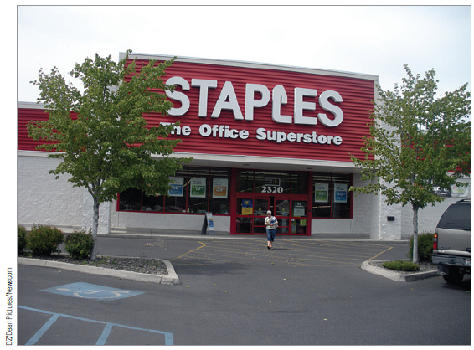
Category Killer
A category killer is a specialty store that carries a large section of products within a given category.
Best Buy
Lowe’s
Toys-R-Us
Notes:
LECTURE NOTES:
A category killer is a specialty store that carries a large selection of products in categories. These stores have become especially important in American retailing. Examples include Office Depot, Staples, Home Depot, Lowe’s, Best Buy, and Toys “R” Us.

Slide 23
Table 12.1 Different Retailers Offer Varying Product Assortments, Levels of Service, Store Sizes, and Prices (2 of 3)
Type | Examples
Category killers | Toys “R” Us, Home Depot, Best Buy
Leased departments | Picture Me portrait studios in Walmart stores
Variety stores | Dollar General, Dollar Tree
General merchandise discount stores | Walmart, Kmart
Off-price retailers | T.J. Maxx, Marshall’s
Notes:
LECTURE NOTES:
Characteristics of various types of retailers.

Slide 24
Department Stores
Department stores sell a broad range of items and offer a deep selection organized into different sections.
Full-service U.S. department stores have struggled in recent years.
Notes:
LECTURE NOTES:
Department stores sell a broad range of items and offer a deep selection organized into different sections of the store.
Grand department stores dominated urban centers in the early part of the twentieth century. In their heyday, these stores even sold airplanes and auctioned fine art.
In many countries, department stores continue to thrive, and they remain consumers’ primary place to shop. In Japan, department stores are always crowded with shoppers who buy everything from a takeaway sushi dinner to a string of fine pearls. In Spain, a single department store chain, El Corte Inglés, dominates retailing.
In the United States, however, department stores have struggled in recent years. On the one hand, specialty stores lure department store shoppers away with deeper, more cutting-edge fashion selections and better service. On the other hand, department stores have also been squeezed by discount stores, catalogs, and online stores that offer the same items at lower prices because they don’t have the expense of rent, elaborate store displays and fixtures, or high salaries for salespeople.
DISCUSSION NOTE:
While full-service department stores like Sears and JCP have struggled, discount department stores like Kohl’s are doing much better and have even become go-to source for fashion today (see Britney Spears ad depicted in slide).

Slide 25
Table 12.1 Different Retailers Offer Varying Product Assortments, Levels of Service, Store Sizes, and Prices (3 of 3)
Type | Examples
Warehouse clubs | Costco, Sam’s Club, BJ’s
Factory outlet stores | Gap Outlet, Liz Claiborne Outlet, Coach Outlet
Department stores | Macy’s, Bloomingdale’s, Nordstrom
Hypermarkets | Carrefour
Pop-up stores | Halloween Costume pop-ups
Notes:
LECTURE NOTES:
Characteristics of various types of retailers.

Slide 26
Popup Stores
Popup stores are temporary retail spaces that a company erects to help build buzz for its products.
Seasonal popup stores at Halloween and Christmas sell costumes and Christmas decorations.
Notes:
LECTURE NOTES:
Popup stores are temporary retail spaces that a company erects to help build buzz for its products.
With the economic downturn creating problems for many retailers, this concept is a popular way to test new product ideas or even whether neighborhoods are a good fit for a new store, with going to the expense of renting a full-blown retail space.
A range of marketers have bought into this concept, include upscale Hermes.
Seasonal pop-up stores are frequently opened to sell Halloween costumes, Christmas gifts and decorations, and fireworks, and traditional retailers, such as Target, Kate Spade, Gucci, and Louis Vuitton, have experimented with pop-ups.

Slide 27
Types of Retail Stores
Retailers may be categorized based on a variety of factors, including:
Merchandise mix—both breadth and depth of assortment
Service levels offered to customers
Store size
At how many different retailer types can a consumer purchase a gallon milk? A greeting card? Gasoline?
Notes:
LECTURE NOTES:
Summary slide for Chapter 12, learning objective 2.
DISCUSSION NOTE:
Instructor can begin by asking students where they purchased their last gallon of milk? Most likely a variety of retail formats will be represented in the answers.
Despite key differences in format, retailers compete against store-based and nonstore retailers of various types.
Consumers can even purchase cereal and other dry goods (plus receive free shipping if they are Amazon Prime customers) from Amazon.com.

Slide 28
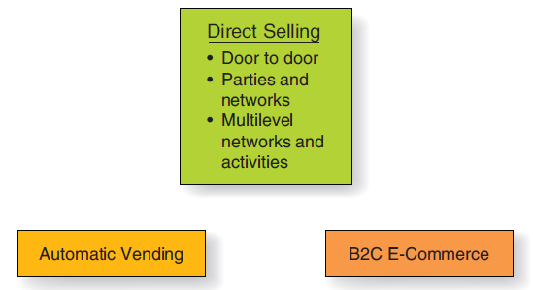
E-Commerce and Other Types of Nonstore Retailing
Nonstore retailing is any method a firm uses to complete an exchange that does not require a customer to visit a store
Notes:
LECTURE NOTES:
Nonstore retailing efforts are increasingly successful at reaching those consumers who don’t like shopping at malls or retail venues, or whose time commitments limit when they can shop. Nonstore retailing describes any method used to complete an exchange with a product end user that does not require a customer visit to the store. One type is direct selling, which as above Figure illustrates, may include door-to-door sales, parties and networks, and multilevel networks. Automatic vending and B2C E-commerce represent the other key forms of nonstore retailing.
Door-to-door selling is still popular in some countries, but is rarely used anymore in the United States. Door-to-door selling is illegal where Green River Ordinances exist. These are essentially community regulations that prohibit door-to-door selling unless given prior permission on a per household basis.
Pampered Chef is an example of a firm that sell products via the party plan system, in which a company representative makes a sales presentation to a group of people who have gathered at the home of a friend who typically provides food and often alcoholic beverages. Attendees often get caught up in the spirit of the event and buy things they wouldn’t normally purchase.
Multilevel networks and activities work for firms such as Amway, in which a master distributor recruits others to become distributors of the firms’ products as well, thereby ensuring him or herself a commission on every sale made by those he or she recruits. A benefit of this system is that it can sometimes reach consumers who belong to tightly knit groups when a member of the group is one of the recruits.
However, some network systems are illegal and are properly referred to as illegal pyramid schemes. These promise large profits from recruiting others to join the program rather than from any real investment or sale of goods, and typically require that those at the bottom of the pyramid pay a fee to advance to the top where they can allegedly benefit from others who are recruited. Other pyramid schemes disguise their true nature by requiring members to buy large costly quantities of merchandise upfront.

Slide 29
B2C E-Commerce
B2C e-commerce is online exchange between companies and individual consumers.
Shoppers purchased $373 billion in consumer goods online in 2016.
Experts predict that by 2017:
60% of all U.S. retail sales will involve the web in some way.
Web-influenced sales will increase to $1.8 trillion.
M-commerce is promotional or other e-commerce activities over mobile devices.
Notes:
LECTURE NOTES:
B2C e-commerce is online exchange between companies and individual consumers.
Forrester Research reports that in 2012, shoppers bought $231 billion worth of consume goods online growing to $370 billion by 2017.
A number of factors prevent online sales from growing even more.
Most consumers prefer stores where they can touch and feel items and avoid issues with returns and shipping costs.
Also, many consumers don’t like to buy online because they want the product immediately.
To address some of these issues, many retailers, such as Best Buy, have merged their online and in-store sales functions so that consumers can select an item and pay for it online, then pick it up at their local store within hours.
M-Commerce involves mobile devices, smartphones, and personal digital assistants. Mobile phones will generate 15% of ecommerce sales by 2020.

Slide 30
Table 12.2 Benefits and Limitations of E-Commerce (1 of 4)
Benefits For the Consumer
Shop 24 hours a day
Less traveling
Can receive relevant information in seconds from any location
More product choices
More products available to less developed countries
Greater price information
Lower prices, so less affluent can purchase
Participate in virtual auctions
Fast delivery
Electronic communities
Notes:
LECTURE NOTES:
As Table 12-2 illustrates, business-to-consumer e-commerce offers a number of benefits to both marketers and consumers.
Clearly B2C e-commerce increases the convenience for consumers by eliminating travelling and allowing for shopping to occur 24 hours a day, from any location. In less developed countries, consumers can find products that can’t be located locally.
For experiential shoppers, a key benefit of online shopping stems from the fact that they enjoy the “thrill of the hunt” when searching for items. Consumers enjoy other benefits as well, such as the ease with which shopping bots allow consumers to price items sold by different vendors.

Slide 31
Table 12.2 Benefits and Limitations of E-Commerce (2 of 4)
Benefits For the Marketer
The world is your marketplace
Decreases costs of doing business
Very specialized businesses can succeed
Real-time pricing
Notes:
LECTURE NOTES:
As Table 12-2 illustrates, business-to-consumer e-commerce offers a number of benefits to both marketers and consumers.
For marketers, the key benefits include the ability to expand their customer base —globally, if desired, and the ability to develop specialized businesses that would not be profitable if bound to a brick-and-mortar store. Excess inventory can be easily be sold by online retailers, or sold through online liquidators such as Overstock.com. E-commerce also reduces business costs—facility rentals and store interior design costs go out the window in the virtual environment, while product and packaging costs disappear for items that can be downloaded virtually such as software or music.

Slide 32
Benefits of B2C E-Commerce
Virtual Experiential Marketing is an online marketing strategy that engages experiential shoppers online by using:
Colors
Graphics
Layout and Design
Interactive Videos
Contests
Games
Giveaways
Notes:
LECTURE NOTE:
Some shoppers want to be “entertained” while shopping online. Virtual experiential marketing caters to this type of consumer.

Slide 33
Table 12.2 Benefits and Limitations of E-Commerce (3 of 4)
Limitations For the Consumer
Lack of security
Fraud
Can’t touch items
Exact colors may not reproduce on computer monitors
Expensive to order and then return
Potential breakdown of human relationships
Notes:
LECTURE NOTES:
As Table 12-2 illustrates, business-to-consumer e-commerce offers a number of benefits to both marketers and consumers.
With respect to the limitations of B2C e-commerce, as fast delivery options may be, consumers must still wait longer to receive most goods than if they went to the local mall and bought purchased the item off of the shelf. Poorly designed web sites can frustrate consumers with poor navigation, disappearing shopping baskets, or lack of FAQs or other access to customer service. Security concerns remain for both the consumer and the marketer. As consumers often want to touch and feel certain items prior to purchase, the Internet is at disadvantage when tactile considerations are important, or when consumers wish to be absolutely certain about how something fits, or the exact color of the item.

Slide 34
Table 12.2 Benefits and Limitations of E-Commerce (4 of 4)
Limitations For the Marketer
Lack of security
Must maintain site to reap benefits
Fierce price competition due to total transparency for branded products
Conflicts with conventional retailers
Legal issues not resolved
Notes:
LECTURE NOTES:
As Table 12-2 illustrates, business-to-consumer e-commerce offers a number of benefits to both marketers and consumers.
For Brick and Click stores, meaning those that have both an online presence as well as physical retail stores, cannibalization of in-store sales by the online alternative can be problematic. Some stores solve this problem by offering online items that are not stocked in the store.

Slide 35
Limitations of B2C E-Commerce
Shopping Cart Abandonment occurs when e-commerce customers leave an e-commerce site with unpurchased items in their cart.
Notes:
LECTURE NOTE:
An estimated 68% of all online customers leave unpurchased items in their cart. Customers are less likely to return to sites that are difficult to navigate. Also, customers ideally want items to remain in their cart if they have to leave the site – in other words, when they return later, they would like those items to still remain in their cart until purchased.

Slide 36
B2C’s Effect on the Future of Retailing
Does growth of B2C e-commerce mean the death of bricks-and-mortar stores as we know them?
Virtual distribution channels unlikely to replace traditional ones
Stores must evolve to lure customers away from the computer.
Consumers will visit destination retail more for the fun they receive from the total experience.
Notes:
LECTURE NOTES:
Despite the growth of B2C e-commerce, it is unlikely that e-commerce will ever completely replace physical store locations. Even in banking, consumers seem to value the choice of being able to go to an actual location for F2F transactions, as well as being able to shift funds or pay bills over the Internet. While many retailers would prefer to avoid the cost and hassle of staffing physical stores, it doesn’t seem to be in the cards anytime soon. However, more and more brick-and-mortar retailers are finding it necessary to entertain consumers as part of the shopping experience in order to lure them away from their computers. One destination retailers is Cabalas in Forth Worth Texas. This store enhances the shopping experience by maintaining huge freshwater aquariums containing a variety of American sporting fish. They also offer a wildlife museum of trophy deer heads and various wildlife animals.
WEBSITE INFORMATION:
Mall of America, one of the largest destination retailing centers, features an aquarium, a flight simulation, an 18-hole miniature golf course, a comedy club, and a massive four-story Lego playground. Click the “Attractions Button” to see the various offerings.

Slide 37
Direct Selling
Direct selling occurs when a salesperson presents a product to one individual or a small group, takes orders, and delivers the merchandise.
Door-to-door sales
Party and networks
Multilevel marketing
Notes:
LECTURE NOTES:
Direct selling occurs when a salesperson presents a product to one individual or a small group, takes orders, and delivers the merchandise.
The Direct Selling Association reported that in 2012, 15.9 million people engaged in direct selling in the United States, and these activities generated $31.63 billion in sales.
Door-to-door selling is still popular in some countries, such as China. But it’s declining in the United States, where two-income households are the norm, because fewer people are home during the day and those who are home are reluctant to open their doors to strangers.
At home shopping parties, also called in-home selling, a company representative known as a consultant, distributor, or adviser makes a sales presentation to a group of people who have gathered in the home of a friend. One reason that these parties are so effective is that people who attend may get caught up in the “group spirit” and buy things they would not normally purchase if they were alone.
Another form of direct selling, which the Amway Company epitomizes, is multilevel marketing or network marketing. In this system, a master distributor recruits other people to become distributors. The master distributor sells the company’s products to the people he or she entices to join and then receives commissions on all the merchandise sold by the people he or she recruits. Today, Amway has over 3 million independent business owners who distribute personal care, home care, and nutrition and commercial products in more than 100 countries.

Slide 38
Automatic Vending
Automatic vending
Usually best suited to low-cost convenience goods
Offers many benefits to consumers and marketers
Notes:
LECTURE NOTES:
When consumers can’t or won’t visit the store, automatic vending machines serve as a tried-and-true method of selling convenience goods. Vending units require relatively little space and personnel to maintain, and offer the advantage of providing products when and where it is convenient for consumers to buy. Lately it seems as if everything from ice, to fishing bait, to DVDs can be purchased from vending units. This is particularly true as touchscreen technology and credit cards make it possible to purchase more costly items.
Japan has the highest number of automatic vending machines per capita, and marketers have developed some very creative vending opportunities. Let’s visit the website on this slide and take a look.
WEBSITE NOTES:
This site offers 14 examples of creative vending machines that sell everything from traditional beverages like Coca-Cola to non-traditional items such as sneakers. While Coca-Cola video is not functioning, the 36 second “egg” video demonstrates

Slide 39
Nonstore Retailing
Nonstore retailing encompasses:
B2C e-commerce
Direct selling
Automatic vending
Many conventional retailers—from Tiffany’s to Walmart—offer nonstore alternatives.
Is multilevel marketing the same as a pyramid scheme?
Notes:
LECTURE NOTES:
Summary slide for Chapter 12, learning objective 3.
DISCUSSION NOTE:
Pyramid schemes are illegal scams that promise consumers or investors large profits from recruiting others to join the program rather than from any real investment or sale of goods to the public.
Often, large numbers of people at the bottom of the pyramid pay money to advance to the top and to profit from others who might join. At recruiting meetings, pyramid promoters create a frenzied, enthusiastic atmosphere complete with promises of easy money.
Promoters also use high-pressure tactics to get people to sign up, suggesting that if they don’t sign on now, the opportunity won’t come around again.
Pyramid schemes are sometimes disguised as multilevel marketing—that is, people entering the pyramid do not pay fees to advance, but they are forced to buy large, costly quantities of nonreturnable merchandise.
That’s one of the crucial differences between pyramid schemes and legitimate network marketers.

Slide 40
Marketing What isn’t There
Services are acts, efforts, or performances exchanged from producer to user without ownership rights.
Service industry account for four out of every five jobs in the United States and nearly 80% of GDP.
Services are targeted toward both consumers and organizations.
Intangibility of services creates unique opportunities and challenges for marketing.
Notes:
LECTURE NOTES:
Services satisfy needs when they provide pleasure (movie theatre showings), information (advertising), or convenience (online banking).
Services in the United States accounted for over 2/3 of the U.S. gross domestic product. Many forms of marketing careers fall within the service industry (advertising, research, sales, retail, etc.)
Consumer services are easy to identify. Many of these same services (lawn care, insurance, security for example), are also targeted towards businesses, though the scope of services provided to consumers vs. businesses may differ substantially. However, there are also some services and service providers who specifically target businesses exclusively.
Intangibles include services and other experience-based products that cannot be touched.
Of course many services actually combine experiences with physical goods as part of the delivery of that service. For example, many movies are seen in a theatres — theatre seats and the sound system are goods that compliment the delivery of the movie experience.
DISCUSSION NOTE:
Ask students if they can come up with some examples of services that are marketed to both individuals and organizations.
POTENTIAL ANSWERS: Consulting, food services

Slide 41
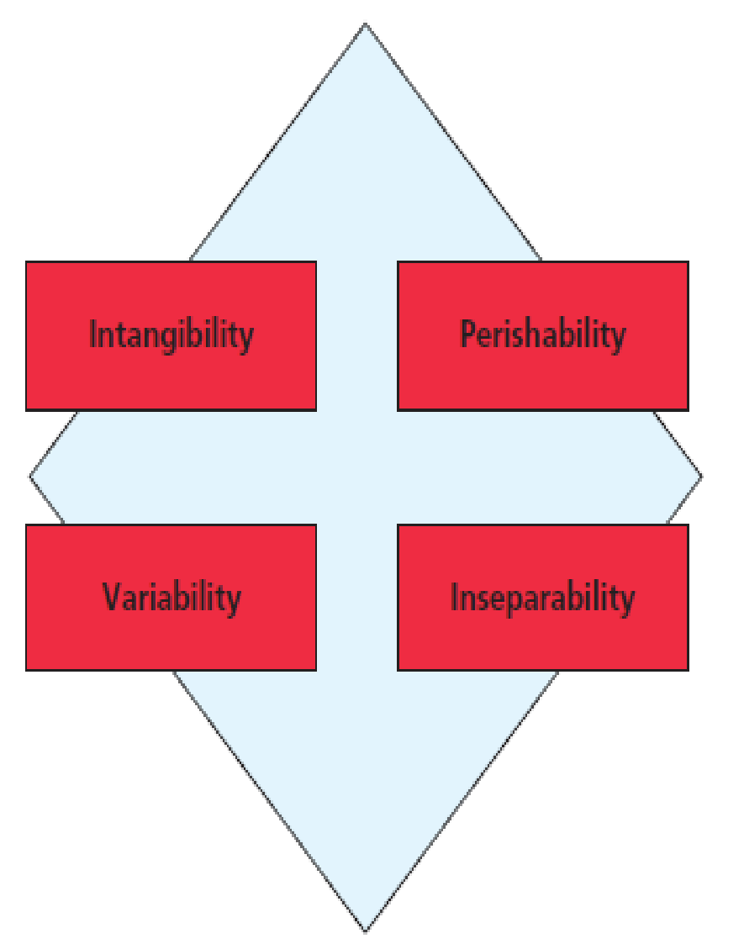
Figure12.4 Characteristics of Services
Notes:
LECTURE NOTES:
Services come in many forms, from those done to you, such as a massage or a teeth cleaning, to those done to something you own, such as having your house painted or your computer fixed.
All services, however, share four key characteristics.
Intangibility: Can’t see, touch, or smell a service. This means services can’t be inspected or tried prior to purchase, which makes it much more difficult to evaluate services offered by different providers. Thus marketers rely on physical cues to reassure the buyer that they are buying a good service. Cues might include the “look” of the facility, its furnishings, lighting, cleanliness, employee appearance, web site or advertising.
Perishability: Services can’t be stored for later sale or consumption and instead MUST be used at the time they are available. There are so many appointment periods in a doctor’s day . . . An empty slot at 8 am cannot be saved and used later. Capacity management allows firms to adjust their services to match supply with demand. We’ll discuss capacity management in more detail soon.
Variability: Even the same service performed by the same person will vary when delivered on different days or at different times. Lack of standardization is often perceived as a problem. Training can minimize wide variations in service delivery, but it is often difficult to eliminate entirely. Explicit standards and operating procedures may also help to minimize variability, while mystery shoppers and customer feedback can be used to identify cases of poor service quality. However, in many cases, the variability of services actually allows different customers to customize services to their preferences (unique hairstyles).
Inseparability: Because services must be experienced to be used, it is impossible to separate the production of a service from its consumption. Its difficult to detach the expertise, skill, and personality of a provider from the firm’s employees (especially when services are delivered by people).

Slide 42
Characteristics of Services (1 of 2)
Intangibility
Can’t see, touch, or smell good service
Marketers provide physical cues
Perishability
Impossible to store for later sale or consumption
Capacity management
Notes:
LECTURE NOTE:
Intangibility: Can’t see, touch, or smell a service. This means services can’t be inspected or tried prior to purchase, which makes it much more difficult to evaluate services offered by different providers. Thus marketers rely on physical cues to reassure the buyer that they are buying a good service. Cues might include the “look” of the facility, its furnishings, lighting, cleanliness, employee appearance, web site or advertising.
Perishability: Services can’t be stored for later sale or consumption and instead MUST be used at the time they are available. There are so many appointment periods in a doctor’s day . . . An empty slot at 8 am cannot be saved and used later. Capacity management allows firms to adjust their services to match supply with demand. We’ll discuss capacity management in more detail soon.

Slide 43
Characteristics of Services (2 of 2)
Variability
Service can vary
Difficult to standardize services
Inseparability
Impossible to separate the production and consumption of a service
Disintermediation
Notes:
LECTURE NOTES:
Variability: Even the same service performed by the same person will vary when delivered on different days or at different times. Lack of standardization is often perceived as a problem. Training can minimize wide variations in service delivery, but it is often difficult to eliminate entirely. Explicit standards and operating procedures may also help to minimize variability, while mystery shoppers and customer feedback can be used to identify cases of poor service quality. However, in many cases, the variability of services actually allows different customers to customize services to their preferences (unique hairstyles).
Inseparability: Because services must be experienced to be used, it is impossible to separate the production of a service from its consumption. Its difficult to detach the expertise, skill, and personality of a provider from the firm’s employees (especially when services are delivered by people). Disintermediation is the elimination of some layers of the channel of distribution to cut costs and improve the efficiency of the channel.

Slide 44
The Service Encounter
A service encounter occurs when the customer comes into contact with the organization.
Social contact dimension
Physical dimension
Quality of the service encounter exerts a big impact on service quality evaluations.
Customer also plays a role in service experiences.
Notes:
LECTURE NOTES:
The social contact dimension refers to that fact that in many service encounters, one person (say a server), interacts with another person (customer). Often, it’s the interaction itself that can make or break a service encounter. The most delicious meal can be ruined by a server who doesn’t get it to the table on time, who forgets the wine, or who is rude to the customers that he or she serves. The interaction element often results in a “moment of truth” meaning that the employee determines whether the customer leaves with a positive or negative impression. The quality of the service is only as good as the business’ worst employee.
The physical dimension of the service encounter means that customers pay close attention to facilities as cues of what to expect in the way of service quality. For example, where would you expect a better experience —at a well-lit, clean restaurant with attractive furnishings or one that has sticky, stained menus with prices crossed out and rewritten, booths with cuts in the faux leather and sprung springs, and flickering lights?
The quality of the service encounter exerts a big impact on how we feel about the service we receive. In other words, the quality of a service is only as good as its worst employee.
However, the customer also plays a part in the type of experience that results from a service encounter. When you visit a doctor, the quality of the health care you receive depends not only on the physician’s competence. It’s also influenced by your ability to accurately and clearly communicate the symptoms you experience and how well you follow the regimen he or she prescribes to treat you.
DISCUSSION NOTE:
Ask students whether they have ever been to a restaurant that didn’t look great from the outside and the furnishing were poor, but provided great food and service?
Conversely, have they ever been poorly treated by a service provider that had a wonderfully designed and decorated physical environment?

Slide 45
Physical Elements of the Service Encounter
Servicescapes are the actual physical facility where the service is performed, delivered, and consumed.
Includes exterior and interior elements of the service facility
Servicescapes can influence customer perceptions.
Not as important if customer does not have to visit a designated location
Notes:
LECTURE NOTES:
Because services are intangible, marketers must pay careful attention to the physical evidence of the service, called the servicescape.
Servicescapes include facility exteriors—the outer building, the landscape, parking lot, etc., as well as facility interior elements —design, color, air quality, temperature, smells, etc.
Consideration of the servicescape is critical, as they influence consumer perceptions in a number of ways. Thus the servicescape should project the image desired for the business.
However, there are some services that come to customers instead of relying on customers to visit a designated location (leak detection services, some fencing companies, pop-a-lock, etc.) If the customer doesn’t visit the service providers office, facility exterior and interior considerations will not influence customer perceptions.
Instead, customers may look towards the VEHICLE delivering the service provider for cues that can influence their perceptions. (Is the car or truck clean? New? Dented? Well-maintained?)

Slide 46
How We Provide Quality Service
Quality service ensures that customers are satisfied with what they have paid for.
Satisfaction is based on customer expectations.
Not all customers expect the same level of service.
Not all customers can be satisfied.
Notes:
LECTURE NOTES:
If a service experience is not positive, dissatisfied customers will often complain to other people. This is called negative word-of-mouth, and the effects of negative WOM can be very powerful, as some people may be influenced to avoid a particular service provider while others may share the negative WOM second hand with their friends or contacts.
Unfortunately, satisfaction with services is relative because each service user will compare the service provided to a set of expectations. Expectations can be formed on the basis of marketing communications (which is why marketers should NEVER promise more than a service provider can offer); they can also be formed on the basis of previous service encounters. Thus the same service might be perceived as “great” by individual “A” but as mediocre by individual “B” who has been spoiled by outstanding service in earlier encounters. Marketers’ goal should be to exceed the customer’s expectations, thereby creating strong customer satisfaction.
Furthermore, it is not always possible to meet, much less exceed, expectations. Exaggerated expectations account for 75%of customer complaints. Explanations for service failures, and compensating customers for bad experiences can help to retail customers over time.
DISCUSSION NOTE:
Disney makes all employees, or “Cast Members” (whether they sell ice cream on Main Street USA or they come in from another company to fill an executive role), go through “Traditions” training, as well as many other training programs, to help ensure that all Disney cast members know how they should interact with guests.
They follow up frequently with refresher seminars and meetings to remind everyone of the company’s history and traditions.

Slide 47
Strategic Issues When We Deliver Service Quality
The SERVQUAL scale is a popular instrument to measure customer service quality.
SERVQUAL identifies consumer perceptions of service quality on five components:
Tangibles
Reliability
Responsiveness
Empathy
Assurance
Notes:
LECTURE NOTES:
SERVQUAL is a popular tool for measuring customer service quality. The “Metrics Moment” sidebar in the text describes the five components.

Slide 48
Marketing People, Places, and Ideas
Services are not the only intangibles that organizations need to market.
Intangibles such as people, places, and ideas must also be marketed.
Notes:
LECTURE NOTES:
Services are just one type of intangible —people, places, and ideas are other intangibles requiring marketing.

Slide 49
Marketing People
Politicians, athletes, and celebrities are commonly marketed.
Consultants “package” celebrities
Name changes and rebranding are common
Notes:
LECTURE NOTES:
Whether it’s a job candidate marketing themselves to a potential employer or an actress auditioning for a movie role, people often find themselves in need of marketing.
Actresses and politicians routinely undergo facelifts or other forms of plastic surgery to improve their marketability.
Image consultants recommend changes in grooming, hair styles, and wardrobe for politicians, celebrities, CEOs, or even “regular people.”. These activities represent “packaging” for people.

Slide 50
Table 12.4 Strategies to Sell a Celebrity
Marketing Approach | Implementation
Pure selling approach | Agent presents a client to the following:
Blank | Record companies
Blank | Movie studios
Blank | TV production companies
Blank | Talk show hosts
Blank | Advertising agencies
Blank | Talent scouts
Product improvement approach | Client is modified:
Blank | New name
Blank | New image
Blank | Voice lessons
Blank | Dancing lessons
Blank | Plastic surgery
Blank | New backup band
Blank | New music genre
Market Fulfillment approach | Agent looks for market opening:
Blank | Identify unmet need
Blank | Develop a new product (band or singer) to the specifications of consumer wants
Notes:
LECTURE NOTES:
Table 12.4 lists three approaches that are commonly used to csell strategies.
The pure selling approach —agents present their celebrities qualifications to various intermediaries who might need the individual’s services.
Product improvement approach —The agent works with the client to modify certain characteristics that will increase his/her market value.
The market fulfillment approach —an agent scans the market to ID unmet needs. After identifying a need, the agent finds a person or group that meets a set of minimum qualifications and develops a “new product” that matches what consumers want.

Slide 51
Marketing Places
Place marketing strategies treat a city, state, country, or other locale as a brand.
Michigan Travel and Tourism Site
Notes:
LECTURE NOTES:
Marketing places can involve creating appeals that promote a city, state, country, or other locale (e.g., Mall of America) to one or more traveler segments. Segments that may be targeted include meeting planners, convention, association, or trade show planners, business travelers and/or corporate travel agents (who book general travel or incentive/rewards travel) or individual/family tourists and tour groups who comprise the leisure segment.
The marketing of Las Vegas as a tourist destination has changed course several times. First they tried to clean up the city’s original image as a den of corruption and vice to encourage family visits. Then they switched direction and plugged the city’s bawdy roots with the slogan “What happens in Vegas stays in Vegas.” Oops, then the recession hit and companies clamped down on business and convention travel to “Sin City.” Now, Vegas no longer promotes its famous tagline as it opens its arms to families once again with all sorts of kid-friendly activities and incentives.

Slide 52
Marketing Ideas
Idea marketing
Gaining market share for a concept, philosophy, belief, or issue (e.g., religious institutions market ideas about faith)
Consumers often do not perceive the value they receive when they conform with an idea or fail to believe an idea is worth its ultimate cost.
Notes:
LECTURE NOTES:
Idea marketing refers to marketing strategies designed to gain market share for a concept, philosophy, belief, or issue. Charities market the idea that donations to worthy causes can make a difference; religions market faith; antidrug ads market the negative consequences of drug use.
Unfortunately, the marketing of ideas is often very difficult because consumers do not perceive when they act in accordance with a particular idea or philosophy. Others fail to believe that an idea is worth the cost (e.g., minimizing global warming).

Slide 53
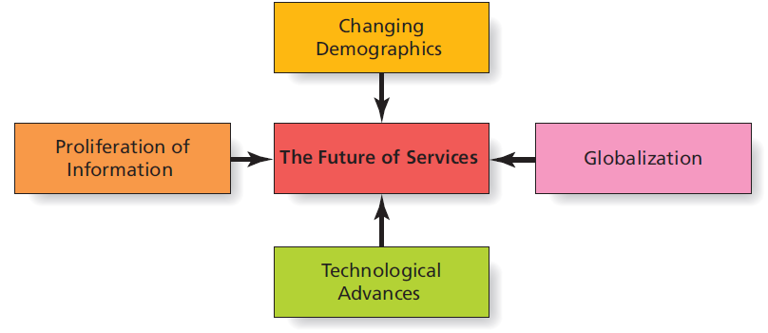
Figure 12.5 Factors that Shape the Future of Services
Notes:
LECTURE NOTES:
The new dominant logic for marketing means that we must rethink our traditional distinction between services and goods. Physical products involved are relatively minor in terms of their contribution to the value proposition while the service aspect is the central element in each exchange.
A number of trends exist that will present challenges and opportunities to service marketers in the future.
Changing demographics: The surge in the birth rate following World War II created the baby boom. As this large group continues to age, service industries which appeal to this demographic will be in high demand (retirement communities, health care, assisted living, etc.).
Globalization: This trend will increase the need for distribution, logistical, accounting, and legal services that have specialized international knowledge. Globalization also means greater competition; for example, U.S. Hospitals will need to compete for elective surgeries with medical facilities in other countries that cost much less.
Technological advances: Improvements in technology offer service providers opportunity for growth in the telecommunications, health care, and Internet service industries. Innovation is also likely as some services which will be offered in the future haven’t even been thought of yet.
Proliferation of information: The availability, flow and access to information are critical to the success of organizations. Database services, artificial intelligence systems and communications systems in general stand to benefit in the future.

Slide 54
Copyright

