Slide 1
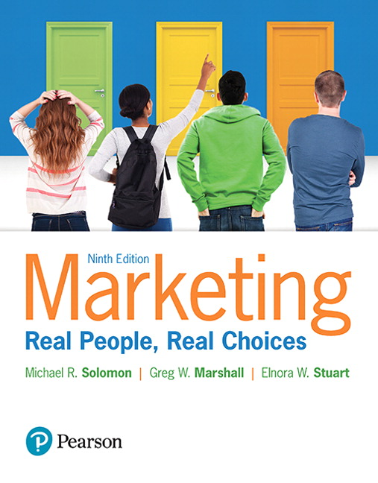
Marketing: Real People, Real Choices
Ninth Edition
Chapter 10
Price
Copyright © 2018, 2016, 2012 Pearson Education, Inc. All Rights Reserved.
Notes:
If this PowerPoint presentation contains mathematical equations, you may need to check that your computer has the following installed:
1) MathType Plugin
2) Math Player (free versions available)
3) NVDA Reader (free versions available)

Slide 2
Learning Objectives
10.1 Explain the importance of pricing and how
marketers set objectives for their pricing
strategies.
10.2 Describe how marketers use costs, demand,
revenue, and the pricing environment to make
pricing decisions.
10.3 Understand key pricing strategies and tactics.
10.4 Understand the opportunities for Internet
pricing strategies.
10.5 Describe the psychological, legal, and ethical
aspects of pricing.
Notes:
LECTURE NOTES:
Learning objectives for Chapter 10 (Price).

Slide 3
Real People, Real Choices: Converse College
Which option should Betsy pursue?
Option 1: Reset tuition to a significantly lower price for traditional undergraduate students.
Option 2: Freeze tuition for each incoming student from the time she matriculated until she graduated.
Option 3: Provide students with a Loan Repayment Program (LRP), which guarantees that any student without employment after college would have her loans covered by an insurance policy.
Notes:
DISCUSSION NOTE:
Explain to students that you want them to think about each option, and that you will return to this question at the end of the chapter.

Slide 4
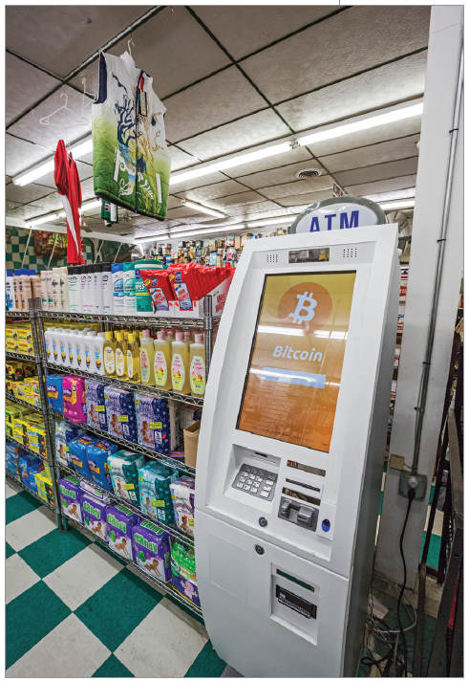
“Yes, but What Does It Cost?”
Price is the assignment of value, or the amount the consumer must exchange to receive the offering.
Includes money, goods, services, favors, votes, or anything else that has value to the other party
Opportunity costs must also be considered.
Notes:
LECTURE NOTES:
When you think of price, you probably think of the amount of money you have to pay to purchase a product, or enjoy a service. Price certainly includes the cost of an item, but it also includes other things that must be exchanged as part of a transaction as well. For example, many international business transactions are characterized by various forms of barter or countertrade that don’t involve an exchange of money at all. Even in the United States, the purchase of a car may include trade-in of your existing vehicle along with a cash payment.
Opportunity costs refer to the something that we have to give up in order to obtain something else. For example, think about the “price” that must be paid by an individual for a two-week-long vacation at an all-inclusive resort. What else must be given up the individual besides the monetary cost of the vacation?
DISCUSSION NOTE:
Students may need some prompting to realize that there could also be a substantial opportunity cost. For part-time employees who are paid by the hour, the income they lose by not working during the vacation period represents an opportunity cost. The situation with full-time employees is a little different. While one can assume that the employee is paid for their vacation time, there is still an opportunity cost in that they can’t “return” the vacation and get their days “back” to use again, if they don’t like the resort, or if the weather is bad.
You might also pose the question about the price paid by children who participate in a family vacation. In this example, a substantial monetary cost is very unlikely as children aren’t expected to contribute to the cost of the resort room or travel. However, children may spend some of their allowance or gift money on souvenirs or special activities during the course of the vacation, which could be considered a monetary cost. The opportunity cost for children may include missed learning opportunities (if the parents take the children out of school for the trip), or missed opportunities for other recreational activities that may be occurring at home during the same time span (football games, parties with friends, etc.).

Slide 5
Figure 10.1 Elements of Price Planning
Notes:
LECTURE NOTES:
Firms undertake price planning in six steps, as shown in Figure 10.1. The process begins by setting objectives. This is followed by estimating demand and determining relevant costs. Examination of the pricing environment precedes the choice of a pricing strategy and the implementation of pricing tactics. Each of these steps will be discussed in more detail as we work through the chapter material.

Slide 6
Step 1: Set Pricing Objectives
Must support the broader objectives of the firm as well as overall marketing objectives.
Notes:
LECTURE NOTES:
When setting pricing objectives, marketers should consider profit, sales, market share, competitive effect, customer satisfaction, and image enhancement.

Slide 7
Pricing Objectives (1 of 2)
Profit Objectives
Sales or Market Share Objectives
Competitive Effect Objectives
Notes:
LECTURE NOTE:
Profit objectives focus on a level of profit growth or a target net profit margin.
Sales objectives focus on the dollar or units sold while market share objectives attempt to increase market share.
Competitive effect objectives with the pricing plan attempt to dilute the competition’s marketing efforts.

Slide 8
Pricing Objectives (2 of 2)
Customer Satisfaction Objectives
Image Enhancement Objectives
Notes:
LECTURE NOTE:
Customer satisfaction objectives focus on keeping customers for the long term.
Image enhancement objectives attempt to get customers to relate a high price to potentially better quality. Prestige products such as Rolls-Royce or Rolex have a high price tag, but appeal to customers’ thoughts about “status.”

Slide 9
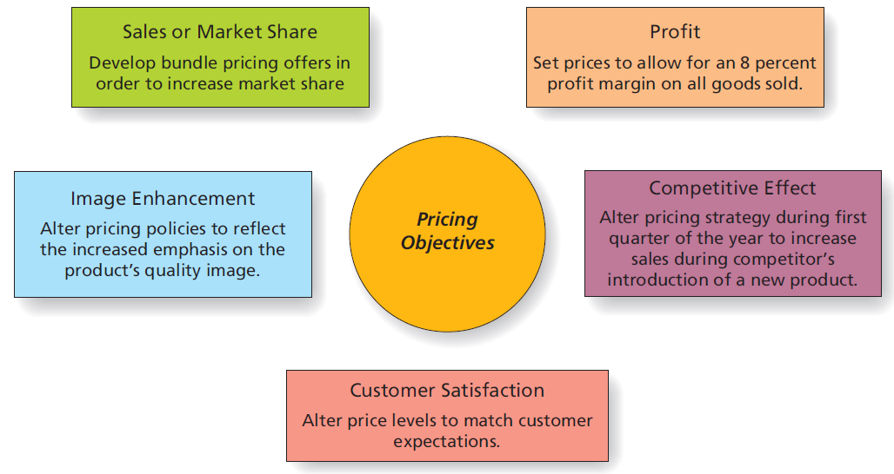
Figure 10.2 Pricing Objectives
Notes:
LECTURE NOTES:
Pricing objectives take five major forms: sales or market share, profit, image enhancement, competitive effect, or customer satisfaction. Examples of each strategy are summarized in Figure 10.2.
Profit objectives are typically used in the pricing of B2B goods. For consumer goods firms, profit objectives may focus on a product line or portfolio of products.
The text mentions that profit objectives are crucial for fad products, because fads tend to be short-lived. But sometimes sales objectives are set for fad products instead. For example, who knew that Pepsi marketed a drink called Ice Cucumber soda? The drink wasn’t available in the United States, but 4.8 million bottles were sold within a two-week time span in Japan. Once the existing inventory was depleted, the product was killed—on purpose— having met it sales objectives. Most students will be surprised to hear this, especially because product development took over two years to complete. Yet this is but one example of a systematic strategy on Pepsi’s part to raise their overall share of the market by playing to cultural differences related to a love of fads. In particular, the Japanese are intrigued by limited edition or fad items, and flock to the stores when new limited edition items become available. Pepsi’s strategy has paid off. According to Business Week, their share of the Japanese beverage market increased from 10% in the late 1990’s to around 20% in August 2007, while chief rival Coca-Cola’s market share has been declining over the same time period. {(SOURCE: “Fad Marketing’s Balancing Act,” Business Week Online, August 6, 2007. Retrieved from http://www.businessweek.com/magazine/content/07_32/b4045055.htm on October 30, 2008.)}
When pricing objectives feature sales or market share, marketers often use sales promotions or pricing discounts to meet these objectives. Such strategies must be approached with caution however, as the case of the U.S. airline industry illustrates.
However, if a product has a competitive advantage, it may well be able to accomplish market share or sales objectives without resorting to the use of discounts or sales promotions.
Sometimes the firm consciously prices its products in a way that negatively impacts competitors marketing efforts. Established brands often react to new market entrants by cutting prices (sometimes even below the cost of the product or service) in an attempt to drive the newcomer out of business or out of the geographic market. Small business marketers often do the same thing.
But marketers must be cautious when implementing such a strategy as predatory pricing practices may be viewed by a given country as anti-competitive, and thus illegal. We’ll discuss predatory pricing in more detail later on in the chapter.
Quality-focused firms believe that profit stems from customer satisfaction, and some firms price their products in a manner that satisfied customers. This philosophy was behind Saturn’s no haggle pricing strategy, as then parent company GM recognized that many car buyers are dissatisfied or even intimidated by the negotiation process that accompanies car buying.
Consumers who lack experience in buying a certain type of product (such as carpet, for example) and who are unfamiliar with brand names within a product category will often rely on price as a cue to product quality. Brands that are marketed on the basis of status or prestige should correspondingly charge higher prices to reflect that image to consumers.

Slide 10
Getting to the Right Price
It is very rare for someone to agree to buy something without knowing the price.
Non-monetary costs are also of great significance for marketers.
Price planning follows a sequence of steps that begins with setting pricing objectives.
Consider tuition at your college or university. What type of pricing objective do you believe is being used by the administration?
Notes:
DISCUSSION NOTE:
Instructor may ask students to contrast tuition and corresponding pricing objectives across different types of higher education institutions/models.
Public universities
Small private colleges
Community colleges and technical schools
“Ivy League” colleges and universities (e.g., Harvard)
For-Profit Online Universities (e.g., University of Phoenix)
MOOCS

Slide 11
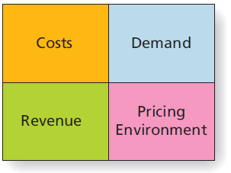
Costs, Demand, Revenue, and the Pricing Environment
In order to set the right price, marketers must understand quantitative and qualitative factors that can influence pricing strategy success.
Notes:
LECTURE NOTES:
Once objectives are set, marketers begin the actual process of setting the price of a brand. This requires estimations of demand, costs, revenues, and an understanding of the pricing environment.

Slide 12
Step 2: Estimate Demand
Demand refers to customers’ desire for a product.
How much are customers willing to pay as the price of the product goes up or down?
Economists use demand curves to illustrate the effect of price on quantity of a product demanded.
The law of demand: As price goes up, quantity demanded goes down.
Notes:
LECTURE NOTES:
The next step is to estimate demand.
Demand refers to customers’ collective desire for a particular product.
A key question is how much does this desire fluctuate with changes in pricing levels, a concept known as a demand curve.
Economists use a graph of a demand curve to illustrate the effect of price on the quantity demanded of a product.
The demand curve, which can be a curved or straight line, shows the quantity of a product that customers will buy in a market during a period of time at various prices if all other factors remain the same.
DISCUSSION NOTE:
In the real world, factors other than the price and marketing activities influence demand.
If it rains, the demand for umbrellas increases and the demand for tee times on a golf course is a wash.
The development of new products may also influence demand for old ones. For instance, even though a few firms may still produce phonographs, the introduction of cassette tapes and then CDs and iPods has all but eliminated the demand for new vinyl records and turntables on which to play them.

Slide 13
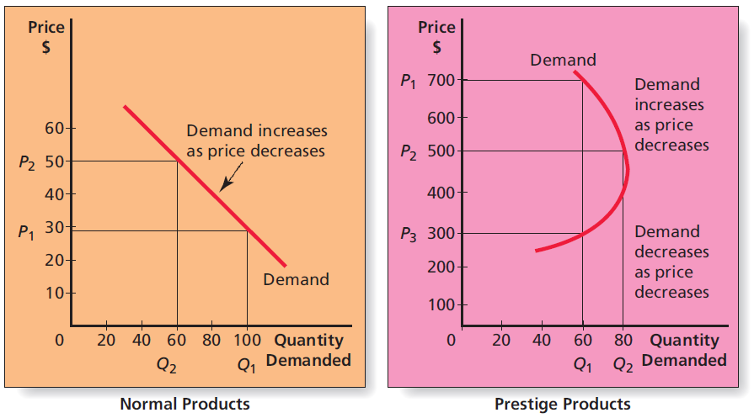
Figure 10.4 Demand Curves for Normal and Prestige Products
Notes:
LECTURE NOTES:
Demand curves illustrate the effect of price on quantity demanded. For normal products, the demand curve isn’t a curve at all, but rather is just a straight line, as shown here for normal products. In this situation, the law of demand dictates that as price goes up, quantity demanded declines.
The vertical axis of demand curves shows the various prices that a firm might be willing to charge for a product. Demand is portrayed as the number of units that consumers are willing to purchase at a given price. Thus when price is set at $30 (P1), the quantity demanded is forecast to be 100 units (Q1) while a price increase to $50 (P2) results in a drop of demand to 60 unit (Q2).
However, the law of demand does not always accurately reflect how price and demand interact. For example, brands that are marketed on the basis of prestige, status, or simple snob appeal are characterized by a very different sort of demand curve, as shown on the right-hand side of Figure 10.4.
In this situation, low prices makes the product undesirable as consumers simply can’t reconcile a low cost with a prestigious product. They may suspect the brand is a counterfeit, for example. As price increases, so does demand, to a certain point. Some consumers feel that a product becomes more desirable as the price increases simply because not everyone can afford to buy it.
However, as price continues to increase, some buyers will drop out of the market.
The combination of these factors creates the backward facing demand curve shown for Prestige Products in Figure 10.4.
For prestige products, a price increase may actually increase the quantity demanded.

Slide 14
Shifts in Demand
A shift is a change in direction or position.
Marketers can stimulate shifts through effective marketing.
An upward shift is when a greater demand for a product occurs.
A downward shift is when demand suddenly drops.
Notes:
DISCUSSION NOTES:
Shifts can occur naturally, such as when the paparazzi catch a celebrity using a company’s products.
Sometimes “viral” social media postings can cause upward or downward shifts in products, depending if the posts are positive or negative.
What shift would occur in demand if your favorite movie star was photographed drinking a Starbucks beverage? Why?
What shift would occur in demand if a YouTube video showed a particular brand of cellphone catching fire all by itself? Why?

Slide 15
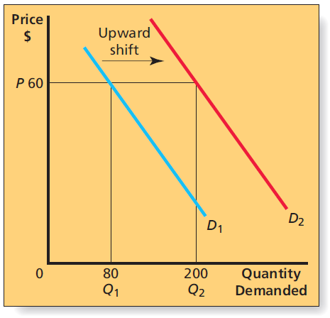
Figure 10.5 Shift in Demand Curve
Notes:
LECTURE NOTES:
Typical demand curves assume that only price changes, but in reality, other factors can change and shift demand upward or downward.
For example, changes in marketing strategy such as the addition of new, highly desired product feature or the launch of a fantastic new advertising campaign can shift the demand curve upward (to the right), meaning that more units are now demanded at a given price compared to before the change in marketing strategy was implemented.
Correspondingly, a variety of things can cause a downward shift in demand. Product recalls can stifle demand, development of new technologies can make a product’s existing technology obsolete and thus less desirable, a scandal in the parent company may stir up negative sentiment against the firm and brand, etc.
Weather can even influence demand for everything from umbrellas and sweatshirts to hotel accommodations and movie tickets.

Slide 16
Table 10.1 Estimating Demand for Pizza
Number of families in market | 180,000
Average number of pizzas per family per year | 6
Total annual market demand | 1,080,000
Company’s predicted share of the total market | 3 percent
Estimated annual company demand | 32,400 pizzas
Estimated monthly company demand | 2,700 pizzas
Estimated weekly company demand | 675 pizzas
Notes:
LECTURE NOTES:
Estimating demand accurately is critical as demand estimates influence production scheduling, marketing planning, budgeting, and more.
Table 10.1 illustrates the demand estimation process in the context of how a new business such as a pizza parlor might estimate demand for the market it expects to serve.
The process begins by identifying the number of potential buyers of the product, and multiplying that number by the average number of purchases each is likely to make over a particular time period. In this example, the geographic area being served by the pizza firm contained 180,000 pizza eating families who on averaged ordered out or dined in at pizza parlors six times a year. Multiplying these two factors yielded a total annual market demand of 1,080,000 pizzas.
The next step to estimating company demand is to multiply the total annual demand by the firm or brand’s forecast market share. Thus 3% of the total market yields an estimated annual company demand of 32,400 pizzas, which divided by 12 and 52, yields monthly and weekly pizza demands of 2,700 and 675, respectively.
While this process may sound simple, marketers must be realistic at each phase of the demand estimation process. For example, using census data to project the number of families in the market would overestimate demand, as not all families eat pizza. Similarly, failing to take into account current economic conditions could cause inaccurate projections. When the economy is in a recession, fewer families may go out for pizza, instead choosing to buy a grocery store pizza. Or, families may eat out less frequently. Furthermore, the level of competition and consumer trends can also influence the accuracy of demand estimates.
What other factors might cause monthly or weekly demand levels to vary?
DISCUSSION NOTE:
Marketers may need to adjust monthly or weekly demand levels when certain factors have a direct or indirect influence on demand levels. Some factors to consider include the impact of special events (e.g., “back to school”; “Black Friday”, the day after Thanksgiving; January inventory clearance sales), and holidays (Christmas, Fourth of July). But many other factors can complicate demand calculations, including seasonal influences, whether the product in question is a durable good (such as a lawn mower), or a non-durable consumer (such as pizza), and the region of the country for which the forecast is being made.

Slide 17
Price Elasticity of Demand
Price elasticity is the percentage change in unit sales that results from a percentage change in price.
Elastic demand is when changes in price have large effects on the amount demanded.
Inelastic demand is when changes in price have little or no effect on the amount demanded.
Notes:
LECTURE NOTE:
Price elasticity is important because marketers need to know how customers are likely to react to a price change.
Elastic demand means that customers are sensitive to changes in price, while inelastic demand indicates that likely customers are not sensitive to changes in price.

Slide 18
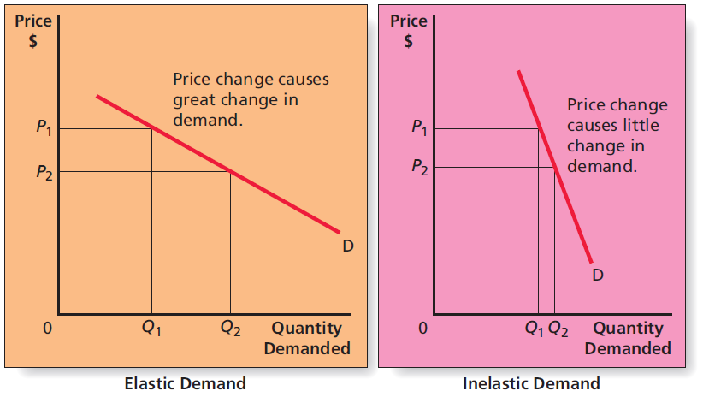
Figure 10.7 Price-Elastic and Price-Inelastic Demand
Notes:
LECTURE NOTES:
Elasticity of demand is defined as the percentage change in unit sales that results from a percentage change in price.
When changes in price have large effects on the amount demanded, demand is elastic. Thus an increase in price can negatively impact revenues when the percentage increase in price cannot compensate for the revenue lost through lower unit sales.
When changes in price have little or no effect on the amount demanded, demand is inelastic. Such situations make it much easier for marketers to change price without negatively impacting the volume of sales.

Slide 19
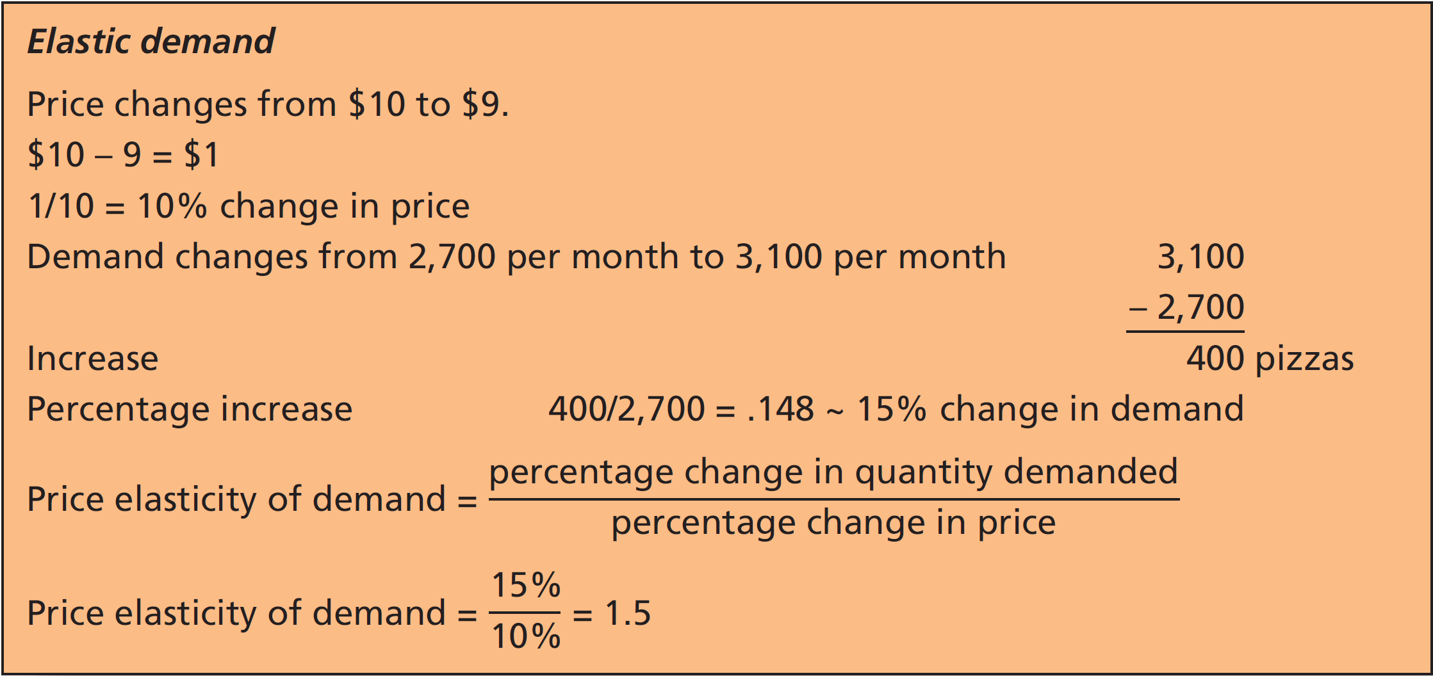
Price Elasticity of Demand: Elastic Demand
Notes:
LECTURE NOTES:
Slide presents an example of elastic demand and how the price elasticity of demand can be calculated.
In this example, a price decrease in the cost of pizza is being considered. A dollar drop in price, a 10% decrease, results in a 15% increase in unit sales.
The price elasticity of demand is calculated by dividing the percentage of change in the quantity demanded by the percentage change in price. If the resulting number is greater than one, price is ELASTIC. If the resulting figure is equal to or less than one, price is INELASTIC.

Slide 20
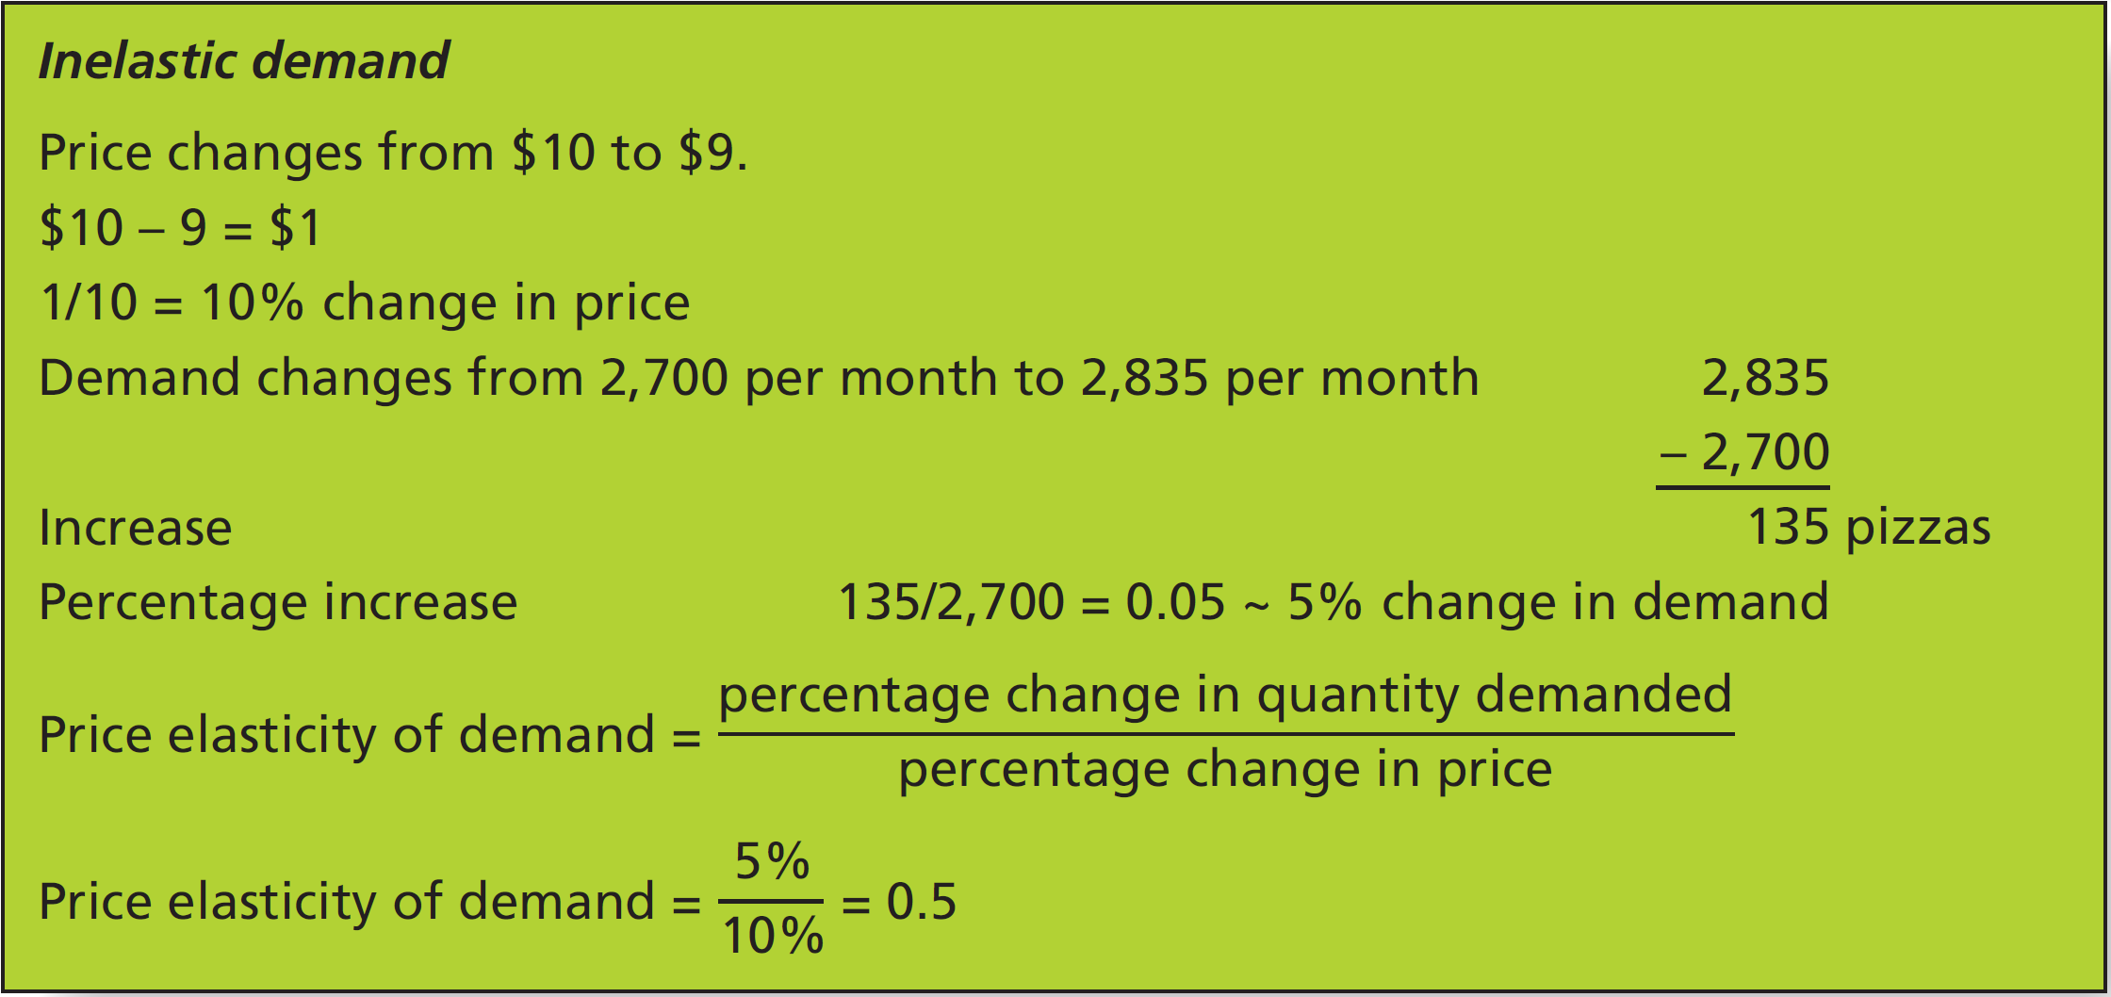
Price Elasticity of Demand: Inelastic Demand
Notes:
LECTURE NOTES:
Slide presents an example of inelastic demand and how the price elasticity of demand can be calculated.
A price decrease is also being considered. This 10% decrease in price resulted in a 5% increase in unit sales.
The price elasticity of demand is calculated by dividing the two percentages as shown, and since the resulting calculation of 0.5 is less than one, it means that demand is inelastic.
The example shown here and on the previous slide show the elasticity of demand at a given price point. It is important to remember that the elasticity for the same product often differs at different price levels. Thus before considering any type of pricing change, marketers must test the elasticity of demand for the specific price points being considered.

Slide 21
Cross-Elasticity of Demand
Changes in the prices of other products may affect a product’s demand.
If products are substitutes, an increase in the price of one will increase demand for the other.
If one product is essential for use of second, an increase in the price of one decreases demand for another.
Notes:
LECTURE NOTES:
The essence of cross-elasticity of demand is that when products are substitutes for one another, a price increase in one will be reflected as an increase in price for the other.
However, when products are complements, meaning that one product is essential to the use of the first, an increase in the price of one will decrease demand for another.
A couple of specific examples are shown below:
Brand Name vs. Store Brand
Increasing the price of Diet Dr. Pepper to $5.99 a 12-pack from $4.99 could easily increase demand for Diet Dr. Thunder (currently selling for over $2.00 less per 12-pack in the PPT author’s market).
Delivery methods
Increasing the price of pay-per-view movies available via cable could increase demand for Netflix (movie rental by mail or download).

Slide 22
Determine Costs
In order to ensure that product price will cover costs, marketers must determine
Variable Costs: Per-unit costs of production that will fluctuate depending on how many units a firm produces (such as the costs to make a pizza, labor costs of cooks, and boxes for the pizza)
Fixed Costs: Costs that do not vary with the number of units produced (such as rent on the building, electricity, water, and insurance)
Notes:
LECTURE NOTES:
The third step of the pricing process requires that the marketer be certain that the products price will cover costs.
For this to happen, marketers must estimated variable and fixed costs.

Slide 23
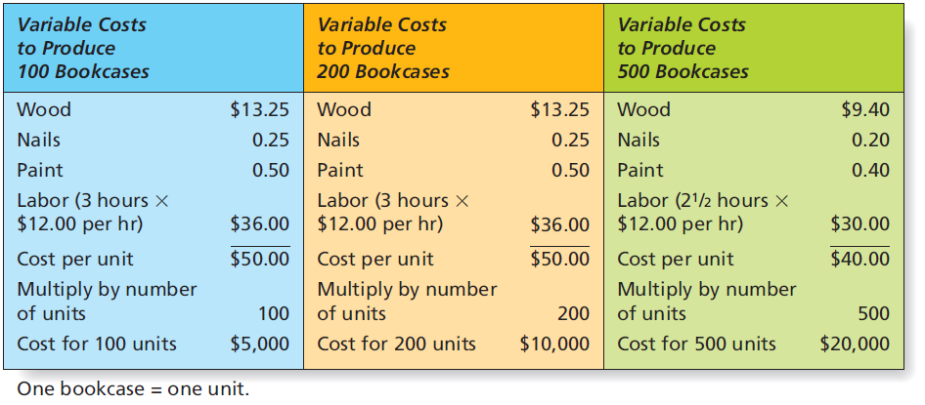
Figure 10.8 Variable Costs at Different Levels of Production
Notes:
LECTURE NOTES:
Variable costs are those production costs that are tied to the number of units produced and thus vary depending on volume. As the example shown here illustrates, materials such as wood, nail, and paint that are used to produce a product are considered variable costs, as are the hourly labor costs associated with the production process.
Figure 10.8 shows how the average variable costs per unit may change as the number of products produced changes. The higher the production level, the more likely it is that the manufacturer will be able to negotiate a better deal for materials due to the larger quantities being purchased.
Fixed costs don’t change with the number of units produced, whether it’s 100 or 10,000. Thus the average fixed cost per unit will always decrease as the number of units produced increases.
Fixed costs include the costs of renting or owning production facilities, the cost of utilities to heat or cool the factor, the cost of equipment used in the production process, etc. Other fixed costs include salaries of administrative personnel (basically anyone who is not directly involved in manufacturing the product). Short-term advertising and marketing expenses are also considered to be fixed costs as well.
Total costs are simply the combined fixed and variable costs at a given production level.

Slide 24
Break-Even Analysis
Break-even analysis tells marketers how many units must be sold in order to cover all costs.
Break-even analysis is important because it helps marketers understand the relationship between costs and price.
Knowing the break-even point will tell you at what point the firm will start making a profit.
Notes:
LECTURE NOTE:
The break-even point is the point at which the total revenue and total costs are equal and beyond which the company makes a profit; below that point, the company will suffer a loss.
Contribution per unit is the difference between the price the firm charges for a product and the variable costs.

Slide 25
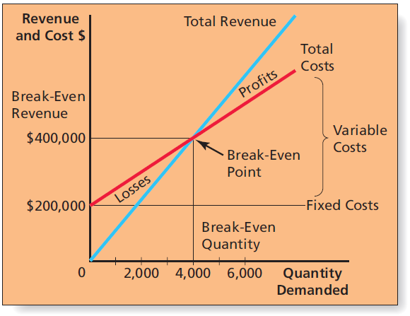
Figure 10.9 Break-Even Analysis Assuming a Price of $100
Notes:
LECTURE NOTES:
Break-even analysis is a critical technique used by marketers to determine the number of units which must be sold at a given price to cover total costs.
As Figure 10.9 demonstrates, total revenue and total cost are equal at the break-even point. Assuming a price of $100, the manufacturer will reach the break-even point (in units) at 4,000, which, when multiplied by the $100 unit price, indicates a break-even point (in dollars) of $400,000.
Sales of more than 4,000 units will yield profits, but sales below the break-even point will lead to financial losses.

Slide 26
Break-Even Calculation
Notes:
LECTURE NOTE:
In this formula, the numerator is the total fixed costs (utilities, salaries, advertising, etc.) and the denominator is the contribution per unit to fixed costs (amount the firm charges for one unit of the product less the variable costs of making that one unit).

Slide 27
Markups and Margins: Pricing through the Channel
Markup is an amount added to the cost of the product to create a price at which the channel member will sell the product.
Gross margin
Retailer margin
Wholesaler margin
List price or manufacturer’s suggested retail price (MSRP)
Notes:
LECTURE NOTES:
Most products are not sold directly from the manufacturer to the consumer; thus channel pricing considerations are often part of the marketer’s job. Marketers must make certain that they price the product in a way that will allow each member of the distribution channel to earn a profit before selling the product in turn to the next member of the distribution channel, or to the ultimate consumer. Of course, the final price to the ultimate consumer cannot be so high that will refuse to purchase the product.
Several terms must be understood as each has a place in pricing the product. Markup is defined on the slide.
The markup amount is often called the gross margin, which not only covers the profit expected by the channel member, but also the fixed costs of the retailer or wholesaler. Retailer margin and wholesaler margin are just two different names for gross margin, but specific, as the names imply, to either retailers or wholesalers.
The markup should never exceed the list price, or manufacturer’s suggested retail price (MSRP), as this is the price the manufacturer has estimated that the end customer should be willing to pay.
This means that even if the customer is willing to pay $10 for a product, the manufacturer must sell the product for less than this amount to the retailer. If a distributor or wholesaler is also used, the price charged by the manufacturer will be lower still to ensure that both the distributor and retailer can add adequate markups to make handling the product viable.
Markup can be calculated as a percentage of the final selling price, or as a percentage of the price paid for the product. For simplicity sake, let’s assume markup is calculated on the basis of final price.
$10 – final price to consumer. Retailer margin = 30%. 1 – 0.3 = 0.7 $10 x 0.7 = $7 price to retailer if manufacturer sells directly to them.
Assuming that a wholesaler is also in the picture, and that the wholesaler’s margin is 20%, 1 – 0.2 = 0.8 $7 x 0.8 = $5.40. Thus the manufacturer would price the product at $5.40 to the wholesaler.

Slide 28
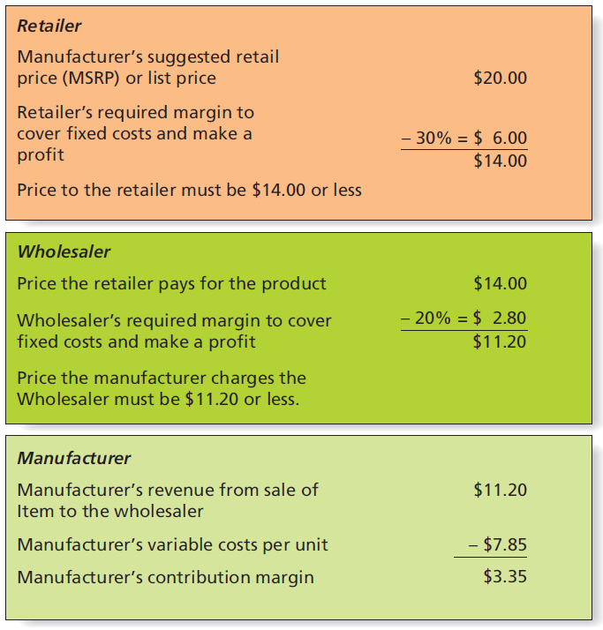
Figure 10.10 Markups Through the Channel
Notes:
LECTURE NOTE:
This figure illustrates channel pricing. It shows how the each facet of the channel (manufacturer, wholesaler, and retailer) must price the good in order to make a profit for that particular organization.

Slide 29
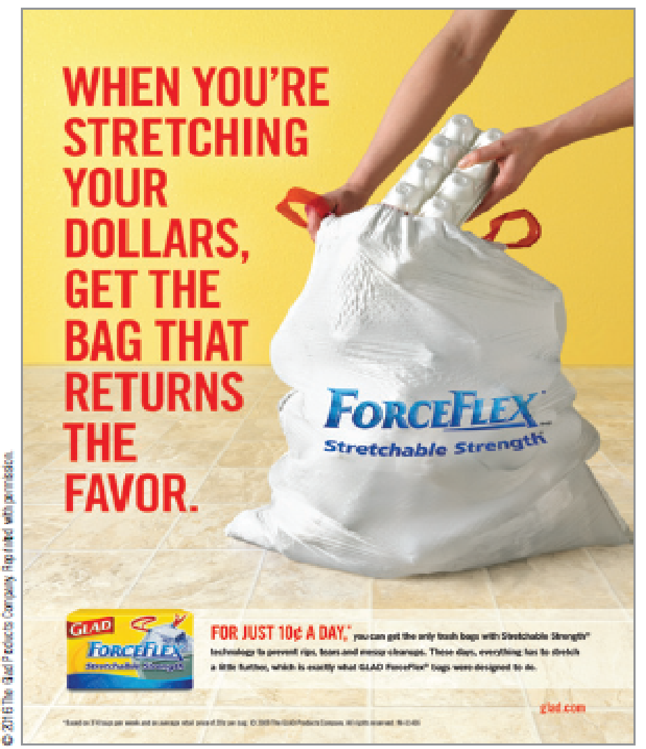
Examine the Pricing Environment
Firm must also consider external influences upon pricing decisions.
Economy
Competition
Government regulation
Consumer trends
International environment
Notes:
LECTURE NOTES:
The fourth step is to examine the pricing environment.
Marketers also try to anticipate how the competition will react to pricing changes.
Pricing wars can be disastrous, so it’s not always smart to continually lower prices. During price wars, consumers’ perceptions of a “fair price” may change, leaving a target market who is unwilling to pay “normal” prices once the war is over.
The industry structure can influence pricing a great deal. Oligopolies, such as the airline industry, typically attempt to avoid price competition and are more likely to price similarly in order to remain profitable. Restaurants and other industries characterized by monopolistic competition -vary their prices, and focus on non price competition as each sells at least a somewhat different product. This type of pricing strategy is aided by the fact that consumers are less likely to comparison shop as they offerings between different firms within an industry are usually different enough to make comparisons difficult. And of course, there is typically little opportunity to alter price in a purely competitive market such as is found with most agricultural products and commodities.
Government regulation impacts pricing in two ways: First of all, the various regulations enforced at the federal and state levels increase the costs of production. Secondly, the President and government has the ability to freeze or regulate prices, including credit card fees, interest rate charges, etc.
Consumer cultural and demographic trends can strongly influence prices. One example is that even consumers who are well-off see nothing wrong with bargain-hunting, particularly in tough economic times.
A special economic consideration in international price setting is the exchange rate and exchange rate volatility. Changes in the exchange rate can substantially influence the profitability of a brand sold in a foreign market. Furthermore, the marketing environment varies widely between countries. Very often unique environmental factors force marketers to adapt their pricing strategies. For example, in developing countries, consumers often cannot afford the cost of a bottle of detergent or shampoo. Instead, marketers create one-use packages called sachets that sell for just a few cents, and make the product affordable to consumers of that country. The competitive environment and government regulation also impact international prices.

Slide 30
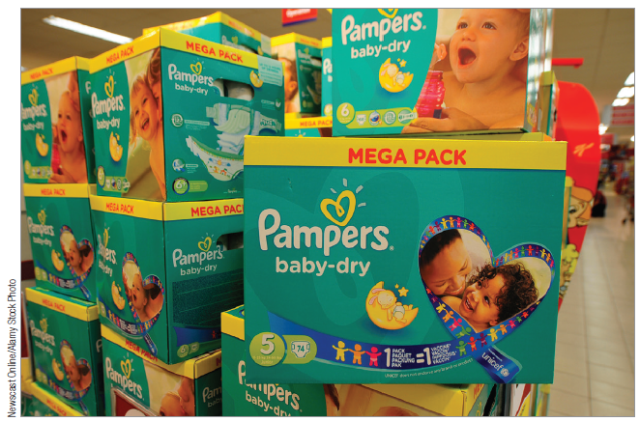
The Economy
Consumers become very price sensitive when economic conditions appear bleak.
Marketers must factor broad macroeconomic trends into pricing decisions.
Economic growth
Consumer confidence
Recession
Inflation
Notes:
LECTURE NOTES:
It’s essential that marketers also consider the firm’s external environment when they set prices.
Broad economic trends such as the business cycle, economic growth, inflation, and consumer confidence may help a firm determine which pricing strategy is most appropriate.
In particular though, marketers need to understand how price impacts consumers during a recession. Consumers’ tend to become very price- sensitive when economic conditions are bleak.
For example, Procter & Gamble (P&G) suffered market share, sales, and profit declines in 2008 as consumers switched away from P&G’s premium priced brands to cheaper alternatives. P&G chose both price cutting and product enhancement strategies as a means of combating the recession. For example, they created a more absorbent Pampers diaper without increasing price.
On the other hand, Starbucks chose to keep its premium image intact by raising prices of its multi-ingredient sugary coffees by between 10 and 30 cents. Popular beverages such as lattes and brewed coffee from 5 to 15 cents.
Inflation, on the other hand, often allows marketers to increase prices because consumers have become accustomed to price increases. Unfortunately, during inflationary periods, consumers may also grow fearful about the future and cut back on purchases. If this happens, the marketers may actually lower prices and temporarily sacrifice profits to maintain sales.
DISCUSSION NOTE:
P&G is the world’s biggest consumer-product maker, producing many premium-priced brands, some at prices twice the category average. But during the 2008 recession, P&G found sales, market share, and profits declining as consumers switched to store brands and other cheaper options. P&G responded with a number of price-cutting and product enhancement strategies. For example, P&G began offering larger packs of Duracell batteries and more absorbent Pampers diapers without increasing prices. The company has also repositioned both Era and Cheer detergent as bargain brands. But will customers return to premium brands after the recession? Many believe that the recession of 2008, the worst since the Great Depression, will probably have a permanent effect on the American consumer. Consumers, even those whose income has not declined, are spending less and saving more.

Slide 31
The Pricing Environment: Non-Economic Influences (1 of 2)
Competition
The type of industry structure (oligopoly, monopolistic competition, or pure competition) can influence pricing.
Government regulation
Laws and government agencies impact pricing decisions.
Notes:
LECTURE NOTES:
Marketers also try to anticipate how the competition will react to pricing changes.
Pricing wars can be disastrous, so it’s not always smart to continually lower prices. During price wars, consumers’ perceptions of a “fair price” may change, leaving a target market who is unwilling to pay “normal” prices once the war is over.
The industry structure can influence pricing a great deal. Oligopolies, such as the airline industry, typically attempt to avoid price competition and are more likely to price similarly in order to remain profitable. Restaurants and other industries characterized by monopolistic competition vary their prices, and focus on non price competition as each sells at least a somewhat different product. This type of pricing strategy is aided by the fact that consumers are less likely to comparison shop as they offerings between different firms within an industry are usually different enough to make comparisons difficult. And of course, there is typically little opportunity to alter price in a purely competitive market such as is found with most agricultural products and commodities.
Government regulation impacts pricing in two ways: First of all, the various regulations enforced at the federal and state levels increase the costs of production. Secondly, the President and government has the ability to freeze or regulate prices, including credit card fees, interest rate charges, etc.

Slide 32
The Pricing Environment: Non-Economic Influences (2 of 2)
Consumer trends
Culture and demographics influence pricing.
International environment
Companies may vary their pricing depending upon the country in which their product is sold.
Notes:
LECTURE NOTES:
Consumer cultural and demographic trends can strongly influence prices. One example is that even consumers who are well-off see nothing wrong with bargain-hunting, particularly in tough economic times.
A special economic consideration in international price setting is the exchange rate and exchange rate volatility. Changes in the exchange rate can substantially influence the profitability of a brand sold in a foreign market. Furthermore, the marketing environment varies widely between countries. Very often unique environmental factors force marketers to adapt their pricing strategies. For example, in developing countries, consumers often cannot afford the cost of a bottle of detergent or shampoo. Instead, marketers create one-use packages called sachets that sell for just a few cents, and make the product affordable to consumers of that country. The competitive environment and government regulation also impact international prices.

Slide 33
Understanding Demand
In order to set price, marketers must have an understanding of product demand.
This includes considerations, such as:
Price elasticity
Variable and fixed costs
Impact of external environment on pricing
What are the implications for upscale retailers of “strategic shopping” by affluent U.S. shoppers?
Notes:
DISCUSSION NOTE:
The chapter discusses the rising trend of strategic shopping, in which affluent shoppers are increasingly seeking bargains on high-quality goods.
How does this cultural trend impact upscale department store retailers, such as Nordstrom’s? What opportunities does this create for online and brick-and-click retailers?

Slide 34
Identify Strategies and Tactics to Price the Product
Choose a pricing strategy.
When is it best for the firm to undercut the competition and when best to just meet the competition’s prices?
When is the best pricing strategy one that considers costs only? When is it best to use a strategy based on demand?
Notes:
DISCUSSION NOTES:
Why are these two questions important for pricing a product? Under what circumstances is pricing to undercut the competition best? Meeting competition’s prices?

Slide 35
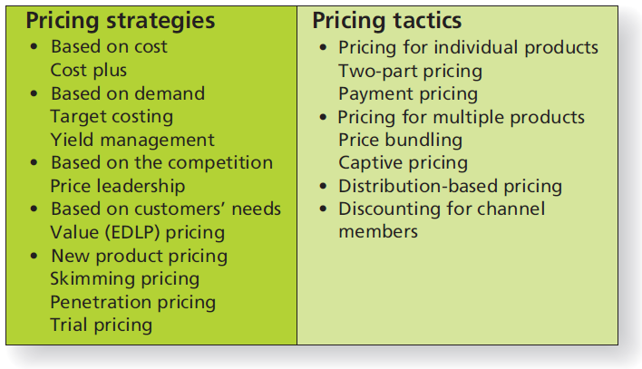
Figure 10.11 Pricing Strategies and Tactics
Notes:
LECTURE NOTES:
The fifth step of the pricing process requires choosing a pricing strategy.
Slide illustrates the variety of pricing strategies and tactics from which marketers can choose.

Slide 36
Pricing Strategies Based on Cost
Cost-based pricing is very common.
Most frequently used cost-based is cost-plus pricing.
Easy to calculate
Relatively risk free
But not without drawbacks …
Cost-based approaches do not factor in key considerations, such as nature of target market and competitors.
Notes:
LECTURE NOTES:
Marketers often choose cost-based strategies because they are simple to calculate and relatively risk free in that they promise a price which will at least cover the costs of producing and marketing the product.
However, cost-based pricing strategies are limited, in that demand, competition, and the nature of the target market are not considered as part of the pricing process. Furthermore, it is often surprisingly difficult to accurately estimate costs.
Still, the most common cost-based approach to price the product using the cost-plus pricing strategy is one in which product per unit costs are totaled and markup is added to arrive at the final price. Retailers and wholesalers are fond of this pricing strategy due to its simplicity.
Dell.com allows consumers, business people, and government buyers to build their own computer using a cost-oriented model. Buyers customize their computers by selecting the model, processor speed, RAM configuration, hard drive capacity, sound card, speed, and number of CD or DVD drives, monitor size, etc. Because each component is treated as an individual element in the building process, Dell can easily change component prices to meet changes in their own cost structure, ensuring that Dell’s costs will be covered and the desired profit-level achieved.

Slide 37
Price Strategies Based on Demand
Demand-based pricing: firm bases selling price on an estimate of volume it can sell in different markets at different prices.
Target costing
Yield management
Notes:
LECTURE NOTES:
Demand-based pricing means that the firm bases the selling price on an estimate of the quantity that it can sell in different markets at different times. Target costing and yield management are two examples of demand-based pricing strategies.
Target costing allows marketers to match price with demand, by first identifying the level of quality and functionality customers need and the price they’re willing to pay before designing product. Then they work backwards to design a product that meets the targeted level of cost.
Yield management pricing is very popular in the service industry to the perishable nature of services. The essence of yield management is that capacity is managed by charging different prices to different customers. A simple example is the “early bird special” pricing offered by many restaurants for those who are willing to dine during the early or mid afternoon. Another example would be how movie theatres price the early show cheaper than those that begin after 5 pm.
Technology has only enhanced service providers ability to maximize profit using yield management pricing techniques. Most airlines have e-mail notification systems that alert customers who have subscribed to their service about the availability of low-priced travel alternatives a few days (to several hours) prior to flight departure. Interested travelers typically book their flight directly through the airlines’ web site at a rate below any published fares. Web sites such as Priceline.com allow consumers to submit their own bid for airfare, which may or may not be accepted by the airline. Either of these systems is more efficient than the “standby” method of yield management, which was commonly used prior to the growth in popularity of the Internet. (Airlines used to sell standby tickets at a huge discount to people who just showed up at the airport the same day they wished to fly. Tickets were honored only if there were empty seats on a plane, otherwise, the consumer was bumped to the next flight, and so on, until a flight operating under capacity was encountered.)

Slide 38
Figure 10.12 Target Costing Using a Jeans Example
Notes:
LECTURE NOTES:
Figure 10.12 provides an example of target costing in the context of blue jeans. Using surveys and marketing research, the manufacturer learned that consumers were willing to pay $79.99 for blue jeans of a certain quality level. Working backwards includes the process of determining retailer markup and price to the retailer, the profit required by the manufacturer, and finally, the target cost to manufacture the product. If this target cost cannot be met given the quality and functionality demands of the consumer, the firm abandons the project because it cannot be undertaken successfully.

Slide 39
Price Strategies Based on Competition and Customer Needs
Pricing based on competition
Price leadership strategy
Pricing based on customer needs
Value or every day low pricing (EDLP)
Hybrid EDLP approaches
Notes:
LECTURE NOTES:
Pricing near, at, above, or below the competition may form the basis of a firm’s pricing strategy.
For example, a price leadership strategy is often used in oligopolistic industries when a dominant firm announces its new price, and competitors get in line or drop out, in order to minimize competition.
Pricing strategies based on customers’ needs tend to take the form of value pricing or everyday low pricing (EDLP) popularized by Wal-Mart.
The purpose of an EDLP or value pricings strategy is to retain customers, and thus rather than focusing on costs, value pricing begins with a consideration of the customer and what prices are justified in their eyes. But, it doesn’t stop there. The competition is also considered in determining the best price the firm should set that will provide ultimate value to customers.
Some firms use hybrid EDLP to compete with low-price retailers such as Wal-Mart. Hybrid EDLPs offer consumers lower prices on thousands of items as well as additional value in the form of a more fun shopping experience.

Slide 40
New Product Pricing
New products present unique pricing challenges!
In absence of reliable demand estimates and pricing norms, common pricing tactics include:
Skimming price
Penetration pricing
Trial pricing
Notes:
LECTURE NOTES:
New product pricing represents a unique challenge. Skimming, penetration, or trial pricing strategies may be followed.
Under a skimming pricing strategy, a very high premium price is charged by the manufacturer when the product first hits the market, with the intention of reducing price in the future. Thus each unit sold incurs a huge profit, though initially, fewer units are sold. As demand at a given price level disappears, the price is dropped, bringing new buyers to the market.
Skimming is often used with new, highly desirable products with unique benefits, particularly if the item in question creates a new product category. For skimming to work, there should be little chance that competitors can get their products to market quickly. Past examples include the VCR (once priced as high as $1200), high-definition TVs (one-time as high as $32,000), and even the iPhone (priced initially at $599 in 2007). However, price drops can enrage those who paid higher prices, as Apple found to its detriment when it dropped the price $200 only months after the initial product introduction.
A penetration pricing strategy is just the opposite. The marketer prices the product very low in order to build unit sales very quickly. By building a large market share quickly, the manufacturer hopes to discourage competitors from entering the market as the profit margin per unit is very small.
Trial pricing sets a low price initially, but only for a limited period of time, after which the price is raised to “normal” levels. The purpose of trial pricing is gain consumer acceptance firm, and defer profits until later. Microsoft used such a strategy when it first introduced Access for $99, although the suggested retail price was $499. Once the short introductory period passed, Microsoft raised the price of the product.

Slide 41
Develop Pricing Tactics: Pricing for Individual vs. Multiple Products
Pricing for individual products
Two-part pricing
Payment pricing
Decoy pricing
Pricing for multiple products
Price bundling
Captive pricing
Notes:
LECTURE NOTES:
The sixth and last step in the price planning process is to develop pricing tactics.
Once a marketer has chosen a pricing strategy, the last step in the process is to implement the strategy by means of a pricing tactic. How marketers present a price to the targeted consumers can make a difference. First, we’ll consider two pricing tactics for individual products.
Two-part pricing is appropriate for services or products that require separate payments to purchase the product. For example, a country club requires an annual membership fee plus separate fees related to usage which might be based on the number of rounds of golf played, pool usage, or the number of meals eaten at the country club restaurant.
Can you think of some other examples of two-part pricing plans?
Payment pricing simply allows consumers to break up the cost of a purchase over time. One example would be any retail store that allows consumers to put items on “lay-away.” Another example would be a mortgage, which allows consumers to buy their home. Few people can afford to pay cash for home, but spreading the cost out over 30 years makes the purchase affordable.
Pricing for multiple products is best thought of in situations when consumers typically buy multiple items at one time. A classic example is the fast food industry, where consumers may purchase a drink along with a sandwich and chips (burgers and fries, etc.).
These situations are wonderful opportunities for price bundling, in which the cost of the combined items is less than if each item were purchased individually. Thus new PCs include the computer, keyboard, mouse, software and sometimes other items such as monitors.
Price bundling does have its downside though. Cable and satellite providers include a variety of channels that consumers don’t want and never watch, while other, more desirable channels can only be purchased as part of a higher cost package. Separately pricing each channel means that consumers would buy some, but not all, and the firm would most likely lose more revenue than is justified by the reduced price for the bundled package.
Captive pricing is appropriate when two products can only work when used together. A classic example is the desktop printer and ink cartridge. The manufacturer typically will price the printer itself low, knowing that the cartridges needed to make the printer work will be priced with a hefty profit margin that will earn greater profits over time.

Slide 42
Price Segmentation
Practice of charging different prices to different market segments for the same product
Peak load pricing
Surge pricing
Notes:
LECTURE NOTE:
Examples of price segmentation include 10% off for senior citizens or buying one item for $9 or two for $15.
Peak load pricing is a pricing plan that sets prices higher during periods with higher demand.
Surge pricing is a pricing plan that raises prices of products as demand goes up and lowers it as demand slides.

Slide 43
Bottom of the Pyramid Pricing
Innovative pricing that will appeal to consumers with the lowest incomes by brands that wish to get a foothold in bottom of the pyramid countries
Notes:
LECTURE NOTE:
* Examples of bottom of the pyramid pricing and marketing include selling nondurable products in smaller packages for just a few cents and encouraging a village to share one cell phone, refrigerator, or computer.

Slide 44
Develop Pricing Tactics: Distribution-Based Pricing
Distribution-based pricing for end-users
F.O.B. (free on board) origin pricing
F.O.B delivered pricing
Uniform delivered pricing
Freight absorption pricing
Notes:
LECTURE NOTES:
Shipping fees can be hefty. Distribution-based pricing helps firms determine how they will handle the cost of shipping products to their customers. A number of factors influence which distribution pricing tactic is chosen, including characteristics of the product, the customer, and the competition.
Business-to-business firms often use one of the F.O.B. pricing strategies. F.O.B. origin pricing means the customer must pay the cost of shipping the items from the factory to the customer’s location. The customer takes title of the merchandise once it is loaded on the truck, rail, or whatever conveyance is being used to ship the product. F.O.B. delivered pricing means the seller pays both the cost of the loading and the cost of transporting the goods to the customer.
By contrast, basing-point pricing, which is also used in B2B transactions, means marketers choose one or more locations to serve as intermediate delivery locations (such as plants, warehouses, or some arbitrarily selected city). Customers must pay the cost of shipping from the basing points to their final destination.
Uniform delivered pricing adds an average shipping cost to the price, no matter what the distance is from the manufacturer’s plant.
Freight absorption pricing means the seller takes on part or all of the cost of shipping—usually used for high-ticket items, and in markets that are highly competitive. For example, Amazon.com has learned that offers of free super saver shipping substantially increase their business.
Zone pricing is similar in nature to the basing-point pricing tactic, but does differ. Ask students to imagine an archery target composed of several concentric circles. The “bulls eye” in the center of the target can be thought of as the distribution point, most likely either a manufacturing plant or warehouse/distribution center. Each ring surrounding the bulls eye represents a geographic zone some distance away from the distribution point. For example, the ring nearest to the distribution point may include delivery points within 50 miles of the facility; the next ring may cover destinations between 51and 100 miles from the facility, and so on. Different prices are charged for different zones, with the points furthest away from the distribution center paying the highest price. More complex variations of zone pricing draw irregular borders rather than simple concentric circles. The borders between price zones may be altered to account for geographic features or aspects of the transportation infrastructure. For example, perhaps a river spans the delivery area—if the nearest bridge is 10 miles downriver, the area on the other side of the river might well be assigned to a different zone because the actual travel distance to cross the river and reach that location is much further away than the simplistic concentric circle method would suggest.

Slide 45
Develop Pricing Tactics: Discounting for Channel Members
When setting prices for channel members, marketers may also apply tactics such as:
Trade or functional discounts
Quantity discounts
Cash discounts
Seasonal discounts
Notes:
LECTURE NOTES:
The previous pricing tactics are appropriate when selling to end customers. However, the following pricing tactics are appropriate when pricing for channel members:
Trade or functional discounts usually set a percentage discount off of the suggested retail or list price for each channel level. The percentage discounts typically relate to the margins needed by the various channel members.
Quantity discounts are useful for encouraging larger purchases, as the amount of the discount varies according to the quantity purchased. These discounts can be figured on a cumulative basis at the end of a specified time period such as a quarter or year, or they can be noncumulative and apply to items purchased on each individual order.
Cash discounts are used to encourage customers to pay their bills promptly, and may be expressed in a fashion similar to “2 percent 10 days net 30”, meaning that the customer would receive a 2% discount if the bill is paid within 10 days. Otherwise the full amount is due within 30 days.
Seasonal discounts, as the name implies, are price reductions that are available only at certain times of the year. Normally such discounts are offered at times of the year when the product is not in high demand. For example, a Christmas card manufacturer may offer retailers a 50% seasonal discount for cards ordered January 1–March 31. Another example would be the lower prices charged by Disney World resorts in the off season, compared to holiday and summertime. Some firms choose to implement a seasonal discount during the height of the season to create a competitive advantage when people are buying.

Slide 46
Pricing Strategies and Tactics
How do you know whether you’ve charged too much or not enough?
Pricing moves and countermoves require ongoing planning.
Appropriateness of pricing strategy and tactics may vary based upon:
number of products, product newness, B2C/B2B.
What types of pricing strategies and tactics are used by your college or university?
Notes:
LECTURE NOTES:
Summary slide for Chapter 10, learning objective 3.
DISCUSSION NOTE:
Based on a review of the chapter, students should be able to find examples of various pricing strategies and tactics in place at their university.

Slide 47
Pricing and Electronic Commerce
Online environment provides even more pricing options.
Technology and market efficiency
Dynamic pricing
Internet price discrimination
Online auctions
“Freemium” pricing models
Notes:
LECTURE NOTES:
Technology available via e-commerce and the Internet in particular makes it easy for pricing to change quickly.
Dynamic pricing strategies are those in which the Internet seller can easily adjust the price to meet changes in the marketplace. The cost of changing prices on the Internet is practically zero, and firms can respond quickly and frequently to changes in costs, supply, and/or demand.
Some people refer to dynamic pricing as “real-time pricing”. For example, electricity prices might change as often as hourly and occasionally even more often based on the time of day and time of year. Another example of dynamic pricing can be found in the mortgage industry, where mortgage interest rates also vary to meet changes in the marketplace.
The link provided leads to a recent article discussing Ticketmaster’s plans to implement dynamic pricing in an effort to thwart scalpers.
Online auctions are familiar to most consumers and allow shoppers to purchase products through online bidding. B2B auction sites also exist. Skoreit.com is one of the newer bid sites targeting consumers. While the site is promoted as making it possible to purchase items for as much as 99% off of retail, the site itself requires users to purchase “bidpacks,” beginning as low as $9.90 Each bidpack contains a limited number of bids which can be used during auctions. The cost of each bid in early 2011 was around 60 cents a piece.
The freemium ((a mix of “free” and “premium”) pricing model is a business strategy in which a product in its most basic version is provided free of charge but the company charges money (the premium) for upgraded versions of the product with more features, greater functionality, or greater capacity. The freemium pricing strategy has been most popular in digital offerings such as software media, games, or web services where the cost of one additional copy of the product is negligible. The idea is that if you give your product away, you will build a customer base of consumers willing to pay for the added benefits.
DISCUSSION NOTE:
Ask students whether they use or are familiar with companies that use a “freemium” model. Companies that have followed this pricing model include Dropbox, Inc., SurveyMonkey, Spotify, and Skype.
Ask students who have experience with “freemium” service whether they have or would consider upgrading to the premium service. If not, why not?
Use this discussion to illustrate that while some products such as Skype have been highly successful, others have found that customers never upgrade to the premium version of the product. For example, Pandora, the firm we met in Chapter 1, has found that many consumers were unwilling to pay for their service. As a result, they changed their business model to include a free service supported by paid advertising plus their Pandora One paid service without the ads.

Slide 48
Pricing Advantages for Online Shoppers
The Internet provides consumers and business buyers more control over the purchase process.
Increased consumer price sensitivity and negotiating power
What do you think are the implications of increased price transparency for marketers (and marketing)?
Notes:
DISCUSSION NOTE:
With increased price transparency, there will be fewer opportunities for business to take advantage of consumers lacking complete information.
Potential implications for marketers include:
More adaptive pricing models (e.g., dynamic pricing, price-matching).
More innovative pricing models (e.g., pay as you wish).
Firms findings way to differentiate and compete more strongly on non-price factors.

Slide 49
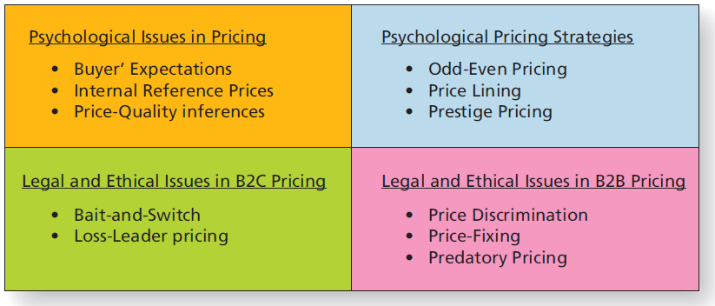
Figure 10.13 Psychological, Legal, and Ethical Aspects of Pricing
Notes:
LECTURE NOTES:
Marketers must also understand and deal with psychological, legal, and ethical issues when attempting to maximize the effectiveness of their pricing plans. We’ll begin with a discussion of psychological issues in pricing, and the psychological pricing strategies which often result.
Prior to this point, pricing has been discussed primarily from the standpoint of economics, which assumes that consumers make logical, rational evaluations of price. Of course it doesn’t always work that way, as certain psychological factors play havoc with “rational” evaluations.

Slide 50
Psychological Issues in Setting Prices
Buyers form expectations of what is fair or customary prices for goods and services.
Price too high = Bad deal
Price too low = Suspect quality
Customary price perceptions are influenced by:
Internal reference prices: A set price or price range consumers have in mind when evaluating a product’s price.
Price–quality inferences : When consumers use price as a cue to infer product quality
Notes:
LECTURE NOTES:
Buyers form expectations of the fair or customary price that should be charged for a given product or service. When a product or service is priced above what the buyer believes to be fair, he or she may refuse to buy, believing the product to be a bad deal. Conversely, while some buyers may gleefully purchase items priced below the fair or customary price, a price too low may send a negative signal to the buyer, raising suspicions that product quality is not up to par.
Therefore, it is important that the marketer understands consumers’ expectations in setting price. It’s also important to recognize that price expectations can vary by country, culture, or even zip code. Victoria’s Secret has learned to send catalogs featuring the same merchandise, but with different prices, to those residing in different zip codes. Those in higher income areas often expect to pay more, and thus receive a catalog that fulfills that expectation.
Internal reference prices sometimes influence consumers’ perceptions of the customary price of a product. Internal reference prices are a set price, or price range, that consumers have in mind when evaluating a product’s price. Marketers often try to influence consumers’ internal reference prices by comparing their price to the competition’s in marketing communications, while retailers may stock a product, such as a store brand, next to higher priced versions of the same or different product. When this occurs, consumers may react in one of two ways. If the price is similar (not too far apart), many consumers experience an assimilation effect in that they come to believe the quality of the two items must also be similar, and with this in mind, ultimately choose the item that is lower priced. On the other hand, a contrast effect occurs when the price gap is too large, and the consumer comes to believe that a true difference in quality between brands exists.
Price–quality inferences are made by consumers about a product when they use price as a cue or indicator of quality. If consumers are unable to judge the product quality by direct examination or experience, they usually assume the higher priced item is of greater quality. This is particularly true for items that are bought infrequently. Furthermore, price becomes an even greater indicator of quality when brand names are unknown. Carpet is an example of a high-cost purchase that most consumers make rarely. Brand names are likely to be relatively unknown. Left with a choice between two similar products, the consumer may very well choose the higher priced option believing it to be of higher quality than the alternative.

Slide 51
Psychological Pricing Strategies
Odd–even pricing
Price lining
Prestige or premium pricing
Notes:
LECTURE NOTES:
How do marketers deal with these psychological issues? Odd–even pricing, price lining, and prestige pricings are some of the more common psychological pricing strategies that are used.
Odd–even pricing is common throughout the United States where prices usually include both dollars and cents rather than even dollar amounts. Is $199.99 really “less” than $200.00? Logically, a penny separates these prices, but psychologically the two prices are worlds apart. Prices ending in 99 lead to increased sales.
However, in some instances having a price end in 99 can be detrimental. Professional service providers such as lawyers, dentists, or doctors who priced their service in this fashion may suffer from the perception that their quality of care is inferior. High-end restaurants have found that prices ending in 9 ($19.99) are more indicative of value than quality.
Price lining is a practice in which a limited number of price points (different specific prices) are set for items in a product line. From a marketer’s viewpoint, price lining maximizes profits by allowing the firm the opportunity to charge the highest price most customers would be willing to pay at each level. Price lining can also be applied to services. For example, many car washes offer different “packages” from which patrons may choose. The low-priced alternative may include a vacuum and quick run through the automatic car wash. A higher-end package might add window cleaning, air fresheners, tire scrubbing, waxing, etc. Price lining is also present in the hospitality industry. Walt Disney World maintains a number of different properties on-site, each having a different price point. As would be expected, the different price points appeal to different segments of the target market.
Prestige pricing turns the relationship between price and demand upside down. Under this scenario, status conscious consumers buying luxury goods become more likely to purchase an item as price increases. The fact that not everyone can afford to purchase an item is exactly what makes it desirable—the more exclusive, the better in many cases.

Slide 52
Legal and Ethical Considerations in B2C Pricing
Bait-and-switch is illegal
Advertise very low-priced item to lure customers to store (bait)
Arriving customers find product is out of stock and are offered more expensive item (switch)
Loss-leader pricing
Use very low prices to get customers into the store
Making up the “loss” through sale of other products
Some states have “unfair sales acts” forbidding loss-leader pricing.
Notes:
LECTURE NOTES:
While the free enterprise system should ideally regulate itself, the fact remains that some businesses are greedy and unscrupulous. As a result, government has found it necessary to enact legislation to protect consumers and businesses from these types of business practices.
Both the FTC (Federal Trade Commission) and the Better Business Bureau have developed pricing rules and guidelines to help protect consumers from unscrupulous businesses. For example, “going out of business” sales must indeed be reserved for the final sale held by a store before it goes out of business. “Fire sale” can only be used following an actual fire and retailers cannot falsely claim to offer lower prices than the competition.
A common form of deceptive pricing and advertising practice that often occurs at the local level is called the bait-and-switch tactic. This occurs when a retailer will advertise an item at a very low price to lure consumers to the store (the bait), who then find it virtually impossible to buy the advertised product that is mysteriously out-of-stock. The sales people then try their utmost to get the consumer to buy a different, more expensive item (the switch). Sometimes salespeople lie and tell customers that the item is of poor quality. If a firm refuses to show, demonstrate, or sell the advertised product, if they disparage it or penalize salespeople who do sell the advertised brand, the FTC is likely to find the ad and pricing to be a bait-and-switch scheme.
Ethical retailers should always offer a rain check for advertised items that are out-of-stock, and should also attempt to order sufficient quantities to meet demand.
Loss-leader pricing is commonly used in the grocery industry when retailers advertise items at very low prices (sometimes even below cost), knowing that consumers who come to buy the item will likely shop for many items which will more than make-up for the money lost on the loss-leader item. Sometimes loss leaders are specific to the season or holiday. The text mentions an example in which an office supply store might sell eight pencils for a penny.
However, some states frown on this practice and have passed legislation which prevents wholesalers and retailers from selling items below cost. The purpose is to protect smaller retailers from the larger competition, as they know small stores can match the bargain prices.
Supplemental discussion:
An interesting question that could add a little spice to class discussion relates to pricing ethics. You might begin this portion of lecture by asking whether students think it’s illegal for mail-order marketers to send catalogs with higher prices to more affluent zip codes, while less economically advantaged areas receive catalogs promoting the exact same item at a lower price.
Although this tactic is not illegal (price discrimination only operates in B2B commerce), some students will invariably argue that it is unethical, while others will claim that it’s just good business.

Slide 53
Legal Issues in B2B Pricing
Illegal B2B price discrimination: Firms sell products to channel members at different prices in a way that “lessens competition.”
Price-fixing: Two or more companies conspire to keep prices at a certain level.
Horizontal vs. vertical price fixing
Predatory pricing: Firm sets very low price for purpose of driving rival out of business.
Notes:
LECTURE NOTES:
Three of the more significant illegal pricing practices in the B2B world include price discrimination, price-fixing, and predatory pricing.
Price discrimination is regulated by the Robinson-–Patman Act. The purpose is to prevent firms from selling the same product to different retailers and wholesalers at differ prices, IF such practices “lessen competition.” This act also prohibits offering “extras” some retailers and note others, such as discounts, allowances, etc. However, there are few exceptions to this rule. If marketers could prove that price differences resulted from differences based on order quantity and economies of scale (perhaps in relationship to shipping charges), then price discrimination would not have occurred. Also, differences in the product itself (new model year, “second” quality vs. prime quality, etc.) would warrant charging different prices. Finally, it should be noted that price discrimination is only applicable in B2B pricing—consumers may very well pay different prices for identical items based on their negotiating skills, zip code, or a host of other factors.
Price fixing occurs when two or more companies conspire to keep prices at a certain level. This level of collaboration is entirely different from the situation previously discussed in which a dominant firm within an oligopoly may take a price leadership role. True price fixing can take two forms: horizontal or vertical.
Horizontal price fixing occurs when competitors making the same product collude by sharing price information and jointly determine what they will charge for the product. If all of the gas stations within a given town all charged the exact same price for unleaded and diesel gasoline, one might suspect that price fixing had occurred (though proving it may be difficult with evidence that all of the sellers had exchanged information and agreed to charge the prices set). In industries with few sellers, there may not be a formal agreement to charge a given price; rather, each firm may independently agree to price to meet the competition. Still, without the exchange of pricing information between sellers, this action would not be consider price fixing.
Vertical price fixing occurs when a manufacturer or wholesaler attempts to force retailers to charge a certain price for their product, usually the “suggested retail price.”. This is illegal, as the Consumer Goods Pricing Act of 1976 leaves retailers free to set whatever price they choose without interference by the manufacturer or wholesaler.
Predatory pricing occurs when a firm sets a very low price for purpose of driving competitors out of business, then later raise prices once the competitor is gone and they have a monopoly again. Both the Robinson–Patman Act and the Sherman Act prohibit predatory pricing.

Slide 54
The Psychology of Price
Many pricing frameworks are based on the notion of a highly rational consumer.
In the real world, consumer perceptions and judgments of price aren’t nearly so logical!
Psychological aspects of price raise a number of ethical and legal considerations.
Restaurants have found odd–even pricing influences spending. Have you seen local dining establishments who have employed such tactics?
Notes:
DISCUSSION NOTES:
Instructor can re-introduce material from the book on odd–even pricing (page 307).
Restaurants (and the menu engineers who work with them) have discovered that how prices for menu items are presented has a major influence on what customers order—and how much they pay.
When prices are given with dollar signs or even the word dollar, customers spend less. Thus, a simple 9 is better on a menu than $9.
For high-end restaurants, the formats that end in 9, such as $9.99, indicate value but not quality.
Have students seen evidence of odd–even pricing and other types of psychologically rooted pricing practices (e.g., price lining, prestige pricing) in place at local restaurants and fast-food dining establishments they go to?
Do they feel like they are being manipulated or taken advantage of when this happens? In other words, does use of odd–even pricing by the restaurant create an ethical issue?

Slide 55
Ethical/Sustainable Decisions in the Real World
First sold in 2008, over 30 million Snuggies were sold by 2015
Allstar (maker of Snuggies) paid $8 million in fines for “false advertising” in that all the costs associated with the second “free” Snuggie were not disclosed.
Do you believe that the FTC should create additional regulations on advertising that would create greater requirements for full disclosure in advertising?
Notes:
DISCUSSION NOTES:
Ask students if they or someone they know bought a Snuggie. Were they surprised that the second “free” Snuggie ended up (with shipping and handling charges) costing as much as the first one?

Slide 56
Copyright

