Slide 1
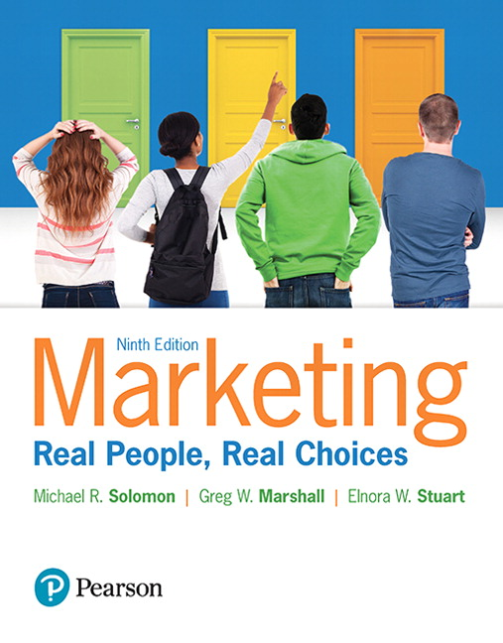
Marketing: Real People, Real Choices
Ninth Edition
Chapter 6
Understand Consumer and Business Markets
Copyright © 2018, 2016, 2012 Pearson Education, Inc. All Rights Reserved.
Notes:
If this PowerPoint presentation contains mathematical equations, you may need to check that your computer has the following installed:
1) MathType Plugin
2) Math Player (free versions available)
3) NVDA Reader (free versions available)

Slide 2
Learning Objectives (1 of 2)
6.1 Define consumer behavior and explain the purchase decision-making process.
6.2 Explain how internal factors influence consumers’ decision-making processes.
6.3 Show how situational factors and consumers’ relationships with other people influence consumer behavior.

Slide 3
Learning Objectives (2 of 2)
6.4 Understand the characteristics of business-to-business markets and business-to-business market demand and how marketers classify business-to-business customers.
6.5 Identify and describe the different business buying situations and the business buying decision processes including the use of e-commerce and social media.

Slide 4
Real People, Real Choices: Weight Watchers
Which option should be pursued?
Option 1: Make the weekly meetings more productive and entertaining.
Option 2: Design an immersive well-being event that would debunk and shift current assumptions about Weight Watchers.
Option 3: Organize a transformational event, but partner with an existing organization like Wanderlust to leverage their experience and infrastructure.
Notes:
DISCUSSION NOTE:
Explain to students that you want them to think about each option, and that you will return to this question at the end of the chapter.

Slide 5
The Consumer Decision-Making Process
Consumer behavior is the process individuals or groups go through to select, purchase, use and dispose of products in order to satisfy their wants and needs.
Decision-making behaviors are influenced by a variety of factors.
Internal, situational, and social factors influence consumer behavior.
Notes:
LECTURE NOTES:
Each of us is unique, with our own reasons to choose one product over another.
Consumer behavior is about understanding the processes by which individuals arrive at those decisions as well as the contextual and social factors that influence decisions.

Slide 6
Not All Decisions Are the Same
Amount of effort expended in decision-making varies according to the
Level of involvement
Perceived risk
Consumers use different approaches depending on the amount of effort.
Habitual problem-solving
Extended problem-solving
Limited problem-solving
Notes:
LECTURE NOTES:
Mainstream economic theory has long assumed that consumers carefully collect information about competing products, determine which products possess the characteristics or product attributes important to their needs, weigh the pluses and minuses of each alternative, and arrive at a satisfactory decision.
But is this the way you buy cereal? Or jeans? Or select a college?
In truth, the amount of effort consumers put forth in arriving at a decision varies according to the decision itself.

Slide 7
Figure 6.1 The Consumer Decision-Making Process
Notes:
LECTURE NOTES:
Consumers who engage in extended problem-solving follow each of the steps outlined in the consumer-decision making process: problem recognition, information search, evaluation of alternatives, product choice, and post purchase evaluation. On the other end of the scale, routine purchases (milk, soft drinks, eggs) are often habitual in nature requiring little if any conscious effort on the part of the consumer. Of course quite a few decisions are characterized by limited problem-solving, rules of thumb may be used to help make a decision (ask a friend for recommendations, only consider well-known brands, etc.)

Slide 8
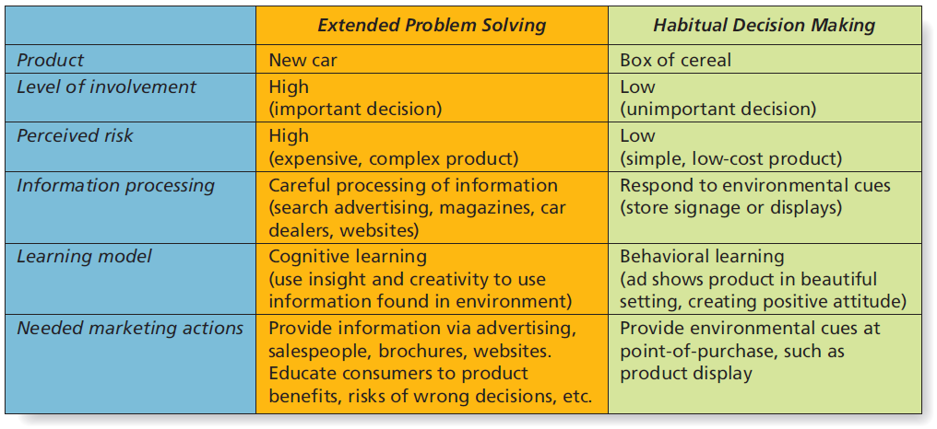
Figure 6.2 Extended Problem Solving vs. Habitual Decision-Making
Notes:
LECTURE NOTES:
The amount of effort devoted by consumers to buying decisions varies according to the level of involvement – how important the decision is perceived to be by consumers.
The level of perceived risk correlates strongly with involvement – the more expensive the product or the more complex it is, the higher the level of perceived risk. The higher the consequences of making a wrong choice, in terms of embarrassment, social rejection, the higher the level of perceived risk.
Consumers are more likely to spend a great deal of time in the decision making process, carefully collecting and processing all of the available information when involved in extended problem solving. This is because the consequences of the purchase are important and risky, as the wrong choice could result in significant financial loses, embarrassment, or other negative outcomes. The opposite, of course, is true for habitual decision making.
Understanding the type of decision making that guides the majority of the target market’s choice is important, as it suggests differing tactics that marketers should use to appeal to consumers, as shown on this slide.

Slide 9
Step 1: Problem Recognition
Occurs whenever a consumer sees a difference between current state and desired/ideal state
Marketers can develop ads that stimulate problem recognition.
Notes:
LECTURE NOTES:
Let’s discuss the consumer decision-making process in more detail. The first step is problem recognition.
Problem recognition occurs whenever the consumer sees a significant difference between his/her current state and the desired/ideal state. It’s the recognition that a problem exists which prompts the consumer to begin looking for a solution.
While most problem recognition occurs spontaneously as needs arise, marketers can develop ads that attempt to stimulate problem recognition. For example, this Campbell’s Soup ad asks, “What shape are your kids in?”, attempting to quick-start problem recognition for parents who may need to consider they feed their kids.
DISCUSSION NOTE:
Ask students for other examples of how marketers stimulate problem recognition.
Example: radio ads promoting restaurants which are played at lunchtime (scheduling ads at relevant time)
Example: TV ad showing excitement of owning a new car, or envy of a neighbor (may create dissatisfaction with current vehicle)

Slide 10
Step 2: Information Search
Consumers need adequate information to make good decisions.
Consumers search memory and environment for information.
If information is inadequate, consumers seek out additional sources
Notes:
LECTURE NOTES:
Following problem recognition, an individual engaged in extended or limited problem solving will engage in information search to at least some degree. As part of this process, consumers search their memory for knowledge of different options that might solve the problem, drawing upon their own experience, what they “know” as a result of being exposed to marketing communications, as well as information shared by friends and family.
Rarely do individuals engaged in extended problem stop here though. Instead, additional search time and effort is expended in an attempt to learn more, or to fill in gaps in existing knowledge. This type of search activity may involve scouring the Internet for information, actively paying attention to ads for the type of product being sought, and perhaps even visiting retailers and talking with salesmen.
So when a consumer recognizes a problem, such as the need to lose weight, he or she will be much more receptive to marketing communications that reflect a product’s ability to help, as the ad for V8 shows here.

Slide 11
Online Search
Internet search engines, portals and shopbots are being increasingly relied upon.
/www.google.com/
www.bing.com
/www.bizrate.com/
/www.pricegrabber.com/
Notes:
LECTURE NOTES:
Shopbots are also known as Comparison Shopping Agents. These are web applications that help online shoppers find what they are looking for at the lowest price and provide customer reviews and ratings of products and sellers.
These are some common websites students are probably already familiar with.

Slide 12
Step 3: Evaluation of Alternatives
Identifying a small number of products for closer consideration
Determinant attributes
Evaluative criteria
Notes:
LECTURE NOTES: During the third step of the consumer decision making process, a consumer will identify a small number of products in which he or she is interested (called the consideration set), then narrow these choices by comparing the pros/cons of each on the basis of evaluative criteria.
Determinate attributes are features that are most important to differentiate and compare among the product choices.
Evaluative criteria are product characteristics which consumers use to compare competing alternatives. Marketers also need to identify and communicate important evaluative criteria to buyers.
For example, a person who is dieting will consider only low-calorie options – a small number of products that will be subjected to additional consideration. Since each product remaining in the consideration set is already low calorie, TASTE may become the ultimate evaluative criteria that helps the consumer decide which low-calorie option is chosen.

Slide 13
Step 4: Product Choice
Consumers often rely on mental shortcuts, or heuristics, in making decisions.
Heuristics are rules of thumb used by individuals to arrive at good decision with less mental effort:
Price equals quality
Brand loyalty
Country of origin
Notes:
LECTURE NOTES:
Choosing which product to purchase and acting on that choice is the next step of the consumer decision-making process.
Decisions are often difficult to make though, because different products may offer differ features or benefits in varying degrees. Weighing the relative value of each product, especially when prices differ, can be very challenging.
For this reason, many consumers rely on mental rules of thumb, called heuristics, to help them make decisions.
For example, some people buy the more expensive brand option, believing that the higher price reflects better quality. Others simplify decision making by purchasing the same brand over and over, so long as it continues to satisfy their needs. Finally, some people assume products have certain characteristics if they come from a particular country (Germany – fine engineering, superior chocolate).

Slide 14
Step 5: Postpurchase Evaluation
Consumer satisfaction/dissatisfaction following purchase of product is critical.
Level of satisfaction is influenced by whether or not expectations of quality are met or exceeded.
Marketing communications must create accurate expectations for the product.
Cognitive dissonance is common.
Notes:
LECTURE NOTES:
The last step of the decision making process is the one in which consumers evaluate how good a choice was made by comparing the expectations they formed regarding the product with its actual performance.
If the benefits and experience delivered exceed expectations, customers are satisfied, but when advertising overpromises what the product can do, or consumers form unrealistic expectations through other means, dissatisfaction will occur.
Cognitive dissonance is common following a major purchase, even in instances where consumers are satisfied with their purchase. Cognitive dissonance refers to the anxiety or regret that a consumer may feel after choosing from among several similar attractive choices. Essentially, consumers become nervous and second guess the choice they made.
DISCUSSION NOTES:
Marketers can take a number of actions that may help to reduce cognitive dissonance:
Include information inside the package praising consumers and reinforcing they made the right choice.
Using follow-up emails, letters, and phone calls to contact the buyer following the purchase as a means of either reassuring them or answering questions they might have.
Offering comprehensive warranties and guarantees.

Slide 15
Consumer Decisions
Decision-making effort varies based on levels of perceived importance and risk.
Marketing can trigger problem recognition and facilitate consumer progression through decision process.
What actions can marketers take to alleviate cognitive dissonance?
Notes:
Lecture Notes:
Summary slide for Chapter 6, learning objective 1.

Slide 16
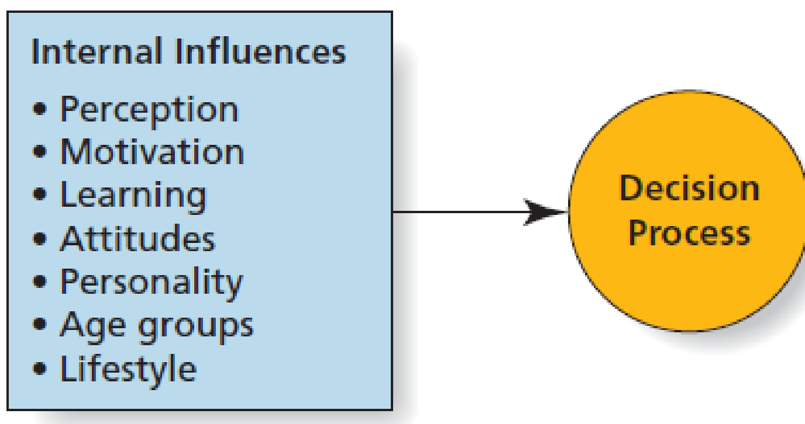
Figure 6.4 Internal Influences on Consumers’ Decisions (1 of 2)
Notes:
LECTURE NOTES:
Marketers also try to understand the influence of each of the factors shown here, and how they impact the decision making process. These include factors internal to the consumer, situational influences, and social influences.

Slide 17
Perception
Perception is the process by which we select, organize, and interpret information from the outside world.
Three factors are necessary for perception to occur:
Exposure: capable of registering a stimulus
Attention: mental processing activity
Interpretation: assigning meaning
Notes:
LECTURE NOTES:
Multiple internal factors cause individual consumers to interpret information about the outside world differently, including perception.
Perception is the process by which we select, organize, and interpret information from the outside world. Information is received from our visual, aural, and tactile senses and then interpreted in light of our past experiences, or lack thereof.
Obviously marketers want consumers to perceive messages in the manner in which they were intended. For this to occur, consumers must be exposed to the message (i.e., be capable of registering the stimulus delivered in the marketing communications); they must pay attention to the message by mentally processing the information and cues it contains, and finally, they must interpret the message correctly by assigning the proper meaning to the words and symbols it contains.
Marketers work hard to achieve exposure for their products, for example, by placing marketing communications in a variety of media and contexts. While some consumers have been concerned that marketers can manipulate them into buying things they don’t need or want via subliminal advertising – hidden messages that supposedly influence our ID and thus work below the conscious threshold – no evidence of subliminal advertising’s effectiveness exists.
Multitasking by consumers and the large number of communications to which consumers are exposed make attracting attention very difficult, though various creative tactics, such as the use of humor and celebrities, can be helpful.
Finally, marketers must make certain that the words, pictures, and other symbols used in their marketing communications efforts are within the realm of consumer’s past experience – cultural, educational, and geographic differences are among the many reasons why a message may not be properly perceived.
We are bombarded by thousands of marketing communications messages daily.

Slide 18
Motivation
Motivation is an internal state that drives us to satisfy needs by activating goal-oriented behavior.
Consumers purchase many products such as bathtubs for both functional and aesthetic reasons.
Notes:
LECTURE NOTES:
Motivation is an internal state that drivers consumers to satisfy their needs. Understanding what motivates consumers can help marketers do a better job of segmenting the market, and communicating with their chosen target.
For example, marketers at the beginning of the walking shoe craze assumed that all recreational walkers were just burned-out joggers. Subsequent psychographic research that examined the AIOs of these walkers showed that there were actually several psychographic segments within the larger group who engaged in the activity for very different reasons. These different motivations included walking for fun, walking to save money, and walking for exercise. This research resulted in walking shoes for different segments, from Footjoy Walkers to Nike Healthwalkers.
DISCUSSION NOTE:
Consumers purchase many products such as bathtubs for both functional and aesthetic reasons.
Instructor should ask some students to write down a recent purchase that they were motivated to make for functional reasons and another group to write down recent purchases made for aesthetic reasons. Compare the two lists – are there crossovers?

Slide 19
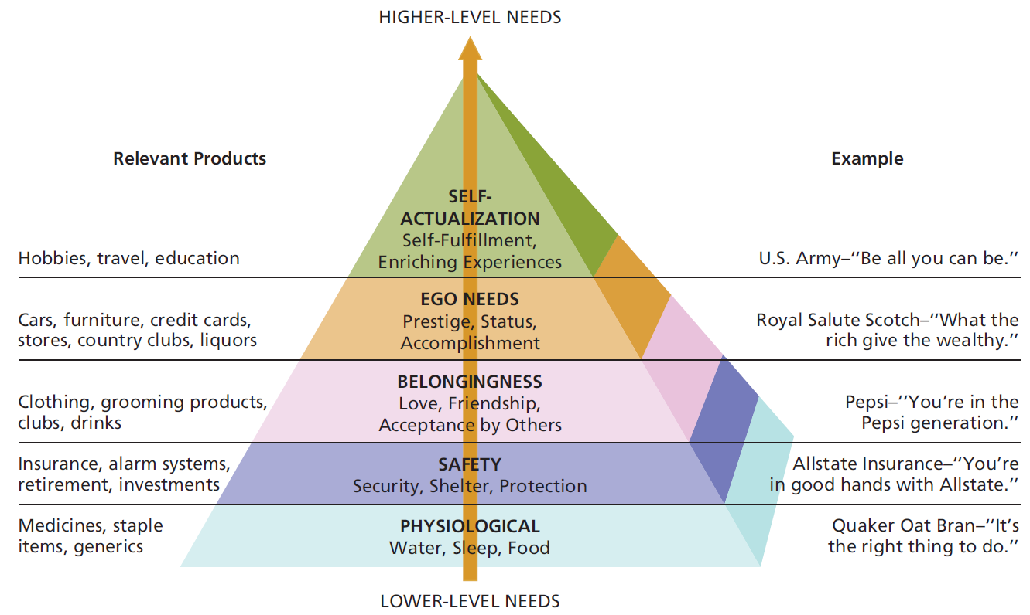
Figure 6.5 Maslow’s Hierarchy of Needs and Related Products
Source: Adapted from Maslow, Abraham H.; Frager, Robert D.; Fadiman, James, Motivation and Personality, 3rd Ed., ©1987. Reprinted and Electronically reproduced by permission of Pearson Education, Inc., Upper Saddle River, New Jersey.
Notes:
LECTURE NOTES:
The hierarchy of needs categorizes motivation as being related to five different types of needs. Need types include physiological, safety, belongingness, ego, and self-actualization. Products and services related to each need level are also shown on the slide.
The basic premise behind the hierarchy of needs is that consumers will seek to satisfy lower level needs (e.g., physiological) before progressing to higher level needs.
When marketers understand the level of need most relevant to their consumer target, they can tailor their product and messages to match.

Slide 20
Gamification
Gamification is a rising business trend.
Enables customers to participate in loyalty programs and promote favorite products in a fun and entertaining way
Participants earn badges, rewards, points
Notes:
DISCUSSION NOTES:
Instructor should introduce gamification concept and ask students about their own experiences.
Some students are likely familiar with apps such as Foursquare as well as websites such as StackOverflow and LinkedIn, which have gamification elements.
Have students debate the pros and cons of companies using such information from games for marketing purposes from the consumer’s perspective.

Slide 21
Learning
Learning is a relatively permanent change in behavior caused by information or experience.
Behavioral theories of learning
Cognitive theories of learning
Notes:
LECTURE NOTES:
Learning is defined as a relatively permanent change in behavior caused by information or experience. Psychologists have advanced several theories as to how learning occurs.
Behaviorally based theories assume that learning takes place as a result of connections we form between events. In classical conditioning, a person perceives two stimuli at about the same time. After a while, the person transfers his response from one stimulus to the other. For example, an ad shows a product and a breathtakingly beautiful scene so that (the marketer hopes) you will transfer the positive feelings you get when you look at the scene to the advertised product.
Another common form of behavioral learning is operant conditioning, which occurs when people learn that their actions result in rewards or punishments. This feedback influences how they will respond in similar situations in the future. Just as a rat in a maze learns the route to a piece of cheese, consumers who receive a reward such as a prize in the bottom of a box of cereal will be more likely to buy that brand again.
Cognitive learning theory views people as problem-solvers who do more than passively react to associations between stimuli. Cognitive learning takes place when consumers make a connection between ideas or by observing things in their environment. Marketing messages facilitate this process when they provide factual information, such as the nutrition facts shown in this print ad.
Observational learning occurs when people watch the actions of others and note what happens to them as a result. This is why many TV ads show the product being used, and the positive benefits that result from that usage.

Slide 22
Ethical/Sustainable Decisions in the Real World
Information about consumers is big business.
Data brokers collect information on consumers.
Data brokers have created a wild, wild West for consumers.
Very few laws
Should there be more government regulations on data brokers to protect consumers’ privacy?
If data on consumers has financial value, should consumers be financially compensated for their information?
Notes:
DISCUSSION NOTE:
Have students think realistically about the impact of data brokers on their everyday lives. But, also play devil’s advocate, and ask what harm is really being done?

Slide 23
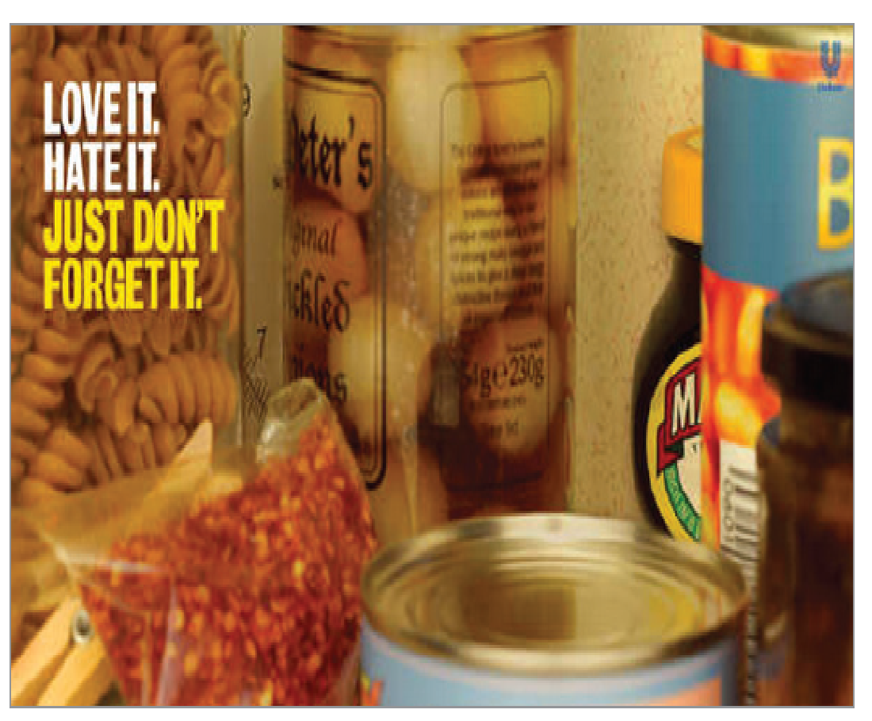
Attitudes
Attitudes represent lasting evaluations of a person, object, or issue.
Three components of attitude:
Affect (feeling): emotional response
Cognition (knowing): beliefs or knowledge
Behavior (doing): intention to do something
Notes:
LECTURE NOTES:
Marketers often try to influence our attitudes via the affective component when they use images that arouse either negative or positive feelings.

Slide 24
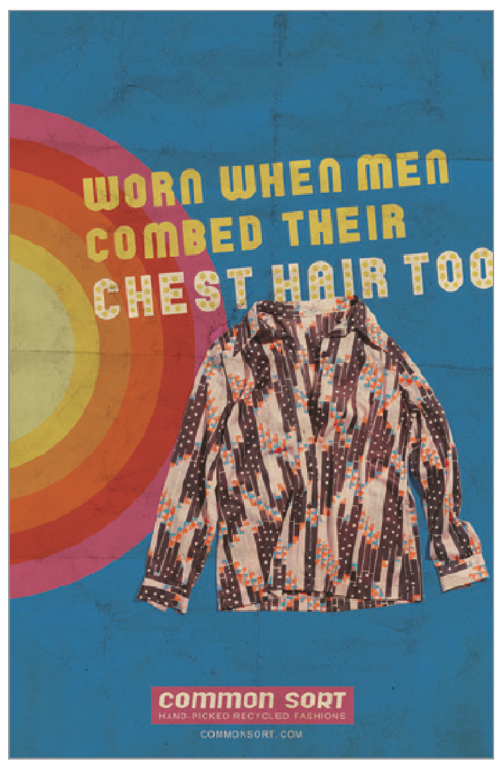
Personality: Are You What You Buy?
Personality is the set of unique psychological characteristics that consistently influence the way a person responds to situations in the environment.
Self concept
Self esteem
Notes:
LECTURE NOTES:
Personality is simply defined as the set of unique psychological characteristics that consistently influences the way a person responds to situations in the environment. Understanding personality can help marketers create brands that appeal to specific personality types.
Self-concept refers to the attitude that an individual has toward himself. A person’s self-concept can influence the products he or she purchases.
Self-esteem refers to how positive a person’s self-concept is, and marketers often attempt to show consumers how the purchase of certain product’s (clothing, jewelry, deodorant) or services (massage, hair styling) can make them feel better about themselves, thereby enhancing their self-esteem.

Slide 25
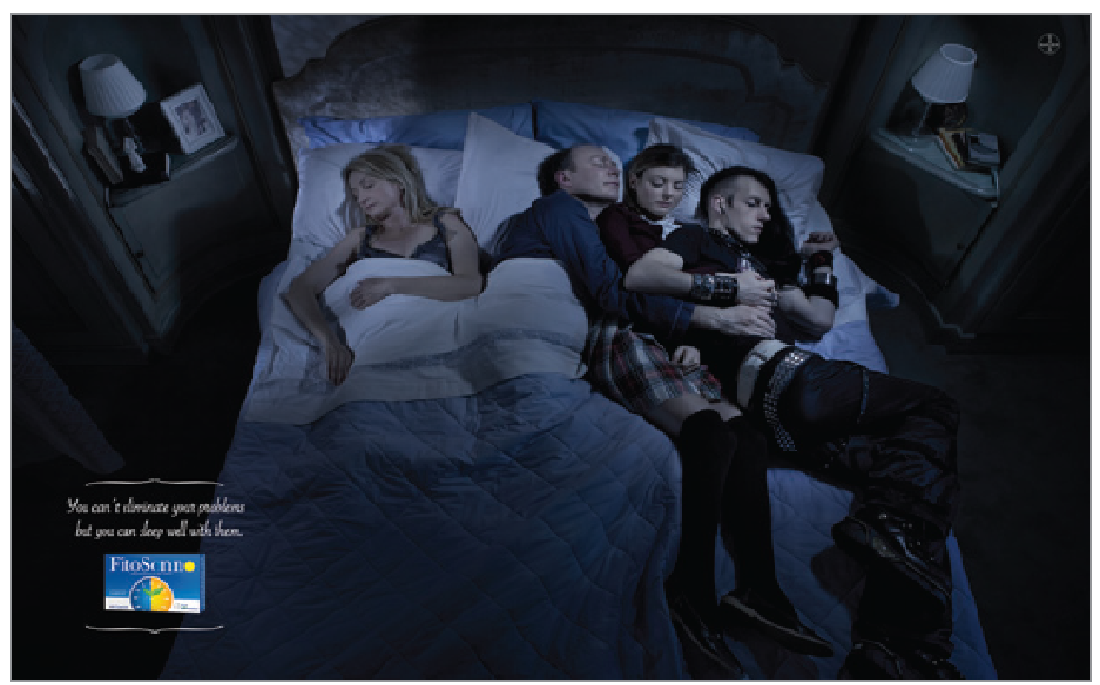
Age
Goods and services often appeal to individuals within a certain age group.
Purchases are often associated with a particular stage in the family life cycle.
Notes:
LECTURE NOTES:
Some products are more likely to appeal to certain consumers based upon their age or a stage in their family life cycle.
DISCUSSION NOTE:
Introduce the family life cycle concept. Have students provide relevant examples of products (e.g., diapers), services (e.g., various types of insurance), or experiences (e.g., family vacation to Magic Kingdom) suitable to families at various life cycle stages.

Slide 26
Lifestyle
Lifestyle reflects a pattern of living.
Marketers seek to describe people according to activities, interests, and opinions.
Psychographics groups people according to psychological and behavioral similarities.
Notes:
LECTURE NOTES:
Lifestyles reflect a pattern of living that determines how people choose to spend their time, money, and energy. For this reason, marketers try to describe target segments by lifestyle, and according to their activities ,interests, and opinions.
Psychographics are used to profile, or group consumers according to these psychological and behavioral similarities. This allows marketers to not only target products more effectively, but also to better communicate with targeted segments by reflecting the unique interests, activities, and lifestyles of the targeted group in marketing communications.
For example, skateboarding has morphed from an activity we associate with the lawbreaking daredevils. Shows on MTV feature professional skateboarders, and sales of a skateboarding video game, Tony Hawk by Activision, are over $1 billion. Many kids happily fork over $20 for T-shirts and more than $60 for skate shoes in addition to the hundreds they may spend on the latest boards.

Slide 27
Figure 6.4 External Influences on Consumers’ Decisions (2 of 2)
Notes:
LECTURE NOTES:
This is the second half of Figure 6.4, showing external influences. The following slides provide details.

Slide 28
Situational Influences on Consumers’ Decisions
Situational factors often shape purchase behaviors.
Sensory marketing
Physical environment
Time poverty
Notes:
LECTURE NOTES:
Situational factors such as the physical environment in which we shop, and time pressures help to share our purchase choices.
Within the physical environment, store décor, smells, lighting, music and temperature can influence consumption, which explains why sensory marketing is such big business. Sensory marketing occurs when a direct sensory experience, such as a unique fragrance, is linked with a particular product or service.
Two factors, arousal and pleasure determine consumers’ reaction to store environment. When the store surrounding is exciting (arousing), reactions are likely to be pleasant, while dull surrounds that do not arouse the consumer and are more likely to stimulate less than pleasant reactions.
The importance of these factors is one reason why retailers try to make the shopping experience more entertaining, and upbeat. Let’s watch this short video clip and see how Stew Leonard’s physical environment helps shape purchase choices.
Time is one consumers’ most limited resources and this sense of time poverty makes consumers more likely to respond to marketing services and products that offer to save time (1 hour film processing, music downloads over the web vs. ordering a CD for delivery, etc.).
Casinos recognize the importance of both influences in their business. They control their physical environments very carefully to project the right mood and to encourage consumers to stay and play as long as possible. Casinos try to negate the time poverty influence by eliminating clocks on the gaming floor. You won’t find windows or clocks on the walls of the gaming floor at the Luxor or any other casino—consumers are less likely to realize how much time has passed without these visible cues, and thus tend to stay and play longer.

Slide 29
Social Influences on Consumer Decisions
We are all individuals …
but we are also members of many groups that influence our purchasing behavior.
Many social influences on consumer decision-making, for instance:
Culture and subcultures
Social class
Reference groups and opinion leaders
Notes:
LECTURE NOTES:
Families, friends, and classmates often sway our consumer decision making, as do larger groups with which we identify, such as ethnic groups and political parties.
The next set of slides consider how social influences, such as culture, social class, influential friends and acquaintances, and trends within the larger society, affect the consumer decision-making process.
DISCUSSION NOTE:
Ask students what they did last weekend and how they arrived at their decision. It is likely that many of the answers will reveal various social influences.

Slide 30
Culture
Culture represents the shared values, beliefs, customs, and tastes produced or practiced by a group of people.
Includes rituals such as weddings and funerals
Marketers tailor products to cultural values
Notes:
LECTURE NOTES:
Despite the fact that we are all individuals, consumers are also members of groups that in turn exert influence over our buying decisions. These social influences include culture, subculture, social class, group memberships, opinion leaders, and gender roles.
Culture is defined as the values, beliefs, customs, and tastes produced or practiced by a group of people.
Culture varies by country though and can manifest in interesting ways. For example, different cultures form different ideas of what particular colors symbolize. The color white is associated with death and mourning in China and some other nationalities, whereas Americans associate the color white with weddings, purity, and cleanliness. (For more in-depth information, see http://en.wikipedia.org/wiki/Color_symbolism and “Color by Numbers,” American Demographics, February 1, 2002.)
Rituals also vary by culture, be they weddings, funerals, or holiday celebrations. Thanksgiving is a unique American holiday typically celebrated with Turkey, dressing, cranberry sauce, and pumpkin pie. Understanding key rituals within a culture is important because these represent opportunities to demonstrate how a brand fits within the culture.

Slide 31
Subcultures and Microcultures
A subculture is a group that
Coexists with other groups within a larger culture
Members share a distinctive set of beliefs, characteristics, or common experiences
e.g., members of a religious or ethnic group
Microcultures are groups of individuals who identify based on a common activity or art form, for instance:
The Voice or Grey’s Anatomy fans
Candy Crush players
Notes:
DISCUSSION NOTES:
Ask students if they can think of other examples of microcultures.

Slide 32
Conscientious Consumerism: An Emerging Lifestyle Trend
Many consumers are more aware of the social and environmental consequences of their purchases
And make decisions accordingly!
In today’s connected world, criticism from consumer sources can be damaging.
Notes:
LECTURE NOTES:
In today’s connected world, criticisms from consumerists can be especially damaging.
A company’s best way to combat such attacks and maintain a good image is to be proactive by practicing good business.
DISCUSSION NOTES:
“United Breaks Guitars" is a protest song by Canadian musician Dave Carroll and his band, Sons of Maxwell. It chronicles a real-life experience of how his guitar was broken during a trip on United Airlines in 2008, and the subsequent reaction from the airline. The song became an immediate YouTube and iTunes hit upon its release in July 2009 and a public relations embarrassment for the airline.

Slide 33
Social Class
Social class is the overall rank or social standing of groups of people within a society, according to factors such as:
Family background
Occupation
Education
Income
Luxury products serve as status symbols.
Notes:
LECTURE NOTES:
Marketers sometimes design communication campaigns to appeal to people of a given social class. Fore example, luxury goods often serve as status symbols that allow people to flaunt their membership in higher social classes.
Many firms now cater the mass-class, the hundreds of millions of consumers who now enjoy a level of purchasing power that’s sufficient to let them afford high-quality products.

Slide 34
Group Membership
Along with the crowd
Riskier alternatives
Reference group
Notes:
LECTURE NOTES:
When you go along with the crowd, you tend to act differently than if you were by yourself. Similarly, when we’re in a group setting, we often consider riskier alternatives than we would alone.
A reference group is an actual or imaginary individual or group that has a significant effect on an individual’s evaluations, aspirations, or behavior. The example illustrated is demonstrating how loyal Star Wars fans are.

Slide 35
Opinion Leaders
Opinion leaders frequently influence the attitudes and behaviors of others.
Such individuals typically share several characteristics:
High interest in a given product category
Update product category knowledge by reading, talking with salespeople, etc.
Impart both positive and negative information
Are among the first to buy goods
Notes:
LECTURE NOTES:
Opinion leaders are people who influence others’ attitudes or behaviors, due to the expertise they hold on a subject.
Opinion leaders have high interest in the product category, and actively stay current by keeping up with new product news, reading blogs, talking with sales reps, etc.
Opinion leaders have nothing to gain by either endorsing or slamming a given brand – they aren’t paid endorsers for the product, just interested amateurs. Thus friends and acquaintances trust that their opinions to be unbiased,
They are also often innovators, meaning they are among the first to buy a new product when it first hits a product.
Now, an important thing to understand is that a true opinion leader is an expert in only one or two product categories at the most. No single person can provide informed opinions on every single product category.

Slide 36
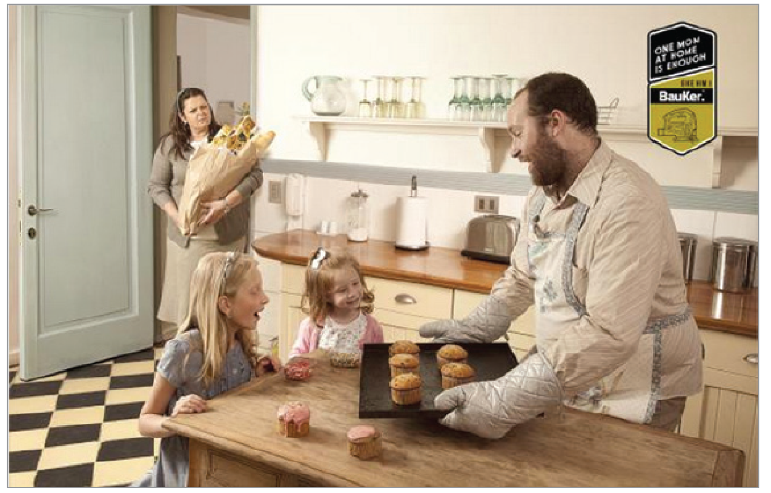
Gender Roles
Gender roles relate to society’s expectations regarding appropriate attitudes, behaviors, and opportunities for men and women.
Consumers often associate sex-typed products with one gender or the other.
Sex roles are constantly evolving.
Notes:
LECTURE NOTES:
Some of the strongest pressures to conform stem from gender roles, society’s expectations regarding the appropriate attitudes, behaviors, and appearance for men and women.
Think about it – would you buy a baby doll for your young nephew?? Not likely, because gender roles stipulate that baby dolls are for girls (thus dolls are a sex-typed product).
Of course sex-typing is not always desirable, and may be criticized by social groups. Many critics have pointed to Mattel’s Barbie doll as setting and perpetuating unrealistic expectations of what women’s bodies should look like.
Sex roles are constantly evolving. Unfortunately, teens are taught early that its cool to be overly provocative. They learn about sex roles from pop stars (how they dress, act and use make-up) and from websites that provide teen style tips.
Men’s sex roles are also changing; while manicures and skincare used to be the sole domain of women, men are increasingly concerned about their appearance.
Metrosexual is the term being used to refer to straight, urban males who are keenly interested in fashion, home design, gourmet cooking, and personal care.
Understanding how gender roles have evolved is important for marketers. Certainly, it presents opportunities for new product development (grooming products for men, pink colored shirts) which can lead to growth for the firm.

Slide 37
Buying and Selling When the Customer is Another Organization
Business-to-business (B2B) markets (also called organizational markets) include:
Manufacturers and other product producers
Resellers (retailers and wholesalers)
Government and not-for-profit institutions
Notes:
LECTURE NOTES:
Introductory slide for Chapter 6, Learning Objective 4.

Slide 38
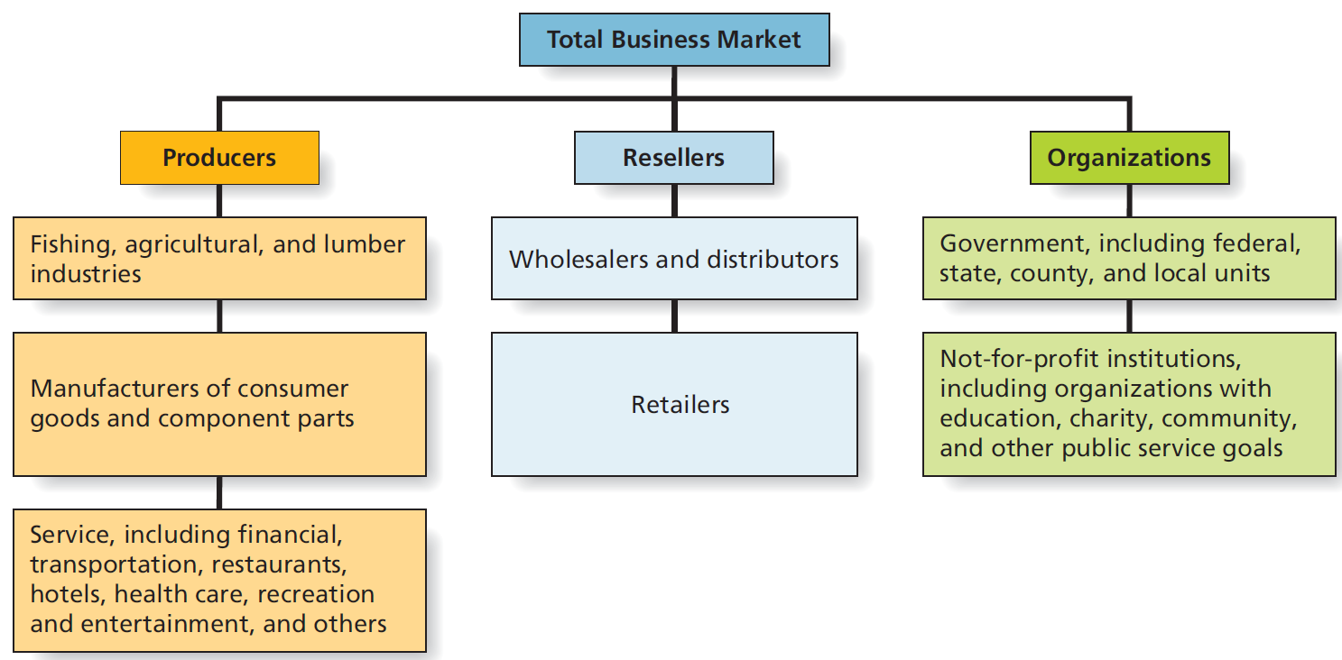
Figure 6.6 The Business Marketplace
Notes:
LECTURE NOTES:
Three major classes of B2B customers include producers, resellers, and organizations.
Producers are individuals or firms that purchase products for use in the production of other goods and services. The goods purchased may be raw materials, component parts, semi-finished goods, or services.
Examples: A) Dell buys RAM chips from Intel for integration into their PCs; B) General Mills buys grains to be used in the manufacture of cereals from ; C) A travel incentive provider purchases hotel rooms, tickets to entertainment venues, and flights, then creates incentive packages that are sold to business corporations looking to reward employees who performed well.
Resellers are individuals or firms that buy finished goods for reselling, renting, or leasing. Resellers include wholesalers, distributors, and of course retailers.
Examples: A) Wholesalers/distributors: Sysco supplies hospitals, educational institutions, and other organizations with a variety of paper goods (napkins, toilet paper, etc.), ingredients (salt, sugar, etc.) and other items. B) Students should be able to come up with a variety of retailer examples quite easily.
The Organizational market includes all levels of government and not-for-profit institutions. Federal, state, county, and local governments that buy goods and services to carry out public objectives and to support their operations. Organizations with charitable, educational, community, and other public service goals that buy goods and services to support their functions and to attract and serve their members.
Dealing with government markets is very different than dealing with other types of organizations, and for that reason many large firms maintain separate divisions that are tasked with dealing only with Government buyers.
Some of the key differences include the fact that government purchasing often is restricted to a list of approved vendors, and even those vendors may need to bid for projects, or agree to a contract in which a fixed price is guaranteed over a given period of time, usually a year. Although the size of the government market is attractive, unanticipated changes such as drastic increases in the cost of fuel can limit the profit potential of the market, and come back to haunt suppliers who are required by contract to fill orders at a predetermined price (if that price includes delivery).
Another key difference is that government purchasing agents are not allowed to accept gifts—accepting even the must mundane promotional item (such as pen, cap, or mouse pad) is illegal, and salespeople who (knowingly or unknowingly) offer such items to government buyers run the risk of being thrown out the door, being accused of bribery, or perceived as an unethical.
Examples: A) The federal government purchases military weapons systems, furniture for offices, copy machines, supplies, and services such as construction. State and local governments purchase many of the same items (with the exception of the cruise missile and other major military weapons).
B) Not-for-profits purchase printing services to create educational brochures, supplies and products for distribution to charity recipients, and items to be used at their place of business.

Slide 39
Table 6.1 North American Industry Classification System
Blank | Frozen Fruit Example | Blank | Cellular Telecommunications Example | Blank
Sector (two digits) | 31–33 | Manufacturing | 51 | Information
Subsector (three digits) | 311 | Food manufacturing | 513 | Broadcasting and telecommunications
Industry group (four digits) | 3114 | Fruit and vegetable preserving and specialty food manufacturing | 5133 | Telecommunications
Industry (five digits) | 31141 | Frozen food manufacturing | 51332 | Wireless telecommunications carriers (except satellite)
U.S. industry (six digits) | 311311 | Frozen fruit, juice, and vegetable manufacturing | 513322 | Cellular and other wireless telecommunications
Notes:
LECTURE NOTES:
NAICS replaced the U.S. Standard Industrial Classification (SIC) system in 1997 so that the North American Free Trade Agreement (NAFTA) countries could compare economic and financial statistics.
NAICS reports the number of firms, the total dollar amount of sales, the number of employees, and the growth rate for industries, all broken down by geographic region.
Many firms use the NAICS to assess potential markets and to determine how well they are doing compared to others in their industry group.
Firms may also use the NAICS to find new customers. A marketer might first determine the NAICS industry classifications of his or her current customers and then evaluate the sales potential of other firms occupying these categories.

Slide 40
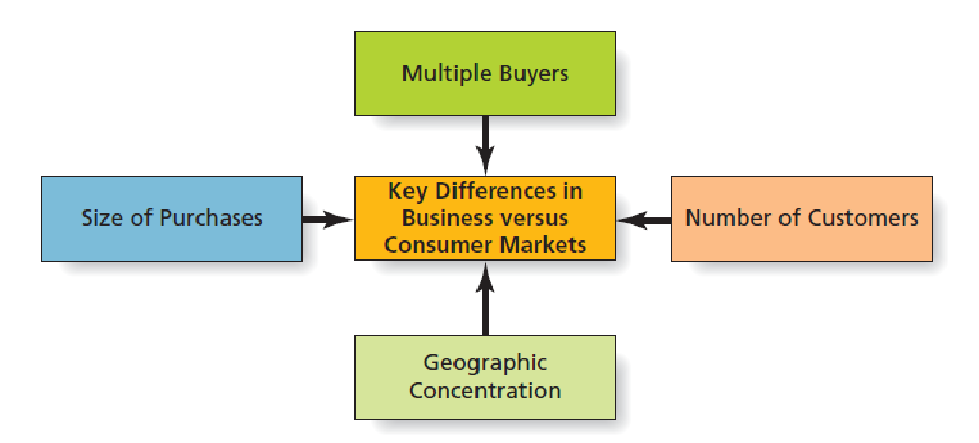
Figure 6.7 Key Differences in Business vs. Consumer Markets
Notes:
LECTURE NOTES:
Aside from the fact that purchases are made for some purpose other than personal consumption, business to business markets differ from consumer markets in several key ways:
Decisions are frequently made by multiple buyers, called buying groups, and the final decision maker is typically someone other than the user of the product. The decision making process also differs, as it is made after careful weighing of alternatives based on rational criteria, according to precise technical specifications based on product expertise.
There are also a limited number of large buyers; in fact, products are frequently purchased directly from the producer. Once a decision has been made, long-term relationships typically develop between buyers and sellers unless dissatisfaction occurs.
A third key difference is that unlike consumers who are literally spread out through the U.S. organizational buyers are often geographically concentrated in certain areas.
Finally, purchases frequently involve high risk and high cost. The process may involve competitive bidding, price negotiations, and complex financial arrangements. This, and the fact that buyers are geographically concentrated makes personal selling the best marketing communications choice. Indeed, the vast majority of B2B marketers emphasize personal selling over advertising.

Slide 41
Table 6.2 Differences Between Organizational and Consumer Markets (1 of 2)
Organizational Markets | Consumer Markets
Purchases made for some purpose other than personal consumption | Purchases for individual or household consumption
Purchases made by someone other than the user of the product | The ultimate user often makes the purchase
Several people frequently make the decisions | Individuals or small groups like couples and families usually decide
Purchases made according to precise technical specifications based on product expertise | Purchases often based on brand reputation or personal recommendations with little or no product expertise
Purchases made after careful weighing of alternatives | Purchases frequently made on impulse
Purchases based on rational criteria* | Purchases based on emotional responses to products or promotions
Purchasers often engage in lengthy decision processes | Individual purchasers often make quick decisions
Interdependencies between buyers and sellers; long-term relationships | Buyers engage in limited-term or one-time-only relationships with many different sellers
Purchases may involve competitive bidding, price negotiations, and complex financial arrangements | Most purchases made at “list price” with cash or credit cards
Notes:
LECTURE NOTES:
Table 6.2 provides a more detailed list of differences between consumer and business markets.

Slide 42
Table 6.2 Differences Between Organizational and Consumer Markets (2 of 2)
Products frequently purchased directly from producer | Products usually purchased from someone other than producer of the product
Purchases frequently involve high risk and high cost | Most purchases are relatively low risk and low cost
Limited number of large buyers | Many individuals or household customers
Buyers often geographically concentrated in certain areas | Buyers generally dispersed throughout total population
Products often complex; classified based on how organizational customers use them | Products: consumer goods and services for individual use
Demand derived from demand for other goods and services, generally inelastic in the short run, subject to fluctuations, and may be joined to their demand for other goods and services | Demand based on consumer needs and preferences, is generally price elastic, steady over time and independent of demand for other products
Promotion emphasizes personal selling | Promotion emphasizes advertising

Slide 43
Business-to-Business Demand (1 of 2)
Business-to-business demand differs from consumer demand.
Demand is:
Derived
Inelastic
Fluctuating
Joint
Notes:
LECTURE NOTES:
Demand in B2B markets differs from demand in consumer markets.
Demand in B2B is: derived, inelastic, fluctuating, and joint.
The following slides cover these aspects of B2B demand in greater detail.

Slide 44
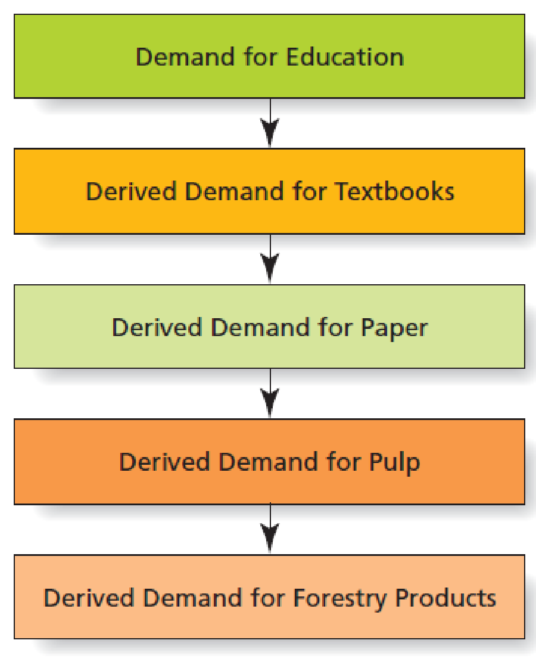
Figure 6.8 Derived Demand
Notes:
LECTURE NOTES:
Demand for B2B products also differs from demand for consumers demands. One of the most important differences is the fact that B2B demand is derived, meaning that it stems directly or indirectly for consumer demand for another good or service.
The example shown here illustrates how consumer’s demand for an education influences derived demand for a number of goods, including textbooks, paper, pulp, and forestry products. Thus demand for a single consumer product may contribute to the derived demand of many B2B goods.
DISCUSSION NOTES:
The threat of substitution is always present when dealing with business demand, and probably should be addressed during the discussion of this slide. For example, you might point to the exhibit on this slide and ask students to consider what substitutes exist for paper textbooks (digital books, online learning centers, or course, etc.). Obviously, if demand were to shift radically toward digital books, it would influence the derived demand for forestry products in a negative manner. (Which might not be a bad thing when considered from a sustainability perspective.)

Slide 45
Business-to-Business Demand (2 of 2)
Inelastic demand occurs when changes in price have little or no effect on quantity sought.
Fluctuating demand is when small changes in consumer demand create large changes in business demand.
Life expectancy of the product can also create fluctuating demand.
Joint demand occurs for two or more goods that are used together to create a product.
Notes:
LECTURE NOTES:
Inelastic demand
Demand in B2B markets is mostly inelastic because what a firm sells often is just one of the many parts or materials that go into producing the consumer product. It is not unusual for a large increase in a business product’s price to have little effect on the final consumer product’s price.
Fluctuating demand:
Small changes in consumer demand can result in large changes in B2B demand. As an example, consider air travel. A rise in jet fuel prices causes higher ticket prices and a shift by some consumers from flying to driving vacations, which may cause airlines to postpone or cancel orders for new equipment. This change in turn creates a dramatic decrease in demand for planes from manufacturers such as Boeing and Airbus.
Another cause of fluctuating demand is product life expectancy. Business customers tend to purchase certain products, such as manufacturing equipment, on a somewhat infrequent basis. They may need to replace some types of large machinery only every 10 or 20 years. Thus, demand for such products fluctuates.
DISCUSSION NOTES:
Can students think of other examples of joint demand?
A classic example of joint demand in a goods context is razors and blades. The demand for razor blades is a function of the number of razors in use. This is why razors are often sold at a loss – in order to increase demand for the higher-margin blades. Printers and ink cartridges would be another.
Joint demand also is present in digital environments. For instance, Apple offers the iTunes app for free while charging for downloads of music and other content.

Slide 46
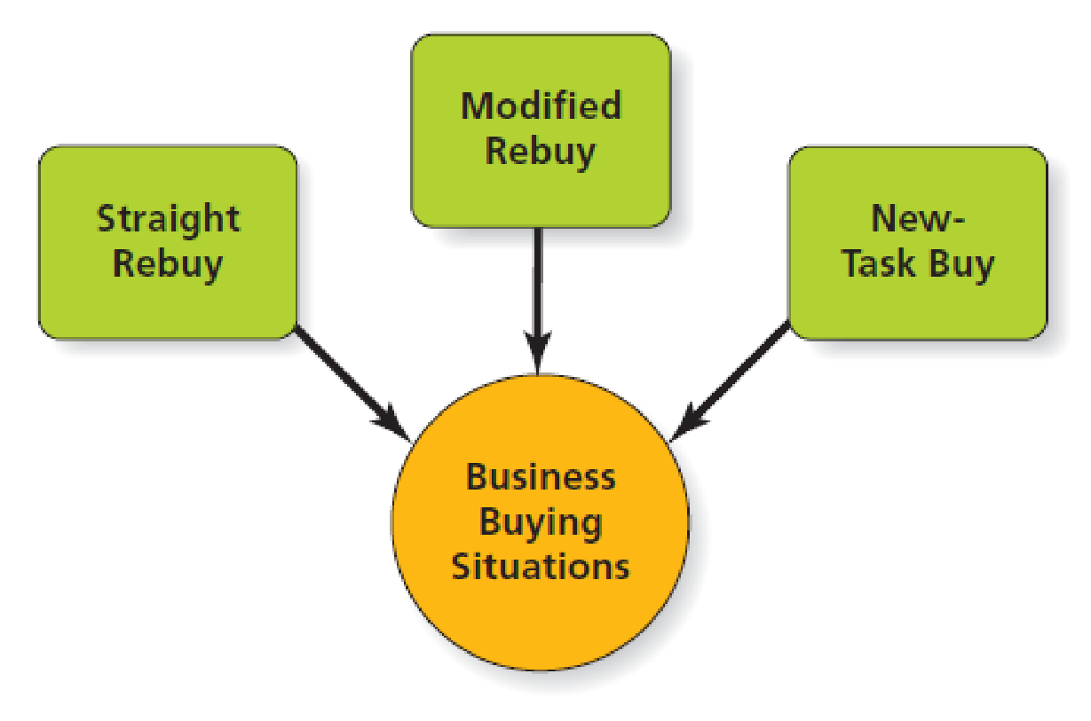
Figure 6.9 Elements of the Buy Class Framework
Notes:
LECTURE NOTES:
The Buy Class framework identifies the degree of effort a firm needs to collect information and make a business-related purchasing decision.
Three buy classes exist:
Straight rebuy: Routine purchases of items bought on a regular basis fall within this class. Little time is spent on the decision, as the business merely reorders items from their existing suppliers. Supplies, such as paper or toner for the copy machine, generally fall within this class.
Marketers should devote sufficient attention to cultivating and maintaining relationships with individuals who are in charge of ordering supplies on a regular basis, and immediately respond to any problems that might crop up. The goal is to never give the customer a reason to search for an alternative provider.
Modified rebuy: Modified rebuys occur when a firm decides to shop around for a new supplier, often because they are looking for a better price, better quality, improved delivery time, or some other improvement. Products that are technological in nature often fall within this category (cell phone service, computers, etc.). Modified rebuys take more time to complete and typically involve the evaluation of more than one supplier, or even multiple product options from a given supplier. However, the buyer usually has a good idea of the general requirements they are looking for, and may limit the search to a few providers.
Buyers may search B2B websites for information, and request presentations from salespeople.
New-Task Buys: New task buys are more complex, and both risk and uncertainty are high. New task buys are considered to be those in which the buyer has no previous experience. As one would expect, this means that new-task buys can be very time-consuming – multiple individuals are typically involved, and multiple vendors are evaluated. Very often the buyer needs to gather information that will help the buying teach to understand what product specifications they should be looking for, and how those specs should be evaluated.
Personal selling is critical. Testimonials from other satisfied customers can also be helpful.

Slide 47
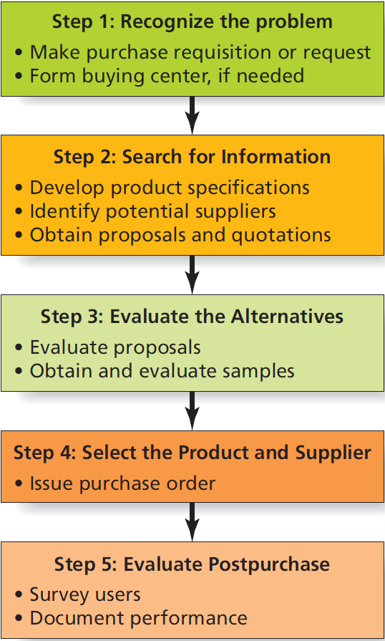
Figure 6.10 Steps in the Business Buying Decision Process
Notes:
LECTURE NOTES:
We’ve seen that there are a number of players in the business buying process, beginning with an initiator and ending with a buyer.
To make matters even more challenging to marketers, members of the buying team go through several stages in the decision making process before the marketer gets an order.
The business buying process is similar to the consumer decision process, with several key differences.
Step 1: Problem recognition: - As in consumer buying, the first step in the business buying decision process occurs when someone sees that a purchase can solve a problem. However, the trigger may differ markedly for straight rebuy/modified rebuy/new task decisions. Two events may occur in the problem-recognition step. First, a firm makes a request or requisition, usually in writing. Then, depending on the complexity of the purchase, the firm may form a buying center.
Step 2: Search for Information: In the second step of the decision process (for purchases other than straight rebuys), the buying center searches for information about products and suppliers. Members of the buying center may individually or collectively refer to reports in trade magazines and journals, seek advice from outside consultants, and pay close attention to marketing communications from different manufacturers and suppliers.
Step 3: Evaluate Alternatives: - In this stage of the business buying decision process, the buying center assesses the proposals it receives. Although a firm often selects a bidder because it offers the lowest price, there are times when it bases the buying decision on other factors. For example, in its lucrative B2B market, American Express wins bids for its travel agency business because it offers extra services other agencies don’t or can’t, such as a corporate credit card, monthly reports that detail the company’s total travel expenses, and perks tied to the company’s customer loyalty program.
Step 4: Select Product and Supplier: - The next step in the buying process is the purchase decision when the group selects the best product and supplier to meet the organization’s needs. One of the most important decisions a buyer makes is how many suppliers can best serve the firm’s needs. Single sourcing, in which a buyer and seller work quite closely, is particularly important when a firm needs frequent deliveries or specialized products. In contrast, multiple sourcing means suppliers are more likely to remain price competitive. And if one supplier has problems with delivery, the firm has others to fall back on.
Step 5: Just as consumers evaluate purchases, an organizational buyer assesses whether the performance of the product and the supplier lives up to expectations. The buyer surveys the users to determine their satisfaction with the product as well as with the installation, delivery, and service that the supplier provides.

Slide 48
Table 6.3 Roles in the Buyer Center
Role | Potential Player | Responsibility
Initiator | Production employees, sales manager, almost anyone | Recognizes that a purchase needs to be made
User | Production employees, secretaries, almost anyone | Individual(s) who will ultimately use the product
Gatekeeper | Buyer/purchasing agent | Controls flow of information to others in the organization
Influencer | Engineers, quality control experts, technical specialists, outside consultants | Affects decision by giving advice and sharing expertise
Decider | Purchasing agent, managers, CEO | Makes the final purchase decision
Buyer | Purchasing agent | Executes the purchase decision
Notes:
LECTURE NOTES:
As mentioned earlier, several people may work together in certain buying situations, such as new task buys, in order to reach a decision.
Buying centers include all people in an organization who participate in a purchasing decision. Buying centers typically include people other than “professional buyers” – line workers, engineers, or even administrative assistants may be part of the buying center. This is because people in a buying center each play one or more roles.
The primary roles that these individuals may play are shown in the slide:
Initiator: recognizes the problem and begins the buying process
Users: individual(s) who actually need and use the product
Gatekeeper: controls the flow of information to other buying center members
Influencer: this person’s expertise and advice may influence the decision, though they may never use the product
Decider: individual who makes the final buying decision
Buyer: person who is responsible for executing the purchase
For example, the administrative assistant to the purchasing agent may be both a user of a copy machine and the gatekeeper who controls the purchasing agents’ schedule and incoming phone calls from vendor reps. In some situations, the administrative assistant may also be the initiator who first notices problems with a copier, and begins “working on the boss” to get it replaced.
DISCUSSION NOTES:
Initiator: could be students, faculty, lab manager, etc.
Users: teachers who either teach classes in the lab or students who use the lab
Gatekeeper: the individual who gathers the majority of the information and/or that person’s administrative assistant
Influencer: individuals in the University IT department (networking), electricians or physical plant workers (wiring, set-up), etc.
Decider: Head of the college technology committee or primary grant author
Buyer: who ever controls the money – the Dean, Grant writer, Lab manager, etc.

Slide 49
Professional Buyers and Buying Centers
Trained professional buyers typically carry out buying in business organizations.
Procurement officers
Buying agents
Directors of Materials Management
In many business buying situations, cross-functional teams of individuals – known as a buying center – work together to reach a decision.
Notes:
LECTURE NOTES:
A buying center is a group of people in an organization who participate in a buying decision. It is not a physical “center,” but instead a cross functional team of individuals who make these key decisions.

Slide 50
B2B E-Commerce
B2B e-commerce refers to internet exchanges of information, goods, services, and payments between two or more organizations.
Creates efficiencies by allowing marketers to link directly to value chain partners.
Intranets link a firm’s departments, employees and databases.
Extranets allow authorized suppliers, customers, and other outsiders to access the firm’s Intranet.
Notes:
LECTURE NOTES:
B2B E-Commerce refers to Internet exchanges between two or more businesses.
These exchanges may take the form of information exchanges, product or service exchanges, and payment exchange.
Another benefit of using the Internet for e-commerce it that it links businesses with their suppliers, factories, distributors, and their customers.
The simplest form of B2B ecommerce occurs when the firm’s website offers an online catalogue of items available for sale.
Of course these websites are also instrumental in providing B2B technical support, item/order status information, and customer service.

Slide 51
Dark Side of B2B E-Commerce
Potential of Security Risks
Malware
Firewall
Encryption
Notes:
LECTURE NOTES:
Security risks are many. Some may be unintentional such as an employee being careless with passwords. But, some security breaches are intentional.
Malware is software designed specifically to damage or disrupt computer systems.
A firewall is a combination of hardware and software that ensures that only authorized individuals gain entry to a computer system.
Encryption is the process of scrambling a message so that only another individual (or computer) with the right key can unscramble it.

Slide 52
B2B and Social Media
Games generate buzz and increase brand awareness.
B2B marketers use social media sites to promote themselves and their businesses.
LinkedIn is the most prominent social networking site for B2B marketers and offers several advantages.
Notes:
LECTURE NOTES:
The use of social media in the B2B marketplace is growing. Games are being used by some B2B marketers to appeal to their customers.
For example, Office Depots “Strange Little Office Beings” (SLOBS) let’s visitors create their own office being and then challenge other SLOBs to duels. Visitors start off with 100 credits to create their own SLOB, which is done via dragging various office supplies into place, including a file cabinet or a garbage bag for a body, a sharpie or a pair of scissors for arms, a desk lamp or tape dispenser for legs, and so forth.
SLOB creators can then register and challenge other participants in a duel and rack up points, or go against in-house SLOBs to attain further bonus credits. The site also features a gallery of homemade slobs, profile pages, and of course, a link to shop direct OfficeDepot.com.
However, the five most popular resources that people turn to find information relevant to their daily jobs includes:
Podcasts and webinars
Online ratings and review of business products and services
Company pages on social networking sites such as Facebook and LinkedIn
Company blogs
Social media searches for business information
The advantages of LinkedIn are substantial, and include . . .
LinkedIn allows you to see who your connections are connected to – these may be people with whom you want to network.
Unlike Facebook, LinkedIn is business oriented, and made up of primarily white collar workers.
LinkedIn has a function that facilitates professional introductions. It allows users to ask those they are connected to provide professional introductions to people the user would like to meet.
LinkedIn can help alumni and colleagues reconnect, due to its extensive search engine.
LinkedIn users are professionals, and follow good business manners.
WEBSITE NOTES:
If you plan on showing this website in class, it would be a good idea to visit the site ahead of time, and see how it works. In fact, you might want to create a SLOB ahead of class, then demonstrate the challenge.

Slide 53
Copyright

