Slide 1
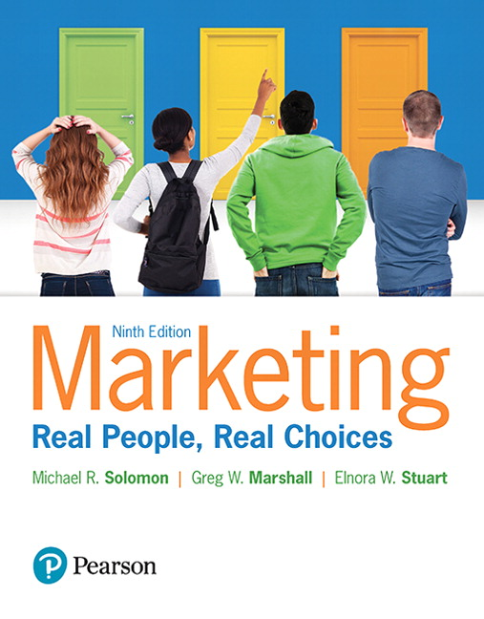
Marketing: Real People, Real Choices
Ninth Edition
Chapter 4
Market Research
Copyright © 2018, 2016, 2012 Pearson Education, Inc. All Rights Reserved.

Slide 2
Learning Objectives
4.1 Explain the role of a marketing information system and
a marketing decision support system in marketing
decision making
4.2 Understand the concept of customer insights and the
role it plays in making good marketing decisions
4.3 List and explain the steps and key elements of the
market research process
Notes:
LECTURE NOTES:
Chapter 4 covers the following three learning objectives:
Explain the role of a marketing information system and a marketing decision support system in marketing decision making
Understand the concept of customer insights and the role it plays in making good marketing decisions
List and explain the steps and key elements of the market research process

Slide 3
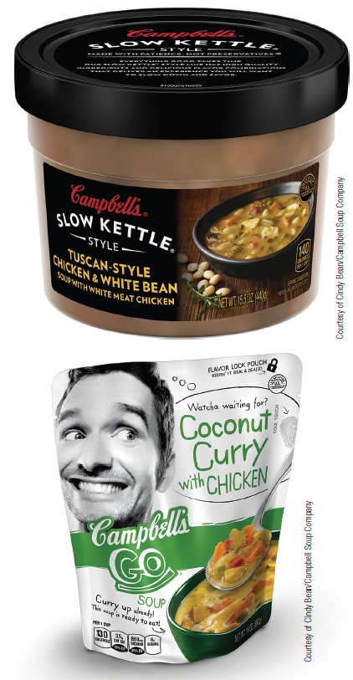
Real People, Real Choices: Campbell’s Soup
Which option should be pursued?
Option 1: Carve out a new space within the soup portfolio for this millennial-driven soup offering.
Option 2: Reposition an existing brand to be the face of the millennial portfolio.
Option 3: Don’t take the risk, and stick with our existing solutions.
Notes:
LECTURE NOTES:
Cindy Bean is a decision maker at Campbell’s. Though Baby Boomers are still buying Campbell’s Soup, very few Millennials are. Bean needed to research why Millennials weren’t buying canned soups. After immersing herself in Millennial ways, she discovered that many Millennials believe canned soups are overly processed and bland. Instead, they want soups that are fresh, healthy, locally sourced, and sustainable. So, Bean must decide between several options for the company.
The options are outlined on the slide above.

Slide 4
Knowledge is Power
Successful market planning depends upon informed decision making.
Developing marketing objectives
Selecting target markets
Positioning products
Developing 4 Ps strategies
Information is the fuel that runs the marketing engine.
Notes:
LECTURE NOTES:
Successful planning requires that managers make informed decisions. Marketing research is the critical function that provides this necessary information.
While this may sound like a straightforward proposition, careful coordination and control is called for in order to ensure that research is conducted in an ethical manner. This means that marketing research should be conducted in an aboveboard manner which does no harm to the participant, either physically, or mentally.
It also means that marketers need to respect consumers privacy. Marketers must clearly explain to respondents how their data will be stored, used, and reported, as well as disclosing the degree to which their individual confidentiality and anonymity will be protected. In particular, it would be considered unethical to collect personal information or other data under the guise of research when in fact the purpose in contacting customers is to build a database for direct marketers.
Collecting marketing research information is only one piece of the puzzle. The marketing information system helps users by bringing a variety of information together and distributing it, via reports, to a variety of users.

Slide 5
Marketing Research Ethics
Marketing research ethics refers to taking an aboveboard approach in conducting market research that does no harm to the participant.
Privacy issues
Confidentiality issues
Notes:
LECTURE NOTES:
Several aspects of market research are fraught with the potential for unethical behavior.
Assuring respondent privacy and confidentiality are is essential.
Researchers should also disclose how the respondent data will be used.
Collecting data under the guise of market research with the intent of developing a database of prospective customers is unethical.

Slide 6
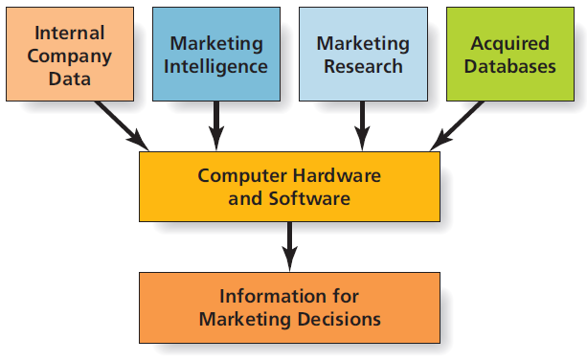
Figure 4.1 The Marketing Information System
Notes:
LECTURE NOTES:
Marketing information systems (MIS) are those which feed internal company data, information gathered via marketing intelligence or marketing research activities, and information found via searching acquired databases into special software programs, which when queried by analysts, generate reports containing useful information which marketing decision makers find helpful in fulfilling their duties.

Slide 7
Internal Company Data
Information generated from within the company
Used to produce reports on sales and marketing activities
Commonly accessed via secure intranets
Notes:
LECTURE NOTES:
A variety of information from within the firm can be helpful to marketers. Internal data collected and analyzed by MIS systems often includes sales data by date, product category, brand, or customers, as well as information pertaining to stock-outs or defective products. Many MIS systems also track marketing “inputs”, such as the amount of money spent on advertising or sales promotions, as well as the resulting “outputs” – coupon redemption rates, for example.
The prevalence of technology in business today makes it easy for sales representatives or other individuals working away from the office to access this wealth of internal information while on the go. Sales representatives in particular benefit from the ability to tap into their firm’s intranet. Instant access to their company’s internal communications network means that representatives can double-check the inventory status of items before they are ordered, as well as provide instant feedback to clients who have questions related to delivery dates, pricing policies, or other information which can be found via the intranet.

Slide 8
Market Intelligence (1 of 2)
Gathered via monitoring of everyday data sources, observations, and discussions with sales representatives.
Notes:
LECTURE NOTES:
The majority of marketing intelligence is gathered by monitoring everyday sources, such as news articles, trade publications, web sites, or even simple observations in the marketplace, as well as discussions with salespeople or others.
DISCUSSION NOTES:
Customers today rely on their phones for much more than calls, so telecommunication companies need to understand the future of texting, online gaming, and other smartphone-based activities.
Ask students what telecommunications companies might do to help them track trends in mobile computing?

Slide 9
Market Intelligence (2 of 2)
Market intelligence system
Information may come from mystery shoppers, speaking with buyers, trade shows, purchasing, or using reverse engineering
Notes:
LECTURE NOTES:
A market intelligence system is a method by which marketers get information about what’s going on in the world that is relevant to their business.
Reverse engineering is the process of physically deconstructing a competitor’s product to determine how it’s put together.

Slide 10
Market Research
Refers to the process of collecting, analyzing, and interpreting data about customers, rivals, and the business environment
Syndicated research
Custom research reports
Q-Scores
Nielsen Ratings
Notes:
LECTURE NOTES: Syndicated research is general information that research companies collect on a regular basis and sell to other firms.
For instance, INC/The Q-Scored Company collects data on consumer perceptions of 1800+ celebrities for companies interested in potential spokespeople.
Other examples include Nielsen’s TV and Radio ratings services.

Slide 11
Acquired Databases
Externally sourced databases can be used to collect various types of useful information
Noncompeting businesses
Government databases
Misuse of databases can be problematic and has led to “do-not-call” lists and anti-spamming laws
Notes:
LECTURE NOTES:
Have you ever wondered why you receive some of the direct mail pieces that you do? Most likely it’s because the marketer has purchased your name from an acquired database of some type. Acquired database are sold by a variety of non-competing businesses and by other entities, such as magazine publishers.
The government offers a wealth of information for free via the Census website as well as others. Auto registration and license information is often sold by states to interested parties.
The use of databases for marketing purposes is being scrutinized carefully by the government though, as misuse of this information can easily result in an invasion of privacy. While analyzing trend data is generally considered to be an acceptable use of database information, using this same data as a source for unsolicited email or phone calls is more problematic, and consumer backlash have eventually led the government to institute anti-spam laws, as well as the do-not-call list.

Slide 12
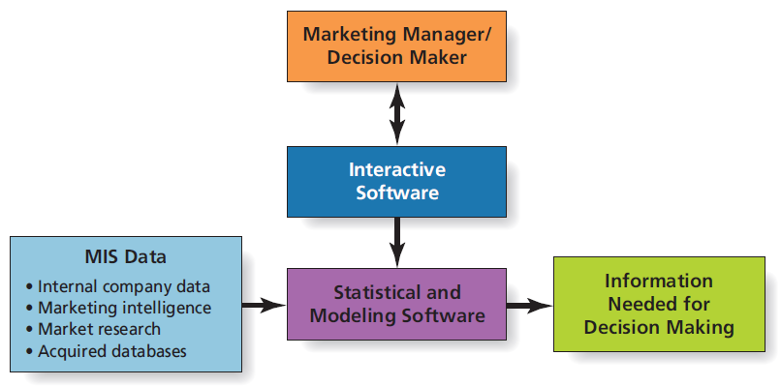
Figure 4.2 Marketing Decision Support System
Notes:
LECTURE NOTES:
While marketing information systems generate reports helpful for routine decision making, sometimes these reports are inadequate or managers want information different from that which is delivered via the reports.
Marketing decision support systems can address problems that are too vague or unusual for an MIS system to easily answer. MDSS is more powerful, because even individuals who aren’t computer experts can run custom reports on their own via the interactive software.
MDSS include both statistical and modeling software tools. Statistical software is helpful in examining complex relationships among variables; perceptual maps and multidimensional scaling are two examples. Modeling software allows decision makers to ask “What IF” types of questions.
Helps answer “What if” type questions.

Slide 13
Table 4.1 Examples of Questions an MIS Answers (1 of 2)
Questions an MIS Answers
What were our company sales of each product during the past month and the past year?
What changes are happening in sales in our industry, and what are the demographic characteristics of consumers whose purchase patterns are changing the most?
What are the best media to reach a large proportion of heavy, medium, or light users of our product?

Slide 14
Table 4.1 Examples of Questions an MDSS Answers (2 of 2)
Questions an MDSS Answers
Has our decline in sales simply reflected changes in overall industry sales, or is there some portion of the decline that industry changes cannot explain?
Do we see the same trends in our different product categories? Are the changes in consumer trends similar among all our products? What are the demographic characteristics of consumers who seem to be the most and the least loyal?
If we change our media schedule by adding or deleting certain media buys, will we reach fewer users of our product?

Slide 15
MIS, MSDS and Customer Insights
To make good decisions, marketing managers need timely access to quality information!
A firm’s MIS stores and analyses data from a variety of sources
A firm’s MSDS makes it easier to access the MIS and find answers to specific “what-if” questions
Suppose your university hired you to lead its customer insights team. What sorts of questions might your MIS and MSDS systems answer?
Notes:
LECTURE NOTES:
Summary slide for Chapter 4, Learning Objectives 1 and 2.
DISCUSSION NOTES:
Instructor may begin discussion by asking students what sorts of research problems university marketing managers may be interested in examining?
If students struggle to come up with examples, instructor might provide direction by discussing issues such as admissions trends, athletic event attendance, underage drinking.
In addition, instructor may wish to refer to Table 4.1, which provides example questions answered by MIS and MSDS systems.

Slide 16
Customer Insights and Marketing
Goal of the Marketing Insights function -transform data into information
Data are raw unorganized facts
Information is interpreted data
More complicated than it sounds
Massive amounts of data
Much data is unstructured
Functional silos
Notes:
LECTURE NOTES:
The idea of customer insights refers to the collection, deployment, and interpretation of information that allows a business to acquire, develop, and retail its customers.
Most large companies today maintain a dedicated team of experts whose jobs are to sift through all the information available in order to support market planning decisions.
Job is complicated by the massive volume of data that is constantly flowing through the organization.
In addition, much of the most useful customer information is unstructured (e.g., customers’ social media posts, tweets, and images).
In addition, many large companies have traditionally been structured as functional silos, so different units may hold different pieces of the puzzle. Integrating and sharing data/information across functional areas raises a number of challenges to customer insights teams.

Slide 17
Figure 4.3 Steps in the Market Research Process
Notes:
LECTURE NOTES:
Ideally, market research is a well-structured, ongoing process with a common aim: help managers make better marketing decisions.
There are seven steps in the marketing research process:

Slide 18
Step 1: Define the Research Problem
Specify the research objectives
What questions will the research attempt to answer?
Identify the consumer population of interest
What are the characteristics of the consumer group(s) of interest?
Place the problem in an environmental context
What factors in the firm’s internal and external business environment might influence the situation?
Notes:
LECTURE NOTES:
As part of this process, research objectives – the questions that the research will answer – are defined. The consumer population from whom the information will be gathered is also identified, and those factors in the firm’s internal and external business environment which might influence the situation are also identified, in order to place the problem into an environmental context.
Research objectives may stem from market feedback that indicates a true problem of some type, or it may reflect the firm’s interest in capitalizing upon a potential opportunity.

Slide 19
Step 2: Determine the Research Design
Once the problem is isolated, the next step is to determine a ‘plan of attack’
A research design is a plan that specifies what information marketers will collect and what type of study they will do
Research designs fall into two categories:
Secondary data
Primary data
Notes:
LECTURE NOTES:
Different market research problems call for different research approaches.
The research design determines the processes by which the researcher will seek to address the specific question.
Research designs generally fall into broad categories based upon the type of data used: primary and secondary data.
Many research designs will integrate various types of primary and secondary data research.

Slide 20
Research with Secondary Data
Does information already exist?
Trade associations compile data
Secondary data can save time and money
Notes:
LECTURE NOTES:
Secondary data already exists – someone or another entity has already gathered the information.
Often, trade associations will compile data on their specific industry.
Secondary data can be very cost effective and far less time consuming that primary data.

Slide 21
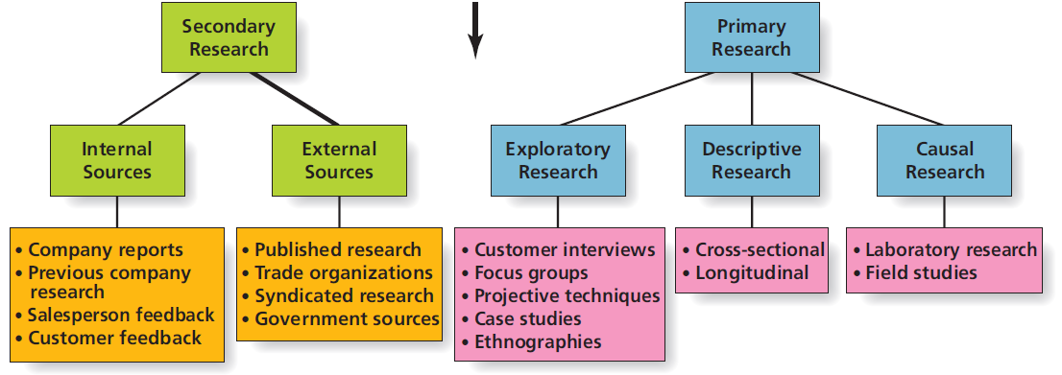
Figure 4.4 Market Research Designs
Notes:
LECTURE NOTES:
The second step of the research process involves determining the research design. A great deal of time, money, and effort can be saved if secondary data is available to help fulfill the research objectives before engaging in the expense of primary research.
Secondary data is information that has been collected for some purposes other than the research problem at hand.
As shown here, there are a number of sources of secondary data, both internal and external to the firm, though the quality of data can vary. For example, data purchased from syndicated research firms which exist solely for the purpose of collecting and selling marketing research data, tends to be very high quality. Information gathered by trade associations and the U.S. government also tends to be of high quality, though data provided by other foreign governments may not be as valid. Care must be taken to carefully evaluate information posted to websites to ascertain whether or not the information found if factual in nature, or simply reflective of the author’s opinion.

Slide 22
Research with Primary Data
Primary data refers to data collected by the firm to address a specific question
When a company needs to make a specific decision, secondary data may not be enough!
May include demographics, psychological info, awareness, attitudes, and opinions
Exploratory, descriptive, and causal research
Notes:
LECTURE NOTES:
Definition of primary data and rationale for its use.
Introduce the three main categories of primary data research: exploratory, descriptive, and causal research.

Slide 23
Exploratory Research
Exploratory research is useful for:
Gaining better understanding of problem
Identifying new opportunities
Often qualitative in nature
Focus
Market research online community (MROC)
Case studies
Ethnographies
Notes:
LECTURE NOTES:
Exploratory research is particularly useful when marketers are trying to identify new strategies, new product opportunities, or when the need to understand in detail how consumers feel about a product or service. Researchers gather this information via in-depth consumer probing using focus groups or ethnographic studies, or by means of case study data.
Exploratory research is qualitative in nature, meaning that research results tend to be non-numeric and thus inappropriate for most forms of statistical analysis. However, many forms of exploratory research provide rich data containing a wealth of thoughts, feelings, verbal descriptions, and even pictures.
Focus groups consist of 5–9 individuals who typically share certain characteristics, and who have agreed to participate in an in-depth discussion of the product or service in question. The video clip discusses how focus groups indirectly led to a key consumer insight that ultimately formed the basis for repositioning that brand.
Case studies examine a firm or organization thoroughly, often for the purpose of identifying how certain processes or procedures are accomplished.
Ethnographic studies borrow their methodology from the anthropology profession, and often visit people’s homes to see how they store and use products and services.

Slide 24
Descriptive Research
Descriptive research
Systematically investigate marketing problem
Results expressed in quantitative terms
Cross-sectional vs. longitudinal designs
Notes:
LECTURE NOTES:
While exploratory research can provide a great deal of interesting and useful information, research results are based on the opinions of only a few individuals. Very often researchers seek to verify these results using a larger, more representative sample using descriptive research studies.
The larger sample size and manner in which the data is collected typically allows researchers to express the results in terms of averages, percentages, and more advanced forms of statistical analyses.
Cross-sectional designs systematically use instruments such as questionnaires to systematically collect information from one or more consumer samples at a single point in time. Longitudinal studies attempt to track changes over time, by collecting data from the same set of consumers at multiple points in time.

Slide 25
Causal Research
Causal research
Attempts to identify cause-and-effect
Often involves experiments
Independent and dependent variables
Sales of beer and diapers are correlated, but does one cause the other?
Notes:
LECTURE NOTES:
Casual research uses experiments to better understand cause-and-effect relationships among two or more variables.
For example, a marketer may be interested in learning the degree to which sales volume will change, if the price of a product is raised. In this instance, PRICE is the independent variable, and SALES is the dependent variable.

Slide 26
Ethical/Sustainable Decisions in the Real World
Should companies that offer products or services that may pose health risks be allowed to fund research that could suggest that those products share little or no responsibility for those health risks?
Coca-Cola spent $132 million on research from 2010 to 2015
Research suggested that Americans held an illegitimate fixation on calorie consumption, but didn’t exercise
As a marketing executive, is it OK to commission and fund research that supports the position that the product posed no health risk when you are aware that other independent research studies contradict that view?
Notes:
DISCUSSION NOTES:
Ask students if they are aware of similar industries where “research” indicated that the product wasn’t harmful (such as the cigarette industry).
Why can’t a company conduct its own research?
In what instances could/should a company conduct its own research?
What if a company commissioned research, but didn’t fund it? Would that make a difference?

Slide 27
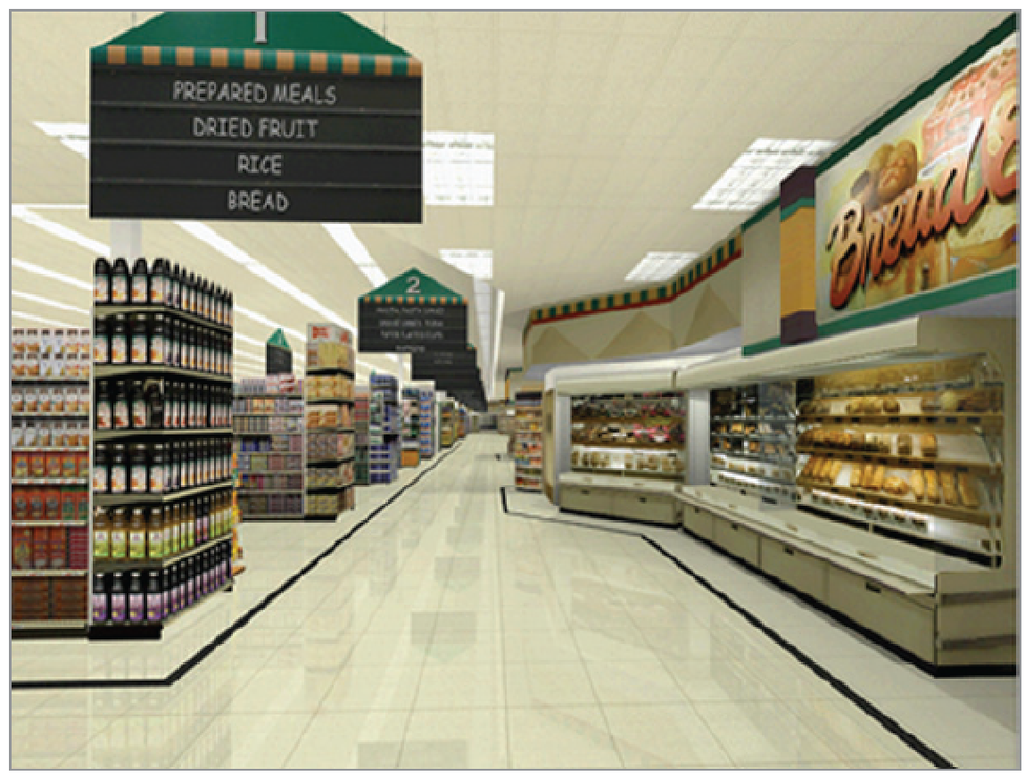
Step 3: Choose the Method to Collect Primary Data
Primary data collection falls into two broad categories
Survey
Observation
Use of new technologies
Neuromarketing
Virtual stores
Notes:
LECTURE NOTES:
Survey and observation are the two main methods of collecting primary data.
Some forms are applying technologies and experimental techniques from neuroscience to obtain sophisticated brain scans and other types of physiological data as consumers perform tasks or make decisions in either a real or virtual setting.
Neuromarketing uses technologies such as functional magnetic resonance imaging (fMRI) to measure brain activity to better understand how and why consumers make the decisions they do.
Some larger consumer products firms, like Google and Frito-Lay, have even built their own labs and employ in-house scientists to perform neuromarketing research.

Slide 28
Survey Methods
Survey methods are used to interview respondents
Mail questionnaires
Telephone interviews
Face-to-face interviews
Online questionnaires
Notes:
LECTURE NOTES:
The third step in the marketing research process is to determine which survey methods and/or observational research methods are appropriate.
Survey methods involve some kind of interview or other direct contact with respondents who answer questions. Each form of survey – mail, telephone, face-to-face, and online has it’s own advantages and disadvantages, as shown in Table 4.3 in your textbook.
Mail questionnaires are typically delivered to respondents’ homes or places of businesses. Mail surveys take time to gather the data, offer little flexibility, and are characterized by low response rates.
Telephone surveys also suffer from low response rates and more importantly, decreasing respondent cooperation, as technology makes it very easy for consumers to screen calls. While results can be gathered faster phone, compared to mail, only homes with phones can be surveyed, which is a growing problem, given that more and more homes are dropping their land lines in favor of cell phones.
The most common form of face-to-face interview takes place as part of a mall intercept study, in which researchers recruit shoppers in malls or other public areas. Face-to-face interviews are subject to interviewer bias, are costly, and mall intercept studies in particular are notoriously unrepresentative of the greater population.
While more and more surveys are being conducted over the Internet due primarily to lower costs and quicker turnarounds, online surveys are not without problems. It’s important that the relative advantages and disadvantages of each survey method be considered before selecting the type of questionnaire to administer.

Slide 29
Table 4.2 Advantages and Disadvantages of Survey Data Collection Methods (1 of 2)
Data Collection Method | Advantages | Disadvantages
Mail questionnaires | Respondents feel anonymous | It may take a long time for questionnaires to be returned
Blank | Low cost | Low rate of response; many consumers may not return questionnaires
Blank | Good for on-going research | Inflexible questionnaire format
Blank | Blank | Length of questionnaire is limited by respondents’ interest in the topic
Blank | Blank | Unclear whether respondents understand the questions
Blank | Blank | Unclear who is responding
Blank | Blank | No assurance that respondents are being honest
Telephone interviews | Fast | Decreasing levels of respondent cooperation
Blank | High flexibility in questioning | High likelihood of respondent misunderstanding
Blank | Low cost | Respondents cannot view materials
Blank | Limited interviewer follow-up | Cannot survey households without phones
Blank | Limited questionnaire length | Consumers screen calls with answering machines and caller ID
Blank | Blank | Do-not-call lists allow many research subjects to opt out of participation

Slide 30
Table 4.2 Advantages and Disadvantages of Survey Data Collection Methods (2 of 2)
Data Collection Method | Advantages | Disadvantages
Face-to-face interviews | Flexibility of questioning | High cost
Blank | Can use long questionnaires | Interviewer bias a problem
Blank | Can determine whether respondents have trouble understanding questions | Blank
Blank | Take a lot of time | Blank
Blank | Can use visuals or other materials | Blank
Online questionnaires | Instantaneous data collection and analysis | Unclear who is responding
Blank | Questioning very flexible | No assurance that respondents are being honest
Blank | Low cost | Limited questionnaire length
Blank | No interviewer bias | Unable to determine whether respondent understands the question
Blank | No geographic restrictions | Self-selected samples
Blank | Can use visuals or other materials | Blank

Slide 31
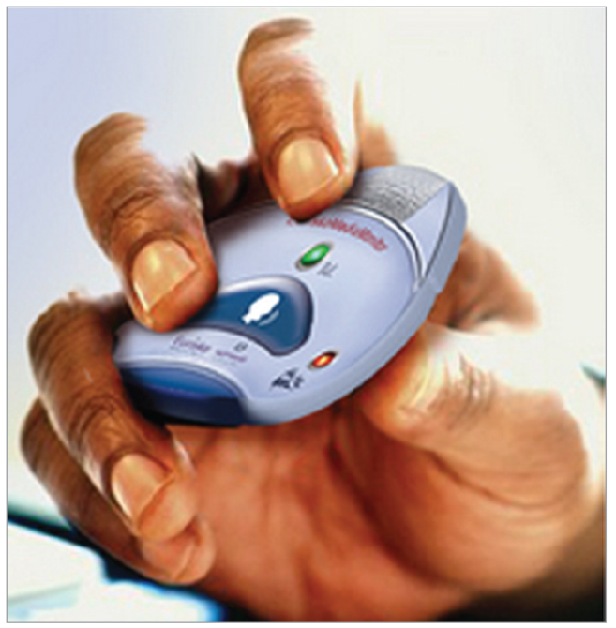
Observational Methods
Data collection approach in which researcher records consumer behaviors, often without their knowledge
Personal observation
Unobtrusive measures
Mechanical systems
Notes:
LECTURE NOTES:
Observation refers to situations in which the researcher records consumer behavior. Personal observation may occur in a grocery store when a researcher watches consumers actions as they take place. Sometimes researchers use unobtrusive measures instead.
Unobtrusive measures require researchers to measure traces of physical evidence that remain after some action on the part of the consumer has been taken. For example, ‘garbologists’ go through consumers trash to find evidence of the products they consume.
Mechanical forms of observation can often provide observations more cheaply and accurately than can in-person methods. Some examples include traffic counters placed at busy intersections, and people meters that track television viewing habits.

Slide 32
Online Research
Two major types of online research
Gathering info from online surfing (e.g., cookies)
Gathering info via online sources (e.g., hash tag searches)
Predictive technology uses shopping patterns of large numbers of people to determine which products are likely to be purchased if others are
Notes:
LECTURE NOTES:
Online research is the fastest way to collect data; it’s also less expensive, and perhaps the most versatile, as marketers can use the Internet for both exploratory research, via online focus groups and in-depth interviews, and descriptive research via Internet surveys.
Data is gathered online via one of two methods: passively, via consumer’s web site surfing, and actively by enticing consumers to answer email questionnaires, online questionnaires, and focus groups.
Cookies make tracking consumer surfing behavior possible. Cookies are small text files inserted by a web site on the user’s hard drive, that the web site recognizes when that surfer returns to the site.
Predictive technology is the specific form of data base mining that uses shopping patterns of large numbers of people to determine which products are likely to be purchased if others are.
Despite the fact that users can delete or block cookies from tracking their behavior, many consumers are concerned over a loss of privacy. In fact, 84% of the respondents to a recent study objected to having their information sold to other companies. Privacy rights advocates are hopeful of governmental regulation designed to protect their rights.
The most serious disadvantage associated with online research is a lack of representativeness among respondents, as certain segments of the population, such as the elderly and the poor, do not have access to the internet and thus cannot have their opinions represented in Internet research studies. Hacking, cheating, and competitive interference in research studies are among the other problems found in online research studies.

Slide 33
Bounce Rate
Bounce rate is a measure of how many visitors come to a page on a website and leave without viewing any other pages.
Marketers use bounce rates to determine whether an entry page effectively generates visitor interest.

Slide 34
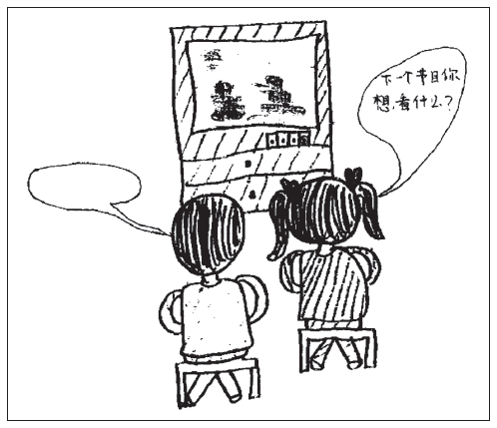
Data and Measurement Quality Issues
Quality of market research insights based on “garbage in, garbage out!”
Three key considerations:
Validity
Reliability
Representativeness
Notes:
LECTURE NOTES:
Decisions made on the basis of marketing research are only as good as the information on which they are based. The three factors which influence data quality include:
Validity: the extent to which the research actually measures what it was intended to measure.
Reliability: the extent to which research measurement techniques are free of errors.
Representativeness: the extent to which consumers in the study are similar to a larger group in which the organization has an interest. Self-selection bias is a threat to representativeness in online and offline research designs.
The more valid and reliable the measures are, and the more representative the sample group of respondents are compared to the population of interest, the greater the degree of confidence a researcher can have in the results of the study. This underscores the reason why probability samples are preferable to non-probability alternatives, as we’ll discuss in just a minute.

Slide 35
Step 4: Design the Sample (1 of 2)
Probability sampling
Each member of the population has some known chance of being included (example: action films vs. “chick flicks”)
Simple random sample
Systematic sampling procedure
Stratified sample
Notes:
LECTURE NOTES:
The process of selecting participants for a research study is known as sampling. Two types of sampling exist: probability and non-probability. Probability samples are generally considered to be the superior choice, because information obtained from probability samples can be generalized to the larger population that the sample is supposed to represent. The same can not be said of non-probability samples.
An example of probability sampling would be if you took a sample of the larger population and a males in the sample indicate they prefer “action films” over “chick flicks,” you can infer with confidence that males in a larger population would also prefer action films over chick flicks.
In simple random sampling, every member of the population has an equal, known chance of being selected to participate in the research study. Pulling names out of a hat or using a random number table to select participants are examples of this method.
Systematic sampling procedure occurs when the researcher has a numbered list of all elements in the population. By dividing the population size by the sample size, a skip interval is determined. The researcher then selects a random starting point on the list, and then counts down the skip interval to select the next member of the sample. This process continues until all sample members have been selected. Note that without a randomly selected starting point, not all elements of the population would have a chance of participating – thus randomness is a key factor in probability sampling.
Stratified sampling is used when the researcher wishes to segment participants within a study. The population is first divided along the characteristic of interest (e.g., gender or some other factors that is closely tied to behavior). Respondents in each segment are then randomly selected in the same proportion as their percentage of the overall population.

Slide 36
Step 4: Design the Sample (2 of 2)
Nonprobability sampling
A sample in which personal judgment is used to select respondents (example: surveying random individuals at your favorite restaurant)
Convenience sample
Quota sample
Notes:
LECTURE NOTES:
Nonprobability sampling is used if the researcher needs a quick answer or just wants to get a general sense of how people feel about a topic.
Surveying individuals at your favorite restaurant may leave out any number of representatives from the general population. Therefore, there is no way to ensure that the sample is representative of the population.
Convenience sampling involves selecting participants just because they happen to be present when and where the data are being collected.
A quota sample consists of the approximate proportion of individuals as the general population. For example, if you were to survey students at your university, you would try and find a proportionate number of freshmen, sophomores, juniors, and seniors to the rest of your university.

Slide 37
Step 5: Collect the Data
The quality of research conclusions is only as good as the data used to generate them
Challenges to gathering data in foreign countries
Cultural issues
Language issues
Notes:
LECTURE NOTES:
The quality of the research results is only as good as the poorest interviewer in the study. Marketers must train and supervise field personnel to gather data appropriately, or the information obtained may be tainted by interviewer bias.
Data gathering in foreign countries presents four key challenges:
Major differences exist in the sophistication of research operations in various countries as well as the amount of data available. For example, it may take years for the appropriate government official to sign-off on a research study in Egypt, as is required by law.
Infrastructure differences may impede telephone surveys or online research efforts among a large proportion of the population that do not have access to the technology, while low literacy hurt marketers ability to gather mail survey data in many countries.
Local customs and cultural differences can also influence how questions are interpreted and answered in different countries. Involving local researchers in the questionnaire design process may be beneficial.
Language translation difficulties are common, because sometimes things just don’t come out right. Embarrassment can often be avoided by using back translation, a process by which 1) a native of the country translates the questionnaire from English to the language of the targeted respondents, and 2) a different native translates the resulting questionnaire back into English.

Slide 38
Step 6: Analyze and Interpret the Data
Data must be analyzed and interpreted to be meaningful!
Tabulation
Arranging data in a table or other summary form to get a broad picture of overall response
Cross-tabulation
Exploring data by sub-groups in order to see how results vary across categories
Notes:
LECTURE NOTES:
The data must be analyzed and interpreted in order to be useful for decision-making. Two of the most common and simplest forms of analysis include the presentation of data in tables, called tabulation, and the use of cross-tabulation to show how data varies by subgroups between two or more variables.

Slide 39
Table 4.3 Examples of Data Tabulation and Cross-Tabulation Tables
Fat Content Preference (number and percentages of responses)
Do you prefer a meal with high-fat content, medium-fat content, or low-fat content?
Questionnaire Response | Number of Responses | Percentage of Responses
High fat | 21 | 6
Medium fat | 179 | 51
Low fat | 150 | 43
Total | 350 | 100
Fat Content Preference by Gender (number and percentages of responses)
Do you prefer a meal with high-fat content, medium-fat content, or low-fat content?
Questionnaire Response | Number of Females | Percentage of Females | Number of Males | Percentage of Males | Total Number | Total Percentage
High fat | 4 | 2 | 17 | 10 | 21 | 6
Medium fat | 68 | 39 | 111 | 64 | 179 | 51
Low fat | 103 | 59 | 47 | 27 | 150 | 43
Total | 175 | 100 | 175 | 100 | 350 | 100

Slide 40
Step 7: Prepare the Research Report
Research reports typically include the following sections:
Executive summary
Description of research methods
Discussion of study results
Limitations of study
Conclusions and recommendations
Notes:
LECTURE NOTES:
The final step in the marketing research process is to prepare a report of the research results that clearly and concisely tells readers what they need to know. Research reports typically contain the following sections:
• An Executive Summary of the report that covers the high points of the total report.
• An understandable description of the research methods.
• A complete discussion of the results of the study, including the tabulations, cross-tabulations, and additional statistical analyses.
• Limitations of the study (no study is perfect).
• Conclusions drawn from the results and the recommendations for managerial action based on the results.

Slide 41
Copyright

