Slide 1
Marketing: Real People, Real Choices
Ninth Edition
Chapter 3
Strategic Market Planning
Copyright © 2018, 2016, 2012 Pearson Education, Inc. All Rights Reserved.

Slide 2
Learning Objectives
3.1 Explain business planning and its three levels.
3.2 Describe the steps in strategic planning.
3.3 Describe the steps in market planning.

Slide 3
Real People, Real Choices: Decision Time at Oracle (1 of 2)
Which option should be pursued?
Option 1: Stay the course with Oracle’s huge roster of corporate marketing clients that are very satisfied with what the company does for them.
Option 2: Acquire companies that already offer new SaaS marketing technologies and go to market with a dedicated sales team that focuses only on selling cloud solutions.
Option 3: Continue to promote the Siebel system for basic data management functions and “deinvest” in the marketing solutions category, where it will be expensive to compete.
Notes:
DISCUSSION NOTE:
Explain to students that you want them to think about each option, and that you will return to this question at the end of the chapter.

Slide 4
Planning: Compose the Big Picture
Planning is everything … almost!
Business planning is an ongoing process that guides short- and long-term decisions.
Helps identify and build on firm strengths
Improves managerial decision making
Develops objectives and provides a means of charting progress toward goals
Notes:
LECTURE NOTES:
Planning is critical to the success of ANY business, no matter how large or how small. Careful planning enables a firm to help customers understand what the firm is and what it has to offer that competitors don’t—especially as it decides how to create value for customers, clients, partners, and society at large.
The authors of your textbook believe this process is so important that they have created a foldout marketing planning “road map” to help you make your way through the book. This roadmap includes important questions which must be asked as you work through the planning process.
What is meant by “business planning”. The basic definition is highlighted on this slide. While both large firms like GM and small firms such as a Mom and Pop business engage should engage in planning, the scope of planning is different. Planning at large firms involves a multitude of individuals at different levels within the firm while planning with a small firm may be undertaken only by the business owner, with relatively little input from others.
Still, good planning at any firm should build on the firm’s strengths and help managers make informed decisions. Objectives should be taken before action is undertaken. Both the business plan (which includes decisions that guide the entire organization) and marketing plan should be created. Marketing plans describe the marketing environment, outline the marketing objectives and strategy, and identify who will be responsible for carrying out each part of the marketing strategy.

Slide 5
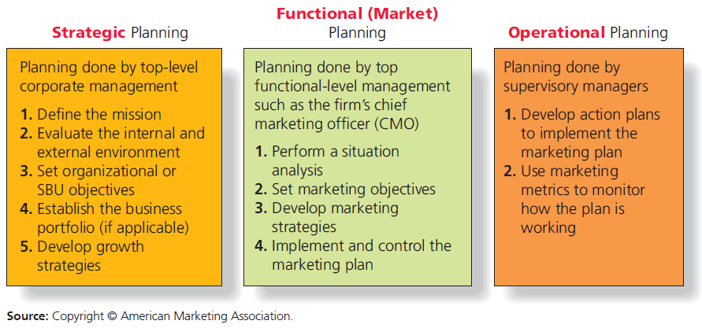
Figure 3.1Three Levels of Business Planning
Notes:
LECTURE NOTES:
Figure 3.1 shows, planning occurs at three levels: strategic, functional, and operational.
The top level is “big picture” stuff, while the bottom level specifies the “nuts-and bolts” actions the firm will need to take to achieve these lofty goals. Planning at the functional and operational levels must be consistent with the mission and objectives of the firm.

Slide 6
Strategic Planning
Strategic planning is the managerial process that matches firms resources and capabilities to market opportunities.
Top management defines firm’s purpose and sets objectives.
Many large firms have separate SBUs (strategic business units).
Notes:
LECTURE NOTES:
Planning done at the strategic level is long range (3–5 years). The mission, objectives, business portfolio, and growth strategy decisions set at this level “set the stage” and FLOW THROUGH to the functional and operational planning levels. For example, a firm’s strategic plan may set an objective to increase total revenues by 20 percent in the next five years.
SBUs are individual lines of business within large firms that are unique and large enough to justify having their own mission, business objectives, resources, managers, competitors, etc.
For instance, Disney has separate SBUs for its theme parks, TV networks, film studios, and cruise lines.

Slide 7
Strategic Business Units (SBUs)
Large, multiproduct firms may have separate divisions, called strategic business units (SBUs).
SBUs operate like a separate business.
Strategic planning is conducted at both the corporate and SBU level.
Notes:
LECTURE NOTES:
Conglomerates and multi-national firms typically are made up of a number of SBUs or strategic business units. SBUs can be defined as “individual units within the firm that operate like separate businesses with their own mission, business objectives, resources, managers, and competitors.”
Large firms like the Walt Disney Company usually operate several SBUs. Disney SBUs include theme parks, movie studios, TV networks, and cruise line. Because each SBU has its own distinct mission and objectives, as well as resources, strategic planning must be undertaken at the SBU unit in order to be meaningful. Firms that are not large enough to have separate SBUs engage in strategic planning at the corporate, or firm level instead.

Slide 8
Functional Planning
Functional – Planning done by top functional level management
Market planning includes:
Situation analysis
Broad 3– 5 year plan to support the strategic plan
Annual plan
Notes:
LECTURE NOTES:
As previously stated, both functional and operational plans need to be consistent with the corporate strategic plan, and developed in a manner that furthers the mission and goals of the organization following the growth strategies set forth in the corporate plan.
Functional level planning is performed by either Vice Presidents or top level functional area managers (VP Sales for many industrial or business-to-business firms; VP of Marketing for many consumer goods firms). Functional planning is also sometimes called tactical planning.
Typically, functional planning includes:
A broad 3–5 year plan to support the strategic plan.
A detailed annual plan. For example, the marketing plan might state as one of its objectives: “to gain a 40% share” of a particular market by means of the introduction of three new products during coming year (consistent with the firms product development strategy).

Slide 9
Operational Planning (1 of 2)
First-line managers focus on day-to-day execution of functional plan.
For marketers, this typically includes
Annual, semi-annual, or even quarterly action plans to guide marketing plan implementation
Use of marketing metrics to monitor performance
Notes:
LECTURE NOTES:
Operational planning flows from the marketing plan, and is further developed by supervisory managers who might be product or brand managers, advertising managers, sales managers for particular products, divisions, or geographic territories, publicists, specialists in marketing research, etc.
These first-line managers focus on day-to-day execution of functional plans which requires detailed annual, semiannual, or quarterly plans
Example: an objective may be set in terms of units of a product a particular salesperson needs to sell per month (sales quota)

Slide 10
All Business Planning is an Integrated Activity
Strategic, functional, and operational plans must be in harmony for firm to succeed.
Planning at all levels flows from organizational mission.
Planners at all levels must keep the “big picture” in mind.
Notes:
LECTURE NOTES:
Summary slide for Chapter 3, Learning Objective 1.

Slide 11
Strategic Planning: Frame the Picture
Strategic planning plays an important role in the modern corporation.
Optimize revenues across multiple lines of business.
Minimize risk in a complex and changing global environment.
Includes a series of steps that results in development of growth strategies.
Notes:
LECTURE NOTES:
Introductory slide for Chapter 3, Learning Objective 2.
Strategic planning process depicted in next slide (Figure 3.2).

Slide 12
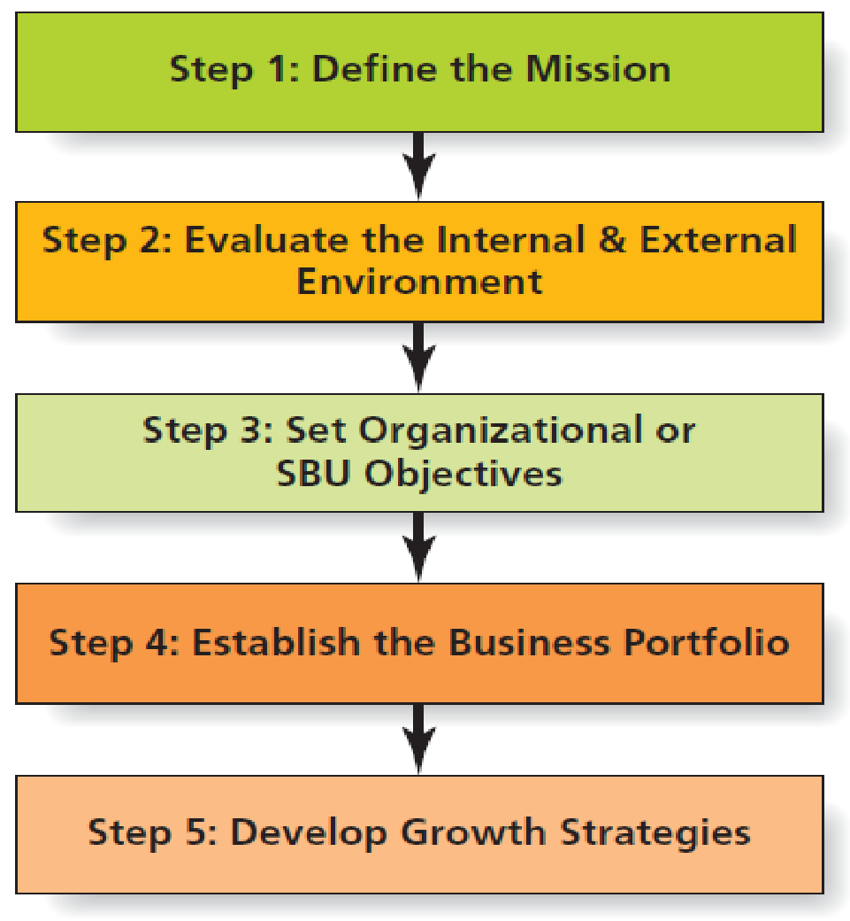
Figure 3.2 Steps in Strategic Planning
Notes:
LECTURE NOTES: Figure 3.2 presents the steps in the strategic planning process, which are explained in more detail on the following slides.

Slide 13
Step 1: Define the Mission
Key questions in determining mission
What business are we in?
What customers should we serve?
How should we develop the firm’s capabilities and focus its efforts?
A mission statement is a formal document that describes the firm’s overall purpose and what it hopes to achieve in terms of its customers, products, and resources.
Notes:
LECTURE NOTES:
Management’s FIRST step in strategic planning is to create a mission statement (if the firm is new) or review the firm’s mission statement in light of market conditions if a mission statement already exists. IN doing so, upper management seeks to answer the three questions shown on the slide. While mission statements are not meant to change on an annual basis, businesses must be open to changing their mission as consumers needs change and markets evolve.
Based on the answer to the key questions shown, the firm creates or revises the mission statement, or “a formal document that describes the firm’s overall purpose and what it hopes to achieve in terms of its customers, products, and resources.”
Ideally, the mission statement shouldn’t be too broad or too narrow. A mission statement that is too narrow may inhibit managers’ ability to visualize possible growth opportunities. If, for example, a firm sees itself in terms of its product only, consumer trends or technology can make that product obsolete—and the firm is left with no future.

Slide 14
Mission Statements Are Important!
Twitter’s mission statement is “To give everyone the power to create and share ideas and information instantly, without barriers.”
The ideal mission statement is not too…
Broad
Narrow
Shortsighted
Notes:
LECTURE NOTES
Twitter’s mission statement describes the organization’s overall purpose.
An ideal mission statement isn’t too broad, narrow, or shortsighted. It is unique to a particular firm and describes the purpose of the company and what it wants to achieve in terms of customers, products, and resources.

Slide 15
Step 2: Evaluate the Environment
Examination of internal and external environments
Managers often synthesize environmental analysis of into a format known as SWOT analysis.
SWOT analysis catalogs firms’ internal strengths and weaknesses and external opportunities and threats.
Notes:
LECTURE NOTES:
The second step in strategic planning is to assess the firm’s internal and external environments. We refer to this process as a situation analysis, environmental analysis, or sometimes as a business review.
Regardless of the name used, this process is critically important as it allows planners to better understand the strengths and weaknesses that are inherent to the firm, as well as key trends or factors that represent opportunities or threats to the firm or its products/services.
SWOT analysis is a popular approach to presenting environmental analysis, formally defining firm strengths and weaknesses as well as trends in the external environment that either favor firm strengths (resource advantages) or exacerbate firm weaknesses (resource deficits).

Slide 16
Internal Environment
Internal environment consists of controllable elements within firm.
Key technologies
Patents
Financial stability
Supplier relationships
Reputation
Human capital
Notes:
LECTURE NOTES: By “internal environment”, we mean all controllable elements within the firm that influence how well it performs. These internal aspects represent key strengths and weaknesses.
DISCUSSION NOTE:
Ask students to name some examples of different aspects or elements within the firm that may represent key strengths and weaknesses. If students have difficulty getting started explain how Southwest Airlines has always been very focused on hiring and developing employees who reflect the “Southwest Spirit” to customers (see picture in slide). Anyone who has flown on Southwest can attest to the fact that the atmosphere is lively and fun, and flight attendants are likely to do most any crazy stunt—bowling in the aisle, or serenading the captain and first officer (and passengers) with a favorite tune. For Southwest, a real strength—one that’s hard for the competition to crack—lies in this employee spirit.
LECTURE POINT #2: Key controllable elements that can represent strength or weaknesses of the firm include not only human capital or people (skills, training, loyalty) such as in the Southwest Airlines example, but also technologies (patents, processes, machinery, etc.), physical facilities (location, scope, quantity, etc.), financial stability, corporate reputation, quality products, strong brands (brand awareness, image, equity, market share, etc.), and intellectual capital.

Slide 17
External Environment
External environment consists of factors outside the firm which that could positively or negatively impact operations.
Largely beyond direct management control, so planning is critical
Economy
Competition
Technology trends
Sociocultural trends
Legal/political/ethical trends
Notes:
LECTURE NOTES:
Elements outside the firm that may affect it either positively or negatively must be constantly scanned and monitored by businesses on an ongoing basis as part of their strategic planning process. In particular, marketers seek to identify economic, competitive, technological, legal/political/ethical, and sociocultural trends, because these trends manifest as opportunities or threats to the business. Because these factors are external to the firm, marketers cannot directly control them, but they can respond to them via planning.
Trendwatching.com offers a free monthly trend insight newsletter via monthly emails. Many of the articles posted on this website are of interest to marketers in general, and students can often find current examples that demonstrate the integration of trends, products, and marketing communication campaigns.

Slide 18
SWOT Analysis
Strengths
Weaknesses
Opportunities
Threats
Notes:
LECTURE NOTES:
The environmental analysis undertaken by a firm is typically summarized in what has come to be known as a SWOT analysis. SWOT is simply an acronym that stands for strengths, weaknesses, opportunities, and threats. Chapter 3 is devoted to an in-depth exploration of the environmental analysis portion of SWOT, in which opportunities and threats are identified.
DISCUSSION NOTE:
Have students review the list of strengths and weaknesses for McDonald’s. and ask them if they can come up with additional examples of internal factors that represent strengths or weaknesses. For example, the real estate holdings of McDonald’s are quite valuable, and McDonald’s has recently made strides into the Smoothie market as well as the coffee/bistro market. Many students might consider McDonald’s service (drive-through time, order accuracy) to be a weakness in addition to the non-healthy nature of the majority of menu items.
Have students review the list of opportunities and threats for McDonald’s and ask them if they can come up with additional examples. For example, over the past several years, several other fast food entities entered into the breakfast market, including Subway, Jack-in-the-Box, and Taco Bell, resulting in increased competition.
DISCUSSION NOTE:
Students may be familiar with the SWOT concept from other classes. A nice outside-the-class activity assigned prior to lecture might challenge half of the students to identify the internal and external strengths of a well-known local business (bar, restaurant, club) or the University itself, while the other half of class identifies current trends stemming from the external environment that are relevant to the business. Class time could then be devoted to demonstrating the SWOT process using the information gathered by the class.

Slide 19
Step 3: Set Organizational or SBU Objectives
Organizational goals and objectives should be direct outgrowth of the mission statement.
Taking into account internal and external environmental factors
Objectives should be specific, measureable, attainable, and sustainable.
May be directed toward financial- , operational- , or customer-based criteria
Notes:
LECTURE NOTES:
After they construct a mission statement, top management translates it into organizational or SBU objectives.
These goals are a direct outgrowth of the mission statement and broadly identify what the firm hopes to accomplish within the general time frame of the firm’s long range business plan. If the firm is big enough to have separate SBUs, each unit will have its own objectives relevant to its operations.
To be effective, objectives need to be specific, measurable (so firms can tell whether they’ve met them or not), attainable, and sustainable.
The subject of these objectives can vary. Objectives are often financially focused sales, profit, market share, shareholder wealth, or ROI. Other firms may choose to focus on productivity, innovation and research, customer satisfaction, or social responsibility.
To ensure measurability, marketers increasingly try to state objectives in numerical terms such as “Increase corporate profitability by 10%”. Objectives should state WHAT the firm wants to accomplish, but NOT HOW it will be done. The HOW is the strategy. For example, there are many ways to increase profitability (cutting costs, introducing new products, etc.); the correct strategy depends on the internal strengths and weaknesses of the firm and the opportunities that the firm has available to them.

Slide 20
Step 4: Establish Business Portfolio
A business portfolio represents the range of different businesses that a large firm operates.
Disney operates multiple lines of business, including movie studios, theme parks, cruises, etc.
Portfolio analysis
Assesses the growth potential for a firms SBUs and product lines
BCG Growth-Share Matrix
Notes:
LECTURE NOTES:
For companies with several different SBUs, strategic planning includes making decisions about how to best allocate resources across these businesses (or the business portfolio) to ensure growth for the total organization. These different businesses usually represent very different product lines, each of which operates with its own budget and management. Having a diversified business portfolio reduces the firm’s dependence on any one product line or one group of customers, which can insulate the firm from disaster if market conditions in a particular industry change unexpectedly.
Portfolio analysis is a tool used by managers to help assess the potential of a firm’s SBUs and whether they should receive more or less of the firm’s resources. It also helps determine which SBUs are most consistent with the firm’s overall mission.
The BCG Matrix is one of the most commonly used forms of portfolio analysis. Developed by the Boston Consulting Group, THE BCG Matrix focuses on determining the potential of a firm’s existing successful SBUs to generate cash that the firm can then use to invest in other businesses. This model is explained in more detail on the next slide.

Slide 21
Figure 3.3 BCG Matrix
Source: Product Portfolio Matrix, © 1970, The Boston Consulting Group.
Notes:
LECTURE NOTES:
The BCG Growth-Market Share matrix is a portfolio based strategy approach.
The purpose of the BCG matrix is to aid management in decisions related to financial resource allocation. It does this by classifying the various SBUs into one of four categories based on the SBUs market growth rate and relative market share.
The market growth rate is meant to provide an estimate of market attractiveness, while the relative market share serves as a proxy for company strength in the market. Market growth rate is usually measured in terms of the annual growth rate. Relative market share is typically measured by calculating the SBU’s market share relative to its’ largest competitor. Thus a relative share of 0.1 would mean that the SBU has only 1/10th of the share of its largest competitor (falling into the low relative market share cell), while a relative share of 2 would indicate that SBU is the market leader, with twice the market share of its largest competitor (falling within the high market share cell). Some caution should be exercised when discussing market growth rates, as this figure does not take into account the overall size of the market itself.
The text describes each of the four subcategories adequately, but the build, hold, harvest, and divesture strategies require additional explanation.
Building is most appropriate for question marks, as their relative shares must grow if they are going to evolve into stars. Building requires substantial resource investment, and if resources are limited, funds may be better allocated to Stars. Stars require heavy investment so that their relative market share keeps pace with and capitalizes upon the market growth. Of course the market growth rate will eventually decline, and Stars eventually grow into Cash Cows.
Cash cows need less investment to hold (e.g., maintain) their market share, and consistently produce more money than they consume.
Harvesting occurs when the decision is make to “milk the cash cow” which results in the elimination of R&D, reduced advertising and promotional expenses, and other cost cutting measures. However, too little resource investment (Harvesting) may result in a slippage of the relative market share to the point where a once profitable cash cow degrades into a dog.
Companies face two alternatives with dogs:
1) Divesting the business early in its life as a dog while it is in relatively good shape and can make a decent return;
2) Harvesting the business decreases the future value of the dog when divested, but harvesting can also provide income in a steady stream over time.

Slide 22
Step 5: Develop Growth Strategies
Product-market growth matrix
Characterizes different types of growth strategies based on market and product types.
Market penetration
Market development
Product development
Diversification
Notes:
LECTURE NOTES:
A major part of strategic planning moves beyond portfolio analysis and focuses on the evaluation of growth strategies. The product-market growth matrix allows marketers to classify opportunities for growth in terms of whether they occur in existing or new markets, and whether they would be best served by putting their resources into existing products, or acquiring new products. For example, the product development strategy followed by Jeep has resulted in new vehicles being introduced to the consumer market.
As the following slide indicates, the product-market growth matrix classification scheme results in four potential growth strategies.

Slide 23
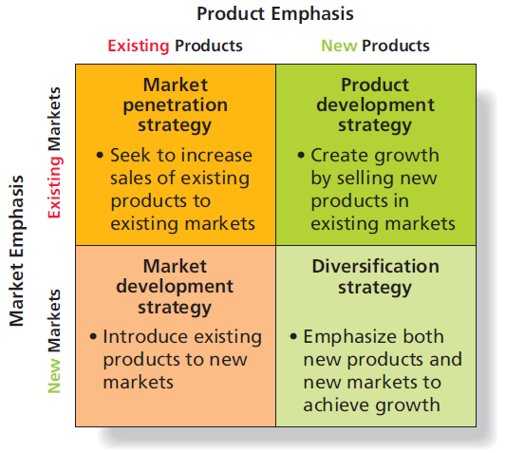
Figure 3.4 Product–Market Growth Matrix
Notes:
LECTURE NOTE:
Figure 3.4 displays the product–market growth matrix which characterizes different growth strategies according to type of market and type of product.
Market penetration strategies seek to increase sales of existing products to existing markets such as current users, nonusers, and users of competing brands within a market. For example, both Quaker Oatmeal and General Mills’ Cheerios (also an oats product) have been aggressively advertising a new use for their products as products that can help lower total cholesterol and help keep arteries clean and healthy.
Market development strategies introduce existing products to new markets. This strategy can mean expanding into a new geographic area, or it may mean reaching new customer segments within an existing geographic market. For example, the wildly popular Wii home gaming system by Nintendo has also become popular with older consumers because its active functionality during the game provides an opportunity for a light and fun physical workout.
Product development strategies create growth by selling new products in existing markets. Product development may mean extending the firm’s product line by developing new variations of the item (new flavors, sizes, packages), or it may mean altering or improving the product to provide enhanced performance (adding features such as vitamins or subtracting features such as fat).
Diversification strategies emphasize both new products and new markets to achieve growth.
DISCUSSION NOTE:
Ask students to identify the correct growth strategy for the following hypothetical examples:
Wal-Mart opens stores in China (market development/new geographic area).
Coca-cola promotes the use of its product as a rust remover in magazine ads targeting the do-it-yourself auto mechanic (market penetration/new use). This last example can be used to discuss the fact that just because a new use for a product exists, it isn’t always the best strategy to capitalize on it. While soaking rusty items in Coca-Cola will remove their rust, ads promoting this benefit may also cause cola consumers to have second thoughts drinking the product, as it’s a short leap mentally from “rust removal” to “stomach lining removal”.

Slide 24
Strategic Planning Summary
Successful executives understand strategic planning as an ongoing process.
One that proceeds from defining a shared purpose, leading to business growth
Define the mission
Evaluate environment
Set objectives
Establish business portfolio
Develop growth strategies
Notes:
Summary slide.

Slide 25
Ethical/Sustainable Decisions in the Real World
Pharmaceutical firms have various costs associated with the development of new drugs.
To offset costs, pharma companies raise the price of drugs that have no or low growth.
Is it appropriate for pharma companies to set prices of prescription drugs at any level they want based on the needs of the business?
Notes:
LECTURE NOTES:
It is estimated that bringing an approved prescription drug to market costs a firm $2.6 billion and over 10 years to develop. An example of a firm that hiked the price of a drug is Turing Pharmaceuticals. They raised the price of a single dose of Daraprim from $13.50 to $750. The idea was that the increased price would generate more funds for the company to develop other drugs that would help an even greater number of people.
DISCUSSION NOTES:
Lead discussion by asking students if they think it’s fair for pharma companies to raise prices so dramatically. Ask, how then can a firm like Turing develop drugs? It may also be prudent to discuss the free enterprise system as well.

Slide 26
Market Planning: Develop and Execute Marketing Strategy
Effective implementation of the four Ps requires a great deal of planning.
Steps are similar to those in strategic planning
Key difference relates to focus on issues relating to marketing mix.
Notes:
Summary slide.

Slide 27
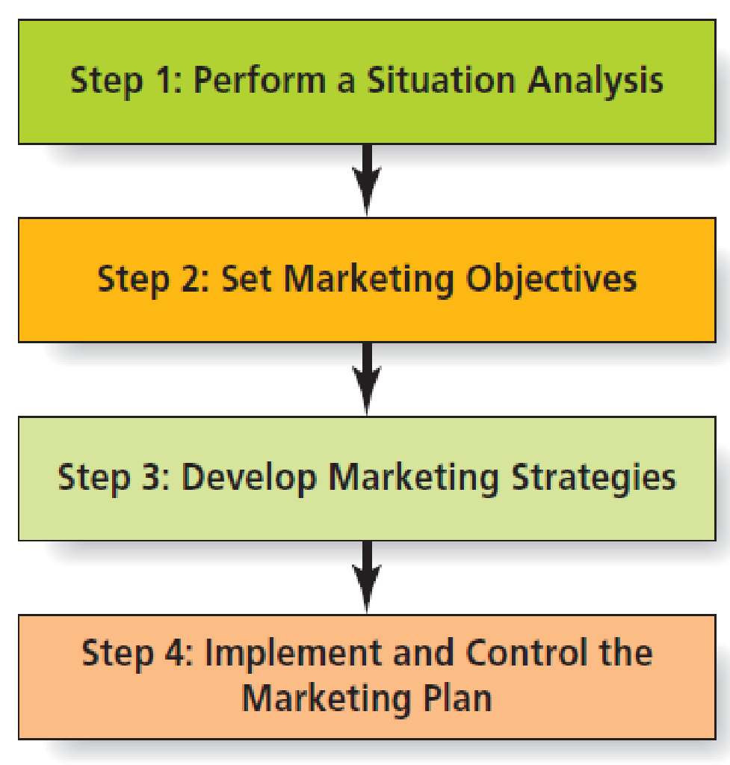
Figure 3.5 Steps in Market Planning
Notes:
Each of the steps are explained in the following slides.

Slide 28
Step 1: Perform a Situation Analysis
Analyze the marketing environment
Conduct SWOT analysis
Notes:
LECTURE NOTES:
The various environments impacting marketers are economic, technological, political and legal, and socioeconomic. To examine these environments, companies conduct SWOT analyses. Specifically, firms are looking for elements that will impact the marketing plan.

Slide 29
Step 2: Set Marketing Objectives
Specific to the firm’s marketing mix-related elements
Marketing objectives help achieve the overall business objectives.
Notes:
LECTURE NOTES:
Marketing objectives are focused on marketing activities. Overall business objectives involve many aspects of the firm – not just marketing. Therefore, when setting marketing objectives, firms attempt to craft objectives that help achieve the business’ overall objectives.

Slide 30
Step 3: Develop Marketing Strategies
Identify target market(s)
Adjust marketing mix for each target market
Product
Price
Promotion
Place (Distribution)
Notes:
LECTURE NOTES:
Marketing mix decisions identify how marketing will accomplish its objectives in the firm’s target markets. First, the target market(s) that are best suited to the firm’s offering need to be identified. Next, the specific product, price, promotion, and place strategies that fit the market need to be developed. The ad on this slide suggests that Lee Jeans has a very diverse product portfolio, including jeans that make you look slimmer.
The development of the marketing mix is described in more detail in the following slides.

Slide 31
Product Strategies
Product strategies include decisions on:
Product design
Packaging
Branding
Support services and maintenance
Upgrades
Product variations
Notes:
LECTURE NOTES:
Product strategies include a variety of factors. Certainly a major consideration relates to the nature of the product – its key benefits and attributes. But product strategies also include considerations related to packaging (colors, sizes, materials uses, information included), branding, support services (maintenances, upgrade opportunities, FAQs on websites, etc.), and product variations (flavors, quantities, variations, e.g., Diet vs. Non-Diet).

Slide 32
Pricing Strategies
Pricing strategy determines how much a firm charges for a product.
A firm may base its pricing strategy on costs, demand, price of competing products.
Debundling
Notes:
LECTURE NOTES:
Pricing Strategies: determine how much a firms charges for a product.
Setting a price is not an easy task – one must consider cost and competitive factors, the price consumers are willing to pay, and the ability of wholesalers and retailers to markup the product and earn a fair profit.
Typically marketers set the price to wholesalers, or if wholesalers are not used, retailers, and suggest a retail price which may or may not be adopted at the point of sale. Sometimes the firm bases its pricing strategy solely on cost, demand, or competitive issues.
DISCUSSION NOTES:
The book illustrates price bundling and de-bundling using the examples of airline services.
In recent years, airlines started to charge extra fees (checked baggage anyone?) for services and perks they used to include in the ticket price, a practice known as de-bundling, in an effort to increase their revenues.
Many passengers have expressed dissatisfaction with this approach, so price bundling—this time for a fee—is on its way back.
Delta Air Lines offers its fliers the Smart Travel Pack, which allows customers to package value-added options like free checked baggage, priority boarding, or preferred seating with their airfare.
Can students think of other examples of either price bundling or de-bundling?

Slide 33
Promotional Strategies
Promotional strategy is how marketers communicate a product’s value proposition to the target market.
Advertising
Sales promotion
Public relations
Direct marketing
Personal selling
Notes:
LECTURE NOTES:
A promotional strategy is how marketers communicate a product’s value proposition to the target market. Marketers use promotion strategies to develop the product’s message and the integrated communications mix of advertising, sales promotion, publicity, direct marketing, and personal selling that will deliver the message. As previously discussed, the marketing mix strategy must be devised with the intent of achieving marketing objectives, which in turn, contribute towards the achievement of corporate or SBU objectives.
DISCUSSION NOTES:
For example, the objective of the California Almond Growers association is to increase consumption of almonds. Their marketing strategy revolves around promoting the nut’s health benefits to consumers via print advertising, as shown here.

Slide 34
Distribution Strategies
Distribution strategies (the place component) outline when, how, and where the firm will make the product available to targeted customers.
Sell directly to the final customer or work through wholesalers and retailers?
Choosing the right distribution strategy depends on product, pricing, and promotion decisions.
Notes:
LECTURE NOTES:
Distribution strategies outline whether marketers sell the product directly to the final consumer, or if instead they sell to intermediaries, such as wholesalers and retailers, who in turn sell to the ultimate consumer.
Not all retailers are equal in terms of their merchandise quality and image; deciding which types of retailers should carry a firm’s products is an important decision.
Using the internet as a distribution channel can save a firm money in the case of products or services that can be delivered “virtually”. For example, airlines used to pay travel agents a commission to book flights. The introduction of online travel agents such as Expedia contributed to the demise of over 80% of traditional travel agencies, as online vendors charged a drastically lower commission than did traditional agencies.

Slide 35
Step 4: Implement and Control the Marketing Plan
During implementation process, firms follow formal process to determine progress toward marketing objectives.
Measure actual performance
Compare performance to established objectives
Make adjustments to objectives or strategies based on this analysis
Notes:
LECTURE NOTES:
In practice, marketers spend much of their time managing the various elements involved in implementing the marketing plan. This involves exercising control over the plan in terms of both budget expenditures and performance. Each action plan must include as accurate a budget as is possible. This allows management at the functional level to monitor budget expenditures and contact the appropriate operational manager if a particular budget line is exceeded within some specified time period. In addition to monitoring budget expenditures, managers must select the metrics to be measured as part of the formal control process. Actual performance on key objectives is measured in terms of these metrics (such as Return on Marketing Investment, or ROMI) and comparing it to the numerical objectives previously set.
ROMI is just one example of a marketing metric; others include measures such as new customer acquisition cost, customer retention rate, customer turnover rates, perceived product quality, customer satisfaction.
Adjustments are made to plan as needed, if for instance, performance seems to be lagging in comparison to the objective that marketers are trying to reach.
How does the implementation and control step actually manifest itself within a marketing plan? One very convenient way is through the inclusion of a series of action plans that support the various marketing objectives and strategies within the plan. Action plans also help managers when they need to assign responsibilities, create time lines, or develop budgets and measurement and control processes for marketing planning.

Slide 36
Return on Marketing Investment (ROMI)
Return on marketing investment
Revenue (or profit) generated by investment in a given marketing program divided by the cost of the program at a given level of risk
For instance, if:
Revenue from Marketing Investment = $150,000
Cost of Marketing Program = $30,000
ROMI = 5.0
Notes:
LECTURE NOTES:
Return on Marketing Investment (ROMI) is a key marketing metric that is often incorporated into marketing objectives. The word “investment” is highlighted in this definition as it implies that marketers must think of marketing as an investment to accomplish goals, rather than simply as one of many expenses which provide little benefit/return to the firm. Although ROMI is a commonly used metric, there are several major objections to relying exclusively on ROMI:
Marketing expenditures aren’t treated as an investment in the firm’s accounting statements, but rather as a cost, which perpetuates the “marketing is an expense” mentality.
Calculating ROMI requires that profit be divided by the expenditure, yet all other bottom-line performance measures consider profit or cash flow after deducting expenses.
Calculating ROMI requires knowing what would have happened if marketing expenditures had never taken place, a virtual impossibility.
ROMI has become a fashionable term for marketing productivity in general, yet firms often calculate ROMI quite differently, which can cause confusion.
ROMI ignores the effect of marketing assets of the firm such as brand equity (which is chiefly built via advertising), and tends to lead managers toward more short-term decision perspectives that focus on short-term incremental profits and expenses without looking at the longer-term effects of any change in brand equity.
ROMI often leads to actions by management that are detrimental to the firm’s sustainability commitment, because it encourages management to shore up short-term performance instead.
ROMI can be used properly if a firm uses an appropriate and consistent measurement process and combines the use of this metric with other critical marketing metrics, such as marketing payback (how quickly marketing costs are recovered).
For an organization to use ROMI properly it must: (a) identify the most appropriate and consistent measure to apply; (b) combine review of ROMI with other critical marketing metrics (one example is marketing payback—how quickly marketing costs are recovered); and (c) fully consider the potential long-term impact of the actions ROMI drives (that is, their sustainability).

Slide 37
Action Plans
Individual support plans included in a marketing plan that provide guidance for implementation and control of the various marketing strategies within the plan.
Sometimes referred to as marketing programs
Managers create actions plans for key elements involved in implementing the marketing strategy.
Notes:
LECTURE NOTES:
Marketing planning includes inclusion of a series of action plans that support the various marketing objectives and strategies within the plan. Action plans are sometimes referred to as “marketing programs.” The best way to use action plans is to include a separate action plan for each important element involved in implementing the marketing plan.
Table 3.1 (next slide) provides a template for an action plan.

Slide 38
Table 3.1 Template for an Action Plan
Title of action plan | Give the action plan a relevant name.
Purpose of action plan | What do you hope to accomplish by the action plan—that is, what specific marketing objective and strategy within the marketing plan does it support?
Description of action plan | Be succinct—but still thorough—when you explain the action plan. What are the steps involved? This is the core of the action plan. It describes what must be done in order to accomplish the intended purpose of the action plan.
Responsibility for the action plan | What person(s) or organizational unit(s) are responsible for carrying out the action plan? What external parties are needed to make it happen? Most importantly, who specifically has final “ownership” of the action plan—that is, who within the organization is accountable for it?
Timeline for the action plan | Provide a specific timetable of events leading to the completion of the plan. If different people are responsible for different elements of the time line, provide that information.
Budget for the action plan | How much will implementation of the action plan cost? This may be direct costs only or may also include indirect costs, depending on the situation. The sum of all the individual action plan budget items will ultimately be aggregated by category to create the overall budget for the marketing plan.
Measurement and control of the action plan | Indicate the appropriate metrics, how and when they will be measured, and who will measure them.
Notes:
LECTURE NOTES:
Slide provides a template for creating an action plan.

Slide 39
Assigning Responsibility in the Action Plan
Who will be responsible for carrying out each part of the marketing plan?
Not everybody involved will be marketers
Sales
Production
Quality control
Shipping
Customer service
Finance
IT
Notes:
LECTURE NOTES:
A marketing plan can’t be implemented without people. And not everybody who will be involved in implementing a marketing plan is a marketer.
Sales, production, quality control, shipping, customer service, finance, information technology—the list goes on—all will likely have a part in making the plan successful.

Slide 40
Creating Action Plan Timelines
Each action plan requires a time line needed to accomplish the various tasks.
Often portrayed in flowchart form to help managers and employees visualize sequence of tasks
Gantt charts
PERT charts
Notes:
LECTURE NOTES:
Create a Time Line - Each action plan requires a time line to accomplish the various tasks it requires. This is essential to include in the overall marketing plan. Most marketing plans portray the timing of tasks in flowchart form so that it is easy to visualize when the pieces of the plan will come together. Marketers often use Gantt charts or PERT charts, popular in operations management, to portray a plan’s time line.

Slide 41
Setting a Budget
Each cost element of the action plan should link to a budget item.
Increases accountability for all parties involved with implementing the marketing plan
Accuracy in estimating individual action plan expenditures helps overall marketing budget forecasting.
Notes:
LECTURE NOTES:
Each element of the action plan links to a budget item, assuming there are costs involved in carrying out the plan.
Forecasting the needed expenditures related to a marketing plan is difficult, but one way to improve accuracy in the budgeting process overall is to ensure estimates for expenditures for the individual action plans that are as accurate as possible.
At the overall marketing plan level, managers create a master budget and track it throughout the market planning process. They report variances from the budget to the parties responsible for each budget item.

Slide 42
Deciding on Measurements and Controls
Marketing control is a formal process for:
Measuring performance
Comparing performance to established marketing and strategy objectives
Making adjustments to the objectives or strategies based on this analysis
Selecting the right metrics should account for short-term objectives balanced against firm’s long-term sustainability.
Notes:
LECTURE NOTES:
The concept of control as a formal process of monitoring progress to measure actual performance, compare the performance to the established marketing objectives or strategies, and make adjustments to the objectives or strategies on the basis of this analysis.
The metric(s) a marketer uses to monitor and control individual action plans ultimately forms the overall control process for the marketing plan.
Many marketers do not consistently do a good job of measurement and control, which, of course, compromises their market planning.
Selecting good metrics needs to take into account short-term objectives balanced against the firm’s focus on long-term sustainability.

Slide 43
Operational Planning (2 of 2)
Operational plans focus on day-to-day execution of the marketing plan.
Cover a shorter period of time than strategic and functional plans
Often falls to lower level managers
Include detailed instructions for activities, specifies responsibilities, and provides time lines
Many key marketing metrics actually are used at the operational level of planning.
Notes:
Summary slide.

Slide 44
Copyright

