Slide 1
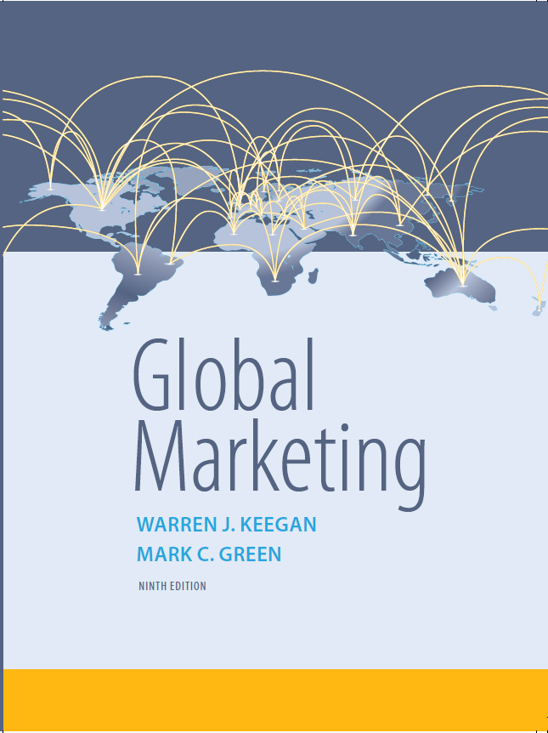
Global Marketing
Ninth Edition
Chapter 7
Segmentation, Targeting, and Positioning
Copyright © 2017, 2015, 2013 Pearson Education, Inc. All Rights Reserved
Notes:
If this PowerPoint presentation contains mathematical equations, you may need to check that your computer has the following installed:
1) MathType Plugin
2) Math Player (free versions available)
3) NVDA Reader (free versions available)

Slide 2
Learning Objectives (1 of 2)
7.1 Identify the variables that global marketers can use to segment global markets and give an example of each.
7.2 Explain the criteria that global marketers use to choose specific markets to target.
7.3 Understand how global marketers use a product-market grid to make targeting decisions.

Slide 3
Learning Objectives (2 of 2)
7.4 Compare and contrast the three main target market strategy options.
7.5 Describe the various positioning options available to global marketers.

Slide 4
Global Market Segmentation (1 of 2)
The process of dividing the world market into distinct subsets of customers that have similar needs (for example, country groups or individual interest groups).
Pluralization of Consumption or segment simultaneity theory was advanced by Professor Theodore Levitt 4 decades ago stating that consumers seek variety and new segments will appear in many national markets. i.e., sushi, pizza

Slide 5
Global Market Segmentation (2 of 2)
Types of segmentation methods
Demographic segmentation
Psychographic segmentation
Behavior segmentation
Benefit segmentation

Slide 6
Geographic Segmentation
Dividing the world into geographic subgroups
The advantage of geography is proximity
However, just because people are in close proximity does not mean they are similar

Slide 7
Demographic Segmentation (1 of 2)
Based on measurable population characteristics
Age
Income
Gender
Age distribution
Education
Occupation
Generally, national income is the most important variable
Notes:
Demographic segmentation is based on measurable characteristics of populations, such as income, population, age distribution, gender, education, and occupation. A number of global demographic trends—fewer married couples, smaller family size, changing roles of women, higher incomes and living standards, for example—have contributed to the emergence of global market segments.

Slide 8
Demographic Segmentation (2 of 2)
500 million Asian consumers aged 16 and younger
India has the youngest demographic profile among the world’s large nations; half are younger than 25, 14 yr. olds & younger equal the entire U.S. population
Half of Japanese will be 50+ yrs. by 2025
20% of Americans (70 million) will be 65+ by 2030
U.S. Ethnic groups-African/Black, Hispanics, & Asian Americans have a combined annual buying power of $233 billion

Slide 9
Income & Population Segmentation
2/3 world G N I in the Triad, 12% o population
Don’t use income as the only variable for assessing market opportunity
Use Purchasing Power Parity
Do not read into the numbers
Some services are free in developing nations so there is more purchasing power
For products with low enough price, population is a more important variable
Notes:
Ideally, gross domestic product (GDP) and other measures of national income converted to U.S. dollars should be calculated on the basis of purchasing power parities (i.e., what the currency will buy in the country of issue) or through direct comparisons of actual prices for a given product. This would provide an actual comparison of the standards of living in the countries of the world.

Slide 10
Market Segments by Income & Population
Global Teens-12 and 19 yr. olds
“A group of teenagers randomly chosen from different parts of the world will share many of the same tastes.”
Global Elite-affluent consumers who are well traveled and have the money to spend on prestigious products with an image of exclusivity

Slide 11
Gender Segmentation
Gender segmentation is an obvious choice for some companies
Fashion designers & cosmetic companies focus on women but may also offer men’s products
Nike is opening shops for women
Levi Strauss opened Levis for Girls in Paris

Slide 12
Psychographic Segmentation
Based on attitudes, values and lifestyle
Lifestyle surveys
S R I International’s Values and Life Styles, V A L S & V A L S 2
Porsche example
Top Guns (27%): Ambition, power, control
Elitists (24%): Old money, car is just a car
Proud Patrons (23%): Car is reward for hard work
Bon Vivants (17%): Car is for excitement, adventure
Fantasists (9%): Car is form of escape

Slide 13
Euroconsumers (1 of 2)
The Euroconsumer:
Successful Idealists-5% to 20% of the population; consists of persons who have achieved professional and material success while maintaining commitment to abstract or socially responsible ideals
Affluent Materialists-Status-conscious ‘up-and-comers’- many of whom are business professionals – use conspicuous consumption to communicate their success to others

Slide 14
Euroconsumers (2 of 2)
Comfortable Belongers
25% to 50% of a country’s population
conservative
most comfortable with the familiar
content with the comfort of home, family, friends, and community
Disaffected Survivors
lack power and affluence
harbor little hope for upward mobility
tend to be either resentful or resigned
concentrated in high-crime urban inner city
attitudes tend to affect the rest of society

Slide 15
Behavior Segmentation (1 of 2)
Focus on whether people purchase a product or not, how much, and how often they use it
User status
80/2 Rule or Law of Disproportionality or Pareto’s Law-80% of a company’s revenues are accounted for by 20% of the customers
Notes:
Behavior segmentation focuses on whether or not people buy and use a product, as well as how often, and how much they use or consume. Consumers can be categorized in terms of usage rates: for example, heavy, medium, light, and non-user. Consumers can also be segmented according to user status: potential users, non-users, ex-users, regulars, first-timers, and users of competitors’ products. Nine country markets generate about 80 percent of McDonald’s revenues. This situation presents McDonald’s executives with strategy alternatives: Should the company pursue growth in the handful of countries where it is already well known and popular? Or, should it focus on expansion and growth opportunities in the scores of countries that, as yet, contribute little to revenues and profits?

Slide 16
Behavior Segmentation (2 of 2)
Benefit segmentation focuses on the value equation
Value=Benefits/Price
Based on understanding the problem a product solves, the benefit it offers, or the issue it addresses
Notes:
benefit segmentation</KT> focuses on the numerator of the value equation—the B in V = B/P. This approach is based on marketers’ superior understanding of the problem a product solves, the benefit it offers, or the issue it addresses, regardless of geography. Food marketers are finding success creating products that can help parents create nutritious family meals with a minimal investment of time. Campbell Soup is making significant inroads into Japan’s $500 million soup market as time-pressed homemakers place a premium on convenience. Marketers of health and beauty aids also use benefit segmentation. Many toothpaste brands are straightforward cavity fighters, and as such they reach a very broad market. However, as consumers become more concerned about whitening, sensitive teeth, gum disease, and other oral care issues, marketers are developing new toothpaste brand extensions suited to the different sets of perceived needs.

Slide 17
Euroconsumers
The population of many countries includes ethnic groups of significant size
Three main groups in the U.S. include African-Americans, Asian-Americans, and Hispanic Americans
Hispanic Americans
50 million Hispanic Americans (14% of total pop.) with $978 billion annual buying power
“$1 trillion Latina” 24 million Hispanic women: 42% single, 35% H O H, 54% working

Slide 18
Assessing Market Potential (1 of 2)
Be mindful of the pitfalls
Tendency to overstate the size and short-term attractiveness of individual country markets
The company does not want to ‘miss out’ on a strategic opportunity
Management’s network of contacts will emerge as a primary criterion for targeting
Notes:
After segmenting the market by one or more of the criteria just discussed, the next step is to assess the attractiveness of the identified segments. This part of the process is especially important when sizing up emerging country markets as potential targets. It is at this stage that global marketers should be mindful of several potential pitfalls associated with the market segmentation process.

Slide 19
Assessing Market Potential (2 of 2)
Three basic criteria:
Current size of the segment and anticipated growth potential
Potential competition
Compatibility with company’s overall objectives and the feasibility of successfully reaching the target audience

Slide 20
Criteria for Targeting
Current size of the segment and growth potential
Potential competition
Compatibility and feasibility

Slide 21
Current Segment Size & Growth
Is the market segment currently large enough to present a company with the opportunity to make a profit?
If the answer is ‘no,’ does it have significant growth potential to make it attractive in terms of a company’s long-term strategy?
Notes:
India is the world’s fastest growing cell phone market. The industry is expanding at a rate of 50 percent annually, with 5 to 6 million new subscribers added every month. By mid-2008, India had 261 million cell phone users; that number approached 900 million by the end of 2011.
1.3 million cars sold annually, 3 million within 10 years, world’s largest car market.
75% of India’s population is under age 35, increasing affluent and looking for designer brands.
Even so, barriers originating in the political and regulatory environments have shackled private-sector growth. From the perspective of a consumer packaged goods company, for example, low incomes and the absence of a distribution infrastructure offset the fact that 75 percent of India’s population lives in rural areas. The appropriate decision may be to target urban areas only, even though they are home to only 25 percent of the population. Visa’s strategy in China perfectly illustrates this criterion as it relates to demographics: Visa is targeting persons with a monthly salary equivalent to $300 or more. The company estimates that currently 60 million people fit that description; by 2010, the number could include as many as 200 million people.

Slide 22
Potential Competition (1 of 2)
Is there currently strong competition in the market segment?
Is the competition vulnerable in terms of price or quality?
Notes:
Over the past several decades, for example, Japanese companies in a variety of industries targeted the U.S. market despite the presence of entrenched domestic market leaders. Some of the newcomers proved to be extremely adept at segmenting and targeting; as a result, they made significant inroads. In the motorcycle industry, for example, Honda first created the market for small-displacement dirt bikes. The company then moved upmarket with bigger bikes targeted at casual riders whose psychographic profile was quite different than that of the hardcore Harley-Davidson rider. In document imaging, Canon outflanked Xerox by offering compact desktop copiers and targeting department managers and secretaries. Similar case studies can be found in earth-moving equipment (Komatsu versus Caterpillar), photography (Fuji versus Kodak), and numerous other industries.
Germany’s DHL tried to enter the U.S. package-delivery market in 2003; to achieve scale, DHL acquired Airborne Express. However, management underestimated the dominance of the entrenched incumbents FedEx and UPS. DHL finally withdrew from the United States market in 2008 after losses totaled about $10 billion.

Slide 23
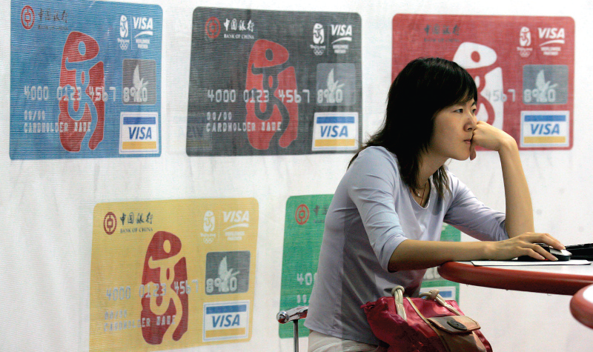
Potential Competition (2 of 2)
Only 1 % of Chinese have credit cards.

Slide 24
Feasibility and Compatibility
Will adaptation be required? If so, is this economically justifiable in terms of expected sales?
Will import restrictions, high tariffs, or a strong home country currency drive up the price of the product in the target market currency and effectively dampen demand?
Notes:
If a market segment is judged to be large enough, and if strong competitors are either absent or deemed to be vulnerable, then the final consideration is whether a company can and should target that market. The feasibility of targeting a particular segment can be negatively impacted by various factors. For example, significant regulatory hurdles may be present that limit market access. This issue is especially important in China today Other marketing-specific issues can arise; in India, for example, three to five years are required to build an effective distribution system for many consumer products. This fact may serve as a deterrent to foreign companies that might otherwise be attracted by the apparent potential of India’s large population.

Slide 25
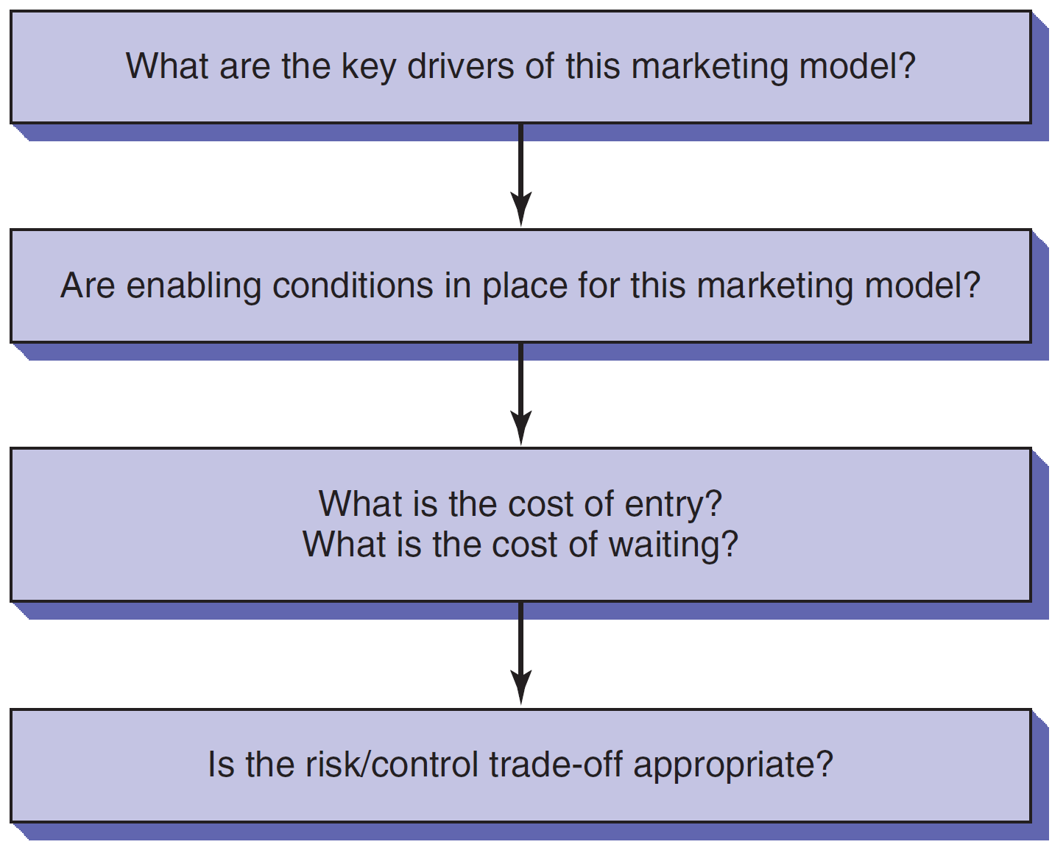
Framework for Selecting Target Markets
Notes:
Global marketing expert David Arnold has developed a framework that goes beyond demographic data and considers other, marketing-oriented assessments of market size and growth potential. Instead of a “top-down” segmentation analysis beginning with, say, income or population data from a particular country, Arnold’s framework is based on a “bottom-up” analysis that begins at the product-market level. After marketing-model drivers and enabling conditions have been identified, the third step is for management to weigh the estimated costs associated with entering and serving the market with potential short- and long-term revenue streams. Does this segment or country market merit entry now? Or, would it be better to wait until, say, specific enabling conditions are established?
Marketing model drivers are key elements or factors required for a business to take root and grow in a particular country market environment. The drivers may differ depending on whether a company serves consumer or industrial markets. Does success hinge on establishing or leveraging a brand name? Or, is distribution or a tech-savvy sales staff the key element? Marketing executives seeking an opportunity must arrive at insights into the true driving force(s) that will affect success for their particular product-market.
Enabling conditions are structural market characteristics whose presence or absence can determine whether the marketing model can succeed. For example, in India, refrigeration is not widely available in shops and market food stalls. This creates challenges for Nestlé and Cadbury Schweppes as they attempt to capitalize on Indians’ increasing appetite for chocolate confections. Although Nestlé’s KitKat and Cadbury’s Dairy Milk bars have been reformulated to better withstand heat, the absence or rudimentary nature of refrigeration hampers the companies’ efforts to ensure their products are in saleable condition.
After marketing model drivers and enabling conditions have been identified, the third step is for management to weigh the estimated costs associated with entering and serving the market with potential short- and long-term revenue streams. Does this segment or country market merit entry now? Or, would it be better to wait until specific enabling conditions are established? The issue of timing is often framed in terms of the quest for first-mover advantage. The conventional wisdom is that the first company to enter a market has the best chance of becoming the market leader.

Slide 26
9 Questions for Creating a Product-Market Profile (1 of 2)
Who buys our product?
Who does not buy it?
What need or function does it serve?
Is there a market need that is not being met by current product/brand offerings?
What problem does our product solve?

Slide 27
9 Questions for Creating a Product-Market Profile (2 of 2)
What are customers buying to satisfy the need for which our product is targeted?
What price are they paying?
When is the product purchased?
Where is it purchased

Slide 28
Product-Market Decisions
Review current and potential products for best match for country markets or segments
Create a matrix with countries and products to help with analysis

Slide 29
Target Market Strategy Options (1 of 2)
Standardized Global Marketing or Undifferentiated target marketing
Mass marketing on a global scale
Standardized marketing mix
Minimal product adaptation
Intensive distribution
Lower production costs
Lower communication costs

Slide 30
Target Market Strategy Options (2 of 2)
Concentrated Global Marketing
Niche marketing
Single segment of global market
Look for global depth rather than national breadth
Example.: Chanel, Estee Lauder
Differentiated Global Marketing
Multi-segment targeting
Two or more distinct markets
Wider market coverage
Example.: P&G markets Old Spice and Hugo Boss for Men
Notes:
A niche is simply a single segment of the global market. In cosmetics, the House of Lauder, Chanel, and other cosmetics marketers have used this approach successfully to target the upscale, prestige segment of the market. Germany’s Winterhalter makes dishwashers for the restaurant industry only.
Danone SA, the French foods company, targets consumers in developed countriews with premium brands like Evian, Badoit mineral waters and Dannon and Activia yougurts.
In the cosmetics industry, Unilever NV and Cosmair Inc. pursue differentiated global marketing strategies by targeting both ends of the perfume market. Unilever targets the luxury market with Calvin Klein and Elizabeth Taylor’s Passion; Wind Song and Brut are its mass-market brands. Cosmair sells Tresnor and Giorgio Armani Gio to the upper end of the market and Gloria Vanderbilt to the lower end. Mass marketer Procter & Gamble, known for its Old Spice and Incognito brands, also embarked upon this strategy with its 1991 acquisition of Revlon’s EuroCos, marketer of Hugo Boss for men and Laura Biagiotti’s Roma perfume. In the mid-1990s, P&G launched a new prestige fragrance, Venezia, in the United States and several European countries. Conversely, in 1997 Estee Lauder acquired Sassaby Inc., owner of the mass-market Jane brand. The move marked the first move by Lauder outside the prestige segment.

Slide 31
Positioning (1 of 4)
Locating a brand in consumers’ minds over and against competitors in terms of attributes and benefits that the brand does and does not offer
Attribute or Benefit
Quality and Price
Use or User
Competition
Notes:
The term positioning is attributed to marketing gurus Al Ries and Jack Trout, who first introduced it in a 1969 article published in Industrial Marketing magazine. As noted at the beginning of the chapter, positioning refers to the act of differentiating a brand in customers’ minds in relation to competitors in terms of attributes and benefits that the brand does and does not offer. Put differently, positioning is the process of developing strategies for “staking out turf” or “filling a slot” in the mind of target customers.
Positioning is frequently used in conjunction with the segmentation variables and targeting strategies discussed previously. For example, Unilever and other consumer goods companies often engage in differentiated target marketing, offering a full range of brands within a given product category. Unilever’s various detergent brands include All, Wisk, Surf, and Persil; each is positioned slightly differently. In some instances, extensions of a popular brand can also be positioned in different ways. Colgate’s Total toothpaste is positioned as the brand that addresses a full range of oral health issues, including gum disease. In most parts of the world, Total is available in several formulations, including Total Advanced Clean, Total Clean Mint Paste, and Total Whitening Paste. Effective positioning differentiates each variety from the others.
In the decades since Ries and Trout first focused attention on the importance of the concept, marketers have utilized a number of general positioning strategies. These include positioning by attribute or benefit, quality and price, use or user, or competitor. Recent research has identified three additional positioning strategies that are particularly useful in global marketing: global consumer culture positioning, local consumer culture positioning, and foreign consumer culture positioning.

Slide 32
Positioning (2 of 4)
Attribute or Benefit
Economy
Reliability
Durability
B M W: The Ultimate Driving Machine or Visa: It’s Everywhere You Want To Be
Foreign Consumer Culture Positioning: Focus on import benefits
Quality and Price
Continuum from high price/quality and high price to good value
Stella Artois beer: Reassuring Expensive
F C C P: Grey Goose (France), Ketel One (the Netherlands)

Slide 33
Positioning (3 of 4)
Use or User
Associates the brand with a user or class of users
Max Factor: The makeup that makeup artists use
Competition
Implicit or explicit reference to competition
Dove: Campaign for Real Beauty
2% of women worldwide think they are beautiful
New definition of beauty

Slide 34
Positioning (4 of 4)
Global consumer culture positioning
Identifies the brand as a symbol of a particular global culture or segment
High-touch and high-tech products
Foreign consumer culture positioning
Associates the brand’s users, use occasions, or product origins with a foreign country or culture
Local consumer culture positioning
Identifies with local cultural meanings
Consumed by local people
Locally produced for local people
Used frequently for food, personal, and household nondurables
Example.: Budweiser is identified with small-town America
Notes:
Global consumer culture positioning:
“United Colors of Benetton” means the unity of humankind.
My First Sony: for kids with discerning parents
High-tech: MP3 players, cell phones, luxury cars, financial services, Canon cameras, Adidas.
High-touch: Nescafe coffee.
Foreign CCP:
Foster’s beer & Australia
Ikea & Sweden

Slide 35
Copyright

