Slide 1
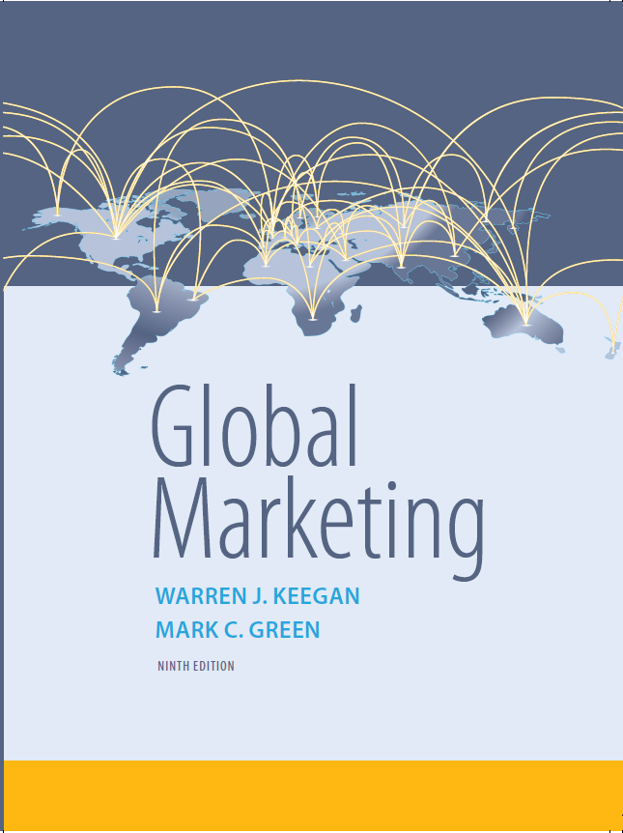
Global Marketing
Ninth Edition
Chapter 4
Social and Cultural Environments
Copyright © 2017, 2015, 2013 Pearson Education, Inc. All Rights Reserved
Notes:
If this PowerPoint presentation contains mathematical equations, you may need to check that your computer has the following installed:
1) MathType Plugin
2) Math Player (free versions available)
3) NVDA Reader (free versions available)

Slide 2
Learning Objectives (1 of 2)
4.1 Define culture and identify the various expressions and manifestations of culture that can impact marketing strategies.
4.2 Compare and contrast the key aspects of high- and low-context cultures.
4.3 Identify and briefly explain the major dimensions of Hofstede’s social values typology.
Notes:
Having an understanding of the culture can actually become a firm’s competitive advantage. To do this we must overcome our prejudices that are a natural result of the human tendency toward ethnocentricity. Cultural factors challenge global marketers because many are hidden from view. In order to do this the chapter will look at culture from several different conceptual frameworks that include Edward T. Hall’s notion of high- and low-context cultures, Hofstede’s cultural typology, the self-reference criterion, Maslow’s hierarchy and diffusion theory.

Slide 3
Learning Objectives (2 of 2)
4.4 Explain how the self-reference criterion can affect decision making at global companies and provide a step-by-step example of a company adapting to conditions in a global market.
4.5 Analyze the components of diffusion theory and its applicability to global marketing.
4.6 Explain the marketing implications of social and cultural environments around the globe.
Notes:
Having an understanding of the culture can actually become a firm’s competitive advantage. To do this we must overcome our prejudices that are a natural result of the human tendency toward ethnocentricity. Cultural factors challenge global marketers because many are hidden from view. In order to do this the chapter will look at culture from several different conceptual frameworks that include Edward T. Hall’s notion of high- and low-context cultures, Hofstede’s cultural typology, the self-reference criterion, Maslow’s hierarchy and diffusion theory.

Slide 4
Task of Global Marketers
Study and understand the cultures of countries in which they will be doing business
Understand how an unconscious reference to their own cultural values, or self-reference criterion, may influence their perception of the market
Incorporate this understanding into the marketing planning process
Notes:
One reason cultural factors challenge global marketers is that many of these factors are hidden from view. Because culture is a learned behavior passed on from generation to generation, it can be difficult for the outsider to fathom. However, as they endeavor to understand cultural factors, outsiders gradually become insiders and develop cultural empathy. There are many different paths to the same goals in life. The global marketer understands this and revels in life’s rich diversity.

Slide 5
Society, Culture and Global Consumer Culture (1 of 2)
Culture–ways of living, built up by a group of human beings, that are transmitted from one generation to another
Culture has both conscious and unconscious values, ideas, attitudes, and symbols
Culture is acted out in social institutions
These institutions reinforce cultural norms
Culture is both physical (clothing and tools) and nonphysical (religion, attitudes, beliefs, and values)
Notes:
This slide is an introduction to the different aspects of culture. The goal of this slide is to help the student see that culture has a number of factors affecting it. Culture is acted out in social institutions and in society.

Slide 6
Society, Culture and Global Consumer Culture (2 of 2)
“Culture is the collective programming of the mind that distinguishes the members of one category of people from those of another.” ~Geert Hofstede
A nation, an ethnic group, a gender group, an organization, or a family may be considered as a category.

Slide 7
Social Institutions
Family
Education
Religion
Government
Business
These institutions function to reinforce cultural norms

Slide 8
Material and Nonmaterial Culture
Physical Culture
Clothing
Tools
Decorative art
Body adornment
Homes
Abstract Culture
Religion
Perceptions
Attitudes
Beliefs
Values
Notes:
Material and nonmaterial (also known as subjective or abstract culture) elements of culture are interrelated. Cultural universals include athletic sports, body adornment, cooking, courtship, dancing, decorative art, education, ethics, etiquette, family feasting, food taboos, language, marriage, mealtime, medicine, mourning, music, property rights, religious rituals, residents rules, status differentiation, and trade.

Slide 9
Society, Culture, and Global Consumer Culture
Global consumer cultures are emerging
Persons who share meaningful sets of consumption-related symbols
Pub culture, coffee culture, fast-food culture, credit card culture, soccer culture
Primarily the product of a technologically interconnected world
Internet
Satellite T V
Notes:
Because of technologies such as satellite TV, Internet, and similar communication channels marketers have begun to see the emergence of the global consumer. The hallmark of this culture is consumption. As the world becomes more interconnected and as cultural imagery continues to freely flow across national borders it can be expected that this culture will grow. It can be exploited by global consumer culture positioning (GCCP) discussed in Chapter 7. In particular, marketers can use advertising to communicate the notion that people everywhere consume a particular brand or to appeal to human universals.

Slide 10
Attitudes, Beliefs, and Values
Attitude-learned tendency to respond in a consistent way to a given object or entity
Belief-an organized pattern of knowledge that an individual holds to be true about the world
Value-enduring belief or feeling that a specific mode of conduct is personally or socially preferable to another mode of conduct
Subcultures-smaller groups of people with their own shared attitudes, beliefs, & values (ex. Vegetarians)
Notes:
By accepting Hofstede’s definition of culture (the collective programming of the mind) it would make sense to learn about culture by studying the attitudes, beliefs, and values shared by a specific group of people. Values represent the deepest level of a culture and are shared by the majority of members. Within any culture, there are likely to be subcultures, that is, smaller groups of people with their own shared subset of attitudes, beliefs, and values. Subcultures may represent attractive niche marketing opportunities, i.e., vegetarians.
Some specific examples will allow us to illustrate these definitions by comparing and contrasting attitudes, beliefs, and values. The Japanese, for example, strive to achieve cooperation, consensus, self-denial, and harmony. Because these all represent feelings about modes of conduct, they are values. Japan’s monocultural society reflects the belief among the Japanese that they are unique in the world. Many Japanese, especially young people, also believe that the West is the source of important fashion trends. As a result, many Japanese share a favorable attitude toward American brands.

Slide 11
Religion (1 of 2)
The world’s major religions include Buddhism, Christianity, Hinduism, Islam, and Judaism and are an important source of beliefs, attitudes, and values.
Religious tenets, practices, holidays, and history impact global marketing activities.
Notes:
McDonald’s does not serve beef hamburgers in India because Hindus do not eat beef.
There were objections raised in the merger of Daimler-Benz and Chrysler relating to Jewish history and the Holocaust.
Some Muslims have tapped into anti-American sentiment by urging a boycott of American brands due to U.S. military action in the Mideast following 9/11.
Europeans are divided on the issue of referring to God and Christianity in a new European constitution. Strong Catholic countries like Ireland, Spain, Italy, and Poland are for inclusion. France and Belgium are strong advocates of separation of church and state. Europe’s politically active Muslim minority are resisting inclusion of Christianity in the EU Constitution.
One entrepreneur, Tunisian-born Tawfik Mathlouthi, launched a soft drink brand, Mecca-Cola, as an alternative to Coca-Cola for Muslims living in the United Kingdom and France. The brand’s name is both an intentional reference to the holy city of Islam as well as an ironic swipe at Coca-Cola, which Mathlouthi calls “the Mecca of capitalism.” London’s Sunday Times called Mecca-Cola “the drink now seen as politically preferable to Pepsi or Coke.” In 2003, Qibla Cola (the name comes from an Arabic word for “direction”) was launched in the United Kingdom. Founder Zahida Parveen hoped to reach a broader market than Mecca-Cola by positioning the brand “for any consumer with a conscience, irrespective of ethnicity or religion. Bill Britt, “Upstart Cola Taps Anti-War Vibe,” Advertising Age (February 24, 2003), p. 1. See also Digby Lidstone, “Pop Idols,” Middle East Economic Digest (August 22, 2003), p. 4.

Slide 12
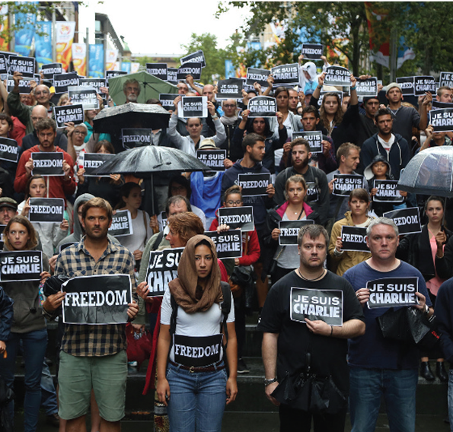
Religion (2 of 2)
In 2014, jihadist gunmen opened fire at the Paris office of Charlie Hebdo.
Notes:
McDonald’s does not serve beef hamburgers in India because Hindus do not eat beef.
There were objections raised in the merger of Daimler-Benz and Chrysler relating to Jewish history and the Holocaust.
Some Muslims have tapped into anti-American sentiment by urging a boycott of American brands due to U.S. military action in the Mideast following 9/11.
Europeans are divided on the issue of referring to God and Christianity in a new European constitution. Strong Catholic countries like Ireland, Spain, Italy, and Poland are for inclusion. France and Belgium are strong advocates of separation of church and state. Europe’s politically active Muslim minority are resisting inclusion of Christianity in the EU Constitution.
One entrepreneur, Tunisian-born Tawfik Mathlouthi, launched a soft drink brand, Mecca-Cola, as an alternative to Coca-Cola for Muslims living in the United Kingdom and France. The brand’s name is both an intentional reference to the holy city of Islam as well as an ironic swipe at Coca-Cola, which Mathlouthi calls “the Mecca of capitalism.” London’s Sunday Times called Mecca-Cola “the drink now seen as politically preferable to Pepsi or Coke.” In 2003, Qibla Cola (the name comes from an Arabic word for “direction”) was launched in the United Kingdom. Founder Zahida Parveen hoped to reach a broader market than Mecca-Cola by positioning the brand “for any consumer with a conscience, irrespective of ethnicity or religion. Bill Britt, “Upstart Cola Taps Anti-War Vibe,” Advertising Age (February 24, 2003), p. 1. See also Digby Lidstone, “Pop Idols,” Middle East Economic Digest (August 22, 2003), p. 4.

Slide 13
Aesthetics
The sense of what is beautiful and what is not beautiful
What represents good taste as opposed to tastelessness or even obscenity
Visual-embodied in the color or shape of a product, label, or package
Styles-various degrees of complexity, for example, are perceived differently around the world
Notes:
Aesthetic elements that are seen as attractive in one country may be viewed differently in another.
In surveys about color preferences, 50 percent of respondents indicate blue is their favorite—and it is favored by a wide margin over the next-preferred color.

Slide 14
Aesthetics and Color
Red-associated with blood, wine-making, activity, heat, and vibrancy in many countries but is poorly received in some African countries.
Blue-since the pigment was rare, ancient Egyptians, Chinese, Mayans associated it with royalty and divinity. Half of interviewees state blue is the favorite color.
White-identified with purity and cleanliness in the West, with death in parts of Asia.
Gray-means inexpensive in Japan and China, but high quality and expensive in the U.S.
Notes:
Some colors may be used in all countries, i.e., Caterpillar yellow, Marlboro’s red chevron, Bluetooth, and JetBlue. Tiffany blue is trademarked. Colors may need to be adapted according to local cultural preferences.
Soft drink labels and color associated with good taste: Chinese associate brown. South Koreans and Japanese associate yellow. Americans associate red.
In some cases, a standardized color can be used in all countries; examples include Caterpillar Yellow, the trademark of the earthmoving equipment company and its licensed outdoor gear. Likewise, Cadbury has trademarked the color purple for its chocolate confectionary packaging. In surveys about color preferences, 50 percent of respondents indicate blue is their favorite—and it is favored by a wide margin over the next-preferred color. The use of blue dates back millennia; artisans in ancient Egypt, China, and Mayan civilizations all worked with the color after the advent of mining led to the extraction of minerals containing blue pigment. Because it was rare and expensive, blue came to be associated with royalty and divinity. Today, Tiffany Blue is a trademarked color that the luxury goods marketer uses on its gift bags and boxes.
There is nothing inherently “good” or “bad” about any color of the spectrum; all associations and perceptions regarding color arise from culture. Red is a popular color in most parts of the world; besides being the color of blood, in many countries red is tied to centuries-old traditions of viticulture and winemaking. One eight-country study of color perceptions found that red is associated with “active,” “hot,” and “vibrant”; in most countries studied, it also conveys meanings such as “emotional” and “sharp.” As such, red has positive connotations in many societies. However, red is poorly received in some African countries. Blue, because of its associations with sky and water, has an elemental connotation with undertones of dependability, constancy, and eternity. White connotes purity and cleanliness in the West, but it is often associated with death, mourning, and funerals in China and other parts of Asia. Attitudes are changing quickly among the younger generation, however; today, many Chinese women rent white wedding gowns and pose for photos with their friends to commemorate graduating from university!
Another research team concluded that gray connotes inexpensive in China and Japan, whereas it is associated with high quality and high cost in the United States. The researchers also found that the Chinese associate brown with soft drink labels and associated the color with a beverage that tastes good; South Korean and Japanese consumers associate yellow with soft drinks that “taste good.” For Americans, the color red has those associations.

Slide 15
Music
Found in all cultures
Rhythm is universal
Styles are associated with countries or regions: bossa nova & Argentina, salsa &Cuba, reggae& Jamaica, blues, rap, rock, country & U.S.
Understand what style is appropriate in advertising; varies by culture and government regulations
Notes:
Music provides an interesting example of the “think globally, act locally” theme of this book. Musicians in different countries draw from, absorb, adapt, and synthesize transcultural music influences, as well as country-specific ones, as they create hybrid styles such as Polish reggae or Italian hip-hop. Motti Regev describes this paradox as follows:
Producers of and listeners to these types of music feel, at one and the same time, participants in a specific contemporary, global-universal form of expression and innovators of local, national, ethnic, and other identities. A cultural form associated with American culture and with the powerful commercial interests of the international music industry is being used in order to construct a sense of local difference and authenticity.

Slide 16
Dietary Preferences (1 of 2)
Domino’s Pizza pulled out of Italy because its products were seen as “too American” with bold tomato sauce and heavy toppings.
Domino’s is India’s largest foreign fast-food chain with over 700 stores. It’s success is attributed to localized toppings.
Dunkin’ Donuts morning business in India was slow. Indians eat breakfast at home. Business took off after it introduced the Original Tough Guy Chicken Burger for later time of day.
Notes:
Despite local preferences, there is evidence that global dietary preferences are converging. When time pressed families do not have time to prepare meals, fast food becomes more popular. Young people experiment with different foods. Global tourism has exposed people to pizza, pasta, and other ethic foods. Shorter work hours and tighter budgets are forcing workers to find a place to grab a quick, cheap bite before returning to work.
Due to the backlash to fast food in France, especially le Big Mac, the French National Council of Culinary Arts designed a course on French cuisine and “good taste” for elementary students. The director of the council, Alexandre Lazareff, warns that France’s haute cuisine is under attack by globalization of taste. The French have a new buzzword, le fooding, to express the notion that the nation’s passion for food goes beyond mere gastronomy:
“To eat with feeling in France is to eat with your head and your spirit, with your nose, your eyes, and your ears, not simply your palate. Le fooding seeks to give witness to the modernity and new reality of drinking and eating in the 21st century. Everything is fooding so long as audacity, sense, and the senses mix.”

Slide 17
Dietary Preferences (2 of 2)
Although some food preferences are deeply rooted in culture, global dietary preferences are converging.
Pasta, pizza, sushi, other ethic foods
Notes:
Despite local preferences, there is evidence that global dietary preferences are converging. When time pressed families do not have time to prepare meals, fast food becomes more popular. Young people experiment with different foods. Global tourism has exposed people to pizza, pasta, and other ethic foods. Shorter work hours and tighter budgets are forcing workers to find a place to grab a quick, cheap bite before returning to work.
Due to the backlash to fast food in France, especially le Big Mac, the French National Council of Culinary Arts designed a course on French cuisine and “good taste” for elementary students. The director of the council, Alexandre Lazareff, warns that France’s haute cuisine is under attack by globalization of taste. The French have a new buzzword, le fooding, to express the notion that the nation’s passion for food goes beyond mere gastronomy:
“To eat with feeling in France is to eat with your head and your spirit, with your nose, your eyes, and your ears, not simply your palate. Le fooding seeks to give witness to the modernity and new reality of drinking and eating in the 21st century. Everything is fooding so long as audacity, sense, and the senses mix.”

Slide 18
Language and Communication (1 of 3)
Semiotics-the study of signs and their meanings
Semiotics includes both spoken and unspoken language
Unspoken language includes gestures, touching, body language
Spoken language has four areas
Notes:
The diversity of cultures around the world is also reflected in language. A person can learn a great deal about another culture without leaving home by studying its language and literature; such study is the next-best thing to actually living in another country. Linguists have divided the study of spoken or verbal language into four main areas: syntax (rules of sentence formation), semantics (system of meaning), phonology (system of sound patterns), and morphology (word formation). Unspoken or nonverbal communication includes gestures, touching, and other forms of body language that supplement spoken communication. (Nonverbal communication is sometimes called the silent language.) Both the spoken and unspoken aspects of language are included in the broader linguistic field of semiotics, which is the study of signs and their meanings.

Slide 19
Spoken or Verbal Language
Linguistic Category | Language Example
Syntax-rules of sentence formation | English has relatively fixed word order; Russian has relatively free word order.
Semantics-system of meaning | Japanese words convey nuances of feeling for which other languages lack exact correlations; ‘yes’ and ‘no’ can be interpreted differently than in other languages.
Phonology-system of sound patterns | Japanese does not distinguish between the sounds ‘I’ and ‘r’; English and Russian both have ‘l’ and ‘r’ sounds.
Morphology-word formation | Russian is a highly inflected language, with six different case endings for nouns and adjectives; English has fewer inflections.
Notes:
American and British English have different meanings. British firm BAA McArthurGlen set up a factory outlet-style store in Austria only to have local officials ask, “Where’s the factory?” The firm had to rename it a “designer outlet center.” “Light beer” failed for both Miller and Anheuser-Busch in the U.K. because it was perceived as light in alcohol. In the European market, Miller Lite is now Miller Pilsner.
When the British/American retail-development firm BAA McArthurGlen sought approval for a U.S.-style factory outlet mall in Austria, local officials wanted to know, “Where’s the factory?” To win approval for the project, McArthurGlen was forced to call its development a “designer outlet center.” Another linguistic issue: The American making the marketing pitch incorrectly rendered the name “Nike”—a prospective anchor tenant at the proposed outlet center—when speaking to French audiences. Summoning his rudimentary language skills, the American assumed that the shoemaker’s name would be pronounced “NEEK” in French. Imagine his dismay when a sympathetic colleague took him aside and told him that the correct pronunciation was “NIk” (rhymes with “bike”). It turns out that “NEEK” is not just the “F-word”; it is the “F-word” in the sense of “fornicating with animals”!
Good Housekeeping magazine had to adapt for the Japanese market. “Housekeeping” is most closely translated as “domestic duties,” which may be tasks performed by servants. The magazine retained the name but the word “Good” is much larger than “Housekeeping” on the cover. The famous Good Housekeeping Seal was eliminated as it caused confusion among readers.
In China, Dell had to find another way to express “direct sales” since the literal translation meant an illegal pyramid marketing scheme. Sales reps now use a phrase that translates as “direct orders.”
Phonology: In Spanish, Colgate means “go hang yourself;” Whirlpool advertised extensively in Europe only to find that Italians, French, and Germans had trouble pronouncing the brand’s name. “Diesel” was chosen for the jeans brand because it is pronounced the same in every language.
Technology is providing opportunities to exploit linguistics. Cell phone text messaging of certain number combinations takes on special meaning. In Korea, 8282 means “hurry up”, 7170 sounds like “close friend” and 4 5683 968 may be interpreted as “I love you.”
After eBay acquired EachNet auction site in China, it used rebates and other promotions to attract visitors. It offered credits of 68 yuan on purchases of 168 or more. In Chinese, the word “six” is pronounced the same as “safe” and “eight” is pronounced the same as “prosperity.”

Slide 20
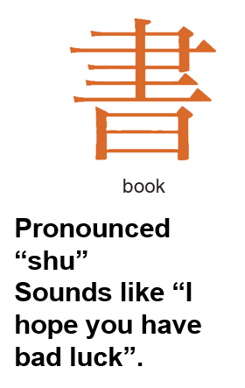
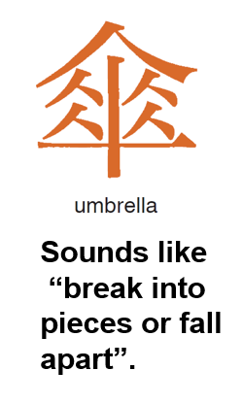
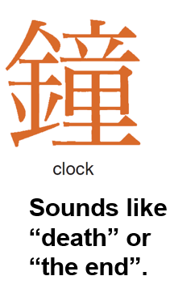
Language and Communication (2 of 3)
In China, it is bad luck to give these three items.
Notes:
Westerners must pay close attention not only to what they hear but also what they see when conducting business in other countries.

Slide 21
American Football in Chinese

Slide 22
Pronunciation Problems
Colgate in Spanish means “go hang yourself”
I K E A hired linguists to rename products in Thailand because they had sexual connotations
Whirlpool spent large sums on advertising only to find out that French, Italian & German consumers could not pronounce the brand name
Diesel brand name was chosen because it is pronounced the same in all languages

Slide 23
Cell Phones & Texting
In Korea, certain number combinations have special meanings
8282 (Paul Yi Pal Yi) sounds like “hurry up”
7179 (Chil Han Chil Han) = ”close friend”
4 5683 968 = I Love You

Slide 24
Language and Communication (3 of 3)
English Around the Globe
More people speak English as a 2nd language than there are native speakers
85% of E U teens study English
Sony (Japan) & Nokia (Finland) require upper managers to pass a proficiency test
Nonverbal Communication
In the Middle East, Westerners should not show the soles of shoes or pass documents with the left hand
In Japan, bowing has many nuances
Asians place greater value on nonverbal communication than Westerners

Slide 25
Marketing’s Impact on Culture
Universal aspects of the cultural environment represent opportunities to standardize elements of a marketing program
Increasing travel and improved communications have contributed to a convergence of tastes and preferences in a number of product categories
Notes:
The astute global marketer often discovers that much of the apparent cultural diversity in the world turns out to be different ways of accomplishing the same thing. Widespread shared preference for convenience foods, disposable products, popular music, and movies in the United States, Europe, and Asia suggests that many consumer products have broad, even universal, appeal. The cultural change and the globalization of culture have been capitalized upon, and even significantly accelerated, by companies that have seized opportunities to find customers around the world.

Slide 26
McDonaldization of Culture (1 of 2)
Many people resent the breaking down of cultural barriers that occurs when global firms expand into new markets.
“Eating is at the heart of most cultures and for many it is something on which much time, attention and money are lavished. In attempting to alter the way people eat, McDonaldization poses a profound threat to the entire cultural complex of many societies.”
Sociologist George Ritzer
Notes:
Fabien Ouaki is living proof that persons outside of academe and government have also joined the battle against McDonaldization. Ouaki is the managing director of Tati, a discount retailer based in France. Ouaki is opening new stores in select countries, including the United States. Ouaki claims that “personal revenge” is one motivation for entering the U.S. market. “As a Frenchman, it makes me sick to see kids crying to go see ‘Titanic,’ eat at McDonald’s, or drink Coke. I want to see New Yorkers crying to have a Tati wedding dress,” he said. Similarly, the international Slow Food movement boasts 70,000 members in dozens of countries. Slow Food grew out of a 1986 protest over the opening of a McDonald’s on a popular plaza in Rome; every two years, Slow Food stages a Salone del Gusto in Italy that showcases traditional food preparation. As a spokesperson said, “Slow Food is about the idea that things should not taste the same everywhere.” In 2008, Slow Food U.S.A. attracted 60,000 people to an event in San Francisco that featured a farmers’ market and a speakers’ series called “Food for Thought”.

Slide 27
McDonaldization of Culture (2 of 2)
The Slow Food Movement
Notes:
Fabien Ouaki is living proof that persons outside of academe and government have also joined the battle against McDonaldization. Ouaki is the managing director of Tati, a discount retailer based in France. Ouaki is opening new stores in select countries, including the United States. Ouaki claims that “personal revenge” is one motivation for entering the U.S. market. “As a Frenchman, it makes me sick to see kids crying to go see ‘Titanic,’ eat at McDonald’s, or drink Coke. I want to see New Yorkers crying to have a Tati wedding dress,” he said. Similarly, the international Slow Food movement boasts 70,000 members in dozens of countries. Slow Food grew out of a 1986 protest over the opening of a McDonald’s on a popular plaza in Rome; every two years, Slow Food stages a Salone del Gusto in Italy that showcases traditional food preparation. As a spokesperson said, “Slow Food is about the idea that things should not taste the same everywhere.” In 2008, Slow Food U.S.A. attracted 60,000 people to an event in San Francisco that featured a farmers’ market and a speakers’ series called “Food for Thought”.

Slide 28
High-and Low-Context Cultures
High Context
Information resides in context
Emphasis on background, basic values, societal status
Less emphasis on legal paperwork
Focus on personal reputation
Saudi Arabia, Japan
Low Context
Messages are explicit and specific
Words carry all information
Reliance on legal paperwork
Focus on non-personal documentation of credibility
Switzerland, U.S., Germany
Notes:
Japan, Saudi Arabia, and other high-context cultures place a great deal of emphasis on a person’s values and position or place in society. In such cultures, a business loan is more likely to be based on “who you are” than on formal analysis of pro forma financial documents. In a low-context culture such as the United States, Switzerland, or Germany, deals are made with much less information about the character, background, and values of the participants. Much more reliance is placed upon the words and numbers in the loan application. Similarly, Japanese companies such as Sony traditionally paid a great deal of attention to the university background of a new hire; preference would be given to graduates of Tokyo University. Specific elements on a resume were less important.
Insisting on competitive bidding can cause complications in low-context cultures. In a high-context culture, the job is given to the person who will do the best work and whom you can trust and control. In a low-context culture, one tries to make the specifications so precise that a builder is forced by the threat of legal sanction to do a good job.

Slide 29
Table 4-1: High-and Low-Context Cultures
Factors or Dimensions | High Context | Low Context
Lawyers | Less important | Very important
A person’s word | Is his or her bond | Is not to be relied upon; “get it in writing”
Responsibility for organizational error | Taken by highest level | Pushed to lowest level
Space | People breathe on each other | People maintain a bubble of private space and resent intrusions
Time | Polychromic-everything in life must be dealt with in terms of its own time | Monochronic-time is money; linear-one thing at a time
Negotiations | Are lengthy- a major purpose is to allow the parties to get to know each other | Proceed quickly
Competitive bidding | Infrequent | Common
Country or regional examples | Japan, Middle East | United States, Northern Europe
Notes:
In a high-context culture, a person’s word is his or her bond. There is less need to anticipate contingencies and provide for external legal sanctions because the culture emphasizes obligations and trust as important values. In these cultures, shared feelings of obligation and honor take the place of impersonal legal sanctions. This helps explain the importance of long and protracted negotiations that never seem to get to the point. Part of the purpose of negotiating, for a person from a high-context culture, is to get to know the potential partner.
For example, insisting on competitive bidding can cause complications in low-context cultures. In a high-context culture, the job is given to the person who will do the best work and whom one can trust and control. In a low-context culture, one tries to make the specifications so precise that the threat of legal sanction forces a builder, for example, to do a good job. As Hall has noted, a builder in Japan is likely to say, “What has that piece of paper got to do with the situation? If we can’t trust each other enough to go ahead without it, why bother?”
Although countries can be classified as high or low context in their overall tendency, there are exceptions to the general tendency. These exceptions are found in subcultures. The United States is a low-context culture with subcultures that operate in the high-context mode. The world of the central banker, for example, is a “gentleman’s” world; that is, a high-context culture. Even during the most hectic day of trading in the foreign exchange markets, a central banker’s word is sufficient for him or her to borrow millions of dollars. In a high-context culture there is trust, a sense of fair play, and a widespread acceptance of the rules of the game as it is played.

Slide 30
Hofstede’s Cultural Typology
Individualism/Collectivism
Power Distance
Uncertainty Avoidance
Achievement/Nuturing
Long-term Orientation
Notes:
Hofstede is well-known for research studies of social values suggesting that the cultures of different nations can be compared in terms of five dimensions. Hofstede notes that three of the dimensions refer to expected social behavior, the fourth dimension is concerned with “man’s search for truth,” and a fifth reflects the importance of time.
The first dimension, is a reflection of the degree to which individuals in a society are integrated into groups. In individualist cultures, each member of society is primarily concerned with his or her own interest and those of the immediate family. In collectivist cultures, all of society’s members are integrated into cohesive in-groups.
The second dimension power distance, is the extent to which the less powerful members of a society accept—even expect—power to be distributed unequally.
Uncertainty avoidance is the extent to which the members of a society are uncomfortable with unclear, ambiguous, or unstructured situations.
Achievement, the fourth dimension, describes a society in which men are expected to be assertive, competitive, and concerned with material success and women fulfill the role of nurturer and are concerned with issues such as the welfare of children. Nurturing, by contrast, describes a society in which the social roles of men and women overlap, with neither gender exhibiting overly ambitious or competitive behavior. Japan and Austria rank highest in masculinity; Spain, Taiwan, the Netherlands, and the Scandinavian countries are among the lowest.
Long-term orientation–People look to the future and value thrift and persistence
Short-term orientation–People value tradition and the past

Slide 31
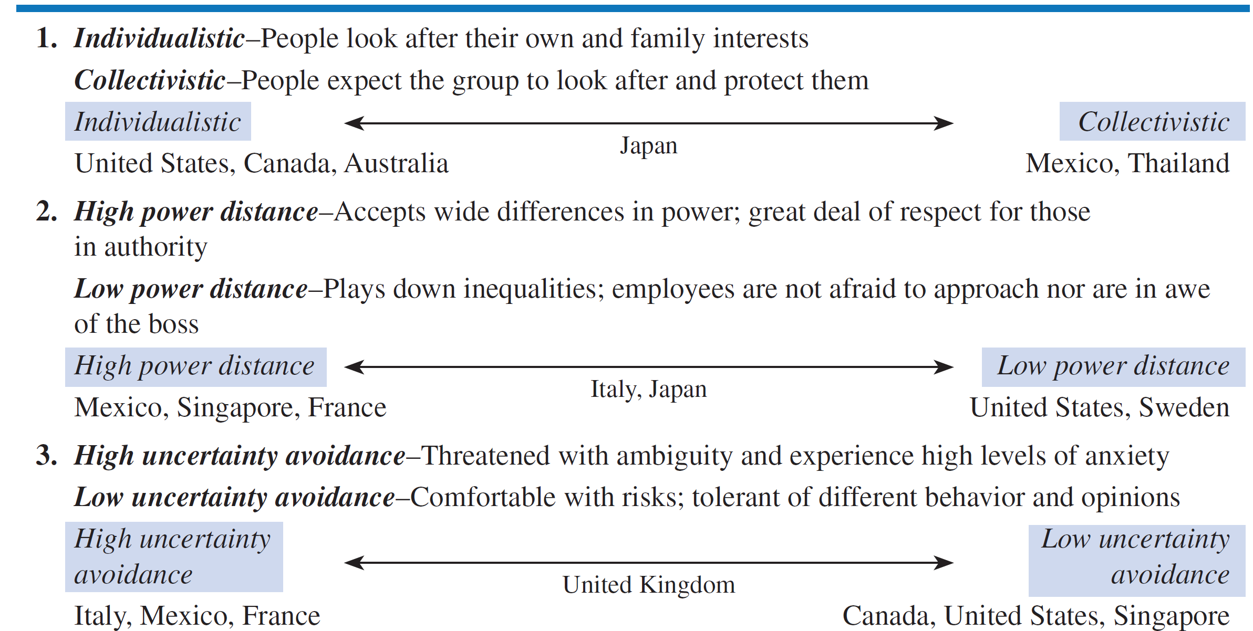
Hofstede’s Five Dimensions of National Culture (1 of 2)

Slide 32
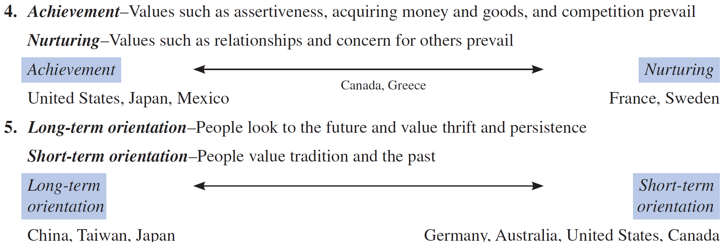
Hofstede’s Five Dimensions of National Culture (2 of 2)

Slide 33
Self-Reference Criterion and Perception
Unconscious reference to one’s own cultural values; creates cultural myopia
How to Reduce Cultural Myopia:
Define the problem or goal in terms of home country cultural traits
Define the problem in terms of host-country cultural traits; make no value judgments
Isolate the S R C influence and examine it
Redefine the problem without the S R C influence and solve for the host country situation
Notes:
The lesson that the SRC teaches is that a vital, critical skill of the global marketer is unbiased perception, the ability to see what is so in a culture. Although this skill is as valuable at home as it is abroad, it is critical to the global marketer because of the widespread tendency toward ethnocentrism and use of the self-reference criterion. The SRC can be a powerful negative force in global business, and forgetting to check for it can lead to misunderstanding and failure.
How might the European Disneyland been different if Disney executives had used the four-step approach?
Step 1. Disney executives believe there is virtually unlimited demand for American cultural exports around the world. Evidence includes the success of McDonald’s, Coca-Cola, Hollywood movies, and American rock music. Disney has a stellar track record in exporting its American management system and business style. Tokyo Disneyland, a virtual carbon copy of the park in Anaheim, California, has been a runaway success. Disney policies prohibit sale or consumption of alcohol inside its theme parks.
Step 2. Europeans in general and the French in particular are sensitive about American cultural imperialism. Consuming wine with the midday meal is a long-established custom. Europeans have their own real castles, and many popular Disney characters come from European folk tales.
Step 3. The significant differences revealed by comparing the findings in steps 1 and 2 suggest strongly that the needs upon which the American and Japanese Disney theme parks were based did not exist in France. A modification of this design was needed for European success.
Step 4. This would require the design of a theme park that is more in keeping with French and European cultural norms. Allow the French to put their own identity on the park.

Slide 34
Disney in France & Tokyo & the Self-Reference Criterion (1 of 2)
Unlimited demand for American culture. Tokyo a huge success. No alcohol in parks.
Europeans, especially the French, are sensitive about American cultural imperialism. Disney characters are based on European folk tales. Real castles here!
Compare Steps 1 & 2. American & Japanese conditions are different. Modify design for European success.
Redesign the theme park in keeping with European cultural norms; allow the French to put their identify on the park.

Slide 35
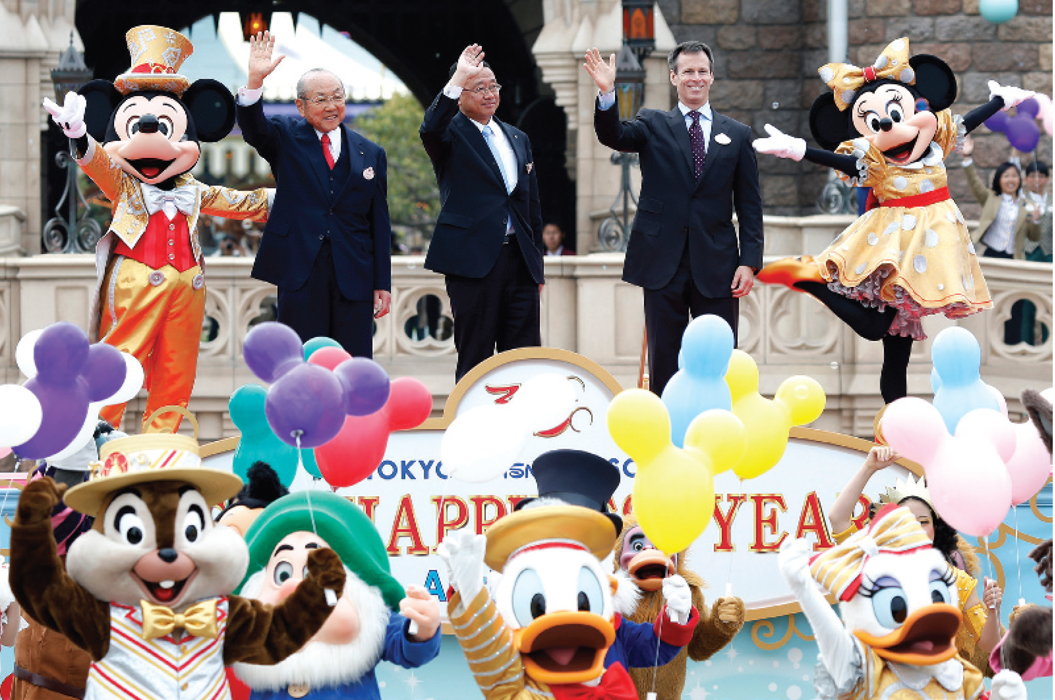
Disney in France & Tokyo & the Self-Reference Criterion (2 of 2)

Slide 36
Diffusion Theory: The Adoption Process
The mental stages through which an individual passes from the time of his or her first knowledge of an innovation to the time of product adoption or purchase
Awareness
Interest
Evaluation
Trial
Adoption
Notes:
In Diffusion of Innovation (1962) Everett Rogers described three concepts that describe the process by which an individual adopts a new idea: the adoption process, characteristics of innovations, and adopter categories. “New” means different things. A product already introduced in one market may be an innovation in another one. Products may be innovations in one market yet mature or declining in others.
1. Awareness. In the first stage the customer becomes aware for the first time of the product or innovation. An important early communication objective in global marketing is to create awareness of a new product through general exposure to advertising messages. Impersonal sources of information are most important at this stage.
2. Interest. During this stage, the customer is interested enough to learn more. The customer has focused his or her attention on communications relating to the product and will engage in research activities and seek out additional information.
3. Evaluation. In this stage the individual mentally assesses the product’s benefits in relation to present and anticipated future needs and, based on this judgment, decides whether or not to try it.
4. Trial. Most customers will not purchase expensive products without the “hands-on” experience marketers call “trial.” A good example of a product trial that does not involve purchase is the automobile test drive. For inexpensive consumer packaged goods, trial often involves actual purchase or the distribution of free samples.
5. Adoption. At this point, the individual either makes an initial purchase (in the case of the more expensive product) or continues to purchase—adopts and exhibits brand loyalty to—the less expensive product.

Slide 37
Diffusion Theory: Characteristics of Innovations (1 of 2)
Innovation is something new; five factors that affect the rate at which innovations are adopted include:
Relative advantage : How the product compares with existing ones
Compatibility: The extent to which a product is consistent with existing values and past experiences of adopters
Complexity: The degree to which an innovation or new product is difficult to understand and use.
Notes:
1. Relative advantage: How a new product compares with existing products or methods in the eyes of customers. The perceived relative advantage of a new product versus existing products is a major influence on the rate of adoption. If a product has a substantial relative advantage vis-à-vis the competition, it is likely to gain quick acceptance. Ex: compact discs vs. vinyl records.
2. Compatibility: The extent to which a product is consistent with existing values and past experiences of adopters. The history of innovations in international marketing is replete with failures caused by the lack of compatibility of new products in the target market. Ex.: VCR’s—Betamax and VHS.
3. Complexity: The degree to which an innovation or new product is difficult to understand and use. Product complexity is a factor that can slow down the rate of adoption, particularly in developing country markets with low rates of literacy. In the 1990s, dozens of global companies were developing new interactive multimedia consumer electronics products. Complexity is a key design issue; it is a standing joke that in most households, VCR clocks flash 12:00 because users don’t know how to set them. To achieve mass success, new products will have to be as simple to use as slipping a prerecorded videocassette into a VCR.
4. Divisibility: The ability of a product to be tried and used on a limited basis without great expense. Wide discrepancies in income levels around the globe result in major differences in preferred purchase quantities, serving sizes, and product portions. U.S.-size jars of Hellman’s Mayonnaise did not sell in South America. Less expensive, no refrigeration required, plastic packets were a hit.
5. Communicability. The degree to which benefits of an innovation or the value of a product may be communicated to a potential market. A new digital cassette recorder from Philips was a market failure, in part because advertisements did not clearly communicate the fact that the product could make CD-quality recordings using new cassette technology while still playing older analog tapes.

Slide 38
Diffusion Theory: Characteristics of Innovations (2 of 2)
Divisibility: The ability of a product to be tried and used on a limited basis
Communicability: The degree to which benefits of an innovation or the value of a product may be communicated to a potential market
Notes:
1. Relative advantage: How a new product compares with existing products or methods in the eyes of customers. The perceived relative advantage of a new product versus existing products is a major influence on the rate of adoption. If a product has a substantial relative advantage vis-à-vis the competition, it is likely to gain quick acceptance. Ex: compact discs vs. vinyl records.
2. Compatibility: The extent to which a product is consistent with existing values and past experiences of adopters. The history of innovations in international marketing is replete with failures caused by the lack of compatibility of new products in the target market. Ex.: VCR’s—Betamax and VHS.
3. Complexity: The degree to which an innovation or new product is difficult to understand and use. Product complexity is a factor that can slow down the rate of adoption, particularly in developing country markets with low rates of literacy. In the 1990s, dozens of global companies were developing new interactive multimedia consumer electronics products. Complexity is a key design issue; it is a standing joke that in most households, VCR clocks flash 12:00 because users don’t know how to set them. To achieve mass success, new products will have to be as simple to use as slipping a prerecorded videocassette into a VCR.
4. Divisibility: The ability of a product to be tried and used on a limited basis without great expense. Wide discrepancies in income levels around the globe result in major differences in preferred purchase quantities, serving sizes, and product portions. U.S.-size jars of Hellman’s Mayonnaise did not sell in South America. Less expensive, no refrigeration required, plastic packets were a hit.
5. Communicability. The degree to which benefits of an innovation or the value of a product may be communicated to a potential market. A new digital cassette recorder from Philips was a market failure, in part because advertisements did not clearly communicate the fact that the product could make CD-quality recordings using new cassette technology while still playing older analog tapes.

Slide 39
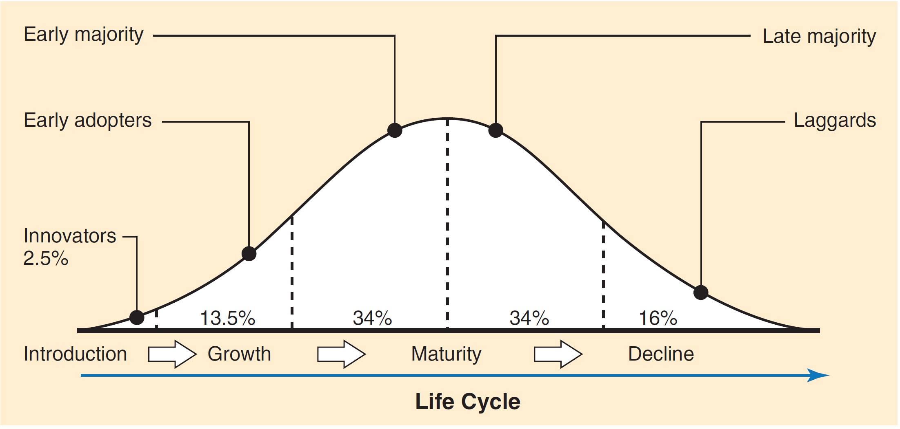
Diffusion Theory: Adopter Categories
Notes:
The first 2.5 percent of people to purchase a product are defined as innovators. The next 13.5 percent are early adopters, the next 34 percent are the early majority, the next 34 percent are the late majority, and the final 16 percent are laggards.
Innovators: These consumers tend to be venturesome, more cosmopolitan in their social relationships, and wealthier than those who adopt later.
Early adopters: Early adopters are the most influential people in their communities, even more than the innovators. Thus the early adopters are a critical group in the adoption process, and they have great influence on the early and late majority, who comprise the bulk of the adopters of any product. Several characteristics of early adopters stand out. First, they tend to be younger, with higher social status, and in a more favorable financial position than later adopters. They must be responsive to mass media information sources and must learn about innovations from these sources because they cannot simply copy the behavior of early adopters.

Slide 40
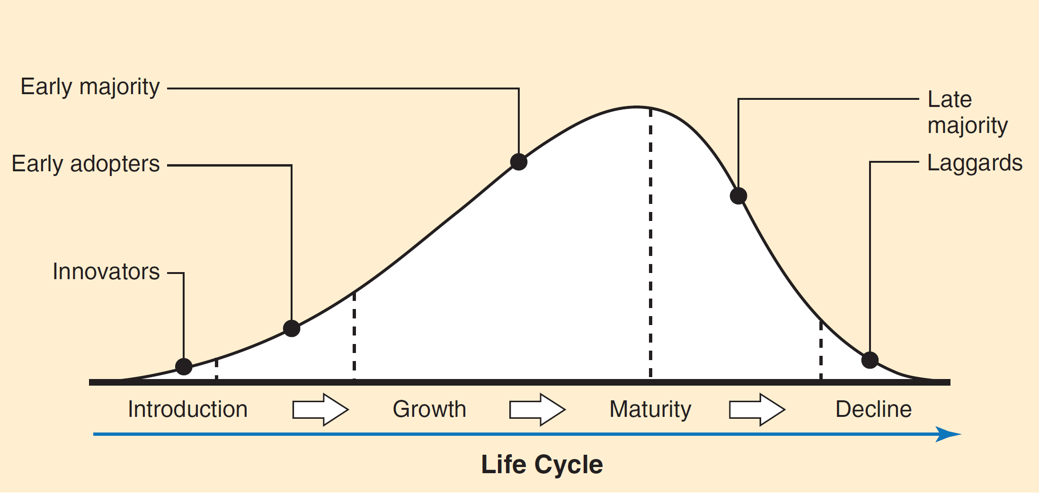
Asian Hierarchy
Notes:
There are likely to be fewer innovators in Japan and other Asian countries, where risk avoidance is high. However, once consumers become aware that others have tried the product, they follow suit quickly so as not to be left behind.

Slide 41
Marketing Implications of Social and Cultural Environments
Cultural factors must be considered when marketing consumer and industrial products
Environmental sensitivity reflects the extent to which products must be adapted to the culture-specific needs of different national markets
Notes:
Environmental sensitivity is a useful approach to view products because it places them on a continuum. At one end of the continuum are environmentally insensitive products that do not require significant adaptation to the environments of various world markets. At the other end of the continuum are products that are highly sensitive to different environmental factors. A company with environmentally insensitive products will spend relatively less time determining the specific and unique conditions of local markets because the product is basically universal. The greater a product’s environmental sensitivity, the greater the need for managers to address country-specific economic, regulatory, technological, social, and cultural environmental conditions. The next slide illustrates this concept.

Slide 42
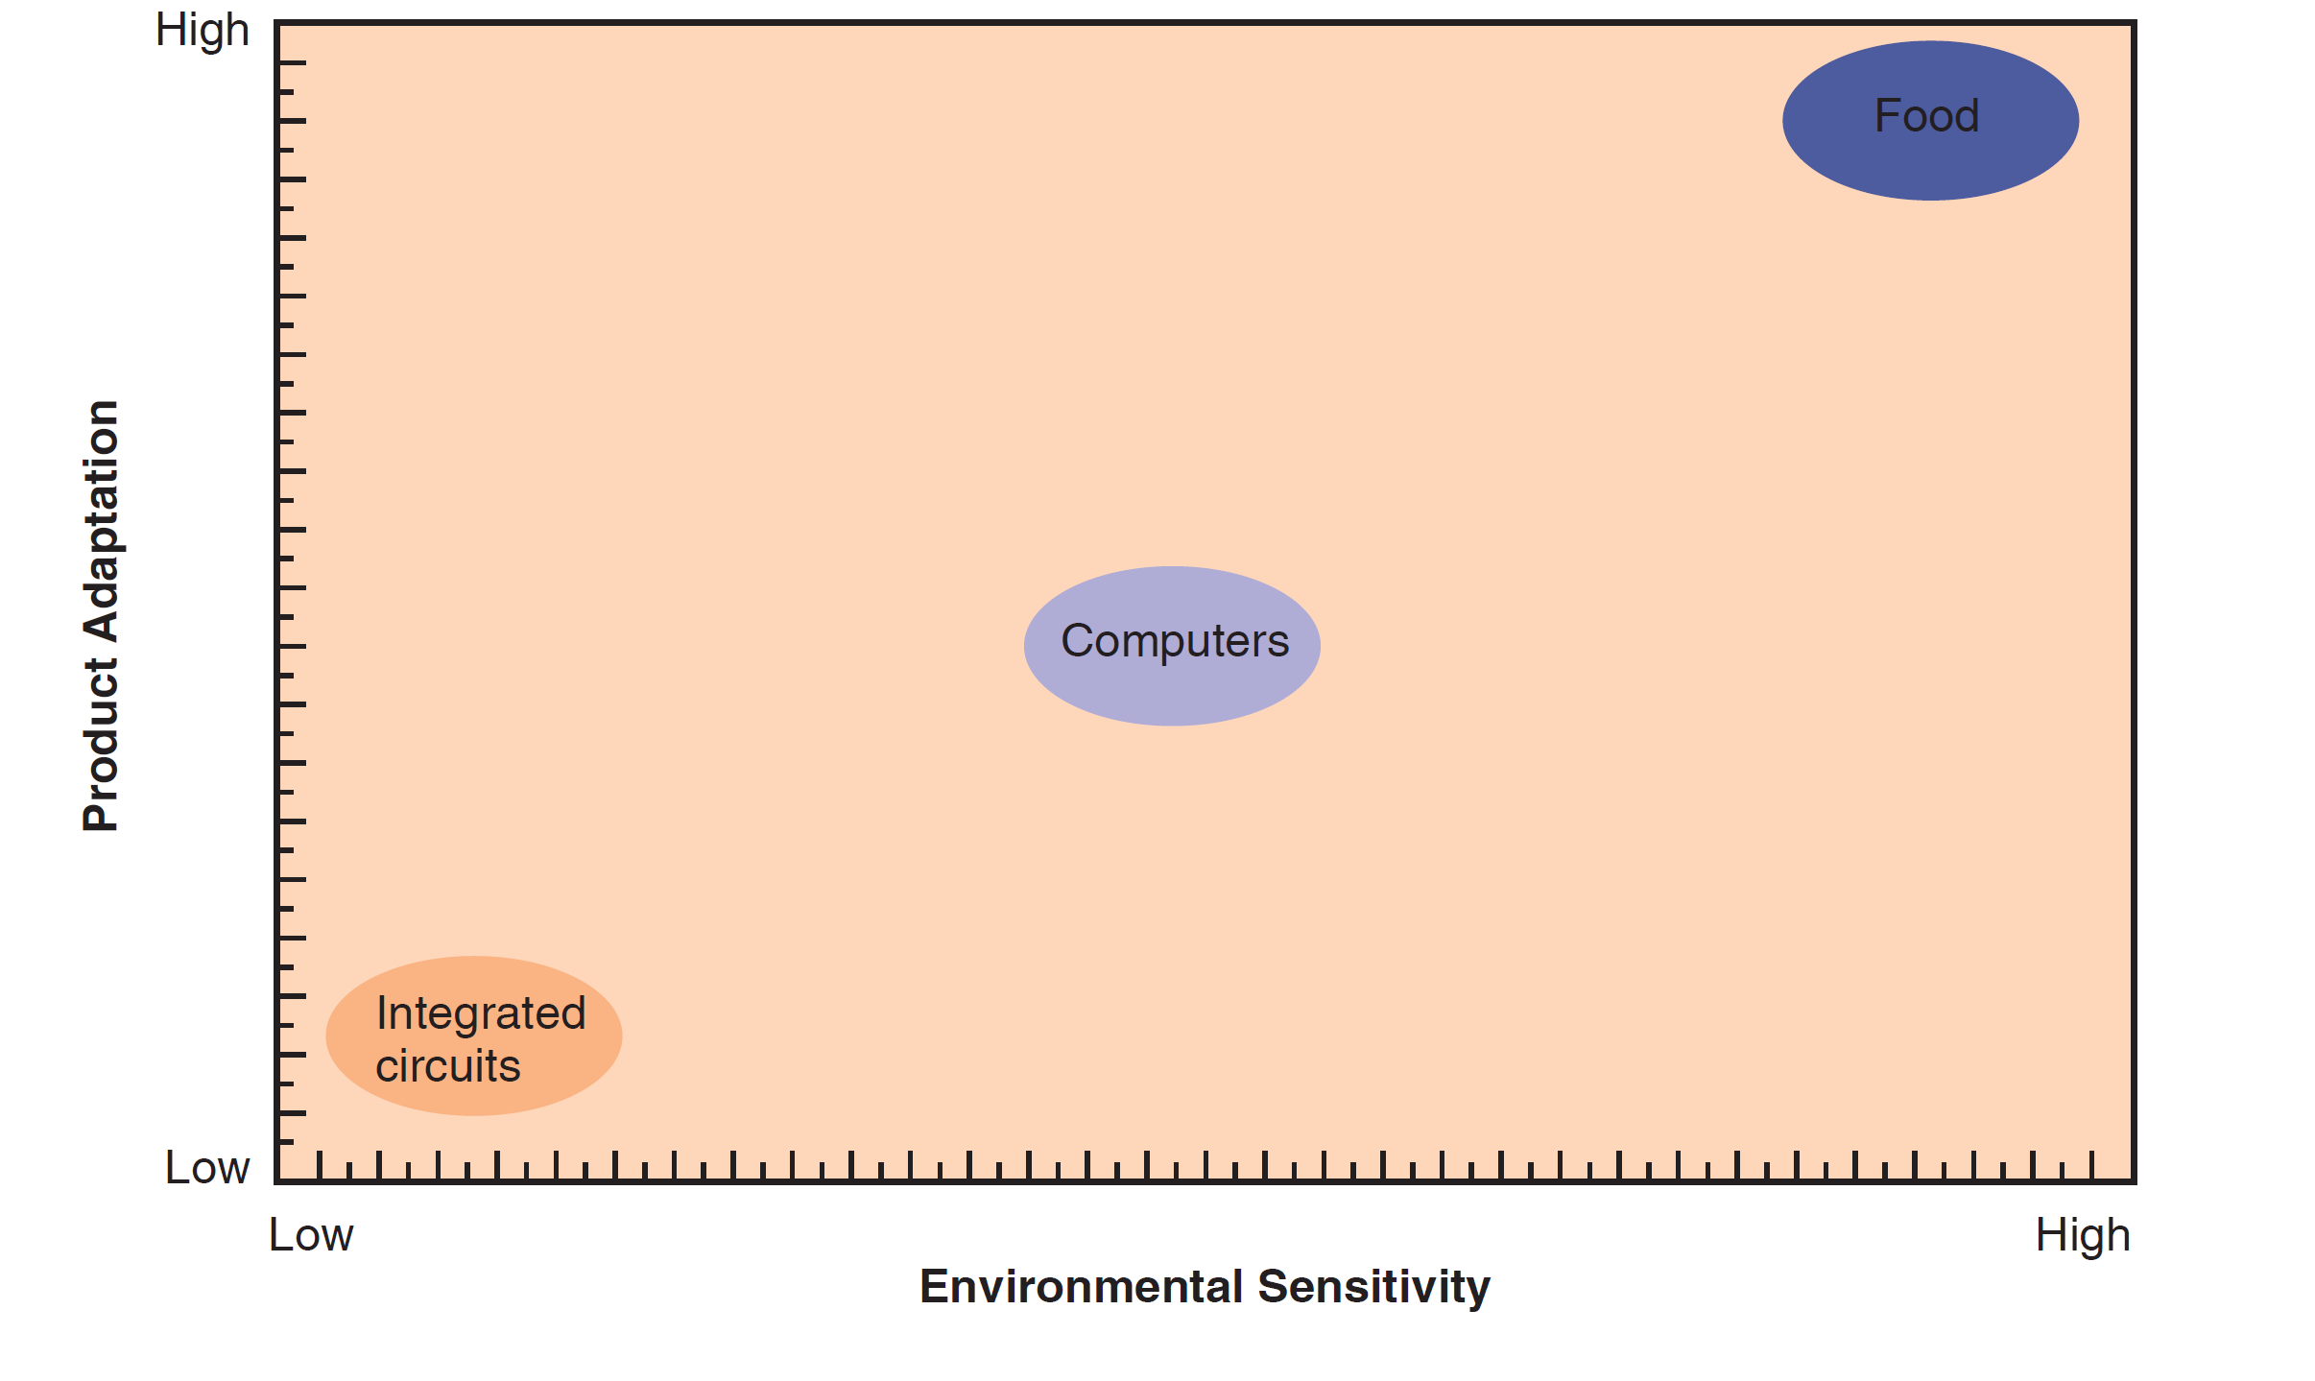
Environmental Sensitivity (1 of 2)
Notes:
The horizontal axis shows environmental sensitivity, the vertical axis the degree for product adaptation needed. Any product exhibiting low levels of environmental sensitivity—integrated circuits, for example—belongs in the lower left of the figure. Intel has sold more than 100 million microprocessors because a chip is a chip anywhere around the world. Moving to the right on the horizontal axis, the level of sensitivity increases, as does the amount of adaptation. Computers are characterized by moderate levels of environmental sensitivity; variations in country voltage requirements require some adaptation. In addition, the computer’s software documentation should be in the local language. At the upper right of Figure 4-3 are products with high environmental sensitivity. Food sometimes falls into this category because it is sensitive to climate and culture. As we saw in the McDonald’s case at the end of Chapter 1, the fast food giant has achieved great success outside the United States by adapting its menu items to local tastes. GE’s turbine generating equipment may also appear on the high sensitivity end of the continuum; in many countries, local equipment manufacturers receive preferential treatment when bidding on national projects.

Slide 43
Environmental Sensitivity (2 of 2)
Independent of social class and income, culture is a significant influence on consumption and purchasing
Food is the most culturally-sensitive category of consumer goods
Bottled water is a convenient alternative in countries where well or tap water may be contaminated. Bottled water consumption as tripled in India, doubled in China in the last five years
Starbucks overcame cultural barriers in Great Britain and today has over 800 locations
Notes:
In countries where water from the tap or well may be contaminated, bottled water is a convenient alternative. The fastest growth in the industry is occurring in developing countries; in the past five years, bottled water consumption has tripled in India and more than doubled in China. Many consumers also choose bottled water as an alternative to other beverage choices. However, the Earth Policy Institute and other groups view bottled water as an overpriced, wasteful extravagance. The International Bottled Water Association disagrees with that view. A spokesman said, “We’re an on-the-go society demanding convenient packaging and consistent quality, and that’s what bottled water provides.”
Coffee is a beverage category that illustrates the point. On the European continent, coffee has been consumed for centuries. By contrast, Britain has historically been a nation of tea drinkers, and the notion of afternoon tea is firmly entrenched in British culture. In the 1970s, tea outsold coffee by a ratio of 4-to-1. Brits who did drink coffee tended to buy it in instant form, because the preparation of instant is similar to that of tea. By the 1990s, however, Britain was experiencing an economic boom and an explosion of new nightclubs and restaurants. Trendy Londoners looking for a non-pub “third place” found it in the form of Seattle Coffee Company cafés. An instant success after the first store was opened by coffee-starved Americans in 1995, by 1998 Seattle Coffee had 65 locations around London. Starbucks bought the business from its founders for $84 million. Today, Starbucks has overcome the challenge of high real estate prices and has more than 800 locations in the United Kingdom.

Slide 44
Copyright

