Slide 1
Chapter 13 Services: The Intangible Product

Slide 2
Learning Objectives
Learning Objective 13.1 Describe how the marketing of services differs from the marketing of products.
Learning Objective 13.2 Discuss the four gaps in the Service Gaps Model.
Learning Objective 13.3 Examine the five service quality dimensions.
Learning Objective 13.4 Explain the zone of tolerance.
Learning Objective 13.5 Identify three service recovery strategies.
Notes:
LO13-1 Describe how the marketing of services differs from the marketing of products.
LO13-2 Discuss the four gaps in the Service Gaps Model.
LO13-3 Examine the five service quality dimensions.
LO13-4 Explain the zone of tolerance.
LO13-5 Identify three service recovery strategies.
These are the learning objectives for this chapter.

Slide 3
The Service Product Continuum
Most offerings lie somewhere in the middle
Jump to Appendix 1 long image description
Notes:
According to Theodore Levitt, all products are services.
Ask students: What does this statement mean? When you purchase products, do you also purchase the services associated with the product? Like what?

Slide 4
Economic Importance of Service
Production is cheaper in other countries
Developed economies are increasingly service
oriented economies
Household maintenance became more specialized
High value placed on convenience and leisure
Notes:
Remind students about how environments influence marketing. As economic, technological, and sociocultural environments change, so do demands for services.
Group activity: Examine some key changes in each of these environments that have led to greater demands for service.
Some potential responses include automation, women in the workplace, new trade realities, or shipping and transportation improvements.

Slide 5
Services Marketing Differs from Product Marketing
Notes:
This graph sets up the following discussion; if you wish to shorten this presentation, simply review these differences. The next slides go into greater detail.

Slide 6
Intangible
Requires using cues to aid customers
Atmosphere is important to convey value
Images are used to convey benefit of value
Notes:
As the title of this chapter implies, the most fundamental difference between a product and a service is that services are intangible—they cannot be touched, tasted, or seen like a pure product can. Consumers use cues to judge the service quality of dentists, including the quality of the furnishings, whether magazines are current, and diplomas on the wall.
Group activity: Think about the cues you use to assess the quality of a service. Choose a particular service (e.g., auto repair, medical care, insurance) and list several cues the provider could use to indicate quality.

Slide 7
Inseparable Production and Consumption
Production and consumption are simultaneous
Little opportunity to test a service before use
Lower risk by offering guarantees or warranties
http://www.youtube.com/watch?v=Set-r53xvBI
Notes:
Services are produced and consumed at the same time; that is, service and consumption are inseparable. When staying at a hotel, you can’t test it out before you stay. Some hotels offer satisfaction guarantees to lower risk.
Ask students what other kinds of products they can’t try before purchasing. Some of them might say delivery, in which case it is funny to show this YouTube ad. The ad (always check links before class) is for FedEx and was one of their most popular Super Bowl ads.
YouTube link: http://www.youtube.com/watch?v=Set-r53xvBI

Slide 8
Heterogeneous
Technology
Training
Automation
Notes:
The more humans are needed to provide a service, the more likely there is to be heterogeneity or variability in the service’s quality.
Many students work in service professions. Ask students: How have your employers attempted to reduce service heterogeneity? Do these programs work? What else could your employer do to reduce heterogeneity?

Slide 9
PROGRESS CHECK (1 of 3)
What are the four marketing elements that distinguish services from products?
Why can’t we separate firms into just service or just product sellers?
Notes:
Services are intangible, inseparable, variable, and perishable.
Many of them are a blend and fall within the product-service continuum

Slide 10
The Knowledge Gap: Understanding Customer Expectations
Marketing research: understanding customers
The Knowledge Gap
Understanding customer expectations
Evaluating service quality
Notes:
Many doctors believe they should be evaluated on the basis of their credentials and find consumers’ interest in wait times, friendliness of staff, and waiting room décor frustrating. Ask students: What can doctors do to close this knowledge gap?

Slide 11
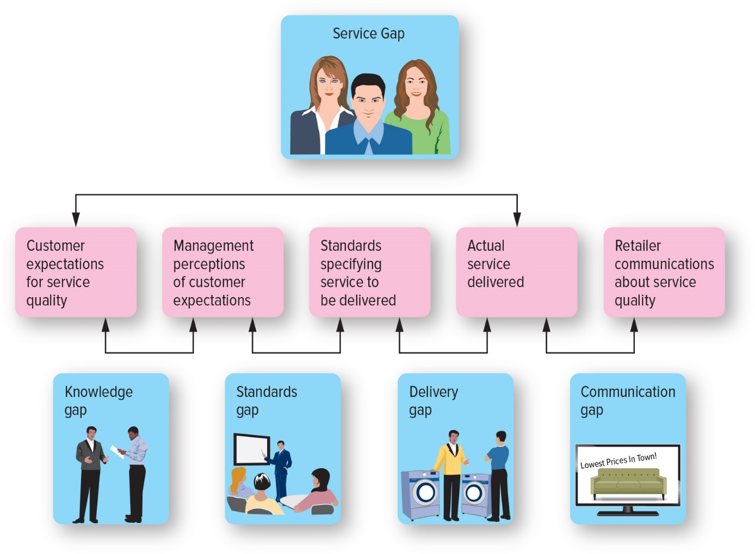
Providing Great Service: The Gaps Model
Sources: Adapted from Valarie Zeithaml, A. Parasuraman, and Leonard Berry, Delivering Quality Customer Service (New York: The Free Press, 1990); and Valarie Zeithaml, Leonard Berry, and A. Parasuraman, “Communication and Control Processes in the Delivery of Service Quality,” Journal of Marketing 52, no. 2 (April 1988), pp. 35–48.
Jump to Appendix 2 long image description
Notes:
This slide sets up the discussion that follows and can be used as the basis for a shorter discussion.

Slide 12
Understanding Customer Expectations
Expectations are based on knowledge and experience
Expectations vary according to type of service
Expectations vary depending on the situation
Notes:
Ask students: What are your expectations of the service provided by these two businesses? Will there be price differences? In what circumstances would you stay at each property?

Slide 13
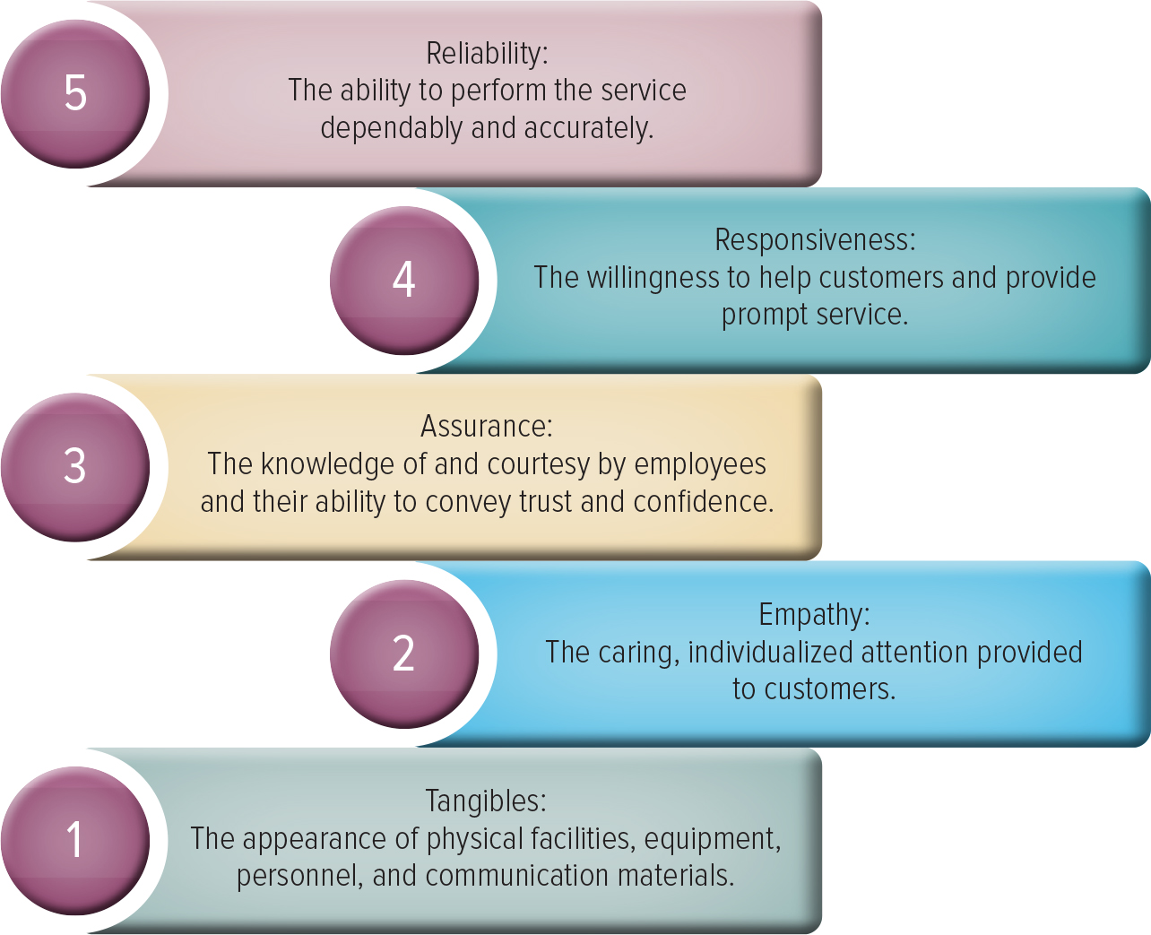
Evaluating Service Quality
Jump to Appendix 3 long image description
Notes:
Class activity. Tell students: Assume you are expecting an important package from UPS. A delivery attempt was made, but you didn't hear the door bell, and missed it. You call the customer service line and they tell you not to worry, and that one of your options is to pick up the package at the terminal that evening. You tell them that you need the package before noon. So, they arrange for you to meet the delivery truck close to your house. You are delighted when you spot the clean brown UPS truck exactly where it is supposed to be. The friendly driver greets you by name, gets your package and you are on your way.
Ask the students: Which of the service building blocks of customer service applies to each aspect of this scenario?

Slide 14
The Standards Gap: Setting Service Standards
Setting standards for quality
Developing systems to ensure high-quality service
Notes:
Quality service requires constant investments in training and monitoring. Similar to any other strategic element, service quality flows from the top down. Rewards and incentives must be in place to support service quality commitments.
Ask students: What types of incentives work best to make service employees buy into their firm’s service standards?
Some will say good working conditions and salaries and others might mention contests and prizes.

Slide 15
The Delivery Gap: Delivering Service Quality
Empowering employees
Reduce delivery gaps
Provide support & incentives
Use of technology
Notes:
This slide sets up the following discussion, which you may omit if you prefer to focus just on these dimensions.

Slide 16
The Communications Gap: Communicating the Service Promise
Manage customer expectations
Promise only what you can deliver
Communicate service expectations
J.D. Power & Associates
Getty Images
Notes:
Many people have never stayed in a five-star hotel, but they know what level of service quality they expect. Often, such expectations develop in response to the promises made in promotional materials provided by the firm. Many firms overpromise and underdeliver; Southwest Airlines attributes its success to underpromising and overdelivering instead.
This web link is for J.D. Power and Associates. Clicking through will show you the different industries that they rate, many of them service industries. Ask students what it means for a company to win this. How should they use this in their communications?

Slide 17
PROGRESS CHECK (2 of 3)
Explain the four service gaps identified by the Service Gaps Model.
List at least two ways to overcome each of the four service gaps.
Notes:
Answer to both questions:
The knowledge gap reflects the difference between customers’ expectations and the firm’s perception of those customer expectations. Firms can understand consumer expectations and evaluate service quality.
The standards gap pertains to the difference between the firm’s perceptions of customers’ expectations and the service standards it sets. Firms can set appropriate service standards and measure service performance.
The delivery gap is the difference between the firm’s service standards and the actual service it provides to customers. This gap can be closed by getting employees to meet or exceed service standards by providing incentives and support.
The communications gap refers to the difference between the actual service provided to customers and the service that the firm’s promotion program promises. If firms are more realistic about the services they can provide and manage customer expectations effectively, they generally can close this gap.

Slide 18
Service Recovery
Resolve problems quickly
Listen to the customer
Provide a fair solution
Increase Service Recovery
Notes:
This slide sets up the following discussion and can be used instead of the more detailed discussion that follows.

Slide 19
PROGRESS CHECK (3 of 3)
Why is service recovery so important to companies?
What can companies do to recover from a service failure?
Notes:
Despite a firm’s best efforts, sometimes service providers fail to meet customer expectations. Effective service recovery efforts can significantly increase customer satisfaction, purchase intentions, and positive word of mouth, though customers’ postrecovery satisfaction levels usually fall lower than their satisfaction level prior to the service failure.
Distributive Fairness and Procedural Fairness

Slide 20
Glossary

Slide 21
Glossary-1
The communications gap refers to the difference between the actual service provided to customers and the service that the firm’s promotion program promises.
Return to slide
Notes:
The communications gap refers to the difference between the actual service provided to customers and the service that the firm’s promotion program promises.

Slide 22
Glossary-2
The delivery gap is the difference between the firm’s service standards and the actual service it provides to customers.
Return to slide
Notes:
The delivery gap is the difference between the firm’s service standards and the actual service it provides to customers.

Slide 23
Glossary-3
The knowledge gap reflects the difference between customers’ expectations and the firm’s perception of those customer expectations.
Return to slide
Notes:
The knowledge gap reflects the difference between customers’ expectations and the firm’s perception of those customer expectations.

Slide 24
Glossary-4
A service is any intangible offering that involves a deed, performance, or effort that cannot be physically possessed.
Return to slide
Notes:
A service is any intangible offering that involves a deed, performance, or effort that cannot be physically possessed.

Slide 25
Glossary-5
Service quality is the customers’ perceptions of how well a service meets or exceeds their expectations.
Return to slide
Notes:
Service quality is the customers’ perceptions of how well a service meets or exceeds their expectations.

Slide 26
Glossary-6
The standards gap is the difference between the firm’s perceptions of customers’ expectations and the service standards it sets.
Return to slide
Notes:
The standards gap is the difference between the firm’s service standards and the actual service it provides to customers.

Slide 27
Glossary-7
A voice-of-customer (VOC) program collects customer inputs and integrates them into managerial decisions.
Return to slide
Notes:
A voice-of-customer (VOC) program collects customer inputs and integrates them into managerial decisions.

Slide 28
Glossary-8
A zone of tolerance is the area between customers’ expectations regarding their desired service and the minimum level of acceptable service.
Return to slide

Slide 29
Image Descriptions Appendix

Slide 30
Appendix 1 The Service Product Continuum
In order from service dominant to product dominant: doctor, hotel, dry cleaners, restaurant, apparel specialty store, grocery store.
Return to slide

Slide 31
Appendix 2 Providing Great Service: The Gaps Model
A service gap is the difference between customer expectations for service quality and the actual service delivered. There are four service gaps.
The knowledge gap reflects the difference between customer expectations for service quality and management perception of customer expectations.
The standards gap pertains to the difference between management perception of customer expectations and standards specifying the service to be delivered.
The delivery gap is the difference between standards specifying the service to be delivered and the actual service delivered.
The communication gap refers to the difference between the actual service delivered and retailer communications about service quality.
Return to slide

Slide 32
Appendix 3 Evaluating Service Quality
The first building block of service quality is tangibles, which is the appearance of physical facilities, equipment, personnel, and communication materials
The second building block of service quality is empathy, which is the caring, individualized attention provided to customers.
The third building block of service quality is assurance, which is the knowledge of and courtesy by employees and their ability to convey trust and confidence.
The fourth building block of service quality is responsiveness, which is the willingness to help customers and provide prompt service.
The fifth building block of service quality is reliability, the ability to perform the service dependably and accurately.
Return to slide

Slide 33
Marketing Chapter 13
The End
The End

