Slide 1
Chapter 7 Business-to-Business Marketing

Slide 2
Learning Objectives
Learning Objective 7.1 Describe the ways in which business-to-business (B2B) firms segment their markets.
Learning Objective 7.2 List the steps in the B2B buying process.
Learning Objective 7.3 Identify the different roles within the buying center.
Learning Objective 7.4 Describe the different types of organizational cultures.
Learning Objective 7.5 Detail different buying situations.
Notes:
LO7-1 Describe the ways in which business-to-business (B2B) firms segment their markets.
LO7-2 List the steps in the B2B buying process.
LO7-3 Identify the roles within the buying center.
LO7-4 Describe the different types of organizational cultures.
LO7-5 Detail different buying situations.
These are the learning objectives guiding the chapter and will be explored in more detail in the following slides.

Slide 3
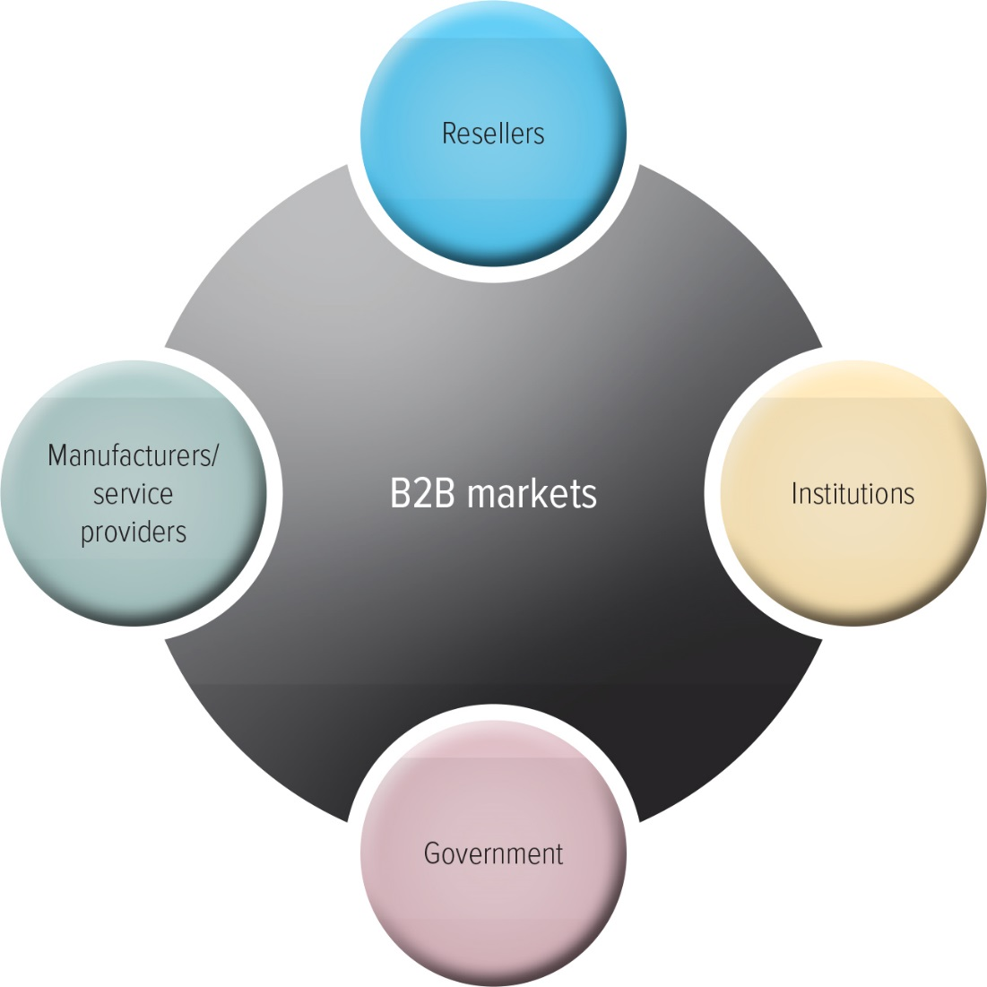
B2B Marketing
U.S. Census Bureau
Notes:
Students must understand the distinction between B2B and B2C. A wide range of businesses participate in B2B transactions.
This weblink is to the census page which contains all the details on the North American Industry Classification System—the government’s method of classifying business activity.
Website: http://www.census.gov/eos/www/naics/

Slide 4
Manufacturers and Service Providers
Buy raw materials, components, or parts
Manufacture their own goods
https://www.youtube.com/watch?v=aKYsOA2ge_A
Car Culture/Getty Images
Notes:
When a company like Burt’s Bees buys raw materials to make their products, it is a B2B purchase. When they sell the products to the retailer it is a B2B purchase. When the retailer sells the product to the end consumer it is a B2C purchase.
Tradeshows are common for B2B selling and allow manufacturers to see new raw materials and for resellers to see new products.
Ask students if they have attended any B2B tradeshows. If so, what typically happens, what is the environment, and what did they learn at the show?
Video link: https://www.youtube.com/watch?v=aKYsOA2ge_A

Slide 5
Resellers
Manufacturer
Reseller
Retailer
Notes:
Resellers perform an essential service: They aggregate goods from manufacturers and sell them to retailers or, in the case of retailers, they sell them to consumers. Thus, one reseller can represent many different manufacturers, which saves the manufacturers the trouble of finding retailers or consumers and gives retailers or consumers the ability to buy only the desired quantity from the reseller.

Slide 6
Institutions
Schools, Museums, and Religious Organizations
Textbooks
B2B relationships to purchase capital construction, equipment, supplies, food, and janitorial services
Notes:
Group activity: Have students consider their university as a purchasing institution. What types of products and services must universities purchase?

Slide 7
Government
The U.S. Government spends $4 trillion annually on procuring goods and services.
State and local governments also make significant purchases.
Firms specialize in selling to government.
Notes:
Many firms sell exclusively to government entities and therefore are adept at meeting the unique needs of governmental buyers. For example, firms in the defense industry generally sell exclusively to governments.

Slide 8
PROGRESS CHECK (1 of 4)
What are the various B2B markets?
Notes:
Resellers, Institutions, Government, Manufacturers/Service providers

Slide 9
B2B Buying Process
Jump to Appendix 1 long image description
Notes:
Although B2B and B2C buying processes are similar, this chapter highlights some key differences.

Slide 10
Stage 1: Need Recognition
Can be generated internally or externally
Sources for recognizing new needs:
Suppliers
Salespeople
Competitors
Notes:
Just like the consumer buying process, the B2B process begins with need recognition. Needs arise from a variety of sources.
For example, a salesperson from firm A attends a trade show and visits firm B’s booth, which features a demonstration of a new sorting process. Although firm A had been looking for ways to improve its efficiency, it had not yet considered the possibility of sorting efficiencies.

Slide 11
Stage 2: Product Specifications
Used by suppliers to develop proposals
Can be done collaboratively with suppliers
Notes:
Not only do RFPs enable the buyer to solicit pricing and other information from a variety of suppliers, but they also allow suppliers to learn about the buyer and its specific needs.

Slide 12
Stage 3: RFP Process (Request for Proposal)
Purchasing company may simply post its RFP needs on its website or work through various B2B web portals or inform their preferred vendors directly.
Federal Business
Opportunities website
©Toyota Motor Engineering & Manufacturing North America, Inc.
Notes:
RFPs enable the buyer to solicit pricing and other information from a variety of suppliers and they also allow suppliers to learn about the buyer and its specific needs.
The web link on this page brings you to the Fed BizOpps site, which exists for any firm that wishes to bid on government contracts.
Potential suppliers can view the products/services being sought.
Website: https://www.fbo.gov/index?cck=1&au=&ck=

Slide 13
Step 4: Proposal Analysis, Vendor Negotiation, and Selection
Often several vendors are negotiating against each other.
Considerations other than price play a role in final selection.
Notes:
Firms apply different strategies for vendor selection: Some always choose the lowest price, whereas others apply more complicated selection criteria. The government uses preferred contractor programs, designed to offer small and minority-owned firms greater opportunity.

Slide 14
Step 5: Order Specification
Firm places the order.
The exact details of the purchase are specified.
All terms are detailed including payment.
Notes:
After a vendor is chosen, terms of the contract still need to be negotiated. When these terms have been agreed upon, the contract can be signed.

Slide 15
Step 6: Vendor Performance Assessment Using Metrics
(1) Key Issues | (2) Importance Score | (3) Vendor’s Performance | (4) Importance x Performance (2) x (3)
Customer Service | .40 | 5 | 2.0
Issue Resolution | .20 | 4 | 0.8
Delivery | .10 | 5 | 0.5
Quality | .30 | 3 | 0.9
Total | 1.00 |  | 4.2
Notes:
After the vendor has performed the service or delivered the order, the buyer conducts a vendor analysis to judge whether the vendor should provide future purchases.

Slide 16
PROGRESS CHECK (2 of 4)
Identify the stages in the B2B buying process.
How do you perform a vendor analysis?
Notes:
Need recognition, Product specification, RFP process, Proposal analysis and supplier selection, Orders specification, Vendor/performance assessment using metrics
Vendor Analysis
The buying team develops a list of issues that it believes are important to consider in the evaluation of the vendor.
To determine how important each of these issues (in column 1) is, the buying team assigns an importance score to each (column 2). The more important the issue, the higher a score it will receive, but the importance scores must add up to.
In the third column, the buying team assigns numbers that reflect its judgments about how well the vendor performs.
To get the overall performance of the vendor, in the fourth column, the team combines the importance of each issue and the vendor’s performance scores by multiplying them together.

Slide 17
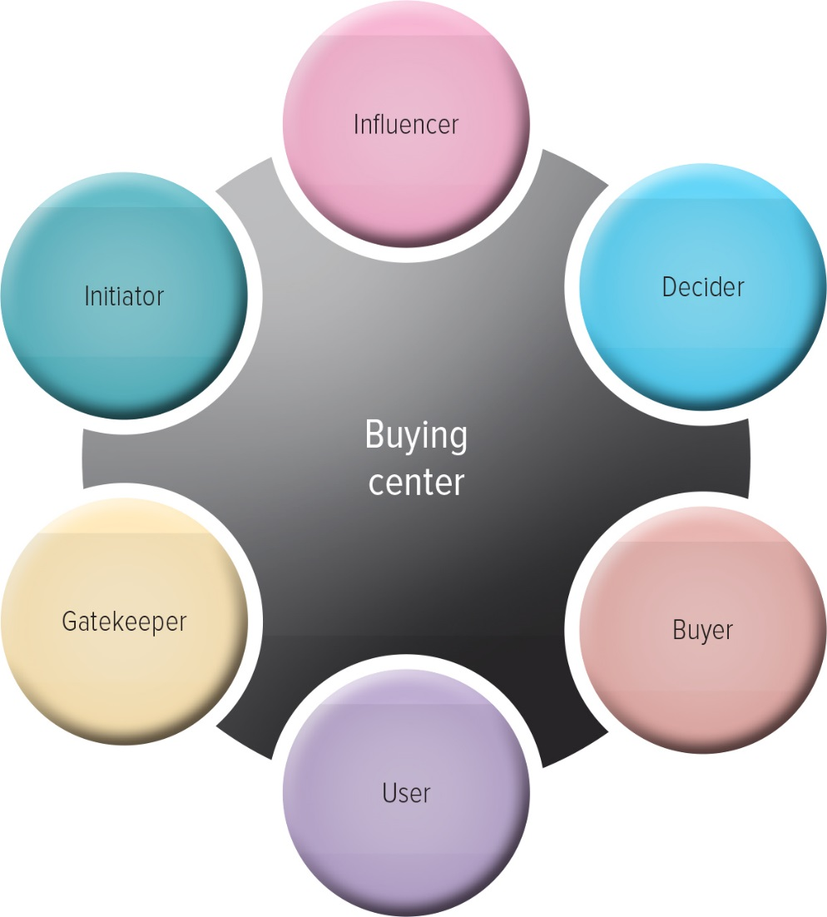
The Buying Center
Notes:
Group activity: Have the students diagram a purchase situation that involves all of these roles.
The book uses the example of a doctor/patient relationship, but many similar examples also exist.

Slide 18
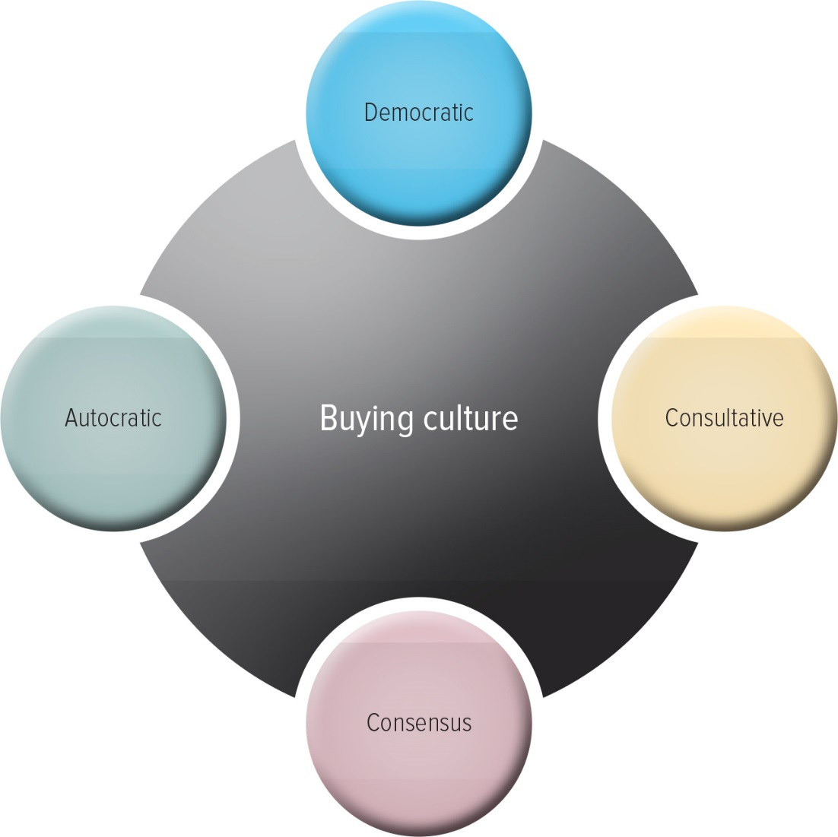
Organizational Culture
Notes:
Different firms assign different ultimate responsibility for purchase decisions. Even within a firm, different buying groups have unique buying styles. Marketers must understand the dynamics of the buying center to succeed.
Ask students: Assume your family or the household in which you live is a buying center. Is it autocratic, consultative, or consensus when making group buying decisions such as planning a vacation or shopping for groceries?

Slide 19
PROGRESS CHECK (3 of 4)
What are the six buying roles?
What are the types of cultures that exist in buying centers?
Notes:
1. Buying roles include:
(1) initiator, the person who first suggests buying the particular product or service
(2) influencer, person whose views influence other members of the buying center in making the final decision;
(3) decider, the person who ultimately determines any part of or the entire buying decision—whether to buy, what to buy, how to buy, or where to buy;
(4) buyer, the person who handles the paperwork of the actual purchase;
(5) user, the persons who consumes or uses the product or service; and
(6) gatekeeper, the persons who controls information or access, or both, to decision makers and influencers.”
2. autocratic, democratic, consultative, and consensus

Slide 20
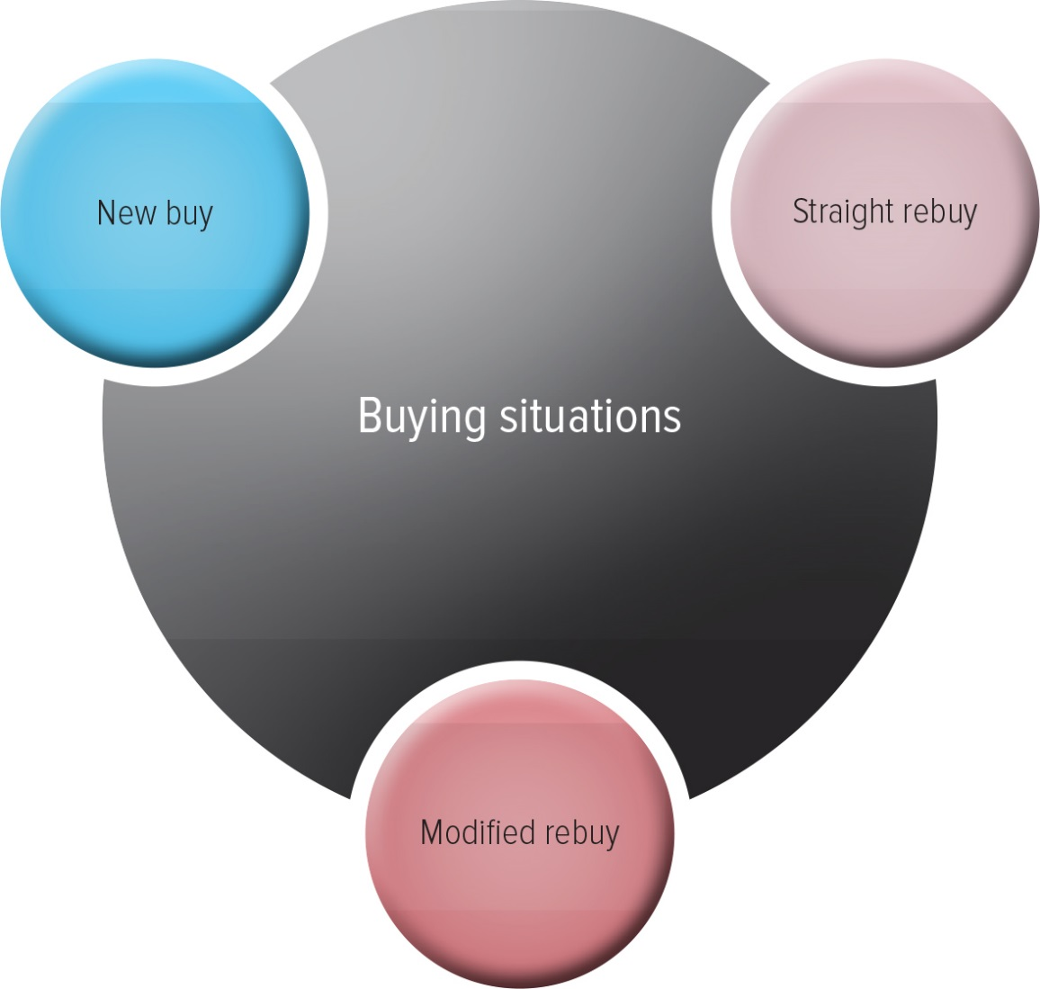
Buying Situations
Notes:
As in B2C, different B2B buying situations require different levels of effort and the involvement of various parties. The effort required by each situation varies.
Ask Students: Suppose you represented a private label manufacturer of women’s apparel that was selling to Target. Think about the differences in the three buying situations. Which would be the easiest option for the apparel salesperson to accomplish? Which would be the hardest? Why?

Slide 21
PROGRESS CHECK (4 of 4)
How do new buy, straight rebuy, and modified rebuy differ?
Notes:
A new buy is a situation in which a customer purchases a good or service for the first time, therefore likely being a more involved buying decision. In a rebuy, a buyer simply buys additional units of products that had previously been purchased. In a modified rebuy, the buyer decides to change some specifications in buying a product similar to one they bought in the past, such as the price, quality level, options, and so forth.

Slide 22
Glossary

Slide 23
Glossary-1
Business-to-business (B2B) marketing refers to the process of buying and selling goods or services to be used in the production of other goods and services, for consumption by the buying organization, and/or for resale by wholesalers and retailers.
Return to slide
Notes:
Business-to-business (B2B) marketing refers to the process of buying and selling goods or services to be used in the production of other goods and services, for consumption by the buying organization, and/or for resale by wholesalers and retailers.

Slide 24
Glossary-2
Buying center participants are people responsible for the buying decisions.
Return to slide
Notes:
Buying center participants are people responsible for the buying decisions.

Slide 25
Glossary-3
The request for proposals (RFP) is a process through which buying organizations invite alternative suppliers to bid on supplying their required components.
Return to slide
Notes:
The request for proposals (RFP) is a process through which buying organizations invite alternative suppliers to bid on supplying their required components.

Slide 26
Glossary-4
Resellers are marketing intermediaries that resell manufactured products without significantly altering their form.
Return to slide
Notes:
Resellers are marketing intermediaries that resell manufactured products without significantly altering their form.

Slide 27
Image Descriptions Appendix

Slide 28
Appendix 1 B2B Buying Process
The steps in the B2B buying process are need recognition, product specification, RFP process, proposal analysis and supplier specification, order specification, and vendor performance assessment using metrics.
Return to slide

Slide 29
Marketing Chapter 7
The End
The End

