Slide 1
Chapter 3 Social and Mobile Marketing

Slide 2
Learning Objectives
Learning Objective 3.1 Describe the 4E framework of social media marketing.
Learning Objective 3.2 Understand the drivers of social media engagement.
Learning Objective 3.3 Understand the types of social media.
Learning Objective 3.4 Understand various motivations for using mobile applications and how they are priced.
Learning Objective 3.5 Recognize and understand the three components of a social media strategy.
Notes:
LO3-1 Describe the 4E framework of social media marketing.
LO3-2 Understand the drivers of social media engagement
LO3-3 Understand the types of social media.
LO3-4 Understand various motivations for using mobile applications and how they are priced.
LO3-5 Recognize and understand the three components of a social media strategy.
These are the learning objectives guiding the chapter and will be explored in more detail in the following slides.

Slide 3
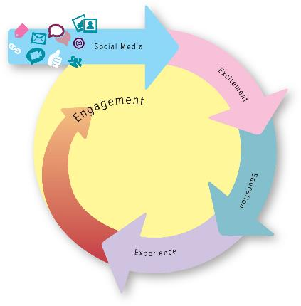
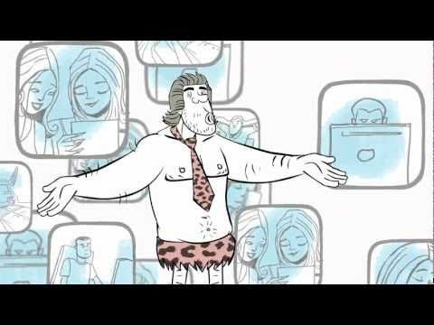
The 4E Framework For Social Media
http://www.youtube.com/watch?v=ah8aHIsAJfc
Notes:
This is an overview of the 4E framework, which will be discussed in greater depth. Ask students to choose a product and ask them to describe the 4Es for that product.
How effective is this video at educating employees on the use of social media? What else should EMC tell their employees? Is this sufficient training, or should they also have a written portion?
YouTube link: http://www.youtube.com/watch?v=ah8aHIsAJfc

Slide 4
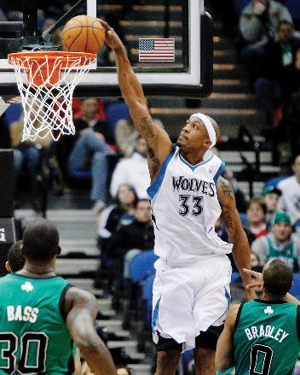
Excite the Customer
Offer must be relevant to its targeted customer.
Relevancy can be achieved by providing personalized offers.
© Genevieve Ross/AP Images
Notes:
To excite customers, an offer must be relevant to its targeted customer. Relevancy can be achieved by providing personalized offers, which are determined through insights and information obtained from customer relationship management and/or loyalty programs.
Ask students what social networks like Facebook or Google+ do to excite them. How is it important to them?

Slide 5
Educate the Customer
Golden opportunity:
Product’s value proposition and offered benefits
Notes:
Marketers must take advantage of the opportunity to educate potential customers about its value proposition and communicate the offered benefits. Social media marketing needs to be well-designed to ensure that this happens.

Slide 6
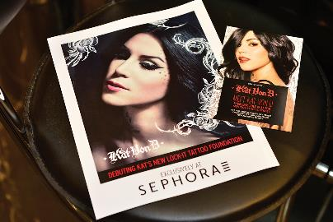
Experience the Product or Service
Information about a firm’s goods and services.
Simulating real experiences.
© Steve Jennings/Getty Images
Notes:
One of a website’s most useful contributions may be the vivid information it provides about a firm’s goods and services—how they work, how to use them, and where they can be obtained.
Ask students how often they use YouTube to find demonstrations of how to use products or services.

Slide 7
Engage the Customer
Action, loyalty, and commitment
Positively engaged consumers lead to more profitability.
Engagement can also backfire.
©Dave Carroll.
Notes:
By encouraging the use of social media tools such as blogging and micro-blogging, firms ensure that customers actively engage with the firm’s products, services, and their own social networks. Positively engaged consumers tend to be more profitable consumers, purchasing 20 to 40 percent more than less engaged customers. But negative engagement has the potential to be even more damaging than positive engagement is beneficial.

Slide 8
PROGRESS CHECK (1 of 2)
What are the 4 Es?
What social media elements work best for each of the 4 Es?
Notes:
Excite the Customer, Educate the Customer, Experience the Product or Service, Engage the Customer
Best social media elements:
Excite the Customer—social networks like Facebook and Google+
Educate the Customer—blogs and blogging tools (e.g., WordPress and Twitter), HubSpot (all-in-one marketing software), YouTube and Google+
Experience the Product or Service—YouTube, blogs, and retailer’s website
Engage the Customer—blogging and micro-blogging

Slide 9
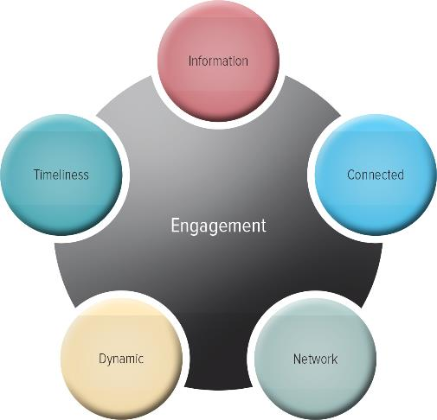
The Wheel of Social Media Engagement
Notes:
Firms work hard to engage customers, and social media provide them with unique abilities to target and participate in dynamic conversations with individual customers, leading to excellent returns on their investments in social media efforts.

Slide 10
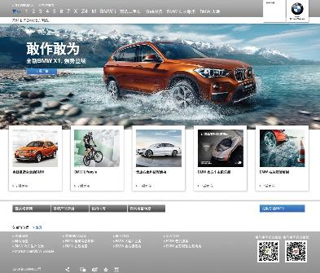
The Information Effect
Outcome in which relevant information is spread by firms or individuals to other members of the social network
Source: BMW Group China
Notes:
Information—whether because it is funny, cute, instructive, surprising, or interesting—is the key to turning the wheel. But the relevance of the information, and therefore its impact, depends on its context and the receiver. Marketers work hard to provide information that is somehow contextually relevant, such as interjecting a humorous advertisement into a social network of users who like to joke around and share funny pictures.
For example, BMW gained in-depth information about visitors to a popular Chinese social media site. Using those data, which included income and prior purchase behaviors, it determined which visitors were likely to be luxury car buyers and targeted advertising at them. That sounds great, except that other visitors, who were not targeted, protested vehemently. By not showing them luxury car ads, they asserted, the car brand and the social media site combined to make them feel like “losers.”

Slide 11
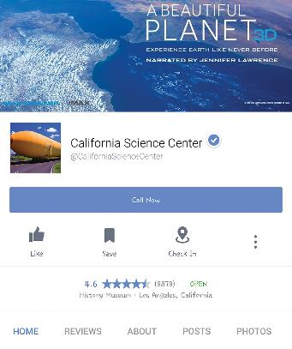
The Connected Effect
Outcome that satisfies humans’ innate need to connect with other people
© Tashauna Johnson Photography/Photoedit
Notes:
This connection in social media is bidirectional: People learn what their friends are interested in, but they also broadcast their own interests and opinions to those friends. Humans seek connections to other people, and social media have provided them with a new, easy, and engaging way to do so.

Slide 12
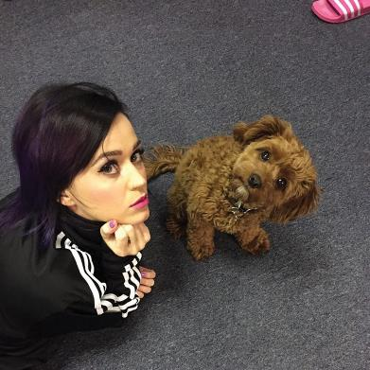
The Network Effect
Outcome in which every post is spread instantaneously across social media
© Photoshot
Notes:
The network effect is the outcome of social media engagement in which every time a firm or person posts information, it is transferred to the poster’s vast connections across social media, causing the information to spread instantaneously.
One way companies can extend their network effects is by paying celebrities or pseudo-celebrities with large followings (i.e., bigger networks), hiring them to write posts about or upload pictures with their products. CoverGirl may have fewer than 2,000 Twitter followers, but one of its CoverGirls, Katy Perry, has more than 80 million. If Katy Perry tweets a closeup of her eyelashes, lengthened using her favorite CoverGirl mascara, CoverGirl will have instantly reached all her millions of followers.

Slide 13
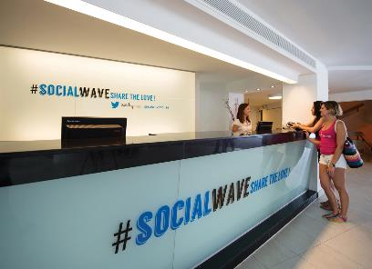
The Dynamic Effect
Information is exchanged to network participants through back-and-forth communications.
Examines how people flow in and out of networked communities as their interests change.
© Ignacio Izquierdo/Rex Features/AP Photo
Notes:
The impact of the dynamic effect of social media engagement is twofold. First it describes the way in which information is exchanged to network participants through back-and-forth communications in an active and effective manner. Second, the dynamic effect expands the impact of the network effect by examining how people flow in and out of networked communities as their interests change.

Slide 14
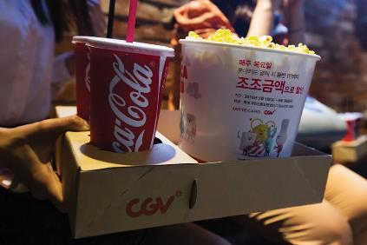
The Timeliness Effect
Firms must engage with the customer at the right place and time
© SeongJoon Cho/Bloomberg/Getty Images
Notes:
The timeliness effect of social media engagement is concerned with the firm being able to engage with the customer at the right place and time—that is, 24/7 from any location. To be effective, firms must, in fact, respond quickly, or the timeliness effect benefit diminishes.
To reach customers at the right time, Coca-Cola relies on beacon technology—that is, technology that allows companies to detect where customers (who have enabled the feature) are at each moment, through their smartphones. In 2015, Coca-Cola’s pilot campaign offered moviegoers a free Coke at the moment they walked through the movie house if they had already downloaded the appropriate app from the brand.

Slide 15
PROGRESS CHECK (2 of 3)
What are the five drivers of social media engagement described in the Wheel of Social Media Engagement?
Notes:
The information effect, the connected effect, the network effect, the dynamic effect, and the timeliness effect

Slide 16
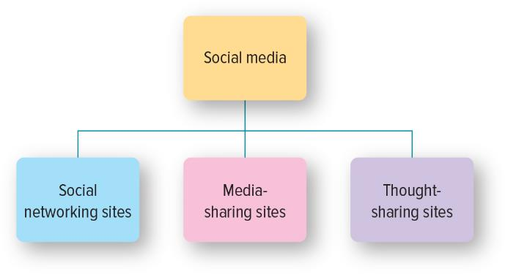
Categories of Social Media
Notes:
The audience for marketers could be bigger on social media sites than through other, more traditional forms of media.
Ask students: Are all your real-life friends your online friends too?
Ask students: Do you actually know all the people you are “friends” with on social media?

Slide 17
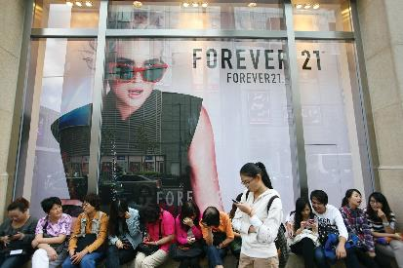
Social Network Sites
Excellent way for marketers to create excitement
Facebook
LinkedIn
Google+
© Weng lei - Imaginechina via AP Images
Notes:
People can interact with friends (e.g., Facebook) or business acquaintances (e.g., LinkedIn). Although the amount of time people spend on such sites varies, research indicates they are widely used—between one and four hours every day.

Slide 18
Media-Sharing Sites
Highlight how consumers can experience
Encourage consumers to engage
© John Boud/Alamy
Notes:
The World Wide Web has the ability to connect people more easily and in more ways than have ever been possible before. Media-sharing sites explicitly rely on this capability to enable users to share content they have generated, from videos on YouTube to pictures on Flickr and so on. In terms of the 4E framework, companies use such sites to highlight how consumers can experience their goods or services as well as encourage consumers to engage with the firm, its other social media outlets, and other consumers.

Slide 19
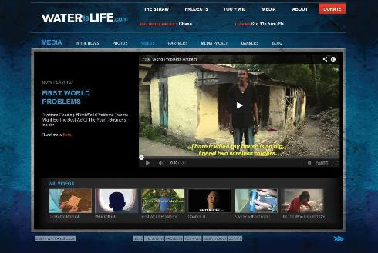
Thought-Sharing Sites
Blogs
Corporate blogs
Professional blogs
Personal blogs
Microblogs
Twitter
Courtesy of WATERisLIFE
Notes:
Thought-sharing sites consist of different types of blogs: corporate, professional, personal, and micro. In terms of the 4E framework, blogs are particularly effective at educating and engaging users, and in many cases enhance their experience with the products and services being discussed.
As the name implies, a microblog differs from a traditional blog in size—short sentences, short videos, or individual images. Twitter provides another option for companies to educate their customers by providing corporate and product information, and to engage them by providing a platform for two-way communications.

Slide 20
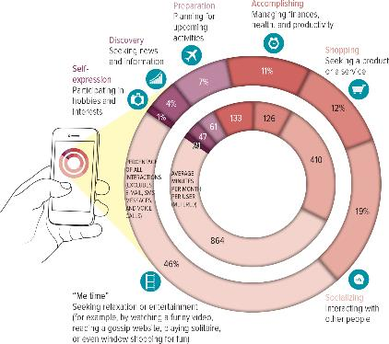
Going Mobile and Social
Need for Me Time
Need to Socialize
Need to Shop
Need to Accomplish
Need to Prepare
Need to Discover
Need to Self-Express
Jump to Appendix 1 long image description
Notes:
Of the more than 184 million people who have smartphones in the United States, approximately 60 percent of them make purchases on these devices. Thus, mobile marketing is significant and growing. There are seven primary needs that apps meet: the need to find “me time,” socialize, shop, accomplish, prepare, discover, and self-express.

Slide 21
App Pricing Models
Ad-supported apps
Freemium apps
Paid apps
Notes:
A key decision for firms producing apps is what to charge for them.
Ask students: How often do you pay out-of-pocket for apps? How much are you willing to pay?

Slide 22
PROGRESS CHECK (3 of 3)
What are the seven types of customer motivations for using mobile apps?
What are the four options to price mobile apps?
What are some of the most popular types of mobile applications?
Notes:
Need for me time, need to socialize, need to shop, need to accomplish, need to prepare, need to discover, and need to self-express
Ad-supported apps, freemium apps, paid apps, and paid apps with in-app purchases.
Navigation, productivity, books, education, news, entertainment, music, newsstand, social networking, and games

Slide 23
Listening
Sentiment analysis
Attitudes
Preferences
©Stockbroker/Purestock/SuperStock.
Notes:
Scouring millions of sites with sentiment analysis techniques provides new insights into what consumers really think.
Ask students: What do you think marketers can discover about your attitudes and preferences if they search your personal social media sites?

Slide 24
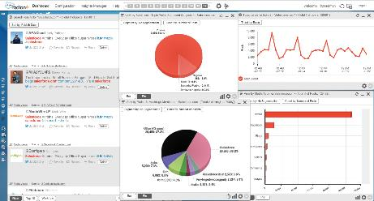
Analyzing
Hits
Page views
Bounce rate
Click paths
Conversion rates
Keyword analysis
© copyright salesforce.com, inc. Used with permission.
Notes:
There are three main categories of analysis used for understanding data collected from social media: (1) determine the amount of traffic using their sites, visiting blogs or tweeting, (2) learn who the visitors are, what they are doing, and what engages and excites them, and (3) analyze data that comes from other sites.

Slide 25
Analytics (1 of 2)
Type of Analytic | How It’s Used | Competitors Offering Similar Analytics
Content | Understand what’s popular and what’s not on a firm’s website, including page load times and site navigation | Adobe SiteCatlyst, Clickstream, Coremetrics, IBM SurfAid
Social | Track effectiveness of social media programs, including information on social media referred conversion rates and engagement metrics | Facebook Insights, Twitter Web Analytics, Webtrends
Mobile | Track website access from mobile devices, track which ads direct people to a firm’s app, understand what mobile platform performs best | Localytics, Medialets, Webtrends
Source: http://www.google.com/analytics/features/index.html.
Notes:
Google Analytics tracks the elements that are shown in the exhibit and is highly customizable.

Slide 26
Analytics (2 of 2)
Type of Analytic | How It’s Used | Competitors Offering Similar Analytics
Conversion | Moving beyond page views and visitor counts, conversion analytics measures sales, downloads, video plays, or any other action important to a firm | Clicktale, KeyMetric, Latitude
Advertising | Track the effectiveness of social, mobile, search and display ads, divide ad effectiveness by device, platform, or type | AdTech, MediaCloud, Metronome
Source: http://www.google.com/analytics/features/index.html.
Notes:
Google Analytics tracks the elements that are shown in the exhibit and is highly customizable.

Slide 27
How to Do a Social Media Marketing Campaign
Identify strategy goals
Target audience
Campaign: experiment and engage
Budget
Monitor and change
Notes:
A well-developed marketing strategy involves a host of social and mobile tools, working in conjunction with the firm’s traditional IMC tactics, to move the consumer up the purchase decision hierarchy from awareness to purchase to loyalty.
To illustrate how firms might go about undertaking such strategy, these are the steps involved in developing and implementing a Facebook marketing campaign.

Slide 28
Glossary

Slide 29
Glossary-1
Bounce rate – the percentage of times a visitor leaves the site almost immediately.
Return to slide
Notes:
Bounce rate – the percentage of times a visitor leaves the site almost immediately.

Slide 30
Glossary-2
Click paths – how users proceed through the information.
Return to slide
Notes:
Click paths – how users proceed through the information.

Slide 31
Glossary-3
Conversion rates – what percentage of visitors act as the marketer hopes.
Return to slide
Notes:
Conversion rates – what percentage of visitors act as the marketer hopes.

Slide 32
Glossary-4
Hits – total requests for a page.
Return to slide
Notes:
Hits – total requests for a page.

Slide 33
Glossary-5
Keyword analysis – what keywords people use to search on the Internet for their products and services.
Return to slide
Notes:
Keyword analysis – what keywords people use to search on the Internet for their products and services.

Slide 34
Glossary-6
Page views – the number of times any page gets viewed by any visitor.
Return to slide
Notes:
Page views – the number of times any pages gets viewed by any visitor.

Slide 35
Glossary-7
Sentiment analysis allows marketers to analyze data from these sources to collect consumer comments about companies and their products.
Return to slide
Notes:
Sentiment analysis allows marketers to analyze data from these sources to collect consumer comments about companies and their products.

Slide 36
Glossary-8
Social media refers to content distributed through online and mobile technologies to facilitate interpersonal interactions.
Return to slide
Notes:
Social media refers to content distributed through online and mobile technologies to facilitate interpersonal interactions.

Slide 37
Image Descriptions Appendix

Slide 38
Appendix 1 Going Mobile and Social
Self expression (Participating in hobbies and interests) – 1 percent of all interactions, 21 average minutes per month per user.
Discovery (Seeking news and information) – 4 percent of all interactions, 47 average minutes per month per user.
Preparation (Planning for upcoming activities) – 7 percent of all interactions, 61 average minutes per month per user.
Accomplishing (Managing finances, health and productivity) – 11 percent of all interactions, 133 average minutes per month per user.
Shopping (Seeking a product or service) – 12 percent of all interactions, 126 average minutes per month per user.
Socializing (Interacting with other people) – 19 percent of all interactions, 410 average minutes per month per user.
Me time (Seeking relaxation or entertainment (for example, by watching a funny video, reading a gossip website, playing solitaire, or even window shopping for fun) – 46 percent of all interactions, 864 average minutes per month per user.
Interactions exclude e-mail, SMS messages, and voice calls.
Return to slide

Slide 39
Marketing Chapter 3
The End
The End

