Slide 1
Chapter 2 Developing Marketing Strategies and a Marketing Plan

Slide 2
Learning Objectives
Learning Objective 2.1 Define a marketing strategy.
Learning Objective 2.2 Describe the elements of a marketing plan.
Learning Objective 2.3 Analyze a marketing situation using SWOT analyses.
Learning Objective 2.4 Describe how a firm chooses which consumer group(s) to pursue with its marketing efforts.
Learning Objective 2.5 Outline the implementation of the marketing mix as a means to increase customer value.
Learning Objective 2.6 Summarize portfolio analysis and its use to evaluate marketing performance.
Learning Objective 2.7 Describe how firms grow their business.
Notes:
LO2-1 Define a marketing strategy.
LO2-2 Describe the elements of a marketing plan.
LO2-3 Analyze a marketing situation using SWOT analyses.
LO2-4 Describe how a firm chooses which consumer group(s) to pursue with its marketing efforts.
LO2-5 Outline the implementation of the marketing mix as a means to increase customer value.
LO2-6 Summarize portfolio analysis and its use to evaluate marketing performance.
LO2-7 Describe how firms grow their business.
These are the learning objectives guiding the chapter and will be explored in more detail in the following slides.

Slide 3
Sustainable Competitive Advantage
Jump to Appendix 1 long image description
Notes:
This slide covers the four strategies to create and deliver value and a sustainable competitive advantage.
Ask students to think of companies who they are very loyal to in many categories (food, electronics, personal care). Is it the product, location, operational, or customer excellence that draws the student’s loyalty?

Slide 4
PROGRESS CHECK (1 of 3)
What are the various components of a marketing strategy?
List the four macro strategies that can help a firm develop a sustainable competitive advantage.
Notes:
1. Identifies a firm’s target market, related marketing mix — their four Ps — and the bases upon which the firm plans to build a sustainable competitive advantage.
2. Customer excellence, operational excellence, product excellence, locational excellence.

Slide 5
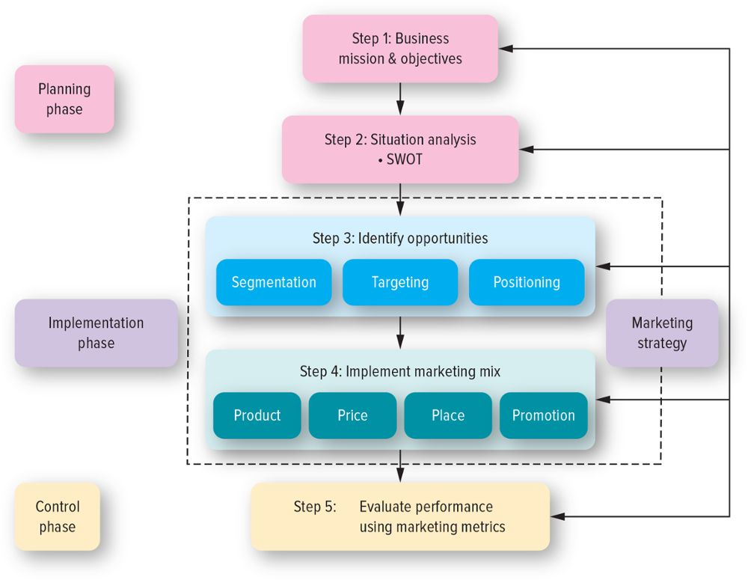
The Marketing Plan
Jump to Appendix 2 long image description
Notes:
Explain to students that the marketing plan should be a written plan yet many companies do not write it down. Ask students why companies tend to not write down marketing plans. The most likely answer is that they don’t take the time or haven’t organized the strategy.

Slide 6
Three Phases of a Strategic Plan
Planning
Implementing
Controlling
Notes:
A poorly executed plan leads to failure, regardless of how good or solid the plan may be. The world is full of good plans poorly executed. When initially introduced, diapers designed differently for boys and girls bombed because the market was not ready for the product; through improved execution, the diaper manufacturer ultimately found success. However, even well-executed plans require monitoring and updating, because the needs of any market constantly change.

Slide 7
Step 1: Define the Business Mission
PepsiCo’s Mission Statement:
“To provide consumers around the world with delicious, affordable, convenient and complementary foods and beverages from wholesome breakfasts to healthy and fun daytime snacks and beverages to evening treats.”
Coke’s Mission Statement:
“To refresh the world … To inspire moments of optimism and happiness … To create value and make a difference.”
Notes:
The mission statement, a broad description of a firm’s objectives and the scope of activities it plans to undertake, attempts to answer two main questions: What type of business are we? What do we need to do to accomplish our goals and objectives? PepsiCo’s Mission Statement emphasizes the global nature of its products, while Coke’s evokes emotions like happiness.
Group activity: Students should develop a mission statement for their school. The resultant mission statement would offer a good way to assess and set student expectations.

Slide 8
Step 2: Conduct a Situation Analysis (1 of 2)
 |  | Environment | Evaluation
 |  | Positive | Negative
Pepsi | Internal | Strengths Brand product portfolio Strong celebrity endorsers Dedication to charitable and social causes | Weakness Relatively lower brand awareness Water source for bottled water
 | External | Opportunity Emerging countries Health food segments Bottled water | Threats Water scarcity Changes to labeling regulations Increase competition
Notes:
A SWOT analysis is comprehensive, in that it offers both an internal and an external assessment. The firm therefore must possess expertise in both what the firm can provide and what the market wants the firm to provide. Consider how PepsiCo might conduct a SWOT analysis, as outlined in the table. We focus on PepsiCo here, but we also recognize that its marketing managers might find it helpful to perform parallel analyses for competitors, such as Coca-Cola.

Slide 9
Step 2: Conduct a Situation Analysis (2 of 2)
 |  | Environment | Evaluation
 |  | Positive | Negative
Coca-Cola | Internal | Strengths Very strong brand Strong global presence Excellent customer loyalty | Weakness Over-reliance on carbonated drinks Negative sugar-related publicity
 | External | Opportunity Emerging countries | Threats Water scarcity Potential market saturation Changes to labeling regulations
Notes:
Students can take a few minutes and fill in a SWOT analysis for their in-class exercise of building a marketing plan for their college.

Slide 10
Step 3: Identifying and Evaluating Opportunities Using STP
Segmentation
Targeting
Positioning
Courtesy The Hertz Corporation
Notes:
After completing the situation analysis, the next step is to identify and evaluate opportunities for increasing sales and profits using STP (segmentation, targeting, and positioning). With STP, the firm first divides the marketplace into subgroups or segments, determines which of those segments it should pursue or target, and finally decides how it should position its products and services to best meet the needs of those chosen targets.

Slide 11
Step 4: Implement Marketing Mix and Allocate Resources
Price
Value Capture
Product
Value Creation
Promotion Value Communication
Place
Value Delivery
Courtesy Bell Brands USA
Notes:
In the fourth step of the planning process, marketers implement the actual marketing mix—product, price, promotion, and place—for each product and service on the basis of what they believe their target markets will value. At the same time, marketers make important decisions about how they will allocate their scarce resources to their various products and services.

Slide 12
Product and Value Creation
Successful products and services are those that customers perceive as valuable enough to buy.
Source: Dyson, Inc.; © Stockbyte/PunchStock RF
Notes:
Because the key to the success of any marketing program is the creation of value, firms attempt to develop products and services that customers perceive as valuable enough to buy. Dyson fans and fan heaters draw in and redirect surrounding air without potentially dangerous or fast-spinning blades or visible heating elements. Although more expensive than conventional fans and space heaters, these sculpturally beautiful appliances are perceived by consumers to be a valuable alternative to products that haven’t significantly changed since the early 1900s.

Slide 13
Price and Value Capture
Price must allow for customers to perceive good value for the product they receive.
Notes:
It may be worth spending some time on value-based pricing. Show students two differently priced products from the same category and ask them which one they view as a better value and why. For example, a Rolex vs. a Timex watch. Or alternatively Aquafina vs. Perrier. Also explain that in this course, more discussion of value will be done throughout the semester.

Slide 14
Place and Value Delivery
The product must be readily accessible
Why is Sephora growing?
Notes:
Getting the product to consumers at the exact moment they desire it is difficult. Firms therefore are experimenting with different forms of distribution, such as vending machines for cell phones, to offer consumers 24/7 access to products. Staples has incorporated web kiosks in their stores to access Staples.com. Thus, consumers are able to buy products that are out of stock in-store. Ask students if they are familiar with Sephora, if they like it, and why. Most likely they will be very fond of this retailer. Sephora offers an incredible assortment in a well organized, well lighted, exciting retail environment.

Slide 15
Promotion and Value Communication
Advertising
Personal selling
Sales promotion
Public relations
Direct marketing
Online marketing (including social media)
Notes:
Integrated marketing communications (IMC) represents the fourth P, promotion. It encompasses a variety of communication disciplines—advertising, personal selling, sales promotion, public relations, direct marketing, and online marketing including social media—in combination to provide clarity, consistency, and maximum communicative impact. Using the various disciplines of its IMC program, marketers communicate a value proposition, which is the unique value that a product or service provides to its customers and how it is better than and different from those of competitors.

Slide 16
Step 5: Evaluate Performance and Make Adjustments
P&G Website
Jump to Appendix 3 long image description
Notes:
Firms cannot simply remain content with a strategy for too long. Over time, all strategies must be revised to adjust to new markets, new competitors, and new technologies. The firm must recognize not only its failures, but also its successes to ensure continued success. Visit the P&G website and ask students to recognize stars, cash cows and question marks (newer products). You won’t find any dogs at the P&G website.
Website: http://www.pg.com/

Slide 17
PROGRESS CHECK (2 of 3)
What are the five steps in creating a marketing plan?
What tool helps a marketer conduct a situation analysis?
What is STP?
What do the four quadrants of the portfolio analysis represent?
Notes:
Business mission and objectives, situation analysis and SWOT, identify opportunities, implement marketing mix, evaluate performance using marketing metrics.
SWOT analysis (strengths, weaknesses, opportunities, threats)
Segmentation, Targeting, Positioning
Stars, Cash Cows, Question Marks, Dogs

Slide 18
Growth Strategies
Jump to Appendix 4 long image description
Notes:
The growth strategies model is crucial for students to understand. Fundamentally, all strategies involve one or a combination of the four factors pictured in this slide. Each can be used to achieve different objectives.

Slide 19
Market Development
What can a company do to continue to grow in a difficult retail environment?
Notes:
This might include targeting growing ethnic groups in the U.S. or global expansion, which is a popular way for many firms to improve their profitability.
Ask international students, if you have them in your class, what types of products and brands are entering their markets.

Slide 20
Product Development
New product or service
Current target market
© Netflix/Photofest
Notes:
A product development strategy requires that the firm understands its current consumers’ needs/wants well enough to identify other products/services that would be attractive to them.
Ask students for examples of products that are targeted to them by companies who already have their business. They will no doubt mention many food products including drinks, candy, and fast food.

Slide 21
Diversification
New product or service
New market segment
Notes:
A diversification strategy introduces a new product or service to a market segment that is not currently served. Diversification opportunities may be either related or unrelated. In a related diversification opportunity, the current target market and/or marketing mix shares something in common with the new opportunity. In other words, the firm might be able to purchase from existing vendors, use the same distribution and/or management information system, or advertise in the same newspapers to target markets that are similar to their current consumers. In contrast, in an unrelated diversification, the new business lacks any common elements with the present business.

Slide 22
PROGRESS CHECK (3 of 3)
What are the four growth strategies?
What type of strategy is growing the business from existing customers?
Which strategy is the riskiest?
Notes:
Market penetration, market development, product development, diversification
Product development and market penetration
Diversification

Slide 23
Glossary

Slide 24
Glossary-1
Customer excellence is achieved when a firm develops value-based strategies for retaining loyal customers and provides outstanding customer service.
Return to slide
Notes:
Customer excellence is achieved when a firm develops value-based strategies for retaining loyal customers and provides outstanding customer service.

Slide 25
Glossary-2
A diversification strategy introduces a new product or service to a market segment that is not currently served.
Return to slide
Notes:
A diversification strategy introduces a new product or service to a market segment that currently is not served.

Slide 26
Glossary-3
Locational excellence occurs by having a good physical location and Internet presence.
Return to slide
Notes:
Locational excellence occurs by having a good physical location and Internet presence.

Slide 27
Glossary-4
A market development strategy employs the existing marketing offering to reach new market segments, whether domestic or international.
Return to slide
Notes:
A market development strategy employs the existing marketing offering to reach new market segments, whether domestic or international.

Slide 28
Glossary-5
A market penetration strategy employs the existing marketing mix and focuses the firm’s efforts on existing customers.
Return to slide
Notes:
A market penetration strategy employs the existing marketing mix and focuses the firm’s efforts on existing customers.

Slide 29
Glossary-6
A marketing plan is a written document composed of an analysis of the current marketing situation, opportunities and threats for the firm, marketing objectives and strategy specified in terms of the four Ps, action programs, and projected or pro forma income (and other financial) statements.
Return to slide
Notes:
A marketing plan is a written document composed of an analysis of the current marketing situation, opportunities and threats for the firm, marketing objectives and strategy specified in terms of the four P’s, action programs, and projected or pro-forma income (and other financial) statements.

Slide 30
Glossary-7
A mission statement is a broad description of a firm’s objectives and the scope of activities it plans to undertake.
Return to slide
Notes:
A mission statement is a broad description of a firm’s objectives and the scope of activities it plans to undertake.

Slide 31
Glossary-8
Operational excellence is achieved through efficient operations and excellent supply chain and human resource management.
Return to slide
Notes:
Operational excellence is achieved through efficient operations and excellent supply chain and human resource management.

Slide 32
Glossary-9
A product development strategy offers a new product or service to a firm’s current target market.
Return to slide
Notes:
A product development strategy offers a new product or service to a firm’s current target market.

Slide 33
Glossary-10
Product excellence occurs by having products with high perceived value and effective branding and positioning.
Return to slide
Notes:
Product excellence occurs by having products with high perceived value and effective branding and positioning.

Slide 34
Glossary-11
A situation analysis uses a SWOT analysis that assesses both the internal environment with regard to its Strengths and Weaknesses and the external environment in terms of its Opportunities and Threats.
Return to slide.
Notes:
A situation analysis uses a SWOT analysis that assesses both the internal environment with regard to its Strengths and Weaknesses and the external environment in terms of its Opportunities and Threats.

Slide 35
Glossary-12
STP stands for segmentation, targeting, and positioning, and is used to identify and evaluate opportunities for increasing sales and profits.
Return to slide
Notes:
STP stands for segmentation, targeting, and positioning, and is used to identify and evaluate opportunities for increasing sales and profits.

Slide 36
Glossary-13
A sustainable competitive advantage is an advantage over the competition that is not easily copied, and thus can be maintained over a long period of time.
Return to slide
Notes:
A sustainable competitive advantage is an advantage over the competition that is not easily copied, and thus can be maintained over a long period of time.

Slide 37
Image Descriptions Appendix

Slide 38
Appendix 1 Sustainable Competitive Advantage
The central circle of customer value is surrounded by smaller circles labeled customer excellence, operational excellence, product excellence, and locational excellence. These are the four macro strategies for developing customer value.
Return to slide

Slide 39
Appendix 2 The Marketing Plan
The Planning Phase
Step 1: Business mission and objectives.
Step 2: Situation analysis (SWOT).
The Implementation Phase
Step 3: Identify opportunities
Segmentation, targeting and positioning.
Step 4: Implement marketing mix
Product, price, place and promotion.
The Control Phase
Step 5: Evaluate performance using marketing metrics.
All of these result in the marketing strategy. It is not necessary for firms to go through the entire process for every evaluation.
Return to slide

Slide 40
Appendix 3 Step 5: Evaluate Performance and Make Adjustments
A square is divided into four equal quadrants. The vertical axis, market growth rate, is labeled high on the upper end and low on the lower end. The horizontal axis, relative market share, is labeled high on the left side and low on the right side. The quadrants are labeled as follows:
Stars. High market growth rate. High relative market share.
Question marks. High market growth rate. Low relative market share.
Cash cows. Low market growth rate. High relative market share.
Dogs. Low market growth rate. Low relative market share.
Return to slide

Slide 41
Appendix 4 Growth Strategies
Market penetration (current market and current products and services).
Product development (current market and new products and services).
Market development (new market and current products and services).
Diversification (new market and new products and services).
Return to slide

Slide 42
Marketing Chapter 2
The End
The End

