Slide 1
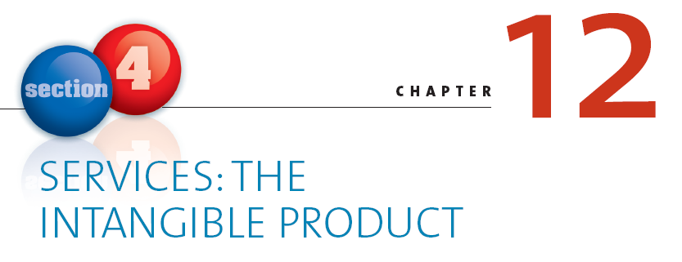

Slide 2
Learning Objectives
How does the marketing of services differ from the marketing of products?
Why is it important that service marketers know what customers expect?
What can firms do to help employees provide better service?
What should firms do when a service fails?
Notes:
These are the learning objectives for this chapter.

Slide 3
Enterprise Rent-A-Car
“Meeting customer expectations is not sufficient; you need to exceed them, or 70% of customers will not buy from you again”
Notes:
Ask students – what are your expectations when you rent a car? How can they be exceeded. Students will mention their basic expectations in terms of fast polite service and a good clean car. It might be challenging for them to figure out how to make it better. They may mention some competitors like zipcar.com which offers a unique service.

Slide 4
Service
By providing good customer service, firms add value to their products and services.
Lands’ End Website
Notes:
In a service economy, firms compete on how well they provide service to their customers. This web link is to the “live” customer service rep at landsend.com
Ask students: Describe your last outstanding and horrible customer service experiences. How did it affect your attitude toward the firm? How did it affect your purchase behavior?

Slide 5
The Service Product Continuum
Most offerings lie somewhere in the middle
Notes:
According to Theodore Levitt, all products are services. Ask students: What does this statement mean? When you purchase products, do you also purchase the services associated with the product? Like what?

Slide 6
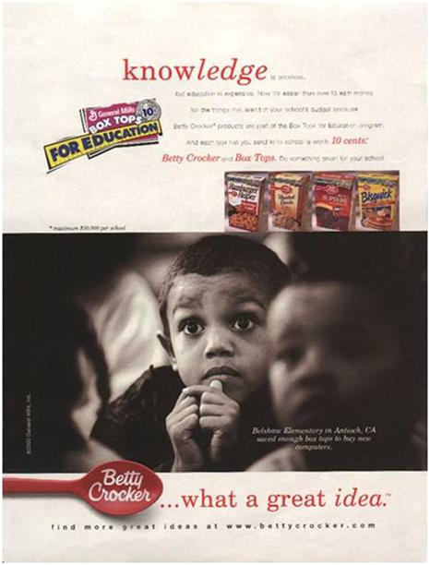
Offering a service with your products
Notes:
This is one of the oldest cause marketing campaigns. In addition to buying Betty Crocker products, consumer’s are buying financial support for their schools

Slide 7
Economic Importance of Service
Household
maintenance
became more
specialized
High value
placed on
convenience
and leisure
Production was
cheaper in
other countries
Developed economies are increasingly service
oriented economies
Notes:
Remind students about how environments influence marketing. As economic, technological, and sociocultural environments change, so do demands for services.
Group activity: Examine some key changes in each of these environments that have led to greater demands for service.
Some potential responses include automation, women in the workplace, new trade realities, or shipping and transportation improvements.

Slide 8
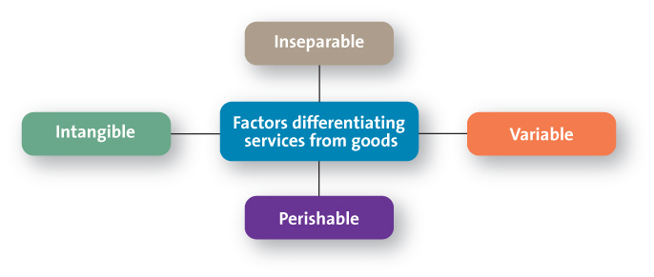
Services Marketing Differs from Product Marketing
Notes:
This graph sets up the following discussion; if you wish to shorten this presentation, simply review these differences. The next slides go into greater detail.

Slide 9
Intangible
Requires using cues to aid customers
Atmosphere is important to convey value
Images are used to convey benefit of value
Notes:
Consumers use cues to judge the service quality of dentists, including the quality of the furnishings, whether magazines are current, and diplomas on the wall.
Group activity: Think about the cues you use to assess the quality of a service. Choose a particular service (e.g., auto repair, medical care, insurance) and list several cues the provider could use to indicate quality.

Slide 10
Inseparable Production and Consumption
Production and consumption are simultaneous
Little opportunity to test a service before use
Lower risk by offering guarantees or warranties
FedEx Commercial
Notes:
When staying at a hotel, you can’t test it out before you stay. Some hotels offer satisfaction guarantees to lower risk. Ask students what other kinds of products can they not test before? Some of them might say delivery in which case it is funny to show this YouTube ad. The ad (always check before class) is for FedEx and was one of their best superbowl ads ever.

Slide 11
Variable
Technology
Training
Automation
Notes:
Many students work in service professions. Ask students: How have your employers attempted to reduce service variability? Do these programs work? What else could your employer do to reduce variability?

Slide 12
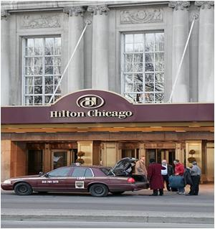
Perishable
How are each of these perishable services?
Notes:
Each of the pictured services are perishable, because as soon as the plane/ship departs, the date ends, or the meal is served, there is no possibility of changing. Unsold seats or rooms are lost revenue.

Slide 13
Check Yourself
What are the four marketing elements that distinguish services from products?
Why can’t we separate firms into just service or just product sellers?
What are some of the ethical issues associated with marketing professional services?
Notes:
Services are intangible, inseparable, variable, and perishable.
Many of them are a blend and fall within the product-service continuum
Advertising is a big ethical issue for professional services. Tension can be
created when service providers use marketing tactics to attract clients to
their service but still attempt to maintain a perception of integrity and trustworthiness.

Slide 14
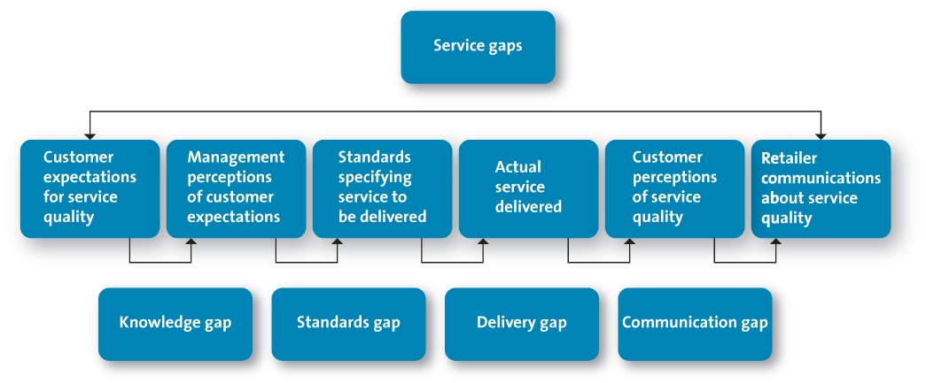
Providing Great Service: The Gaps Model
Notes:
This slide sets up the discussion that follows and can be used as the basis for a shorter discussion.

Slide 15
The Knowledge Gap: Knowing What Customers Want
Marketing research: understanding customers
Evaluating service quality
Understanding customer expectations
The Knowledge Gap
Notes:
Many doctors believe they should be evaluated on the basis of their credentials and find consumers’ interest in wait times, friendliness of staff, and waiting room décor frustrating. Ask students: What can doctors do to close this knowledge gap?

Slide 16
Filling the Knowledge Gap
How does a college increase successful outcomes for its students?
Notes:
Higher education often gets accused of being customer unfriendly. How can a university close the knowledge gap and thus improve service quality and outcomes?

Slide 17
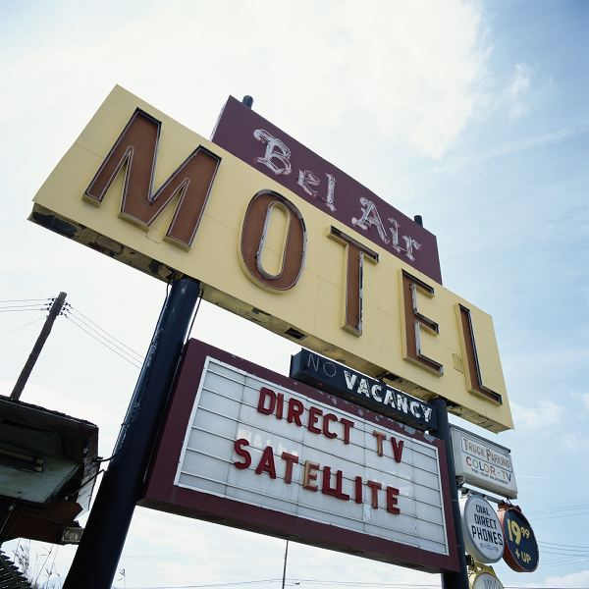
Understanding Customer Expectations
Expectations are based on knowledge and experience
Expectations vary according to type of service
Expectations vary depending on the situation
versus
Notes:
Ask students: What are your expectations of the service provided by these two businesses. Will there be price differences? In what circumstances would you stay at each property?

Slide 18
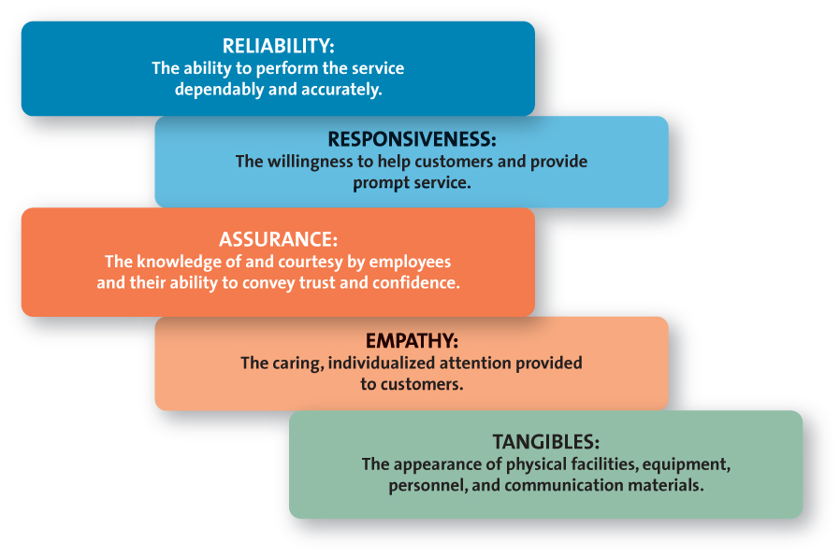
Evaluating Service Quality
Notes:
Class activity. Tell students: Assume you are expecting an important package from UPS. A delivery attempt was made, but you didn't hear the door bell, and missed it. You call the customer service line and they tell you not to worry, and that one of your options is to pick up the package at the terminal that evening. You tell them that you need the package before noon. So, they arrange for you to meet the delivery truck close to your house. You are delighted when you spot the clean brown UPS truck exactly where it is supposed to be. The friendly driver greets you by name, gets your package and you are on your way.
Ask the students: which of the service building blocks of customer service applies to each aspect of this scenario

Slide 19
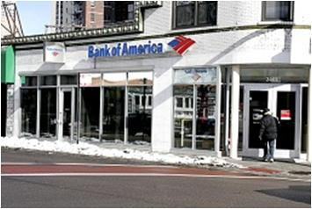
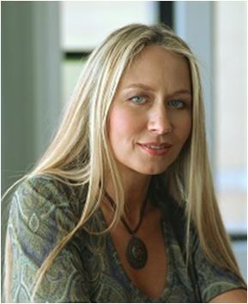
Marketing Research: Understanding Customers
Voice-of-customer program
YouTube Commercial
Notes:
This is a funny YouTube (always check before class) that has a little girl talking about a snotty doctor she recently visited.
Ask students what the company learned from their research that they used in these ads.

Slide 20
Zone of Tolerance
What is the desired and expected level of service for each dimension?
What are the customer’s perceptions of how well the focal service performs and how well a competitive service performs?
What is the importance of each service quality dimension?
Notes:
Consumers often have a range of acceptable outcomes. Discuss the example of a hotel room: You prefer a king bed but will accept two queen beds; you will not, however, accept a room without towels or a lumpy mattress. Therefore, you have defined your zone of tolerance for hotels.

Slide 21
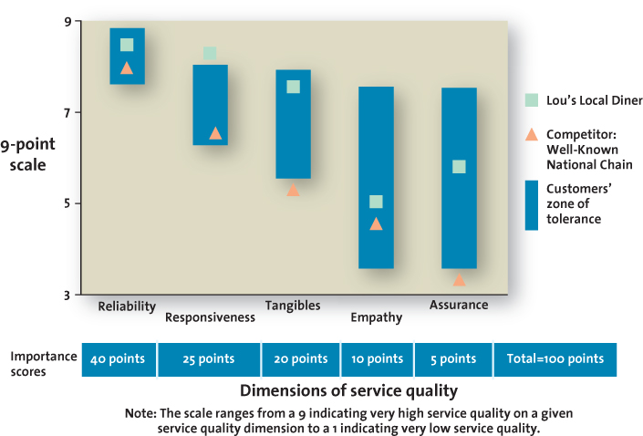
Customer Evaluation of Service Quality
Notes:
Class exercise: Have students evaluate the zone of tolerance for the food service options on campus. This exercise forces students to think about the five service quality dimensions. It will also reinforce the idea that if a firm is above the zone, particularly on an unimportant dimension, they are probably spending too much. At the same time, if it is below the zone, it’s service is substandard. Being substandard on an important dimension is potentially a devastating problem.

Slide 22
The Standards Gap: Setting Service Standards
Setting standards for quality
Developing systems to ensure high-quality service
Notes:
Quality service requires constant investments in training and monitoring. Similar to any other strategic element, service quality flows from the top down. Rewards and incentives must be in place to support service quality commitments.
Ask students: What types of incentives work best to make service employees buy in to their firm’s service standards? Some will say good working conditions and salaries and others might mention contests and prizes.

Slide 23
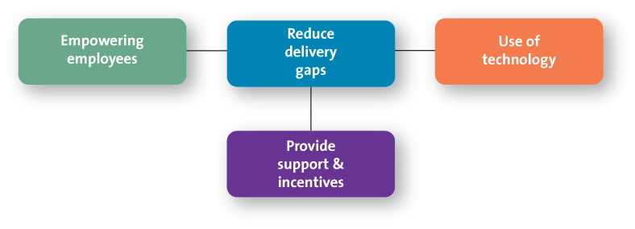
The Delivery Gap: Delivering Service Quality
Notes:
This slide again sets up the following discussion, which you may omit if you prefer to focus just on these dimensions.

Slide 24
Empowering Service Providers
Allowing employees to make decisions about how service is provided to customers
Notes:
Frontline employees must be able to solve customer problems. Ask students: The last time you returned something to a store, did the person waiting on you process the return, or did he or she need to get a manager’s approval? Which do you prefer?

Slide 25
Providing Support and Incentives
Reducing delivery gap
Provide support necessary to deliver service
Consistent and coherent management
Reward employees for excellent service
Provide emotional support to service providers
Notes:
If the firm has just a paper commitment to service quality, it will not happen. Systems must support the service providers and allow them to do their job and exceed customer expectations.
Ask students: What types of incentives do you believe would best motivate UPS delivery drivers?
Of course they will say money. This could lead to an interesting discussion about how intrinsic rewards like recognition plaques can mean as much or more than money

Slide 26
Use of Technology
RFID (radio frequency identification device)
Retail store assistant (RSA)
Notes:
Technology has become an increasingly important method for facilitating the delivery of services. RFIDs (radio frequency identification devices) are tiny computer chips that automatically transmit to a special scanner all the information about a container’s contents or individual products. Another way to use technology in the service delivery process is with a retail store assistant (RSA). An RSA can be a kiosk or a device attached to the customer’s shopping cart. Instead of bringing a shopping list to the store, a customer can swipe a loyalty card or enter a phone number at an RSA. Any information the customer has entered online from home will show up on the customer’s profile. Ask Students what new technologies they have seen at retailers?

Slide 27
The Communications Gap: Communicating the Service Promise
Manage customer expectations
Promise only what you can deliver
Communicate service expectations
J.D. Power and Associates Website
Notes:
Many people have never stayed in a five-star hotel, but they know what level of service quality they expect. Often, such expectations develop in response to the promises made in promotional materials provided by the firm.
Many firms over promise and under deliver; Southwest Airlines attributes its success to under promising and over delivering instead.
This web link is for J.D. Power and Associates. Clicking through will show you the different industries that they rate, many of them service industries. Ask students what it means for a company to win this? How should they use this in their communication?

Slide 28
Check Yourself
Explain the four service gaps identified by the Gaps Model.
List at least two ways to overcome each of the four service gaps.
Notes:
Answer to both questions:
The knowledge gap reflects the difference between customers’ expectations and the firm’s perception of those customer expectations. Firms can understand consumer expectations and evaluate service quality
The standards gap pertains to the difference between the firm’s perceptions of customers’ expectations and the service standards it sets. Firms can set appropriate service standards and measure service performance
The delivery gap is the difference between the firm’s service standards and the actual service it provides to customers. This gap can be closed by getting employees to meet or exceed service standards by providing incentives and support.
The communication gap refers to the difference between the actual service provided to customers and the service that the firm’s promotion program promises. If firms are more realistic about the services they can provide and manage customer expectations effectively, they generally can close this gap.

Slide 29
Service Recovery
Increase Service Recovery
Listen to the customer
Resolve problems quickly
Provide a fair solution
Notes:
This slide sets up the following discussion and can be used instead of the more detailed discussion that follows.

Slide 30
Listening to the Customer
Customers get emotional over a service failure
Often customers just want someone to listen
Notes:
Group activity: Think about the last time you called a firm about a service issue. How were you treated? What determined your level of satisfaction with the result? Sometimes, just having someone who listens and tries to understand the issue is sufficient. According to a recent airline study, if the airline provides a reason for delays, travelers are less annoyed by the service interruption.

Slide 31
Finding a Fair Solution
Distributive fairness
Procedural fairness
Notes:
Even if they eventually receive a solution that seems fair, when consumers must work hard to achieve it, their low procedural fairness perceptions may cause them to believe that they are being punished for receiving bad service.
Ask students: How can service firms enhance both distributive and procedural fairness simultaneously? By establishing firm policies, such as the “Customer Bill of Rights” adopted by Jet Blue. This statement details what type of service the firm should provide as well as the remedies that will be offered in case of service failure. This statement allows consumers to understand how and when they will be compensated for service failures.

Slide 32
Resolving Problems Quickly
The longer it takes to resolve service failure the more irritated the customers
It is in the firms best interest to solve problems quickly
Notes:
By compounding a service failure with long delays in correcting it, the firm creates a hostile customer. Remind students about the strong influence of negative word of mouth.

Slide 33
The CREST Method of Resolving Service Failures
C: “Calm the Customer”
R: “Repeat the Problem”
E: Use “Empathy Statements”
S: “Solve the Problem”
T: Make a “Timely Response”
Notes:
Although it sounds incredibly simplistic, this model is extremely valuable to firms.
Group activity: Role play a service failure, in which one student in each group is the unhappy customer and another is the service employee. The service employee should apply the CREST model to attempt to address the customer’s complaint. As a class, critique the application and discuss how well the method worked.

Slide 34
Check Yourself
Why must companies worry about service recovery?
Name the two types of fairness that consumers might demand from a service recovery.
What does CREST stand for in the model of the same name?
Notes:
Despite a firm’s best efforts, sometimes service providers fail to meet customer expectations. Effective service recovery efforts can significantly increase customer satisfaction, purchase intentions, and positive word of mouth, though customers’ post recovery satisfaction levels usually fall lower than their satisfaction level prior to the service failure.
Distributive Fairness and Procedural Fairness
CREST is
C: “Calm the customer”
R: “Repeat the problem”
E: Use “empathy statements,”
S: “Solve the problem”
T: Make a “timely response”

Slide 35
Glossary
The communications gap refers to the difference between the actual service provided to customers and the service that the firm’s promotion program promises.
Return to slide

Slide 36
Glossary
The delivery gap is the difference between the firm’s service standards and the actual service it provides to customers.
Return to slide

Slide 37
Glossary
The knowledge gap reflects the difference between customers’ expectations and the firm’s perception of those customer expectations.
Return to slide

Slide 38
Glossary
A service is any intangible offering that involves a deed, performance, or effort that cannot be physically possessed.
Return to slide

Slide 39
Glossary
Service quality is the customers’ perceptions of how well a service meets or exceeds their expectations.
Return to slide

Slide 40
Glossary
The standards gap is the difference between the firm’s service standards and the actual service it provides to customers.
Return to slide

Slide 41
Glossary
A voice-of-customer (VOC) program collects customer inputs and integrates them into managerial decisions.
Return to slide

Slide 42
Glossary
A zone of tolerance is the area between customers’ expectations regarding their desired service and the minimum level of acceptable service.
Return to slide

