Slide 2
Learning Objectives
What factors aid the growth of globalization?
How does a firm decide to enter a global market?
What ownership and partnership options do firms have for entering a new global market?
What are the similarities and differences between a domestic marketing strategy and a global marketing strategy?
How do ethical issues affect global marketing practices?
Notes:
These are the learning objectives for this chapter.

Slide 3
Marriot Hotels
Dependable luxury and absolute quality
Marriot Commercial
Notes:
Ask students: Why has Marriot been successful? The answer is that they have invested consistently in global markets for decades and built brand equity around the world. They also craft messages that are relevant to all travelers. Third they choose media that reaches their target including global channels, in-flight television ands and print placements in Economist. This YouTube link (always check before class) shows their International TV ad.

Slide 4
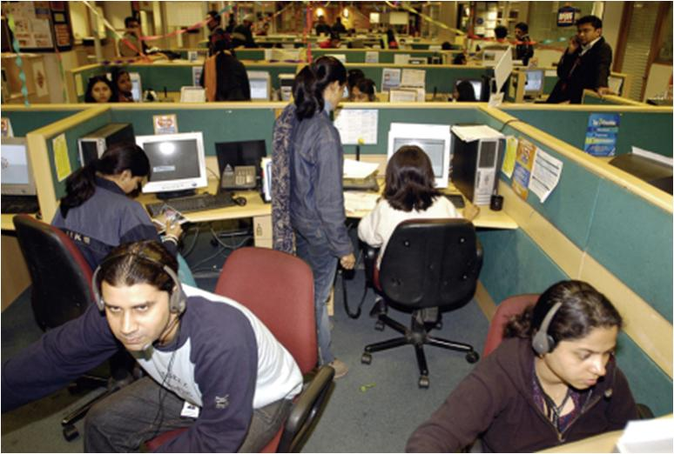
Growth of Global Market
Notes:
As the text notes, countries such as India have benefited extensively from the globalization of production. With a large, educated workforce India has been able to attract firms from across the world to locate operations there. These operations represent a wide variety of industries from banking to medicine and include insurance, accounting, radiography, etc. Globalization of production refers to the manufacturer’s procurement of goods and services from around the globe.

Slide 5
General Agreement on Tariffs and Trade (GATT)
World Trade Organization (WTO)
WTO Website
Notes:
Facilitating trade across borders is not easy, especially when countries have conflicting regulations that impede trade.
This link is to the WTO page “What is the WTO” which would be interesting to view with the students.

Slide 6
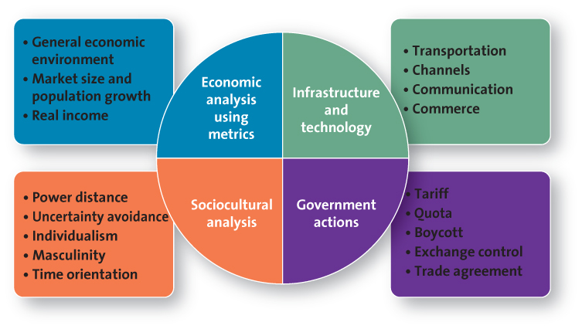
Assessing Global Markets
Notes:
Any entry into a new market, especially into a new country, requires careful planning. A formal market assessment prevents firms from making costly mistakes.

Slide 7
Economic Analysis General Economic Environment
Gross domestic product
Gross national income
Purchasing power parity
Human development index
NationMaster Website
Notes:
Each of these standardized measures allow for comparisons across countries. The use of each depends on specific circumstances. Many reports now feature GNI rather than GDP, because it includes the economic impact of firms that earn income from their global operations, unlike GDP, which dramatically undercounts the impact of those activities on the economy of the firms’ home markets.
The human development index is interesting to students. Ask students what it might include as an indicator of quality of life in the country. It includes life expectancy at birth, educational attainment and whether average incomes are sufficient to meet the basic needs of life in that country. The web link brings you to the current index which can be viewed as a map OR as a bar chart.

Slide 8
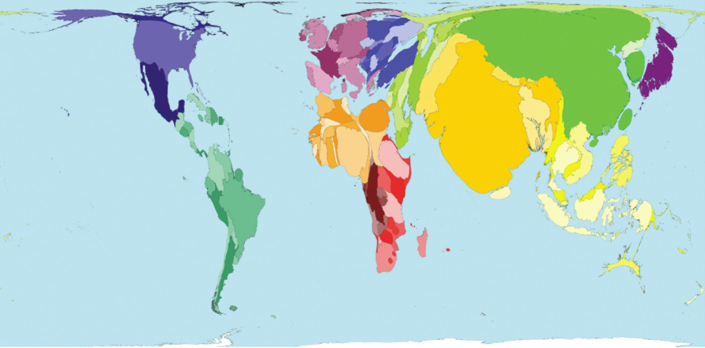
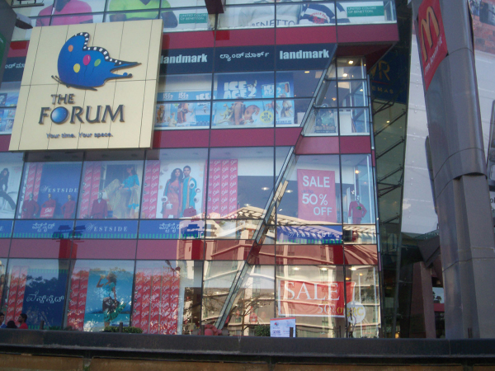
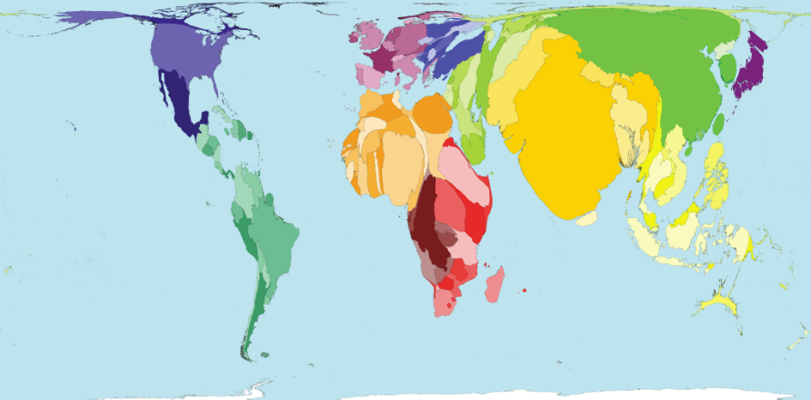
Evaluating Market Size and Population Growth Rate
Population 2002
Population 2050
Notes:
Ask students: is it in the best interest of a rapidly developing country to encourage foreign retailers to stimulate the economy even though they might harm small family owned businesses? Students are likely to reflect on the landscape of the U.S. retail industry and notice the harm of some large retailers.

Slide 9
Evaluating Real Income
P&G targets developing countries
Sotheby’s grows in Asia
Notes:
Group activity: Break students into groups. Have each group choose a less developed country for a new marketing venture. Then have each group represent a firm considering marketing a new product or service in that country. What adjustments would they have to make to their marketing strategy to be successful with their new venture? There is more detail on this activity on the following slide…

Slide 10
Analyzing Infrastructure and Technological Capabilities
Transportation
Communication
Distribution Channel
Commerce
Notes:
A firm’s ability to conduct business in a particular country is in large measure determined by that country’s infrastructure.
Group activity: Continue with the group activity above. Have students assess how the current infrastructure in their chosen country will affect the success of their new venture.

Slide 11
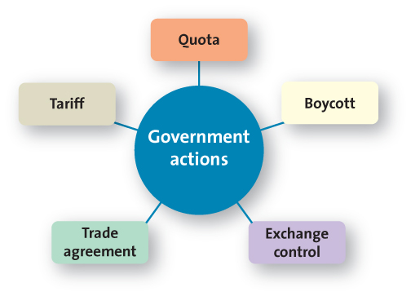
Analyzing Government Actions
Notes:
Remind students that this category includes not just the impact of governmental actions but also those of non-governmental organizations (NGOs).

Slide 12
Tariff and Quotas
Tariffs
Tax
Quotas
Maximum limit
Artificially raises prices
Lowers demand
Reduces availability of imported goods
Both benefit domestically made products because they reduce foreign competition
Notes:
Trade negotiations often revolve around reducing or eliminating tariffs, quotas, or similar impediments to trade. Discuss the recent trade battles between the United States and foreign agriculture producers (e.g., sugar, corn). Many foreign producers accuse the United States of limiting market access through unfair tariffs and quotas, whereas the United States insists that it must protect United States agriculture.
Ask students: What do you think? Which side would you take in this debate?

Slide 13
Boycott
Ethical Consumer Website
Notes:
Both governments and independent groups call boycotts. The hyperlink to Ethical Consumer offers a list of current boycotts by various groups.
Ask students: What would prompt you to participate or organize a boycott? Consumers are likely to call a boycott if they believe that a marketing practice is unethical or unfair to group of individuals.
For example many students demanded that their Universities boycott Nike products for their sports teams in protest of Nike’s labor practices.

Slide 14
Exchange Control
Exchange rate
Countertrade
Notes:
The Central Bank of a country generally regulates its currency. Many countries try to keep their markets attractive to foreign investors while simultaneously making their goods attractive to foreign buyers through exchange control.
Ask students: If the value of the U.S. dollar goes up compared to other currencies, what happens to international trade?
Answer: U.S. businesses and consumers will buy more imports, but since the dollar is worth more, exports will go down.

Slide 15
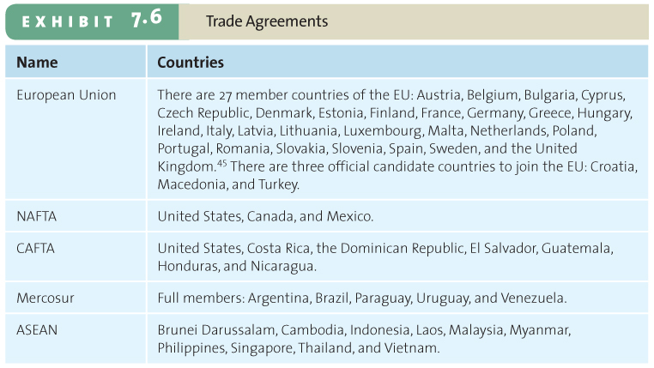
Trade Agreements
Notes:
Ask students: What trade agreements have you heard of? Can you think of an existing trading bloc? What benefits does belonging to a trading bloc offer members?

Slide 16
The European Union (EU)
Monetary and Trade Union
Euro
Membership does not consists of Croatia, Macedonia, Turkey and several others
Notes:
Group activity: Brainstorm about how the introduction of a single currency affected various marketing aspects in the EU.
The conversion to the Euro presented serious concerns for marketers, most of which have been resolved. But in France, retailers still list prices in both Euros and the now defunct French Franc, which allows consumers, especially older consumers, to make better purchasing decisions. Since the Euro is used across all EU countries, it makes pricing a challenge. Many items do not sell for the same price across the EU. Will different Euro prices irritate consumers? However, having one currency across all EU countries does facilitate trade. For instance, tourists across the EU find it easier to gauge value when everything is priced in Euros.

Slide 17
Analyzing Sociocultural Factors
Culture
Power distance
Uncertainty avoidance
Individualism
Masculinity
Time orientation
Notes:
Perhaps no other aspect of globalization has posed more difficulties to marketers than culture. Outsiders often have trouble understanding the detailed meanings associated with proper communication in a foreign culture.

Slide 18
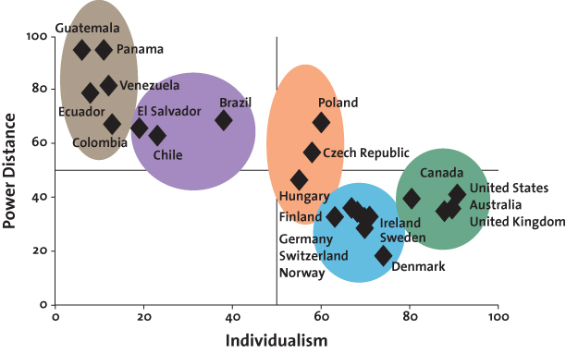
Country Clusters
Notes:
Hofstede’s cultural dimensions offer an effective understanding of the subtle elements of a culture. Taken together, these dimensions enable marketers to group countries together according to their similarity on these dimensions and therefore engage in more efficient planning.
Ask students: How would you characterize American culture on these dimensions? How would you characterize other cultures with which you are familiar?

Slide 19
Spanish Ad
Notes:
Ask students – given their awareness of Spanish culture – why might this ad be effective? How is it different than a U.S. ad?
The answer is that it is not that different at all.

Slide 20
Check Yourself
What are key metrics that can help analyze the economic environment of a country?
What types of government actions should we be concerned about as we evaluate a country?
What are five important cultural dimensions?
Notes:
The general economic environment, the market size and population growth rate, and real income.
Tariffs, quotas, boycotts, exchange controls, and trade agreements
Cultural Dimensions include power distance, uncertainty avoidance, individualism, masculinity and time orientation

Slide 21
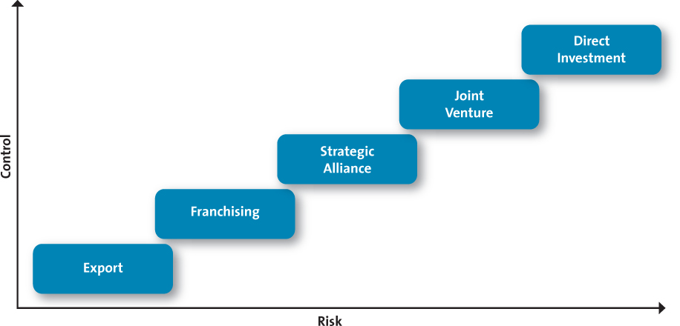
Choosing a Global Entry Strategy
Notes:
Ask students: Why do you think most firms try exporting first? In each strategy, the risks and rewards change. As risk increases, so do the potential rewards. Exporting represents the lowest risk level for the firm.
Group activity: Divide into groups that represent different firms. Each group should outline its product offering and the entry strategy it would choose for its global strategy. Ask students: Why is your chosen entry strategy appropriate for your offering? What criteria did you use to determine your strategy? What risks does your strategy entail, and are the potential rewards worth those risks?

Slide 22
Check Yourself
Which entry strategy has the least risk and why?
Which entry strategy has the most risk and why?
Notes:
This entry strategy requires the least financial risk but also allows for only a limited return to the exporting firm. Global expansion often begins when a firm receives an order for its product or service from another country, in which case it faces little risk because it has no investment in people, capital equipment, buildings, on infrastructure.
Direct investment requires a firm to maintain 100 percent ownership of its plants, operation facilities, and offices in a foreign country, often through the formation of wholly owned subsidiaries. This entry strategy requires the highest level of investment and exposes the firm to significant risks, including the loss of its operating and/or initial investments

Slide 23
Choosing a Global Marketing Strategy: Target Market (STP)
Cultural nuances
Subcultures
View of product and consumer role
Different positioning
Adaptation
Single positioning strategy
Notes:
Adjusting the marketing mix and positioning strategy to meet the needs of a new market may represent the most complex topic for global marketing.
Chapter 8discusses segmentation, targeting, and positioning in greater detail.
Group Activity: Divide the class into groups. Have them choose a product that they want to introduce into another country. (It may be the same product/firm they used in previous group activity). Have students consider how they would adapt their positioning strategy in the new country.

Slide 24
The Global Marketing Mix: Product or Service Strategies
Sell the same product or service in both the home country market and host country
Sell a product or service similar to that sold in home country but include minor adaptations
Sell totally new products or services
Notes:
Ask Students: What products are the easiest to standardize? What makes these products easy to standardize?
Products at the extreme ends of high tech (i.e., electronics, computers, software versus paper and pencil) or high touch (i.e., luxury goods, jewelry versus staple products) continuums are easy to standardize, but those in the middle generally require varying levels of adaptation to local markets.

Slide 25
Global Marketing Mix: Pricing Strategies
Price
Tariffs
Quotas
Anti-dumping
Policies
Economic
Conditions
Competitive
factors
Notes:
In addition to competitive, cost, and other considerations, global pricing involves additional dimensions that increase its complexity.

Slide 26
Whole Foods in London
Notes:
Ask students: Why is this so successful? Whole foods is focusing on the shopping experience and playing up its mystique from the U.S. They have staff to answer consumer’s questions and offers more choice than other organic retailers. In addition they will offer services including facials and chair massages.

Slide 27
Global Marketing Mix: Global Distribution Strategies
Some global channels are very long and complex.
Consumer shop local small local stores.
Suppliers must be creative in delivering to these outlets.
FedEx Commercial
Notes:
Delivering products to local retailers can be incredibly difficult and frustrating. Infrastructure issues often prevent traditional distribution methods and require creative adjustments. Global firms must find distribution strategies that enable them to reach even really remote markets. For instance, Avon sells and delivers cosmetics to customers using canoes. This example could also prompt an ethical discussion on whether or not firms should be marketing hedonic products or services to consumers with very little disposable income. This YouTube ad (always check before class) is for FedEx and shows how it international distribution can be difficult for many companies.

Slide 28
Global Marketing Mix: Global Communication Strategies
Literacy levels vary by country
Firms choose whether to adapt to language differences
Cultural and religious differences also matter
Notes:
Ask students: How do firms market their products in countries with very low literacy levels? Imagine you are promoting a new soft drink. How would you do it without written communication?

Slide 29
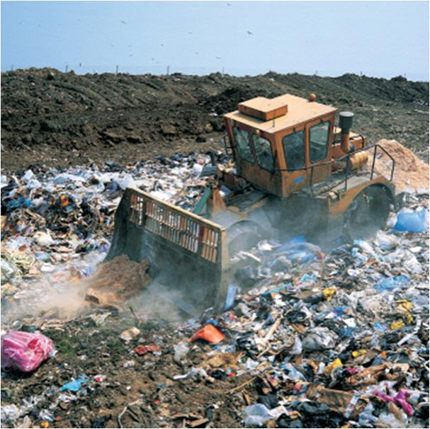
Ethical Issues in Global Marketing: Environmental Concerns
Waste Management
Pollution
Notes:
The process of industrialization often goes hand-in-hand with negative environmental impacts. Planning and foresight can minimize this impact as much as possible. Waste management is a big problem
Ask students: Would you buy a product that was made in a factory in another country that you knew was polluting the air and water if it were significantly less expensive than a similar product made under environmentally friendly conditions?

Slide 30
Ethical Concerns: Global Labor Issues
Fair Wages
Working conditions
Child Labor
Notes:
Global firms must address the issue of who produces their products—literally, factory workers in developing countries. Most manufacturers do not own the plants in which workers create their goods and therefore must negotiate with factory owners to bring the factory into compliance with global labor standards. Many firms are partnering with labor advocates to improve working conditions and wages.
Ask students: Would you buy a product that was made in a factory in another country that you knew paid unfair wages, had poor working conditions, and/or used child labor if it were significantly less expensive than a similar product made under environmentally friendly conditions?

Slide 31
Ethical Concerns: Impact on Host Country Culture
Cultural imperialism
Notes:
How do countries balance their competing desires to participate in the global economy while still holding on to their traditional cultures and lifestyles? This question lies at the heart of the globalization debate. There is no easy answer, and future generations will continue to deal with these enduring challenges.

Slide 32
Check Yourself
What are the components of a global marketing strategy?
What are the three global product strategies?
Notes:
Determining the target markets to pursue and developing a marketing mix that will sustain a competitive advantage over time.
Global product strategies:
Sell the same product or service in both the home country market and the host country.
Sell a product or service similar to that sold in home country but include minor adaptations.
Sell totally new products or services.

Slide 33
Glossary
A boycott pertains to a group’s refusal to deal commercially with some organization to protest against its policies.
Return to slide

Slide 34
Glossary
Cultural imperialism is the belief that one’s own culture is superior to that of other nations.
Return to slide

Slide 35
Glossary
Exchange control refers to the regulation of a country’s currency exchange rate, the measure of how much one currency is worth in relation to another.
Return to slide

Slide 36
Glossary
The purpose of the General Agreement on Tariffs and Trade (GATT) was to lower trade barriers such as high tariffs on imported goods and restrictions on the number and types of imported products that inhibited the free flow of goods across borders.
Return to slide

Slide 37
Glossary
Infrastructure is the basic facilities, services, and installations needed for a community or society to function.
Return to slide

Slide 38
Glossary
A quota designates the maximum quantity of a product that may be brought into a country during a specified time period.
Return to slide

Slide 39
Glossary
A tariff is a tax levied on a good imported into a country.
Return to slide

Slide 40
Glossary
A trade agreement is an intergovernmental agreement designed to manage and promote trade activities for a specific region.
Return to slide

